Slide 1
SM Measurements at ATLAS and CMS
Michael Schmitt (Northwestern University)
for the ATLAS and CMS collaborations
CORFU 2018
September 2, 2018

Slide 2
Selected topics:
Drell-Yan differential cross section: dσ/dφ*
sin²θ_{W}
M_{W}
Angular decorrelation of jets
Same-sign WW

Slide 3
Differential cross section dσ/dφ*:
φ* is closely related to q_{T} (dilepton transverse momentum). (Banfi et al.)
It is based on angles, so resolution is very good.
First explored by D0 at the Tevatron.
Analysis is fairly straight forward:
Dilepton pairs
Small backgrounds
Very minor resolution effects
Normalize to total fiducial cross section – reduce systematic uncertainties.
Study φ* distributions for various kinematic regions.
ATLAS published 2016, CMS in 2018.
Primary goal: Check models at the level of event generators.

Slide 4
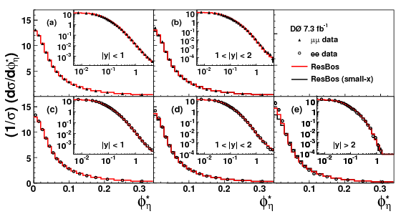
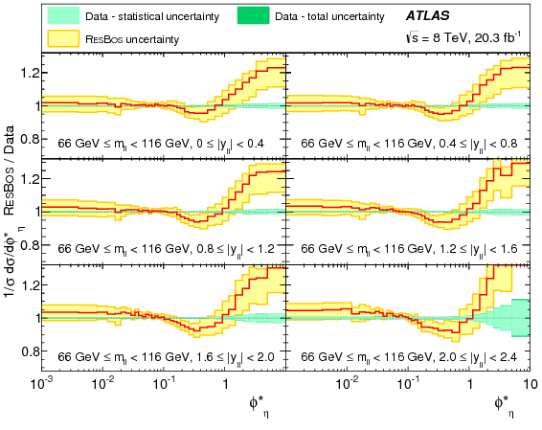
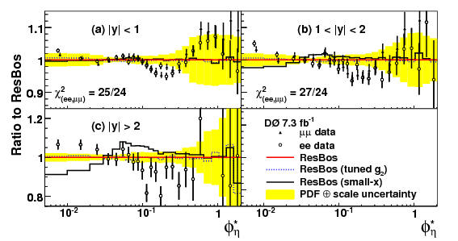
Does ResBos match the data?
Check as a function of rapidity y.
ATLAS, EPJC 76 (2016) 291
ResBos/Data
D0 Collab, PRL 106 (2011) 122001
D0
Data/ResBos

Slide 5
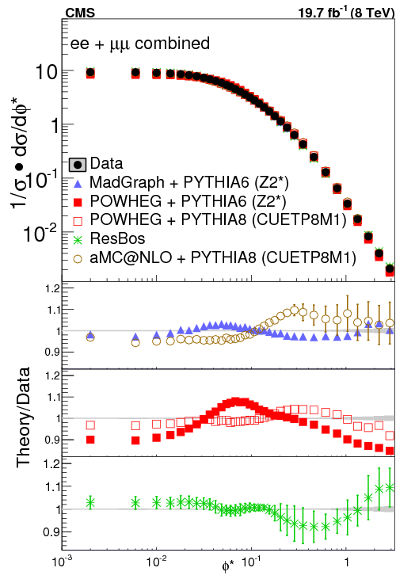
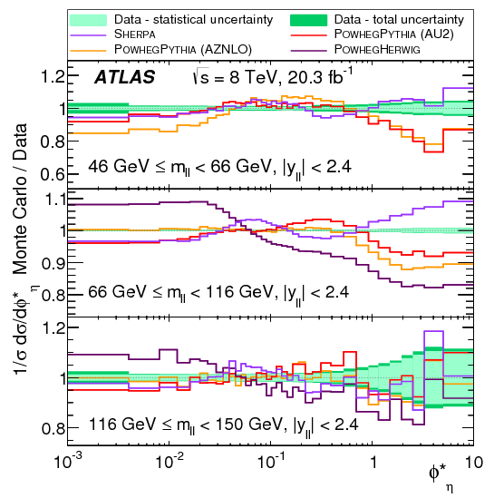
Compare to other models: MadGraph, POWHEG, aMC@NLO, SHERPA
None is successful at this level.
CMS, JHEP03(2018)172
ATLAS, EPJC 76 (2016) 291

Slide 6
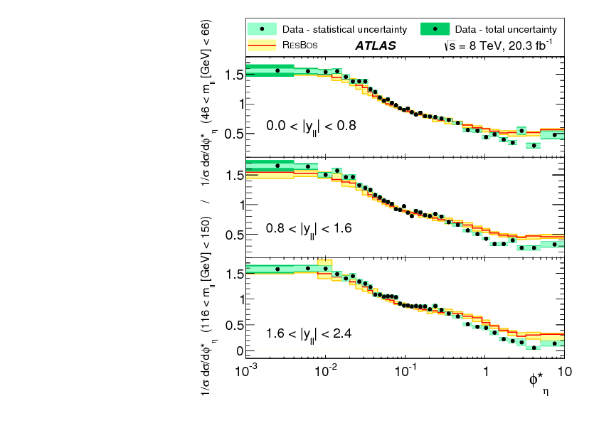
ATLAS made unique measurements below and above the Z resonance.
Use the low-mass data to normalize the Z resonance data (and still look as a function of rapidity).
Precise!
ResBos is generally successful; some tension at higher φ∗.

Slide 7
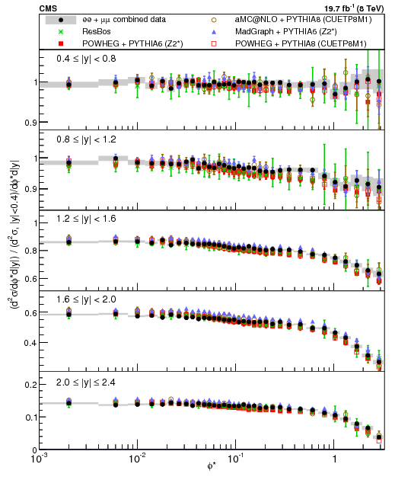
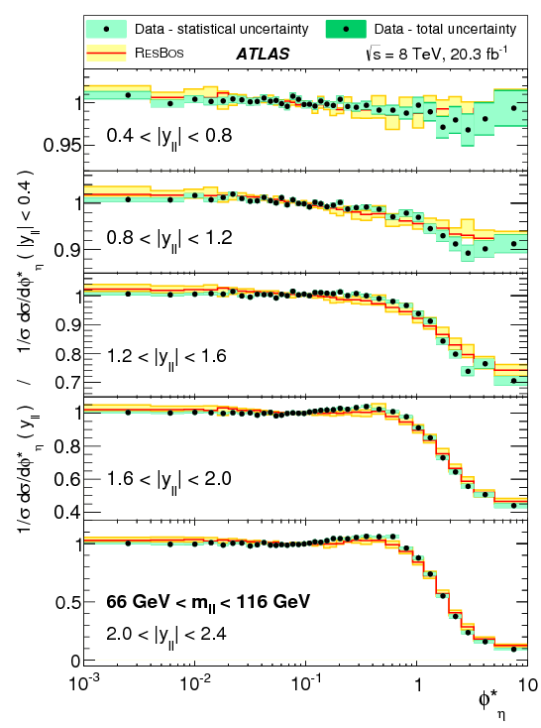
Similar: normalize to central Z production: |y| < 0.4
ATLAS
CMS

Slide 8
sin²θ_{W}:
sin²θ_{W} is a fundamental parameter of the SM.
There is a long-standing tension between certain values from LEP & SLD.
Hadron colliders provide huge samples of Z bosons.
sin²θ_{W} determines the interference of axial and vector couplings near the Z pole
Extract sin²θ_{W} by analyzing decay distributions Z → l⁺l⁻ e.g. A_{FB} asymmetries.
Entangled with PDFs (axial and vector couplings are different for u, d quarks).
PDF uncertainties are the large component of the uncertainty.
“Dilution” of asymmetries makes the job much harder, especially at the LHC.
CMS posted in June 2018, ATLAS has conference note from July 2018.
Methodology is quite different.
Primary goal: Measure a fundamental parameter of the SM.

Slide 9
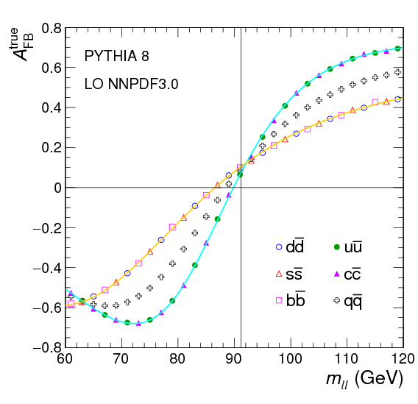
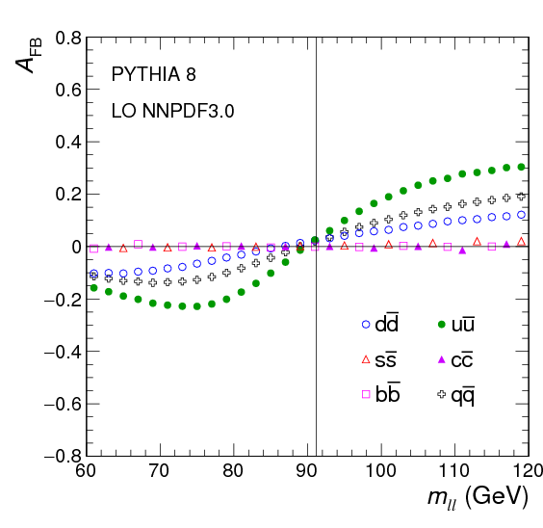
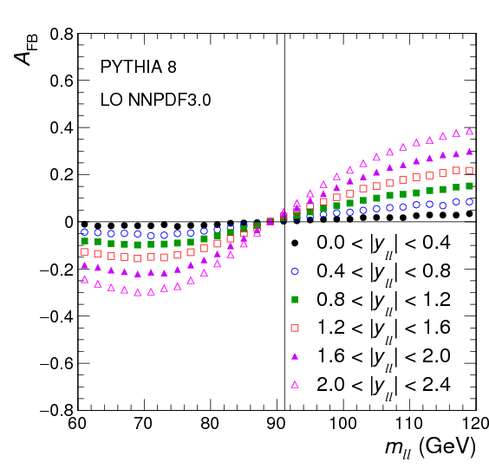
CMS, arXiv:1806.00863
Ideal
Diluted
As function of |y|
all
u
all
all
d
d
u

Slide 10
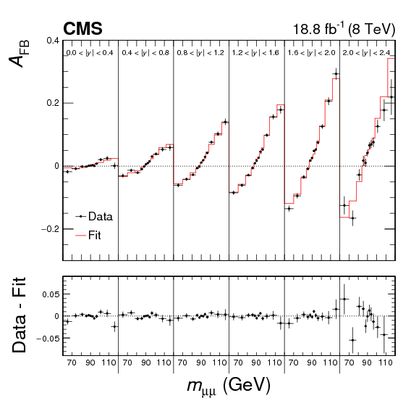
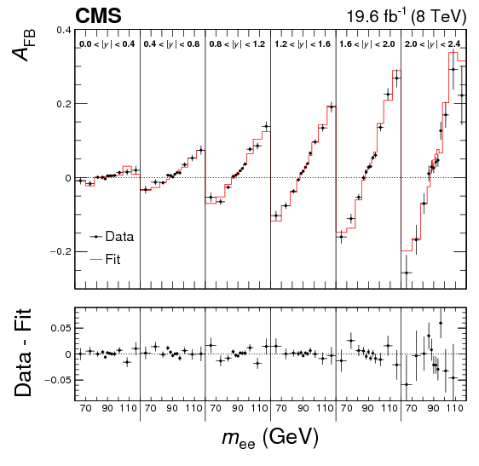
muons
electrons
increasing |y|
mass
mass
mass
CMS, arXiv:1806.00863
(sin²θ_{W} is proportional to the slope at M_{ll} = M_{Z}.)

Slide 11
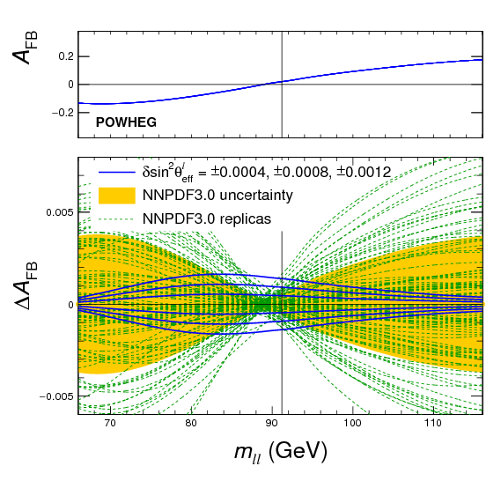
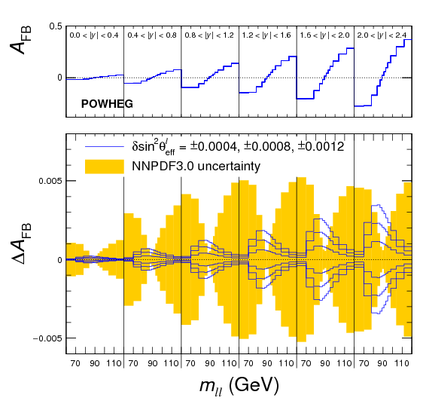
The PDF variations are vaguely orthogonal to the dependence on sin²θ_{W}
CMS, arXiv:1806.00863
variation with sin²θ_{W}
various NNPDF replicas

Slide 12
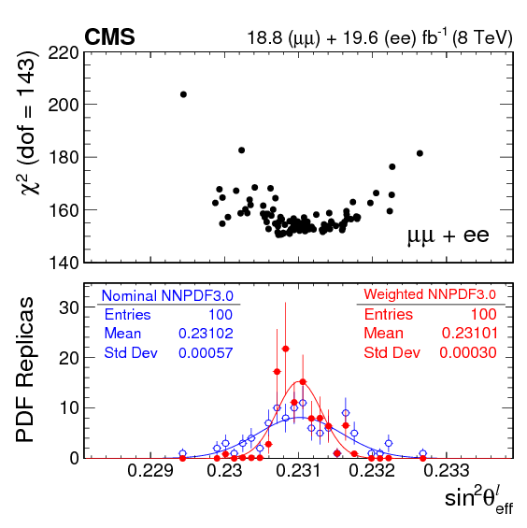
weight depends on χ²
A_{FB} versus M_{ll} provides an in situ constraint on PDFs.
Assign weights according to how well a given PDF reproduces the A_{FB} versus M_{ll} data.
Reduces PDF uncertainties by 30% with no bias in sin²θ_{W}.
CMS, arXiv:1806.00863

Slide 13
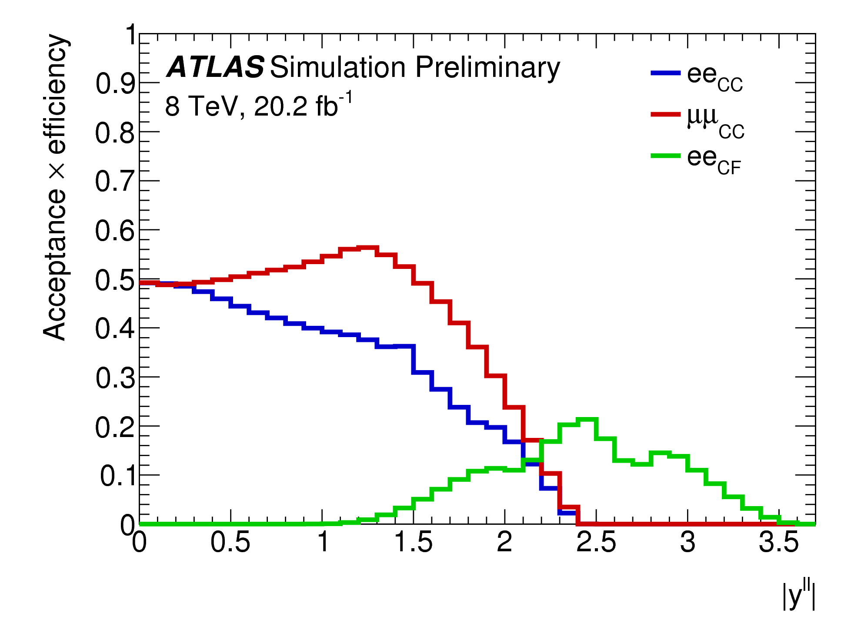
ATLAS-CONF-2018-037 and ATLAS, JHEP08(2016)159
ATLAS determine all eight of the coefficients governing the lepton kinematic distributions.
Sophisticated template fits.
Utilize the full phase space (m_{ll} and y but integrate over p_{T})
Key feature: use forward electrons
central +
forward

Slide 14
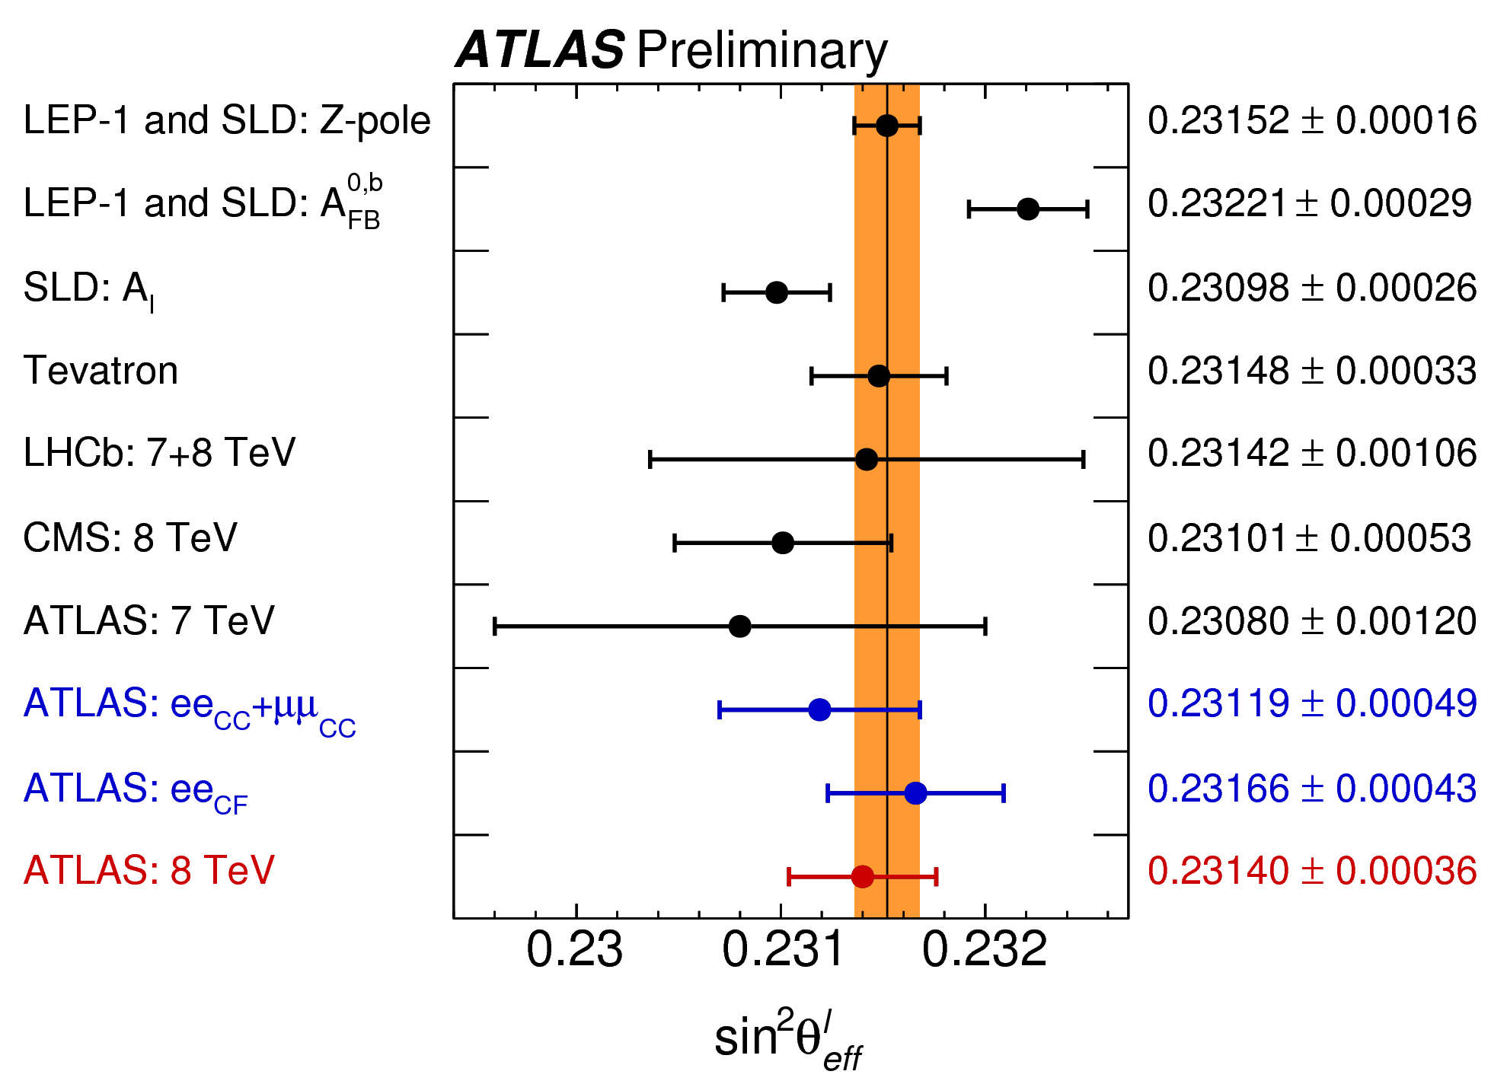
CMS & ATLAS approach Tevatron, maybe LEP/SLD
Central values lower than but consistent with earlier measurements.
CMS: sin²θ_{W} = 0.23101 +/- 0.00053
ATLAS: sin²θ_{W} = 0.23140 +/- 0.00036

Slide 15
statistical exp. syst. theory syst. PDFs
CMS: sin²θ_{W} = 0.23101 +/- 0.00036 +/- 0.00017 +/- 0.00016 +/- 0.00031
ATLAS: sin²θ_{W} = 0.23140 +/- 0.00021 +/- 0.00016 +/- 0.00024
Extra statistical power from forward electrons
Theory uncertainties
come out smaller.
Difficult to understand given
CMS weighting approach.

Slide 16
M_{W}:
One of the big prizes of a high luminosity hadron collider.
Provides crucial test of the standard model
Global electroweak fits provide a precision of about 8 MeV which sets the goal for direct measurements of M_{W}.
One of the very most challenging analyses at a hadron collider
lepton calibration, hadronic recoil calibration, background estimation, modeling of kinematics, PDFs, etc. etc.
Progress make by working on all fronts – no single key to the 8 MeV goal.
ATLAS published early in 2018 (public in early 2017). CMS is working.
Primary goal: Measure a fundamental parameter of the SM.

Slide 17
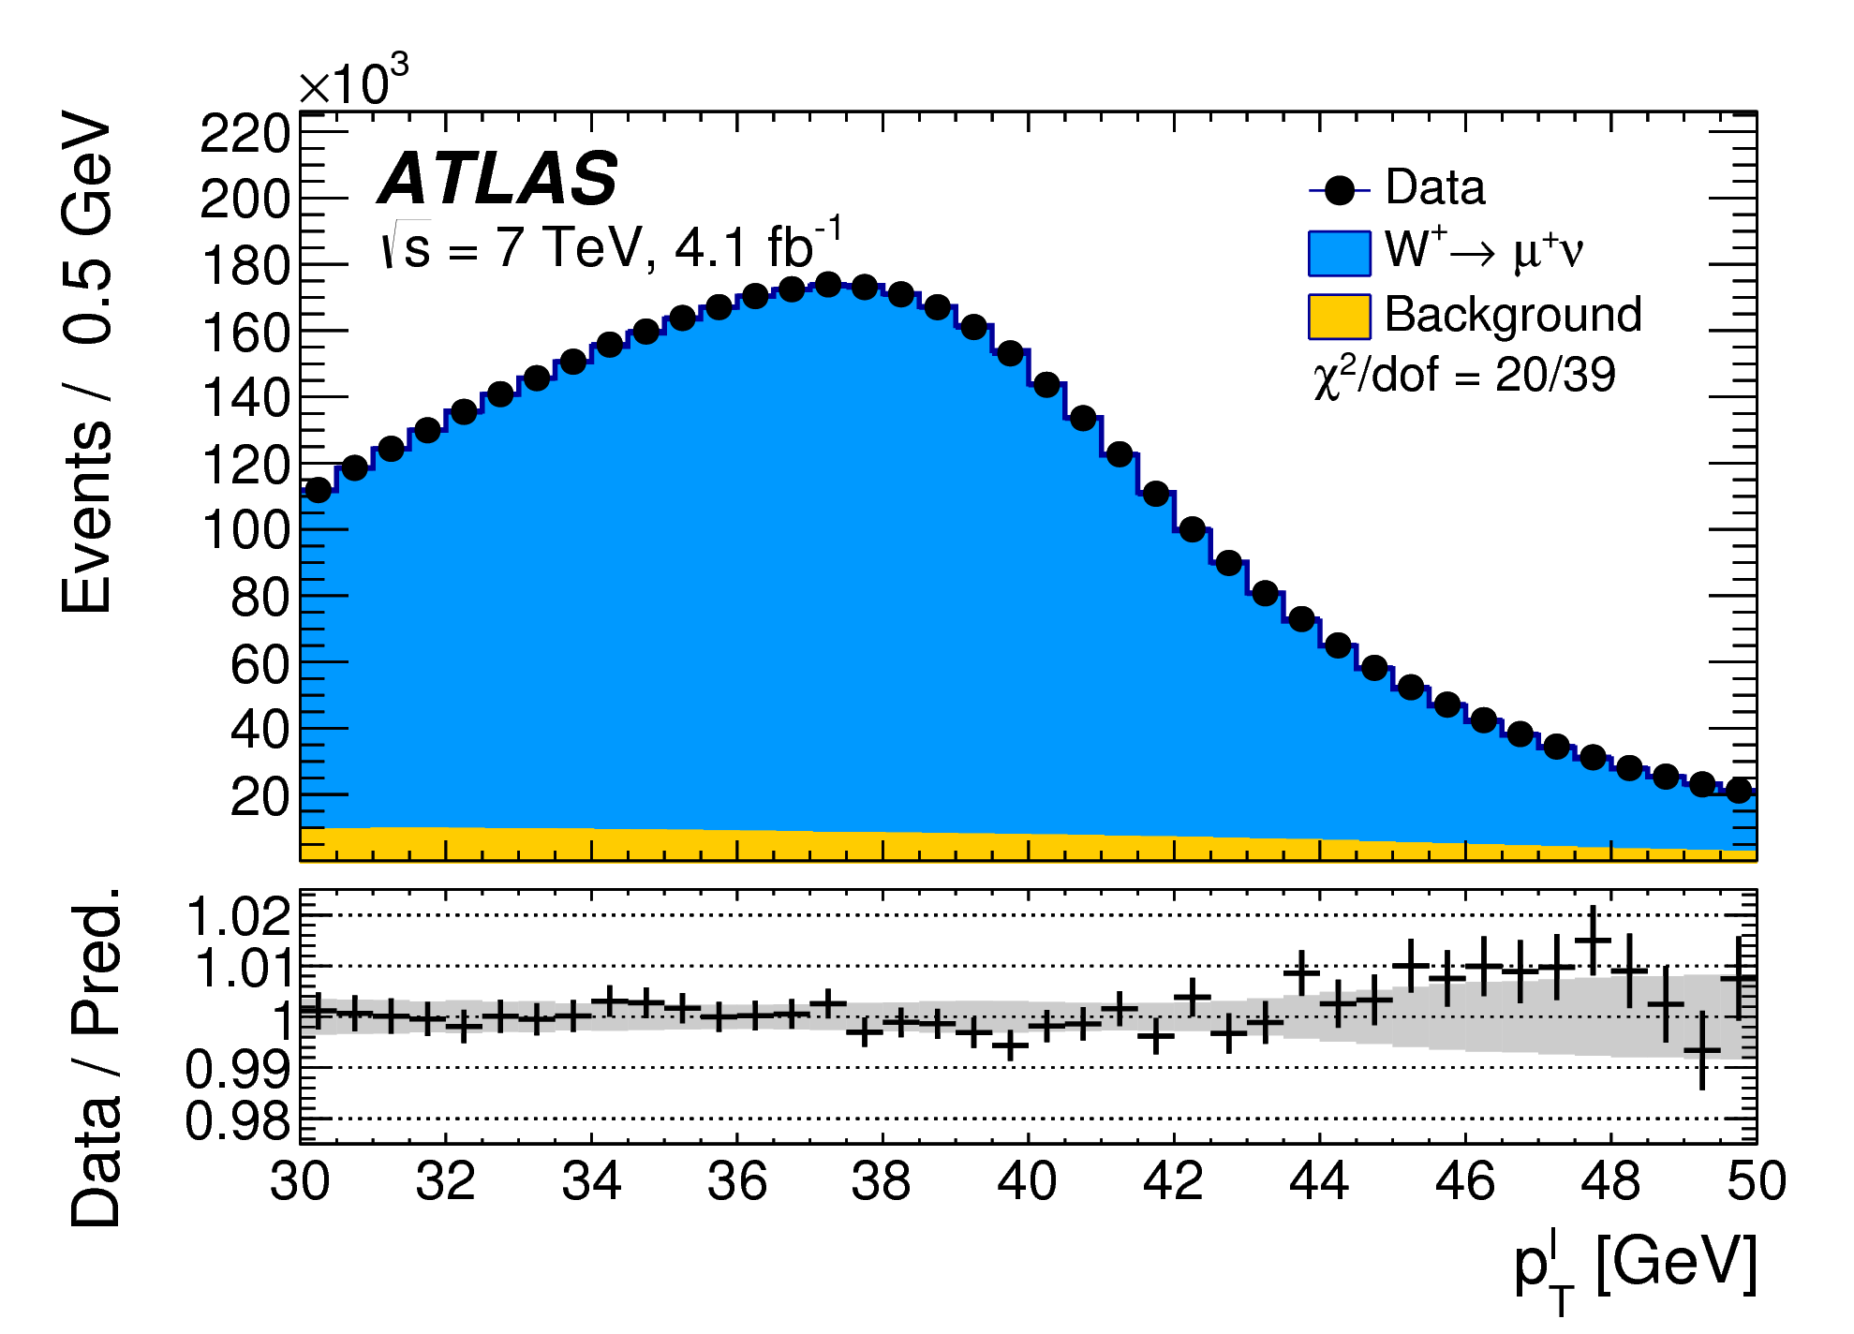
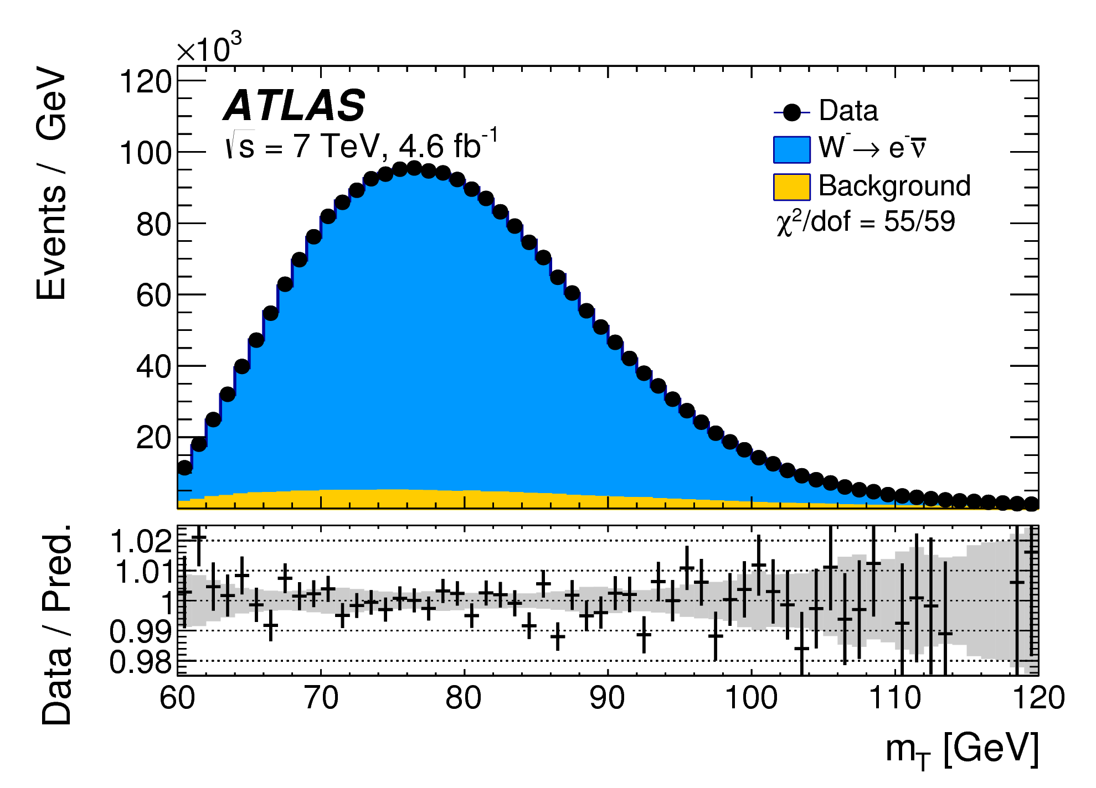
Technique is similar to Tevatron measurements: fit lepton p_{T} and transverse mass m_{T}
Calculate full χ² for a set of templates – vary assumed M_{W} for each template.
Quadrative behavior gives best M_{W} and the uncertainty.
Obtain M_{W} for several cases/channels and combine them taking correlations into account.
ATLAS, EPJC 78 (2018) 110

Slide 18
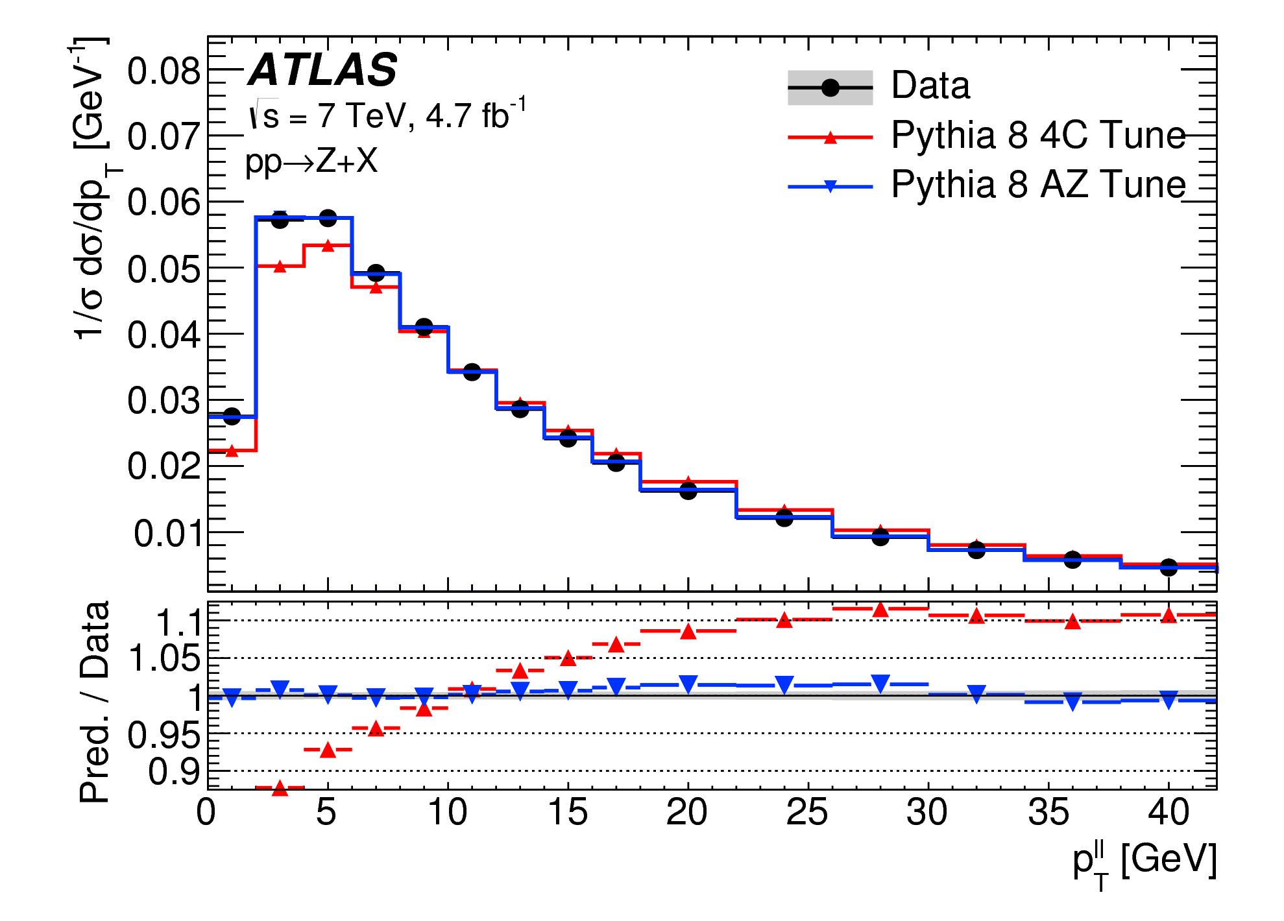
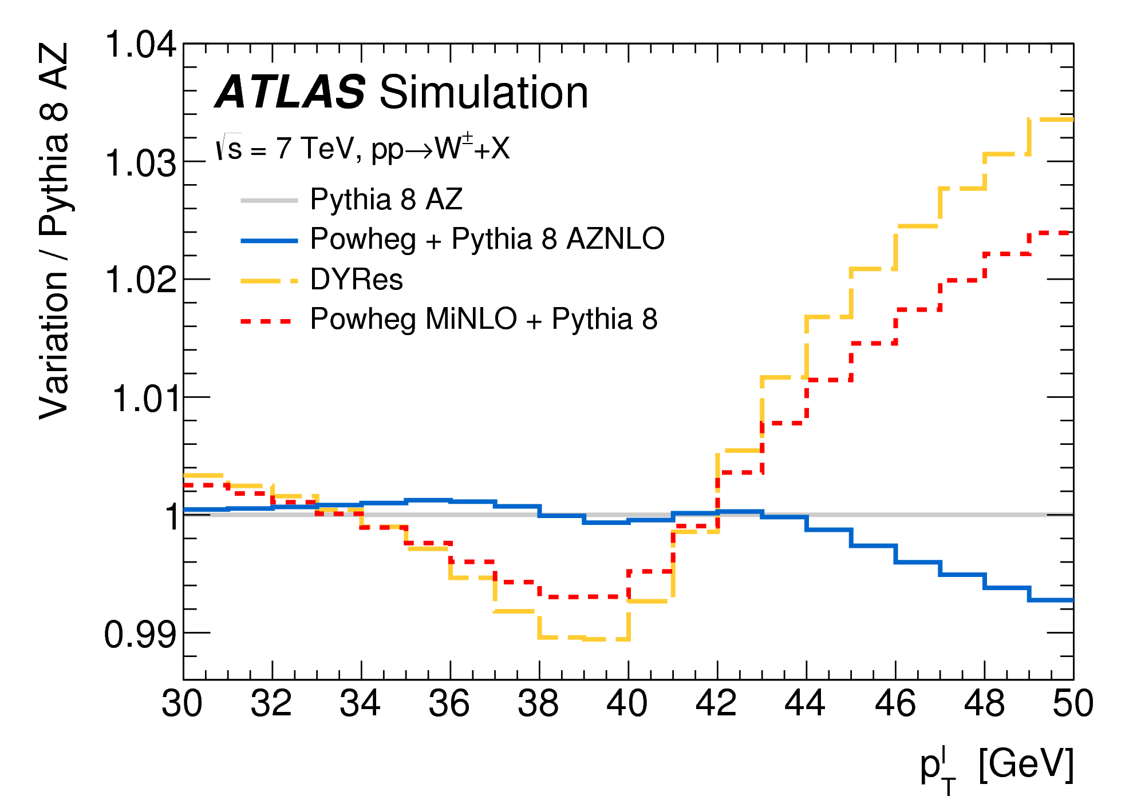
ATLAS developed a careful “AZ” tune of POWHEG+PYTHIA8 that matches several key measurements.
ATLAS, EPJC 78 (2018) 110
Other advanced programs (DYRes, POWHEG MiNLO) match the data poorly.
If considered as part of the kinematic model, would lead to large (30 MeV) uncertainties.
ATLAS decided to simply reject these programs…

Slide 19
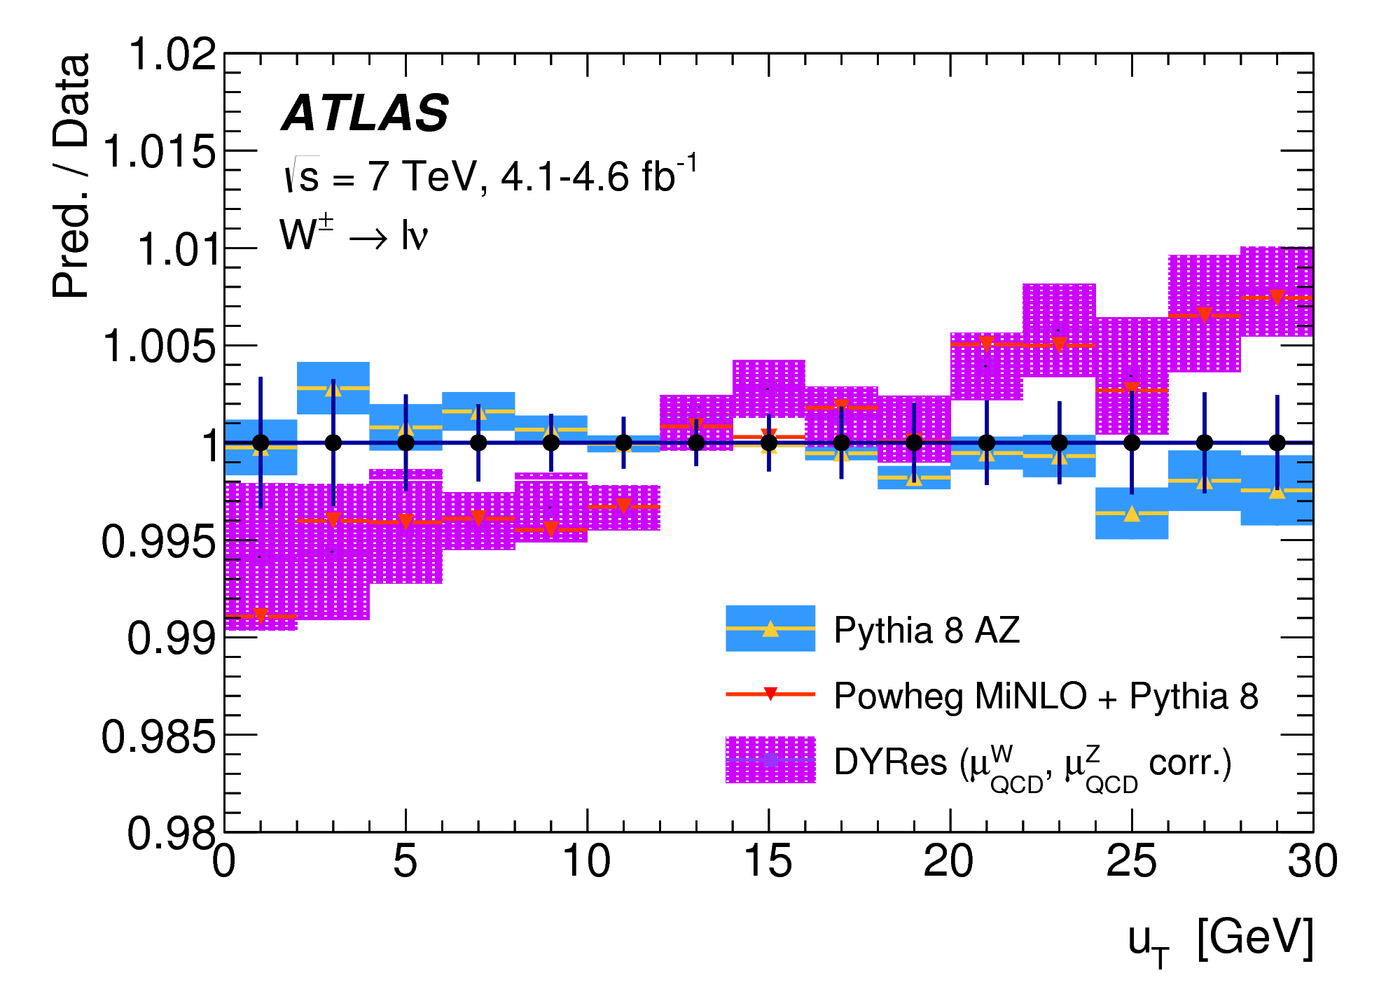
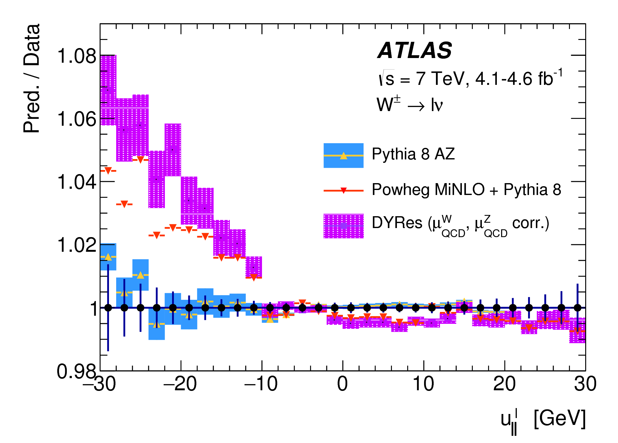
The discrepancies would be very evident in the hadronic recoil modeling.
These plots show that the prediction would not be in line with the measurements.
ATLAS, EPJC 78 (2018) 110

Slide 20
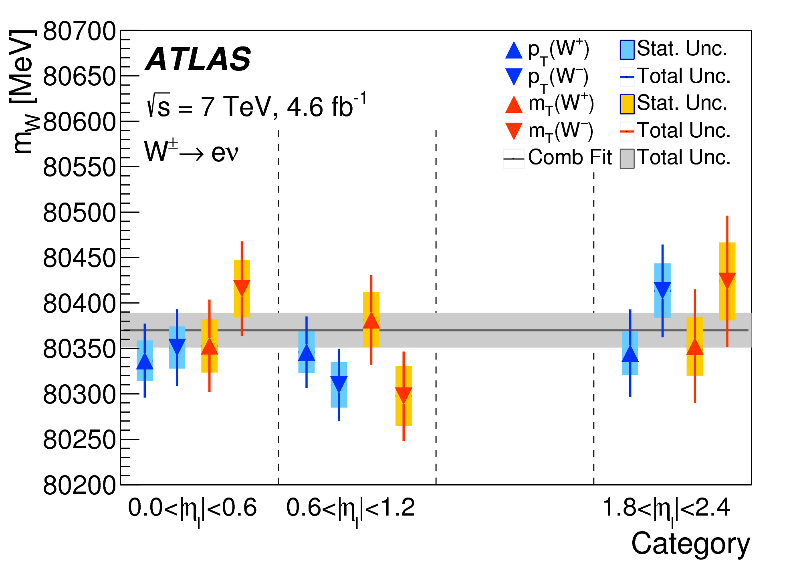
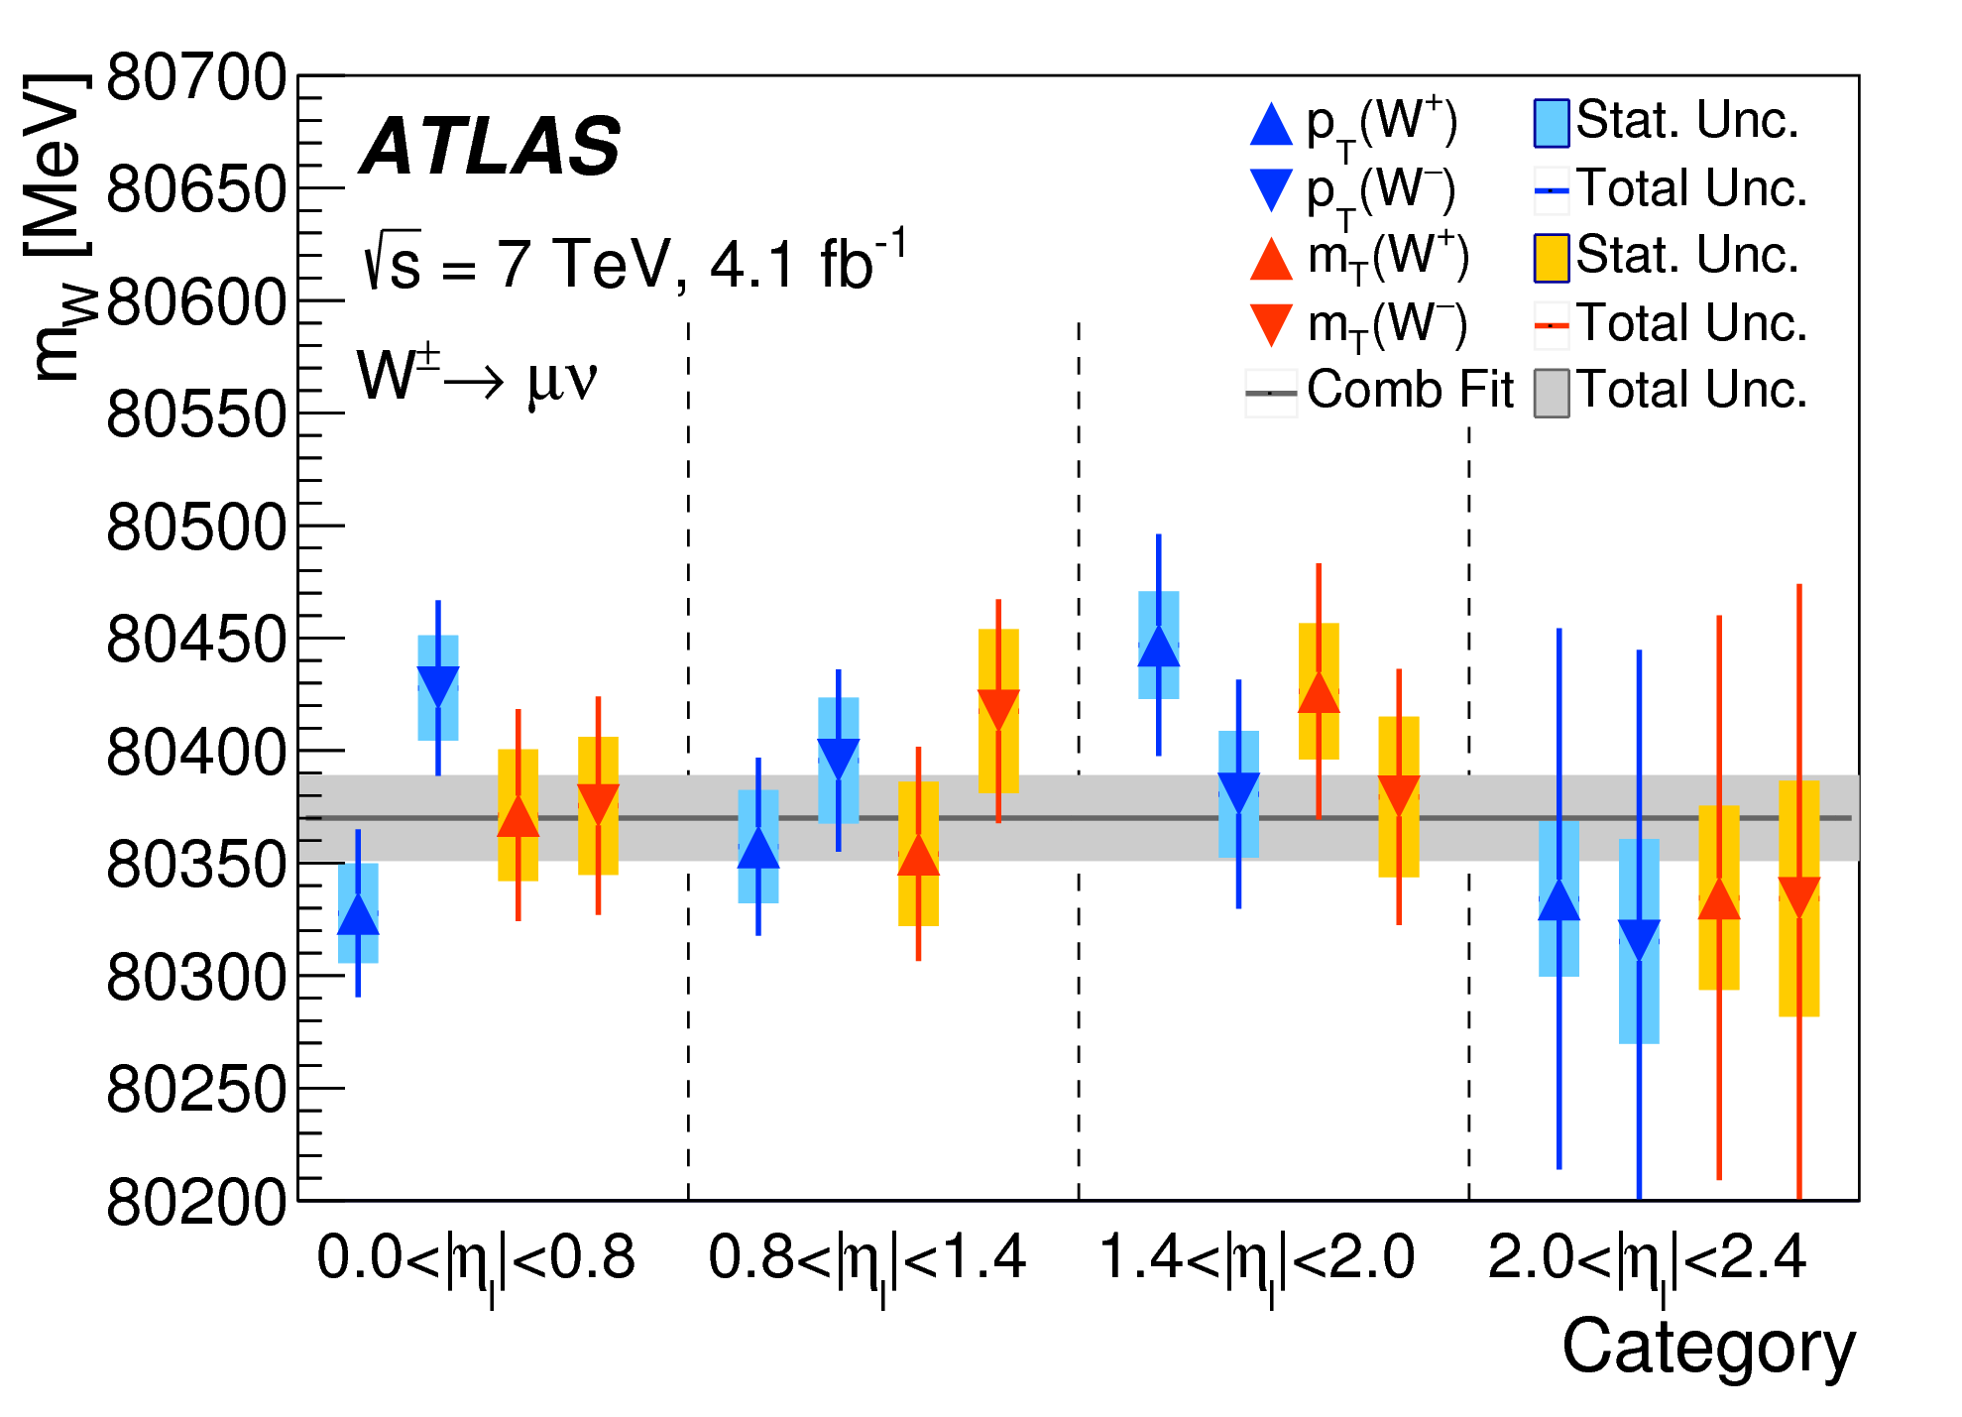
The ATLAS results are impressively consistent and stable.
positive and negative cancel PDF uncertainties
electron and muon channel have completely different (and challenging) lepton calibration issues
M_{T} is sensitive to hadronic recoil, p_{T} is not.
ATLAS, EPJC 78 (2018) 110

Slide 21
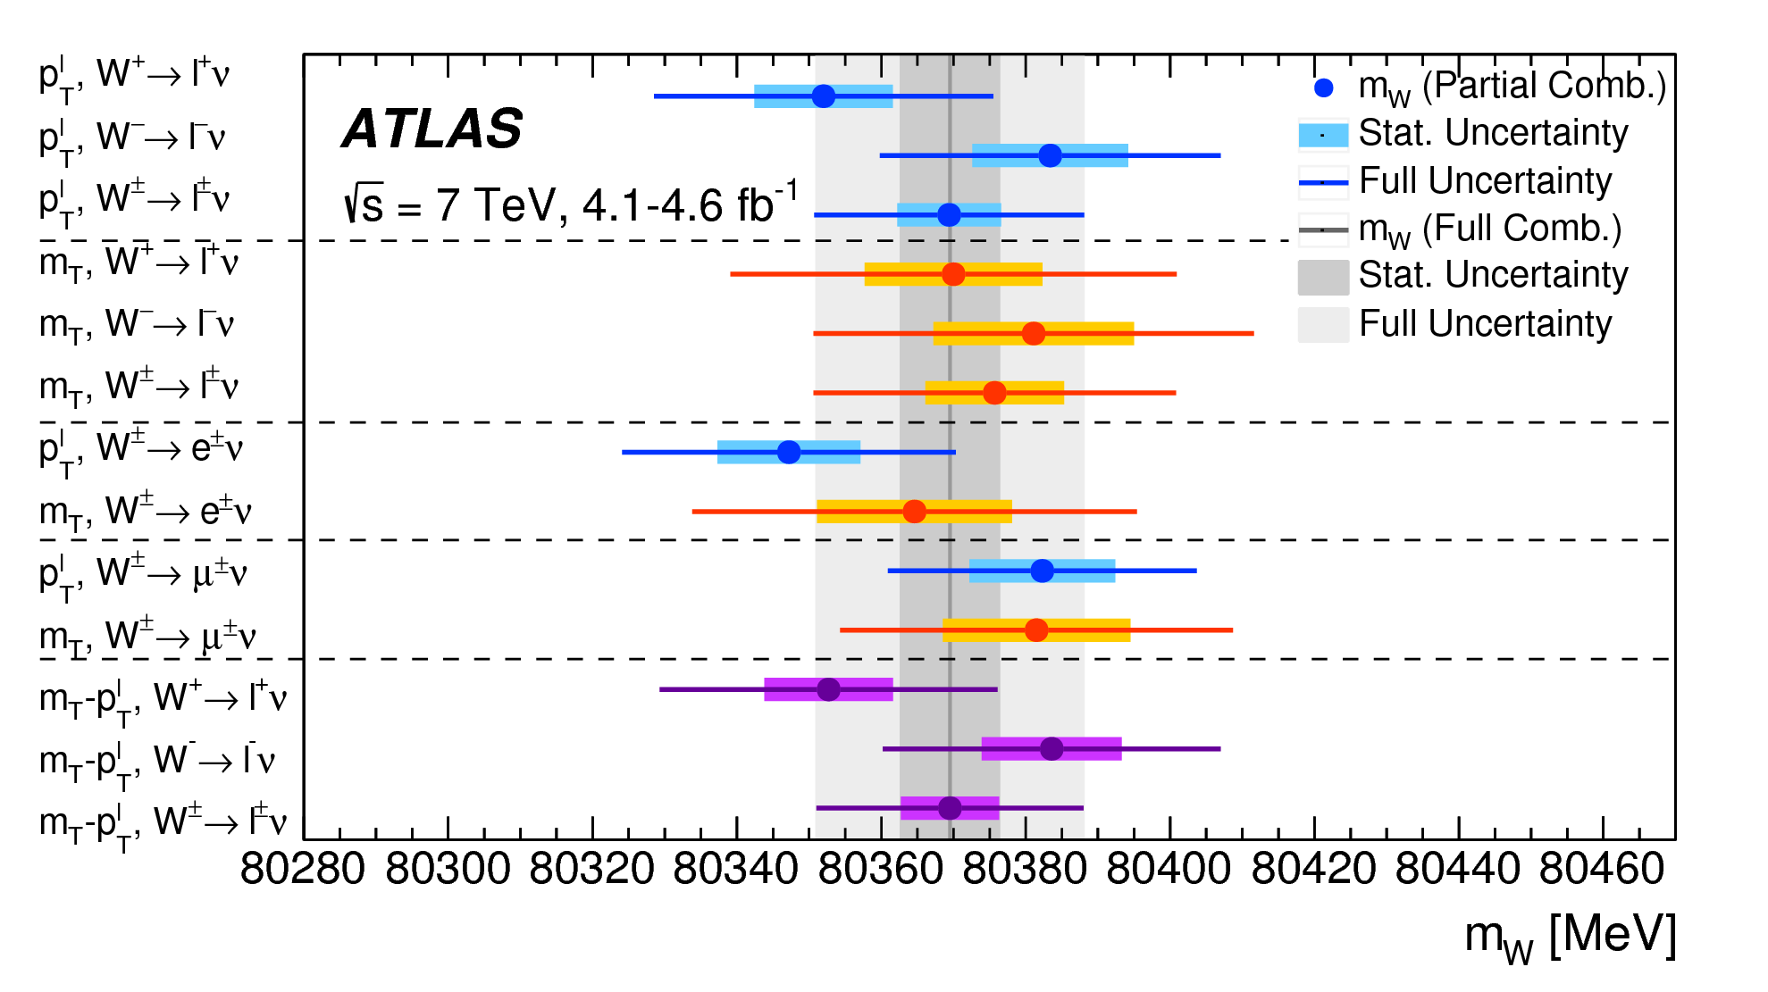
ATLAS, EPJC 78 (2018) 110

Slide 22
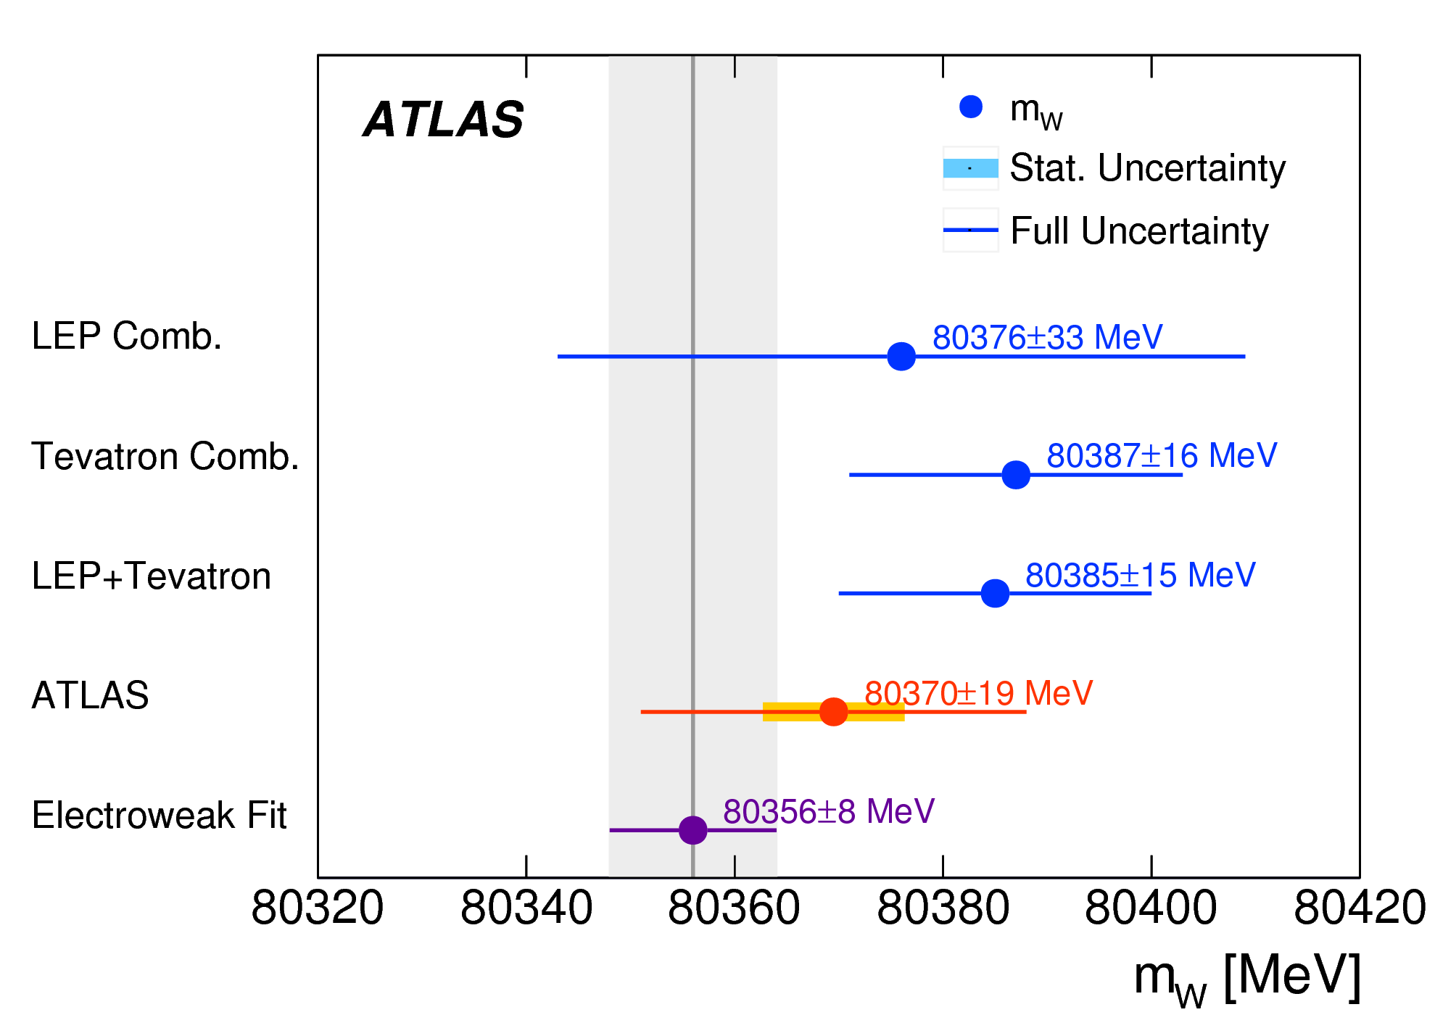
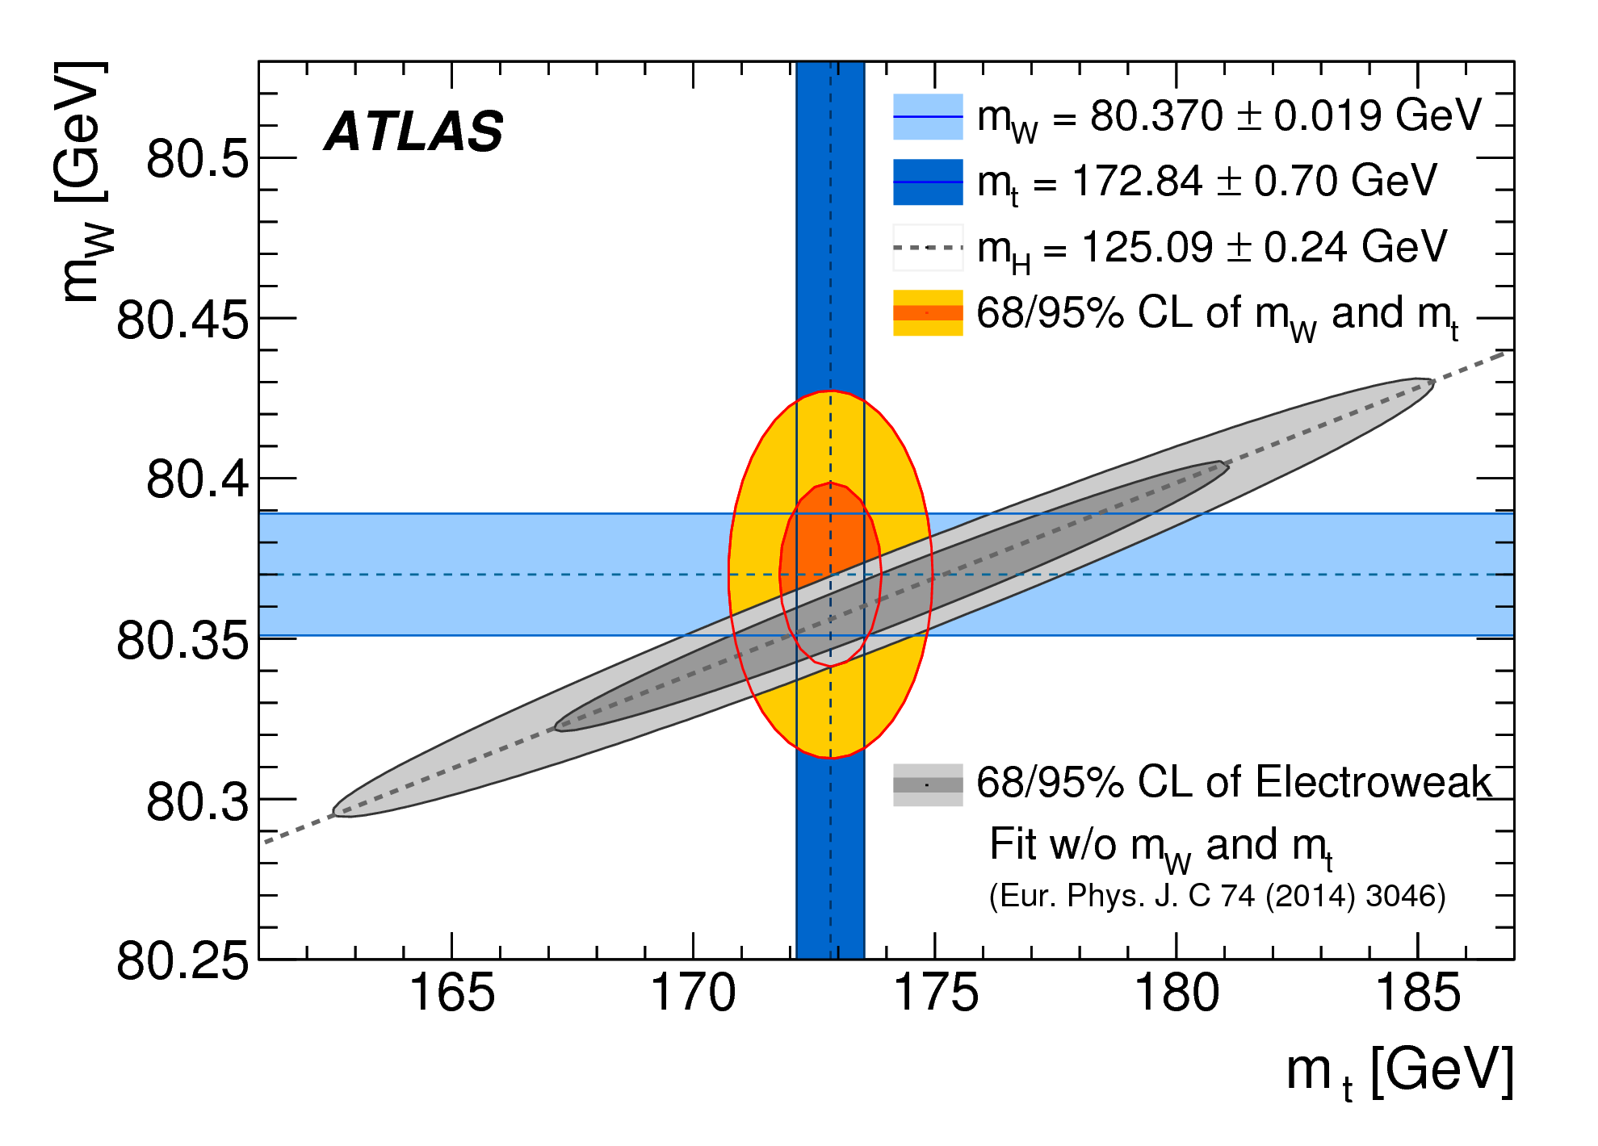
ATLAS, EPJC 78 (2018) 110

Slide 23
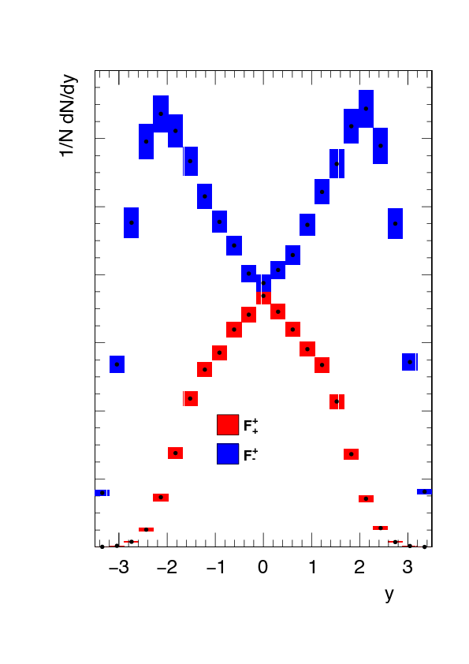
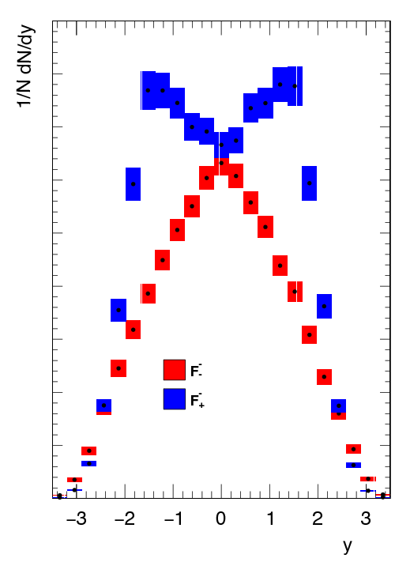
Manca et al. JHEP 12 (2017) 030
What’s coming from CMS: W helicity measurements
Template fits not dissimilar to ATLAS Z angular coefficient analysis. Not as straight forward due to neutrino – must rely on charged lepton alone.
negative W
both helicities
positive W
both helicities

Slide 24
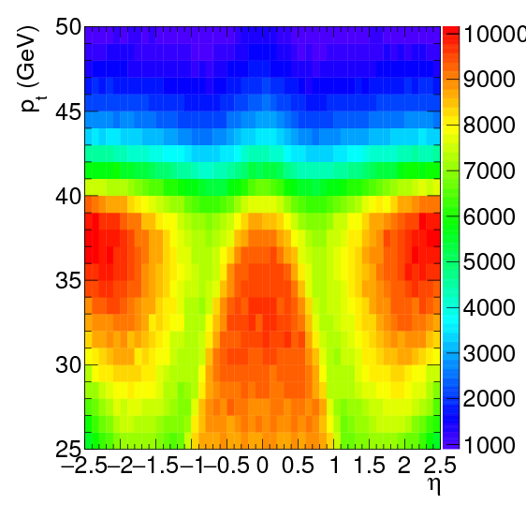
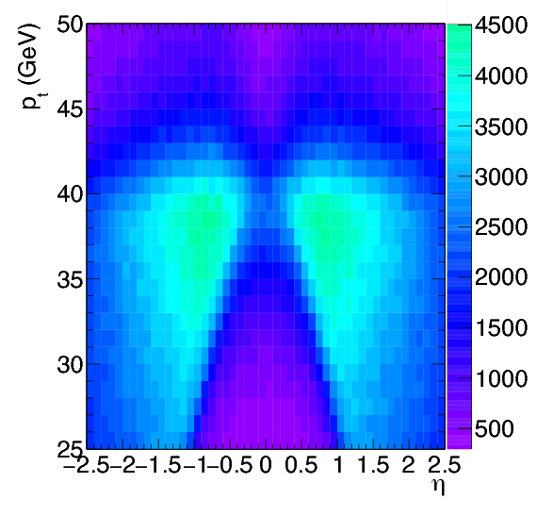
The parity violation in W decay helps out: the lepton (p_{T},η) distribution is highly discriminating.
Fit templates like these to the data.

Slide 25
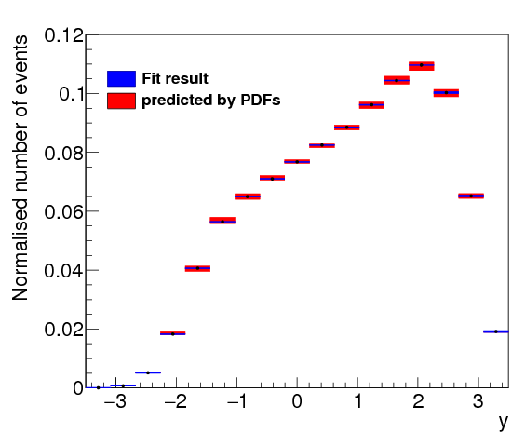
Envelope for PDFs
y
Envelope for W p_{T} spectrum
y

Slide 26
Azimuthal decorrelations:
At LO, pp →2 jets must have Δφ = π. ie, perfect correlation.
At NLO, can have a 3rd jet; at NNLO, a 4th. This leads to Δφ < π ie, decorrelation
How accurate are the NLO and NNLO calculations?
CMS published in 2016, ATLAS has a paper on the arXiv out May 2018.
These measurements probe the dynamics of multi-jet production.
Look as a function of the leading jet p_{T} and H_{T}.
Primary goal: Check predictions of pQCD.

Slide 27
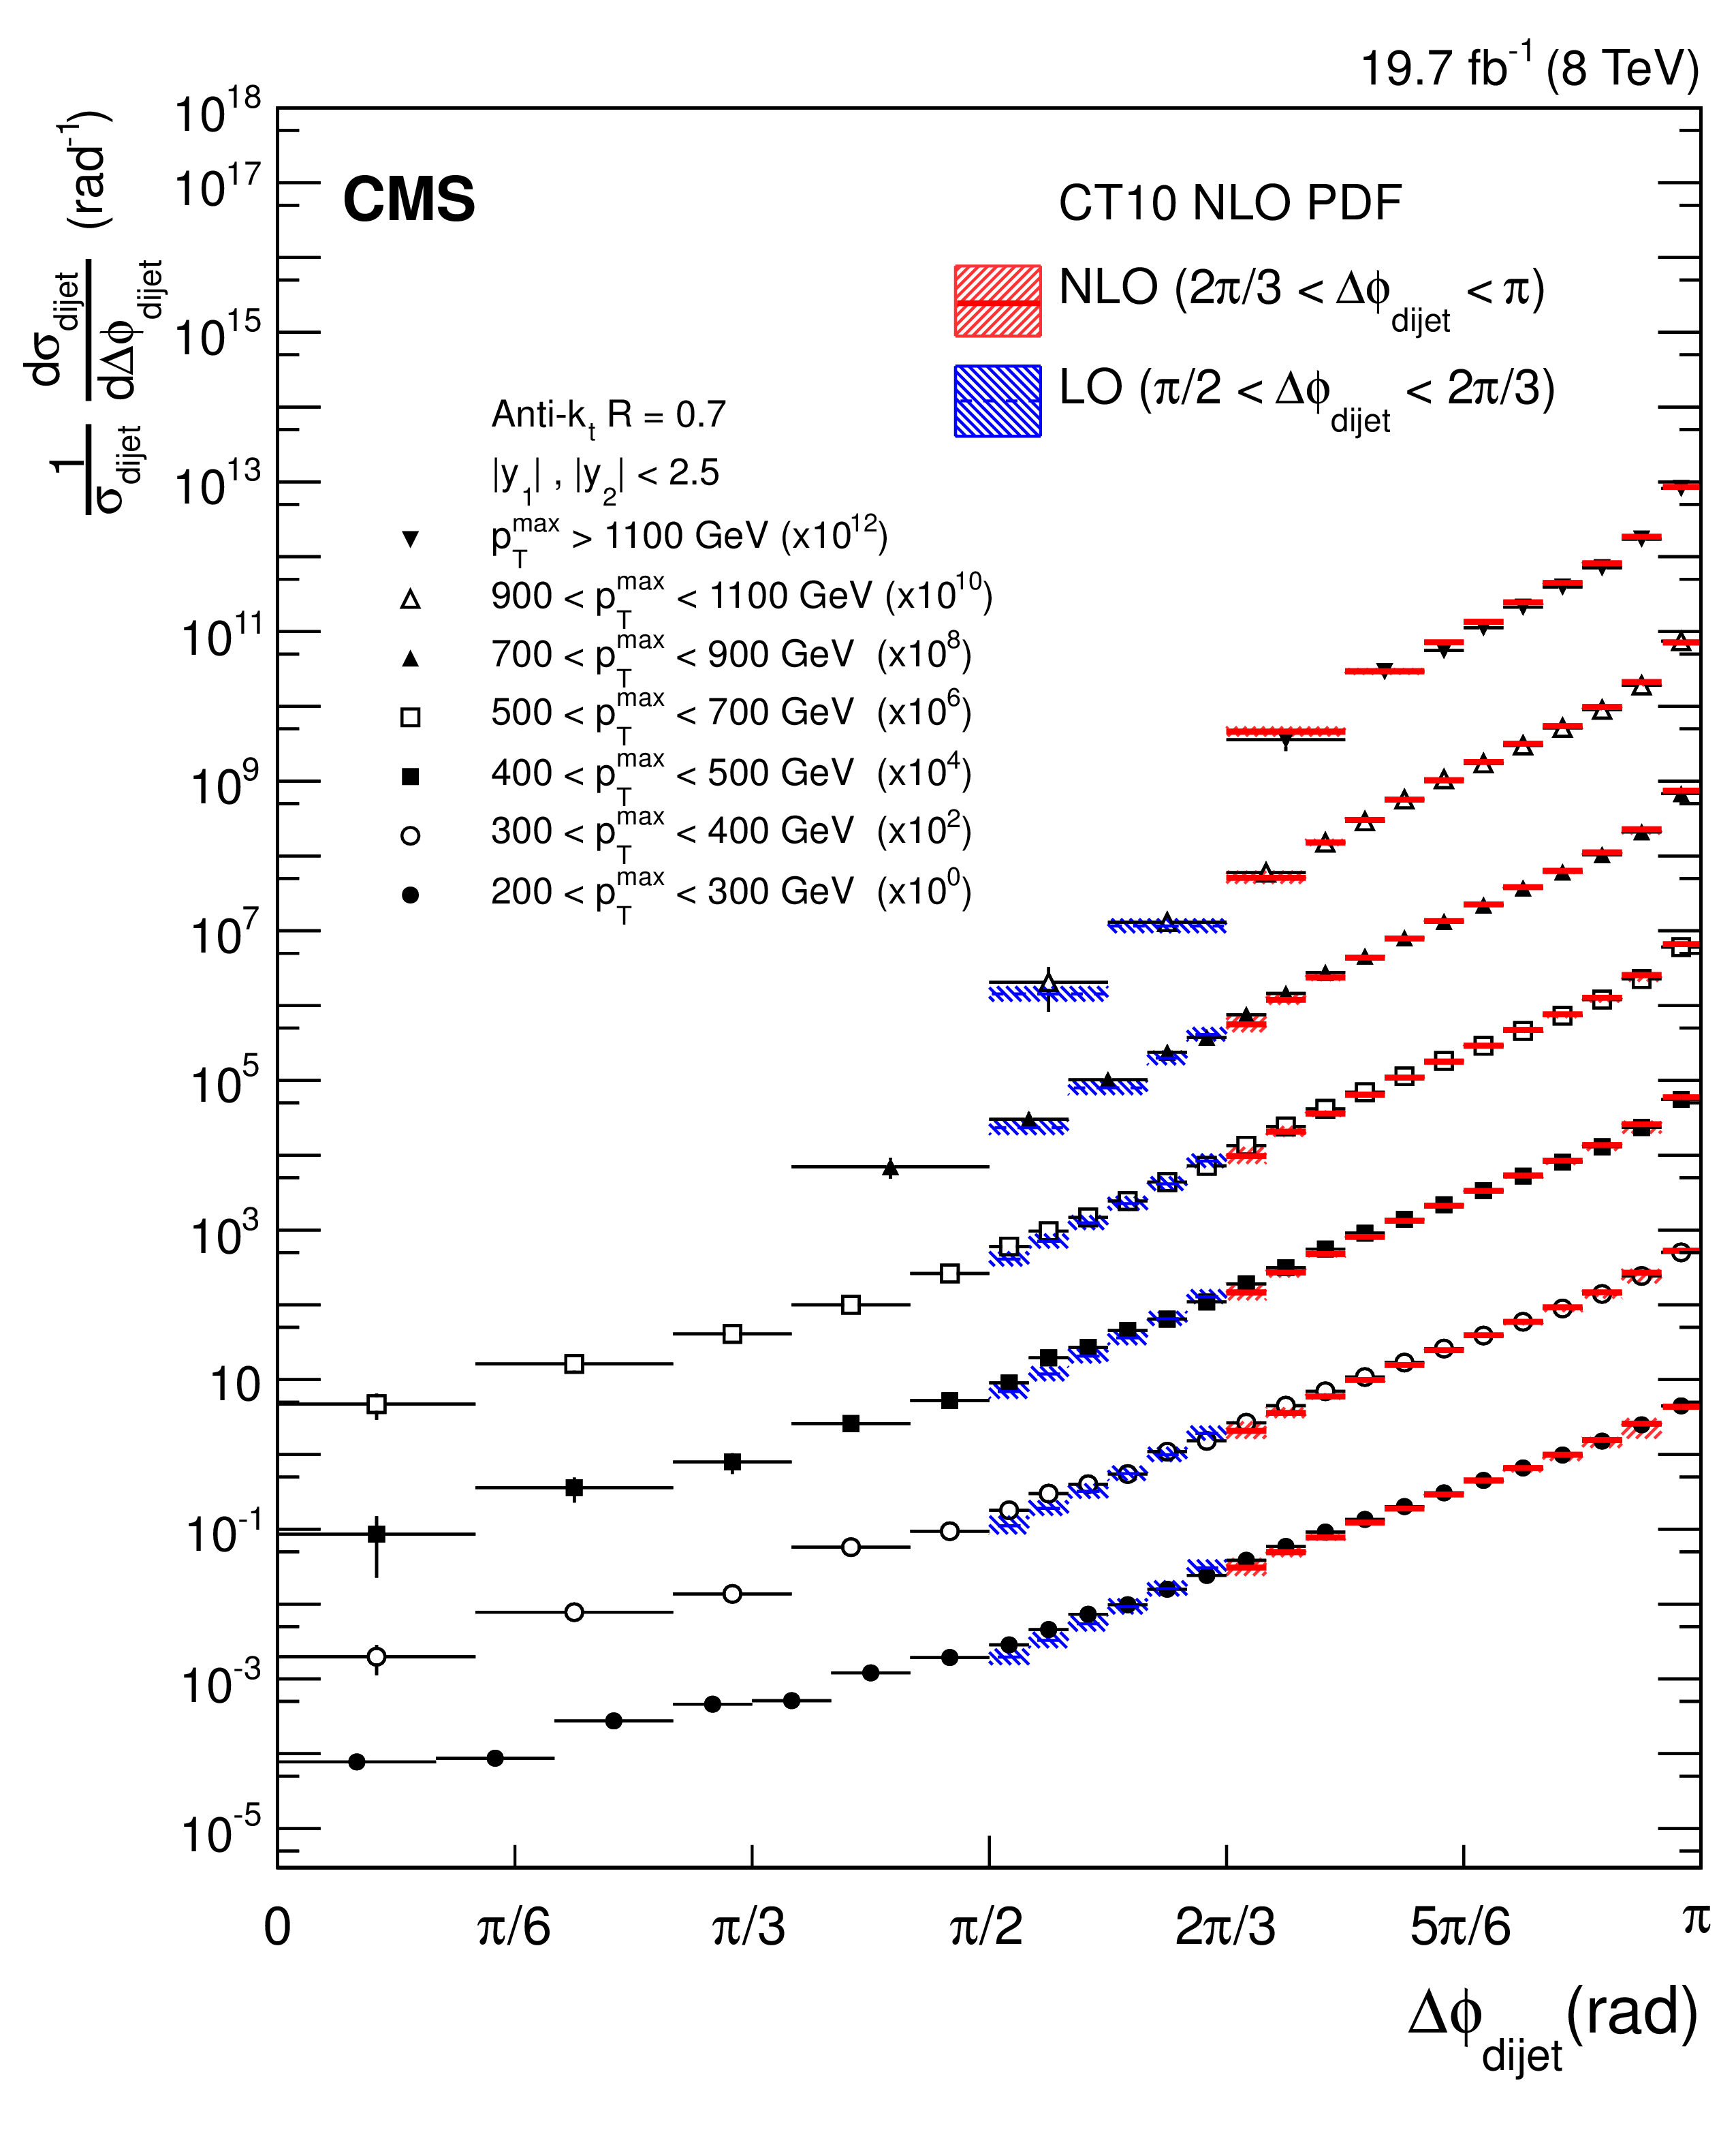
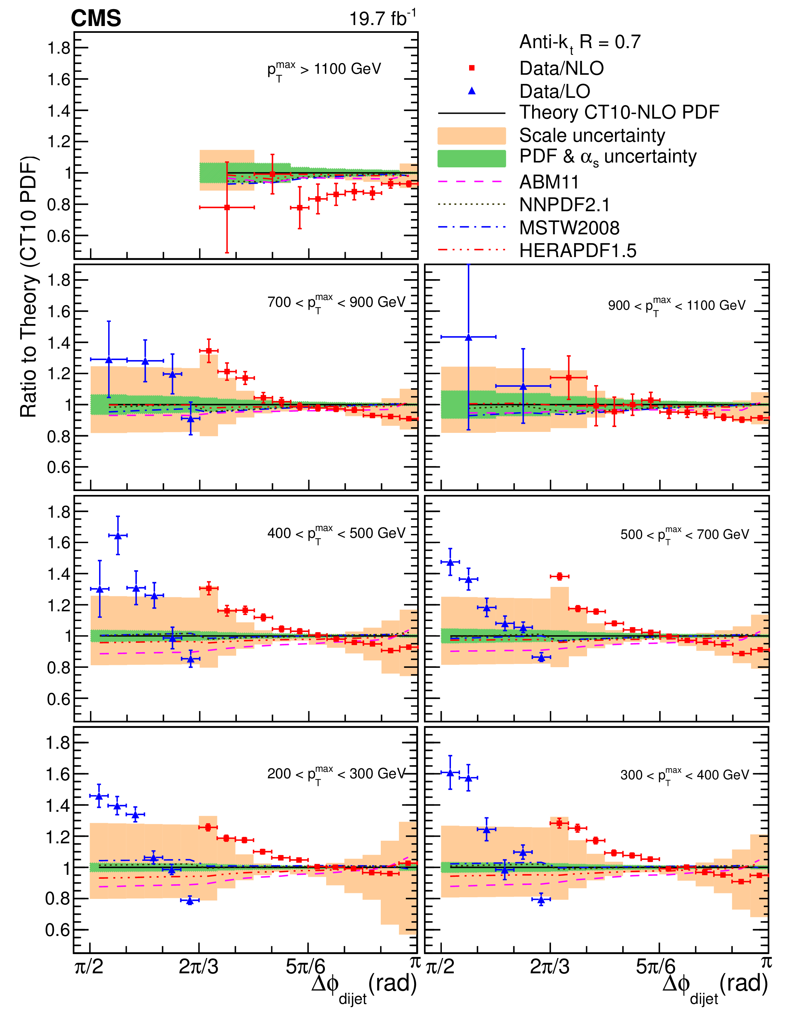
normalized differential cross sections
CMS, EPJC 76 (2016) 536

Slide 28
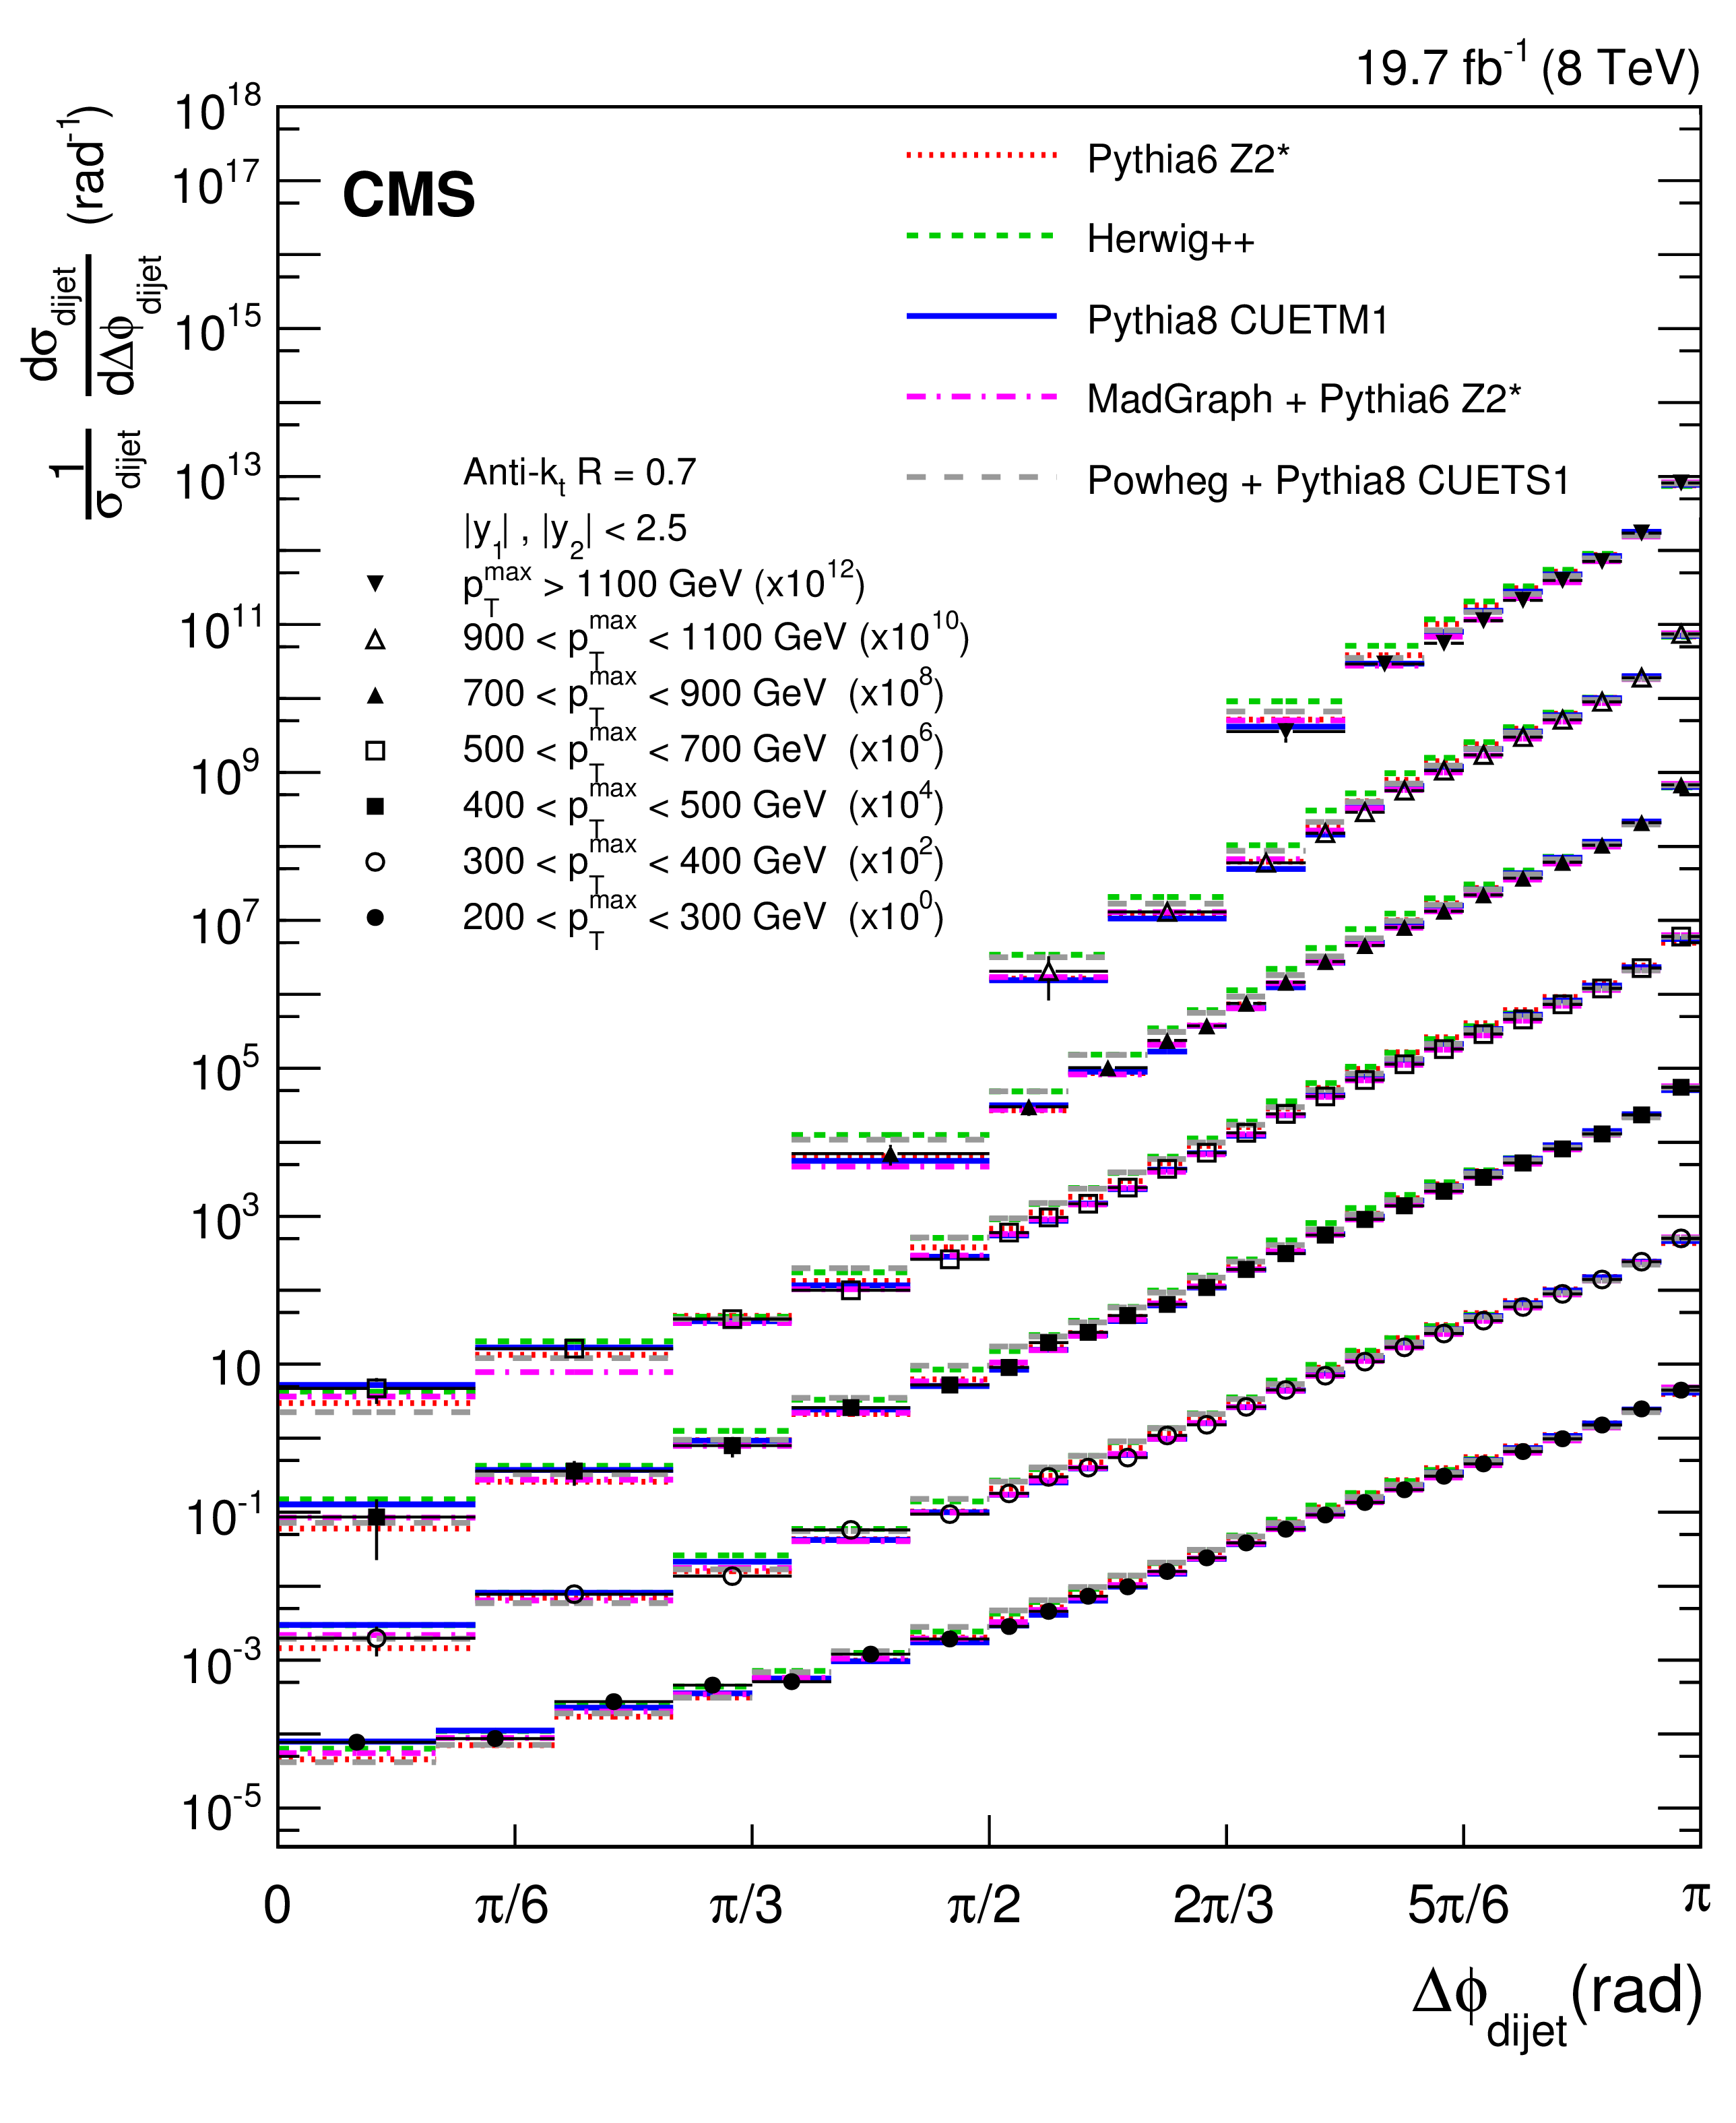
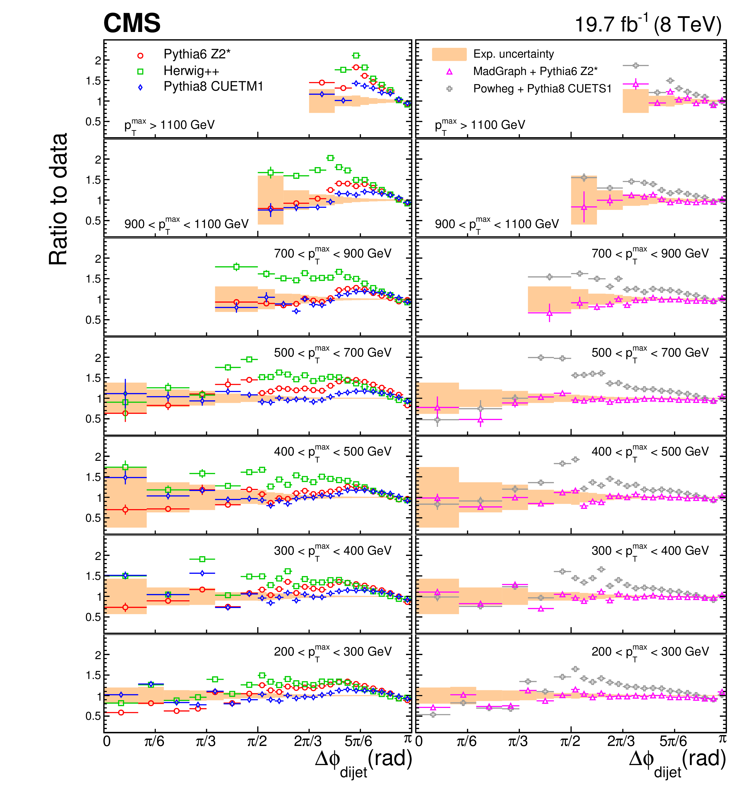
normalized differential cross sections
CMS, EPJC 76 (2016) 536

Slide 29
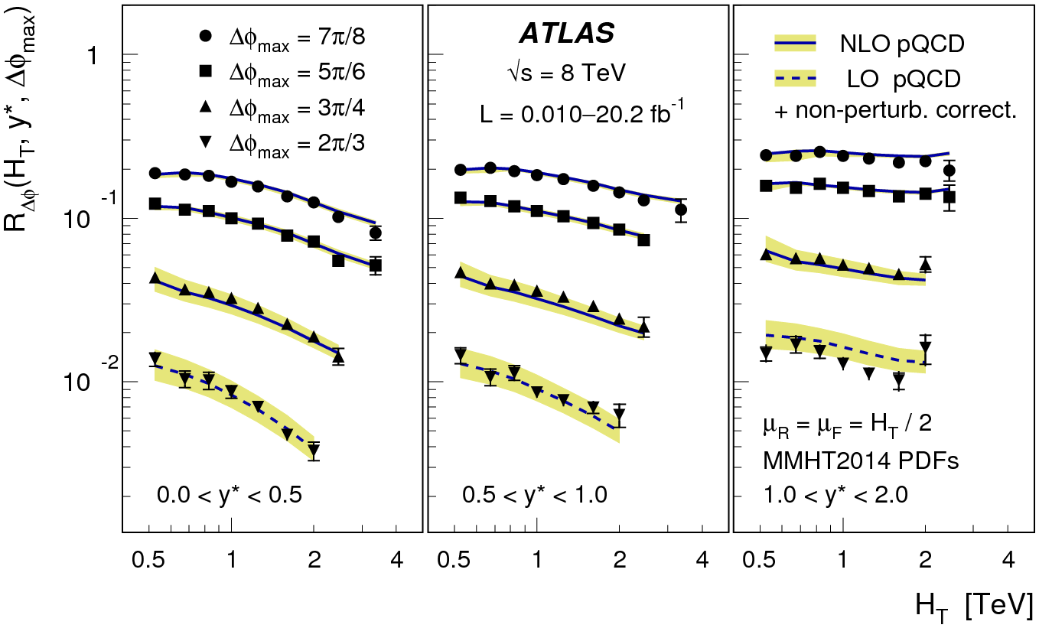
ATLAS took a completely different approach.
Look at ratio of cross sections for Δφ < Δφ_{max} to all Δφ as a function of H_{T} .
Make slices in the relative different in rapidity.
ATLAS, arXiv:1805.04691

Slide 30
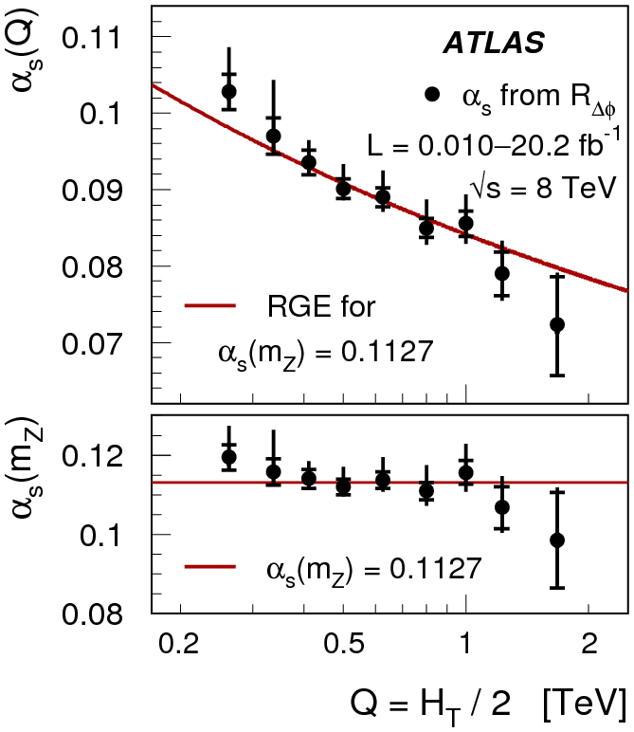
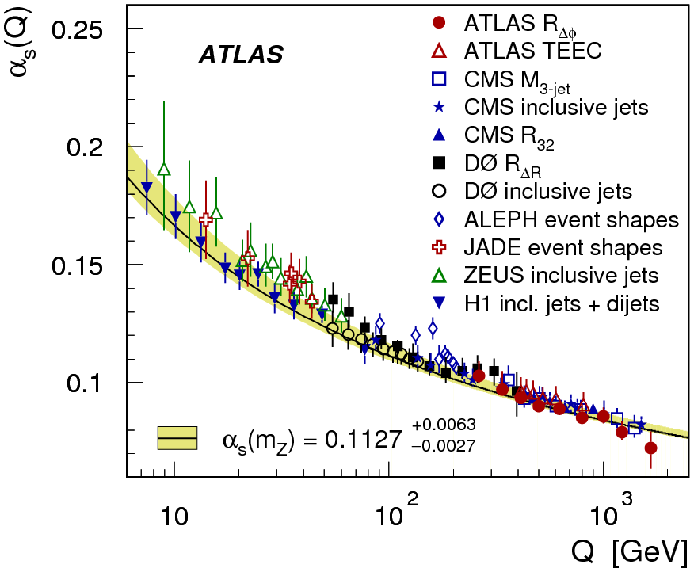
ATLAS recognized an opportunity to measure α_{S} .
Not the most precise values, but they do occur for high Q.
ATLAS, arXiv:1805.04691

Slide 31
Same-sign WW production:
Same-sign WW production probes vector-boson fusion.
It is a very rare process, with distinctive features.
Two charged leptons of same sign. Missing energy.
Two energetic jets widely separated in rapidity.
Both CMS and ATLAS have observed this process
CMS published in 2018, ATLAS has a conference note from July 2018.
Primary goal: Observe rare process and check for anomalous production.

Slide 32
Feynman diagrams for same-sign WW production:
Weak
Strong
No gauge couplings.
Triple-gauge couplings.
Quartic-gauge couplings.
(Background)

Slide 33
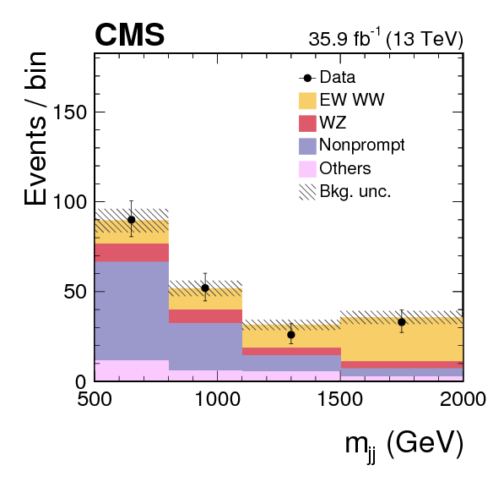
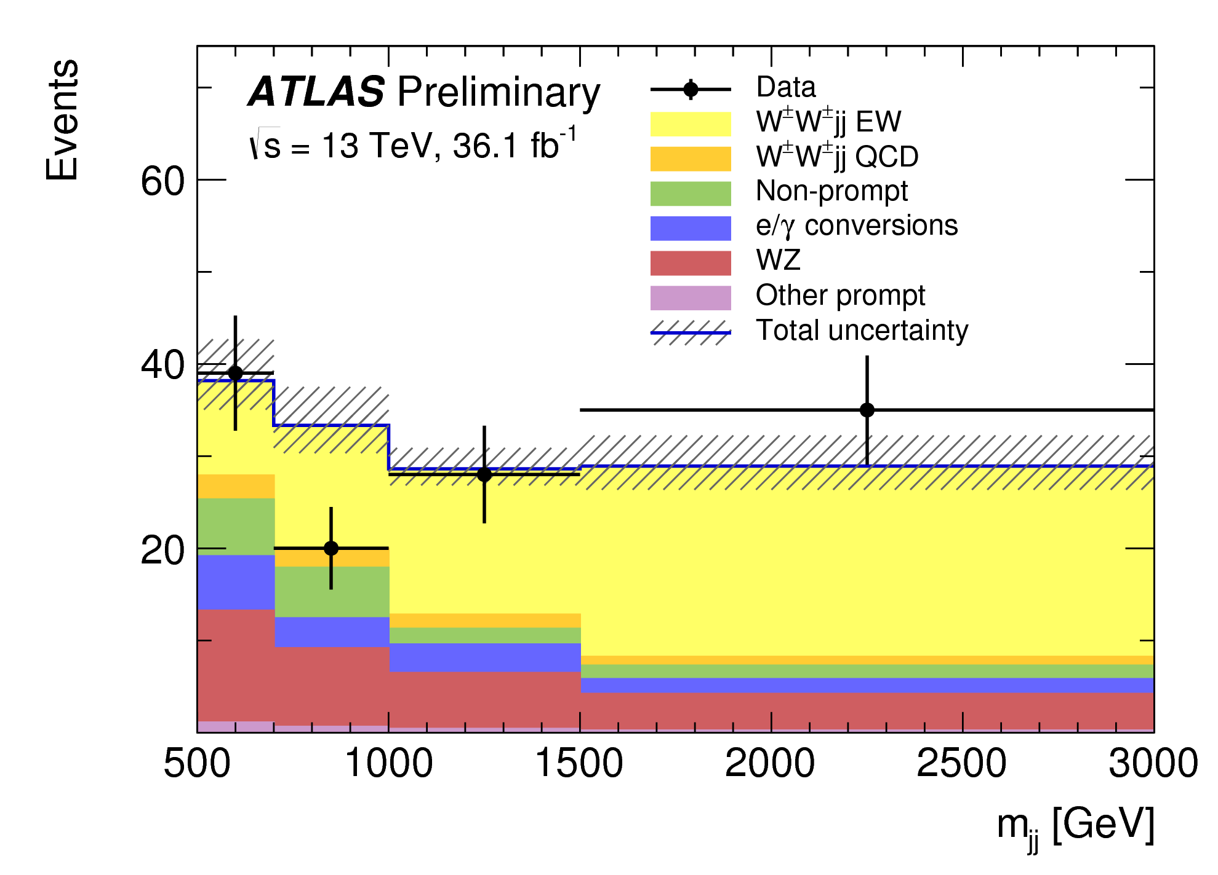
5.5 st. dev. observed
5.7 st. dev. expected
6.9 st. dev. observed
4.6 st. dev. expected
CMS, PRL 120 (2018) 081801
ATLAS-CONF-2018-030

Slide 34
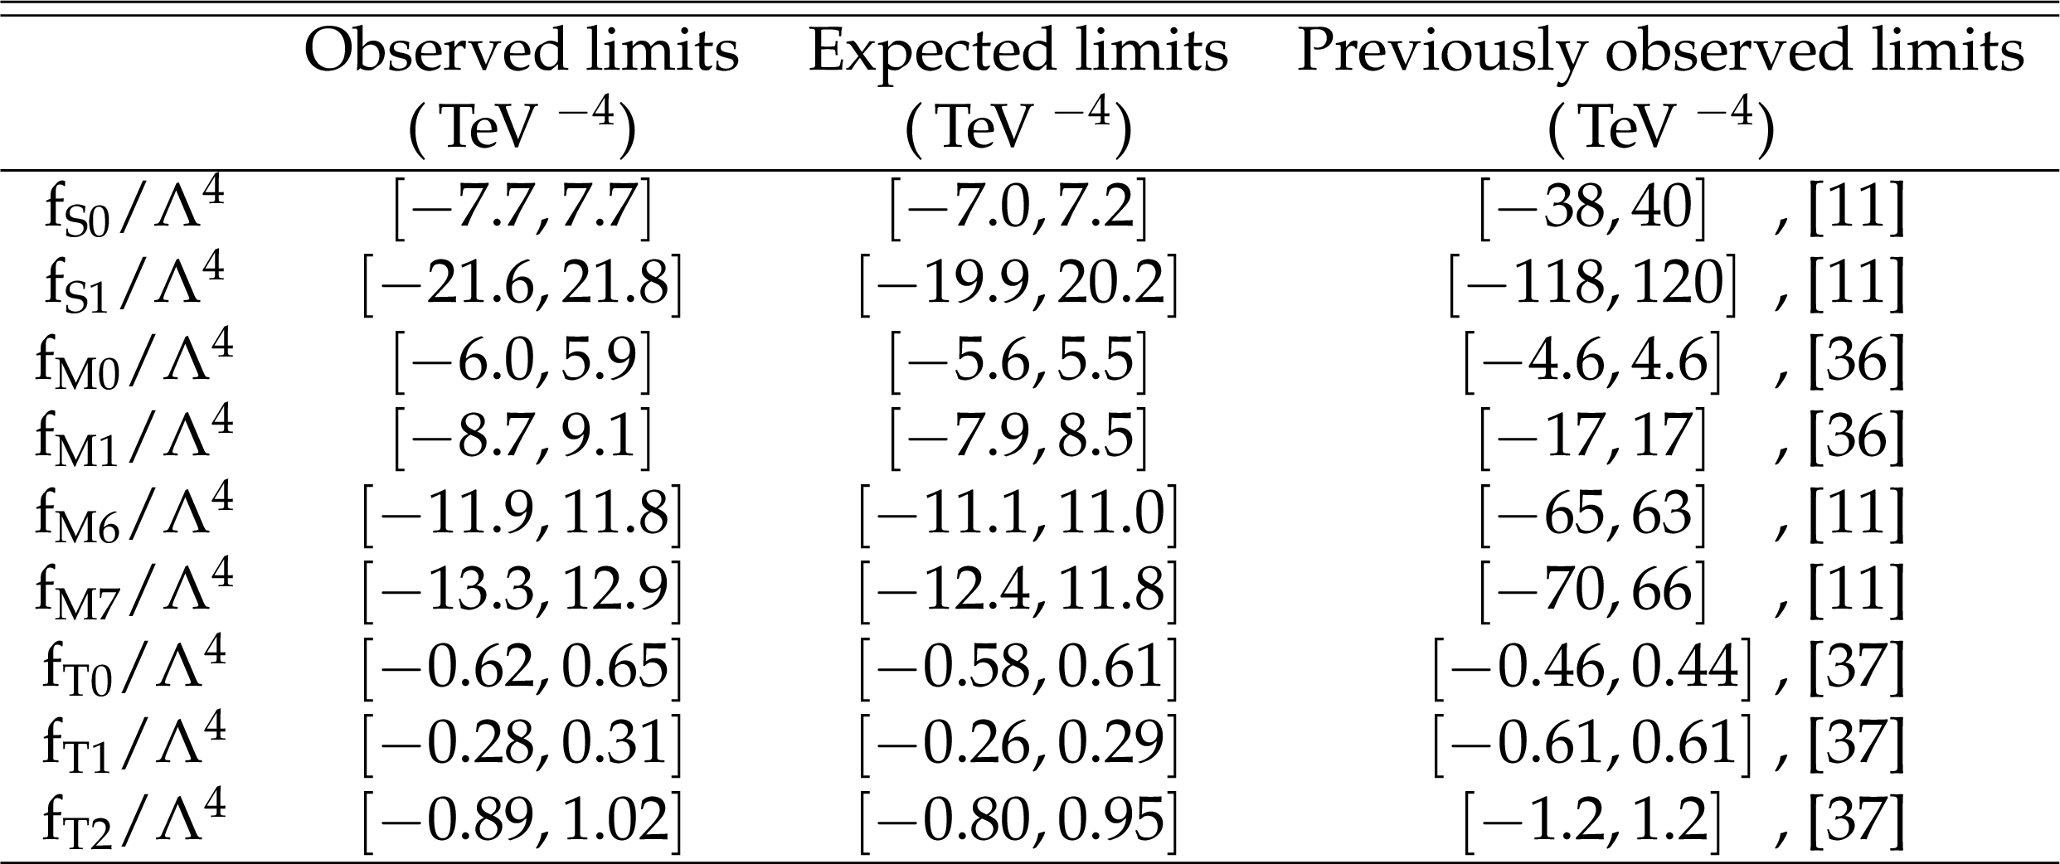
No anomalous production observed.
CMS derived bounds on quartic anomalous couplings (assuming no anomalous TGCs).
Sensitivity is very good and led to major improvements for some coefficients.
CMS, PRL 120 (2018) 081801

Slide 35
Summary and Conclusion:
This presentation could not include many, many interesting analyses.
Those that were presented could not be investigated in any depth.
Some experiments left out: LHCb, Tevatron…
Nonetheless, SM studies at the LHC are entering deep territory and quality and probative power surpasses past experiments by far.
SM studies are multifaceted and rich.
I predict major growth in the years to come.
We still need better theory calculations!

