Slide 1
Lepton Flavor Violation at the LHC
Michael Schmitt
Northwestern University
COFI Workshop
May 22, 2018

Slide 2
This talk is not about the fascinating observations in B decays.
My assignment is to focus is on heavier particles:
gauge bosons, the Higgs boson, and the top quark

Slide 3
Of course, lepton flavor violation has already been observed
through neutrino oscillations.
This implies, through loops, charged lepton violation.
The predicted rate is far too small to be observed, however.
If charged lepton violation is observed at the LHC,
then new physics beyond the standard model must be present.
This makes it worthwhile.

Slide 4
Three opportunities for Lepton Flavor Violation:
At a vertex (not necessarily at tree level) Example: Z decays to e mu
Non-universality of gauge couplings Example: BF(Z to ee) and BF(Z to tautau) are different
Participation of a non-SM boson with non-universal couplings Example: top decays to tau are enhanced due to charged Higgs

Slide 5
Z decays that violate lepton flavor conservation
In principle, already strongly constrained indirectly.
Indirect constraints always have loopholes.
LEP experiments tested this with a few million recorded Z decays.
Pristine event properties make this relatively easy(?)
What can the LHC experiments do?
They have many more Z decays.
Events are messy, but lepton reconstruction and ID are excellent.
A good opportunity.

Slide 6
Synopsis of a search for Z decays to eμ
Signal marked by a Z resonant peak in the eμ invariant mass spectrum.
Mass resolution is very good.
Major backgrounds from τ pairs, W pairs, top pairs
Lead naturally to the eμ final state
Suppress Z → ττ using missing energy p_{T}^{miss}
WW also suppressed by p_{T}^{miss} cut
Suppress tt by vetoing events with (b-)jets
Difficult background from Z → μμ

Slide 7
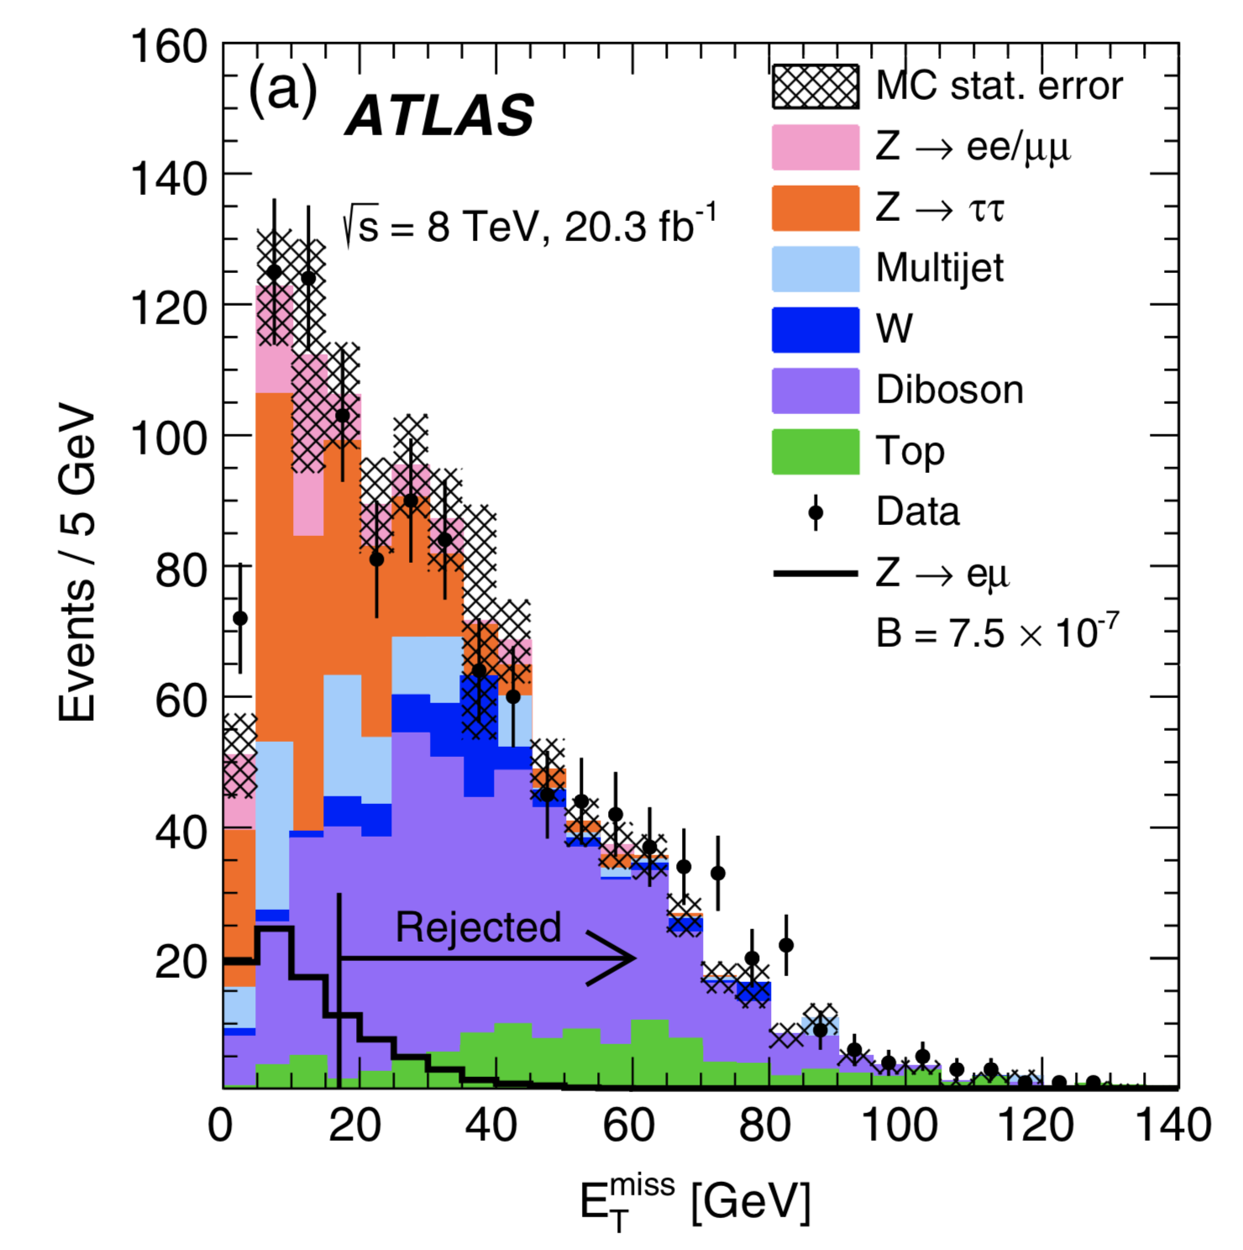
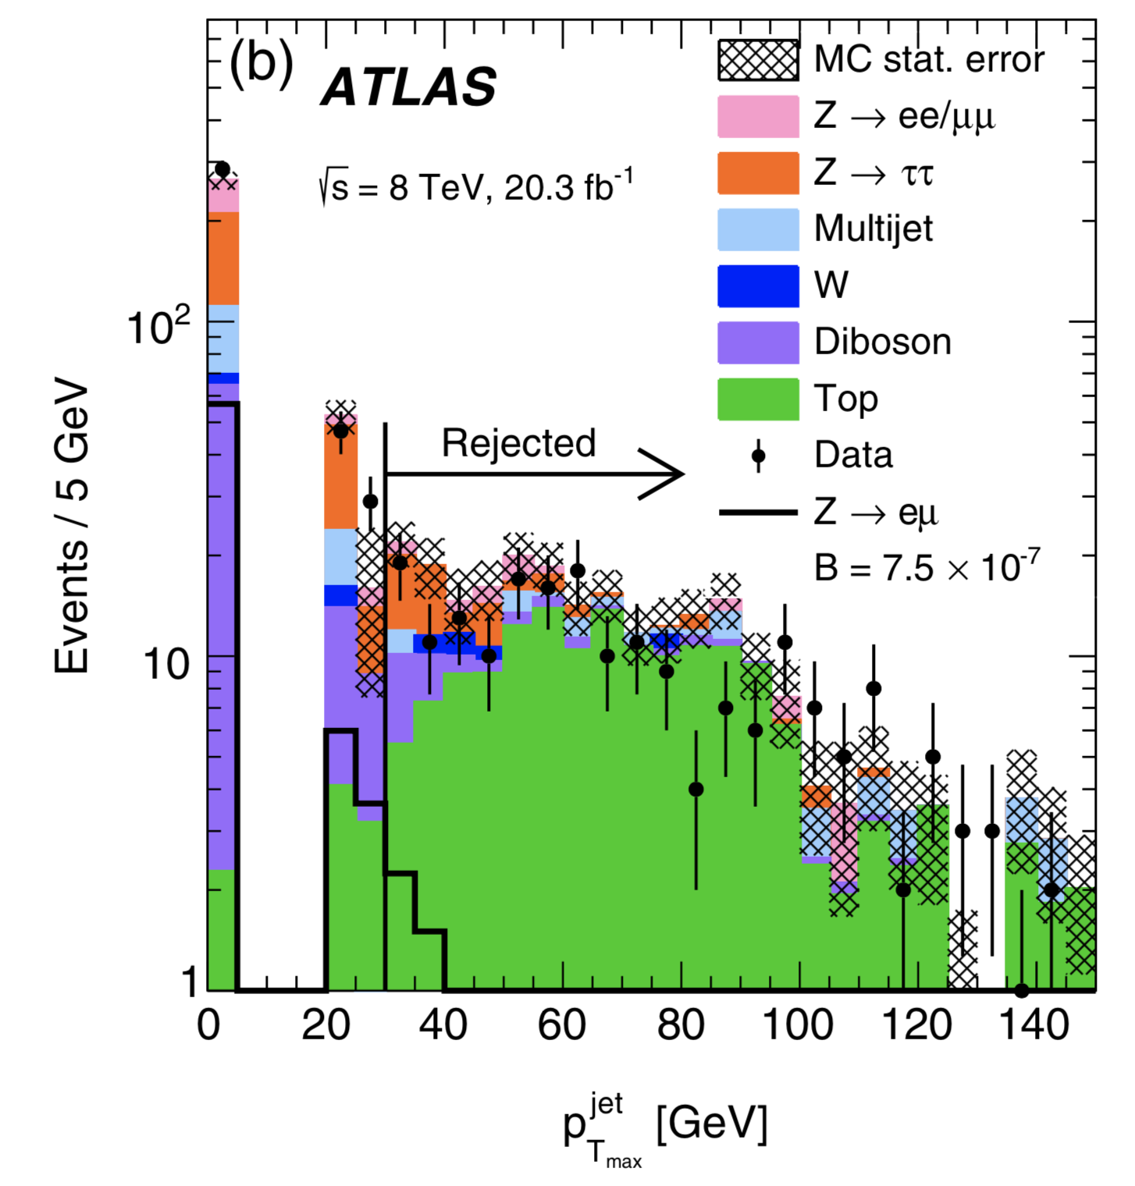
PRD 90 072010 (2014)

Slide 8
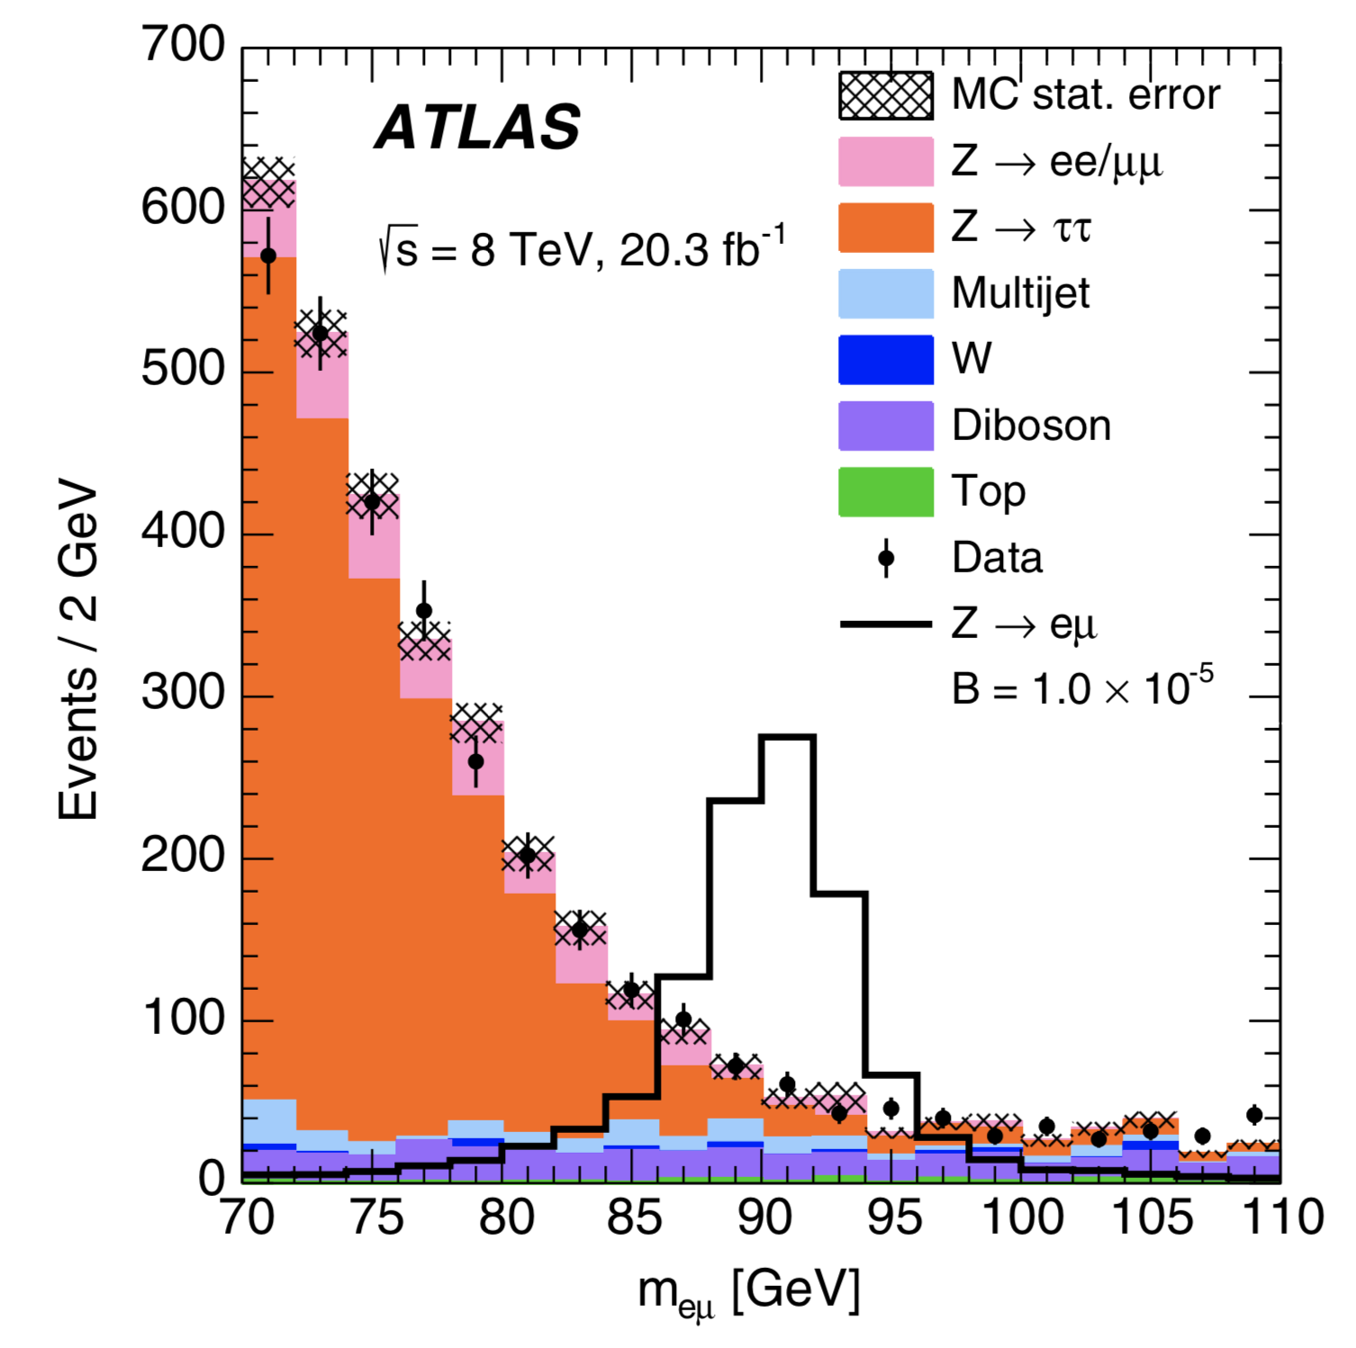
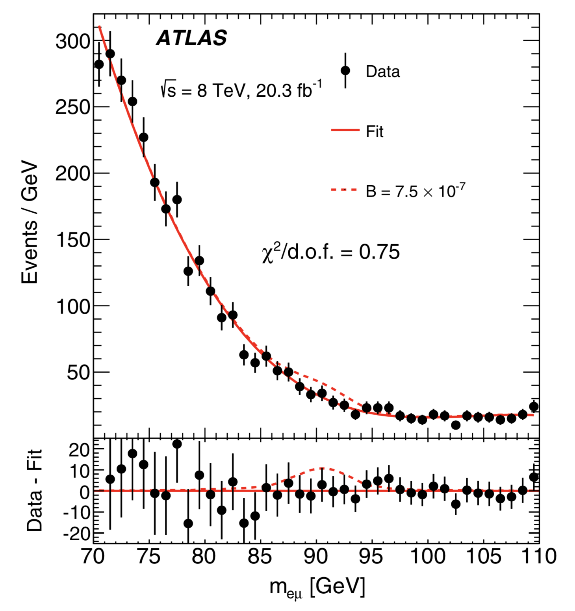
After all cuts applied, perform fit for a signal peak on a smooth background:

Slide 9
ATLAS result (8 TeV 20 fb⁻¹)
B(Z→eμ) < 7.5 x 10⁻⁷ (95% CL)
Better than the LEP result: 17 x 10⁻⁷
Similar but unpublished [public] result from CMS.
ATLAS also searched for Z → eτ and Z → μτ
13 TeV 36 fb⁻¹
Reconstruct τ leptons in hadronic decay modes
Use neural network classifiers to identify signal events
Fit the output of the classifier
B(Z→eτ) < 5.8 x 10⁻⁵ but mild excess observed
B(Z→μτ) < 2.4 x 10⁻⁷

Slide 10
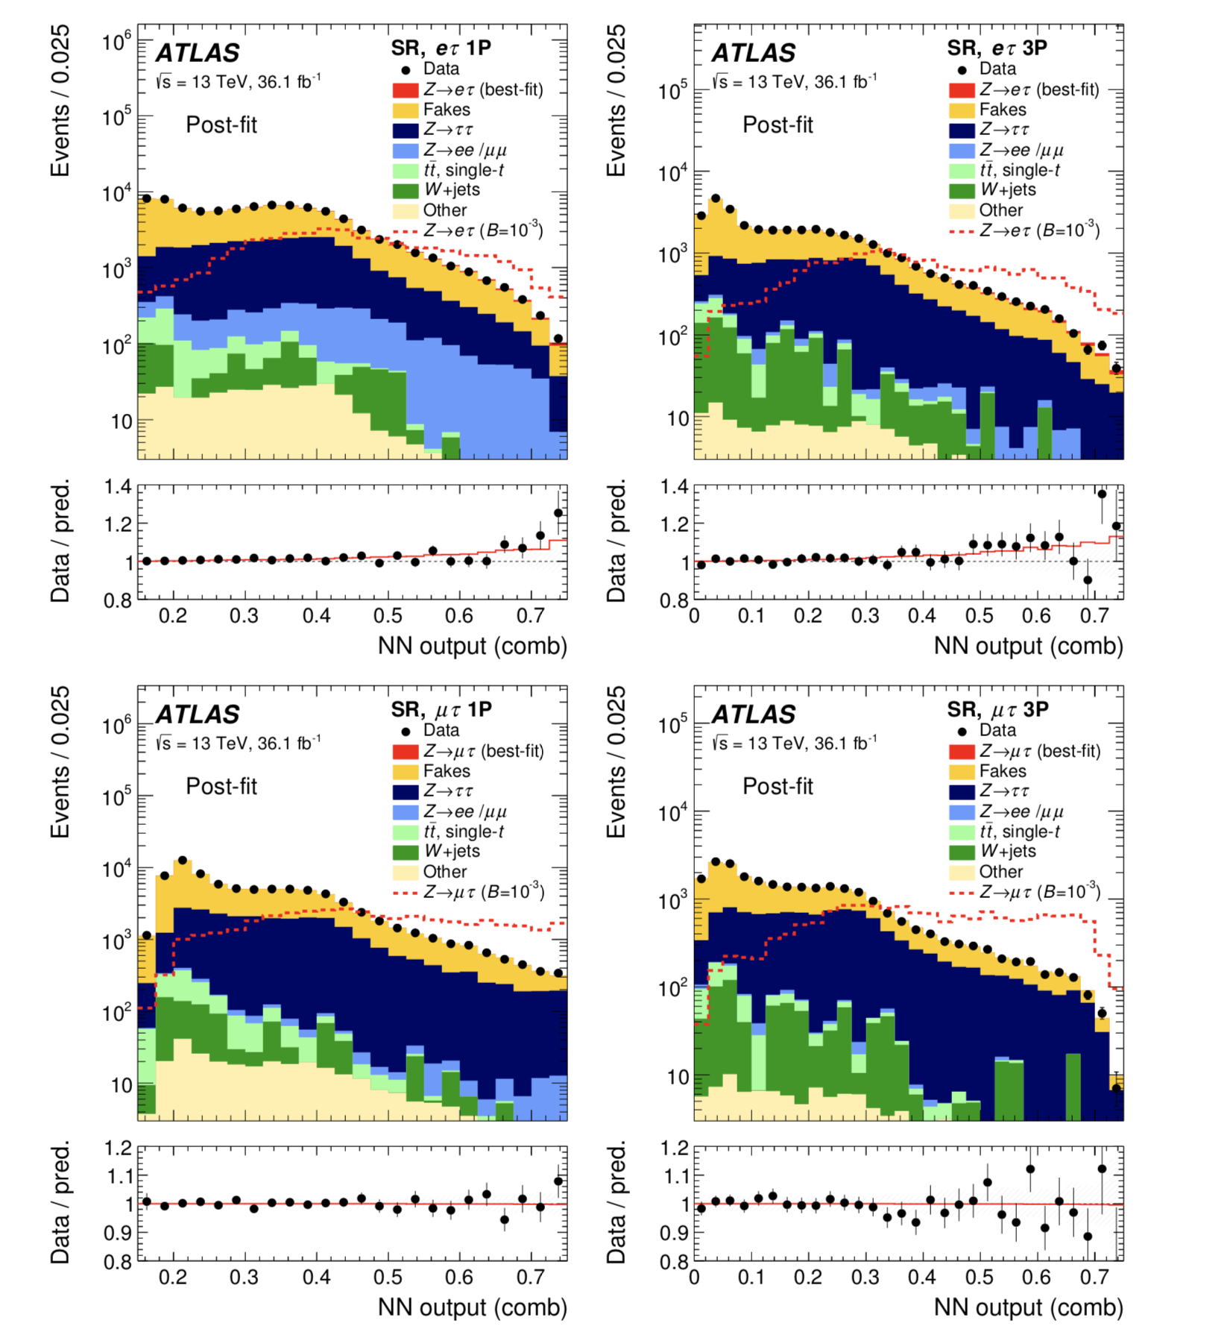
Output of NN classifier
electrons
1-prong τ on left. 3-prong τ on right
muons

Slide 11
Higgs decays that violate lepton flavor conservation
Higgs boson is the one real fundamental discovery from the LHC.
It opens a new window on the SM and possibly onto new physics.
SM predictions are very concrete – are they correct?
This probes something completely different: Yukawa couplings.
Indirect bounds are relatively weak, especially for eτ and μτ decay channels.
A great opportunity.

Slide 12
Synopsis of a search for H decays to eμ, eτ, μτ
Similar to LFV decays of Z bosons.
Signal appears as a resonant peak
Background sources are the same.
Several event categories / signal regions
Utilize all possible Higgs production mechanisms.
Mass resolution differs across the detector.
Backgrounds have different characteristics.
For eτ, μτ use the collinear mass M_{coll}
neutrino parallel to visible τ decay products
systematic uncertainties associated with Higgs production modes

Slide 13
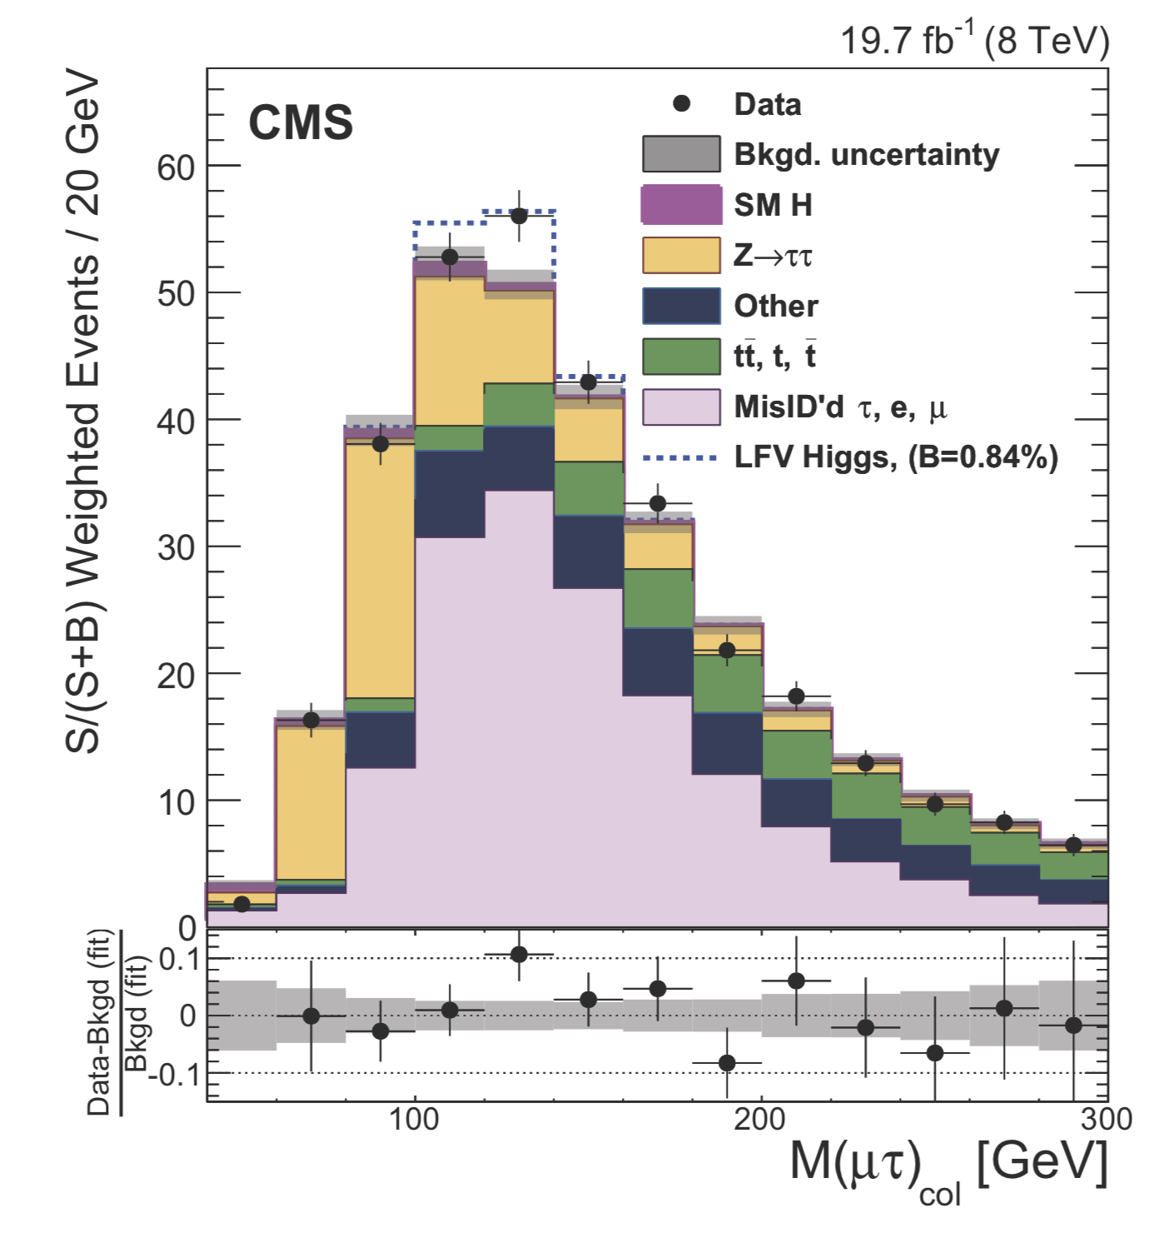
PLB 763 (2016) 472
CMS result (8 TeV 20 fb⁻¹)
B(H→eμ) < 0.035%
B(H→eτ) < 0.69%
B(H→μτ) = 0.84 +/- 0.38 % excess observed! (2.4σ)
UL: B(H→μτ) < 1.51%

Slide 14
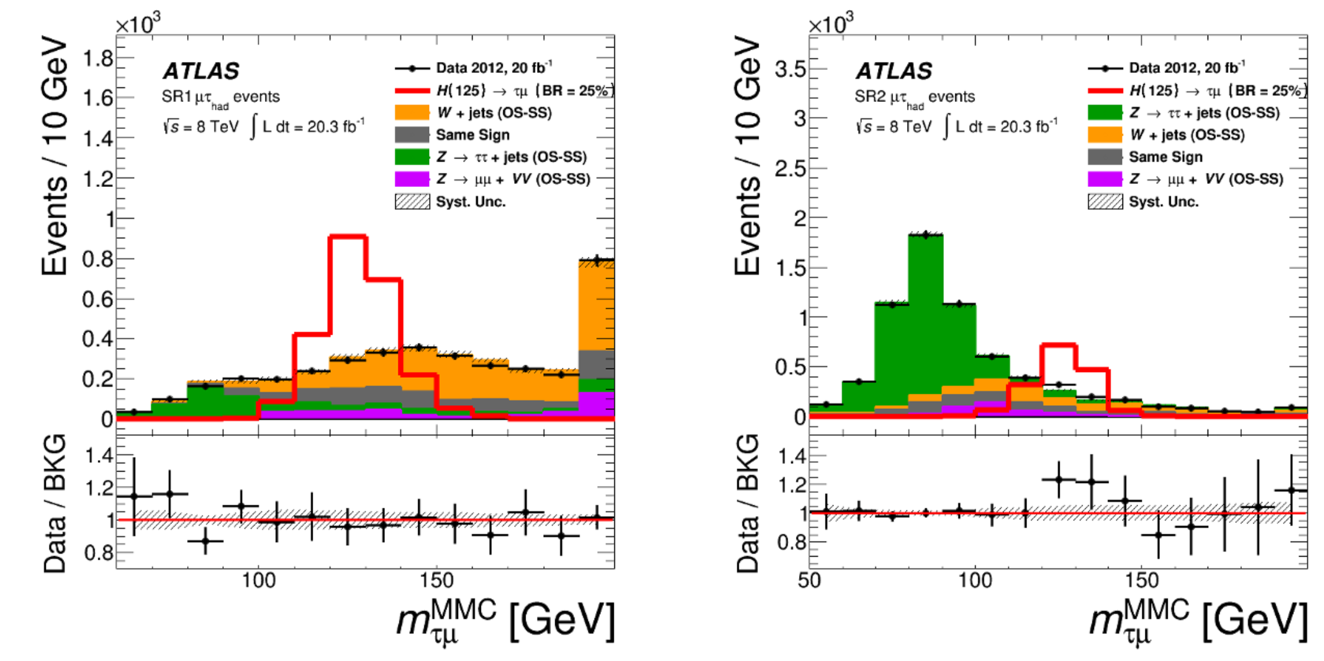
ATLAS responded with a search for H → μτ (8TeV 20 fb⁻¹)
JHEP11(2015)211
Use the same tools as Z → μτ
Define two signal regions
SR1 dominated by W + jets
SR2 dominated by Z → ττ
Use hadronic τ decays.

Slide 15
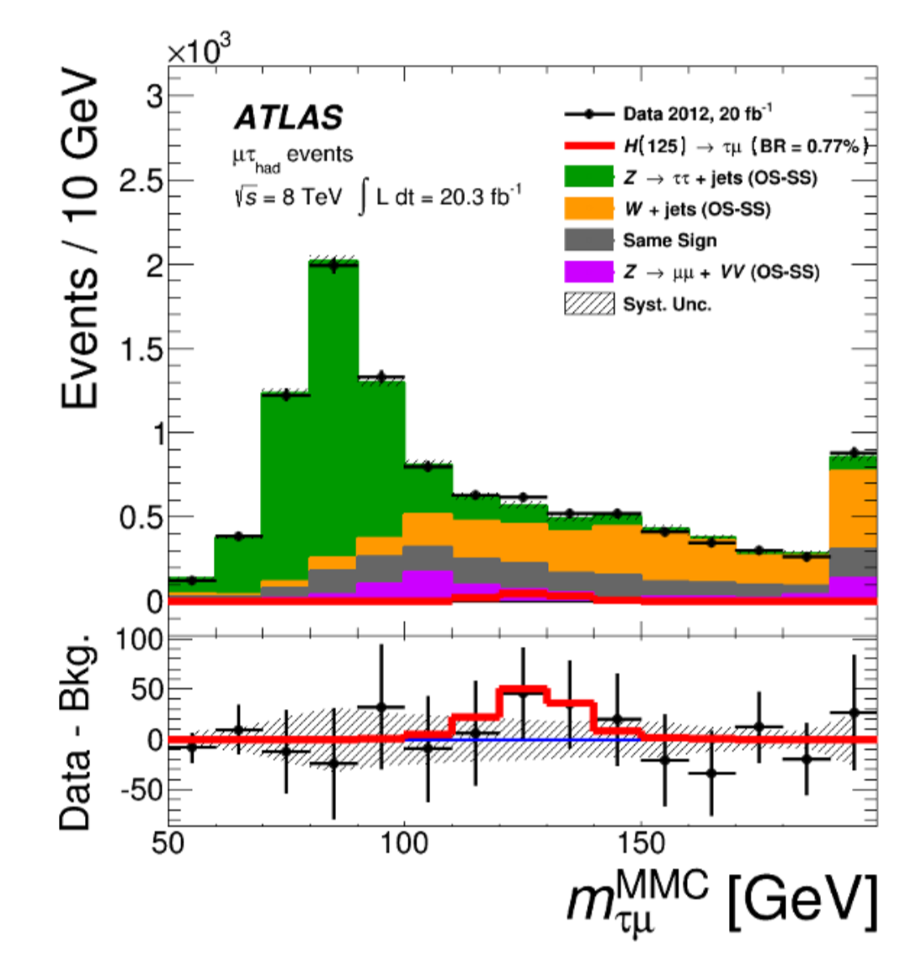
ATLAS result:
JHEP11(2015)211
B(H→μτ) = 0.77 +/- 0.62 % excess observed! (2.2σ)
UL: B(H→μτ) < 1.85 %
Reminder, CMS result:
B(H→μτ) = 0.84 +/- 0.32 % excess observed (2.4σ)
UL: B(H→μτ) < 1.51 %

Slide 16
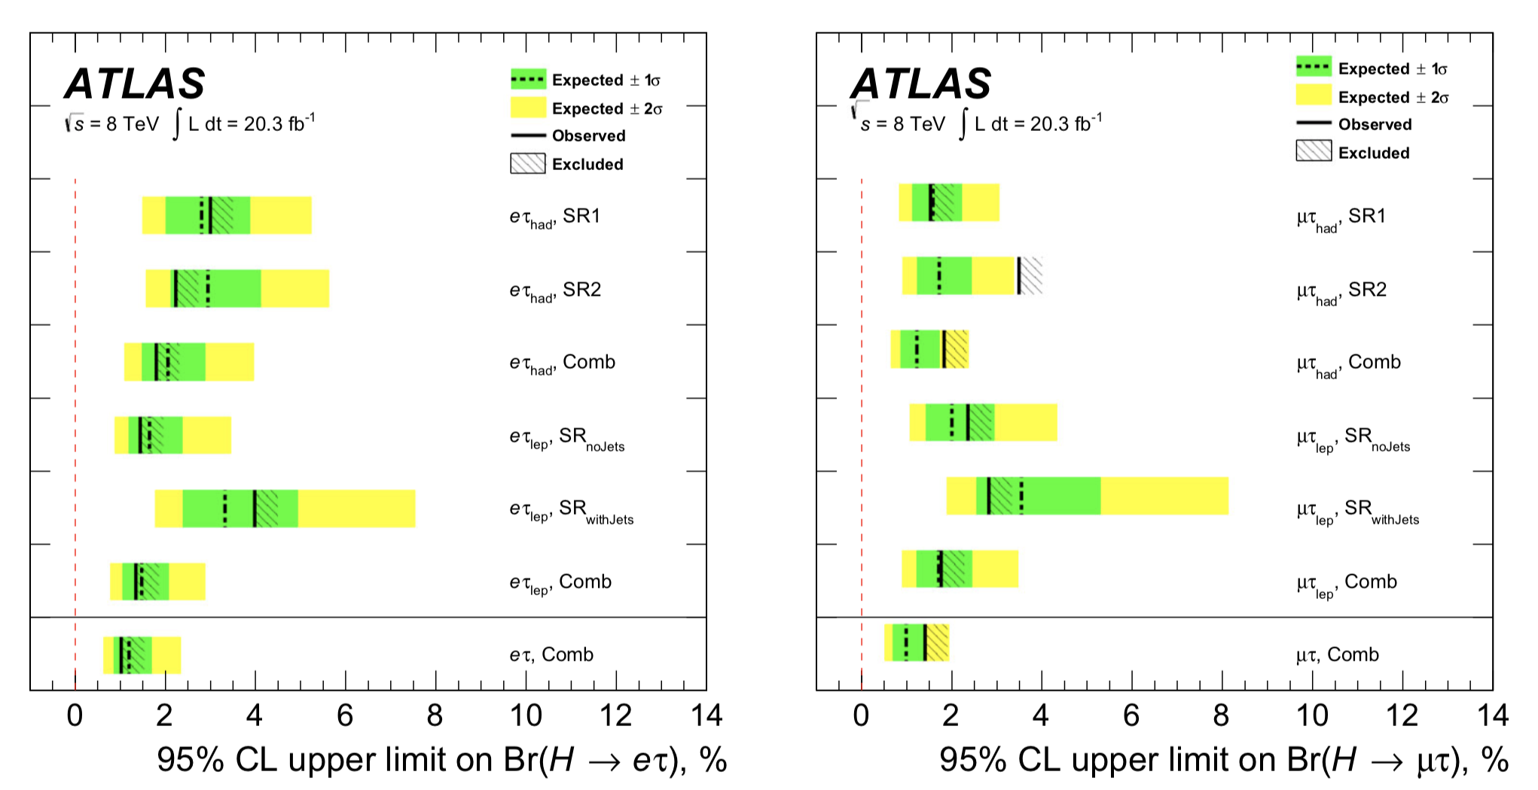
A more complete ATLAS analysis (8 TeV 20 fb⁻¹)

Slide 17
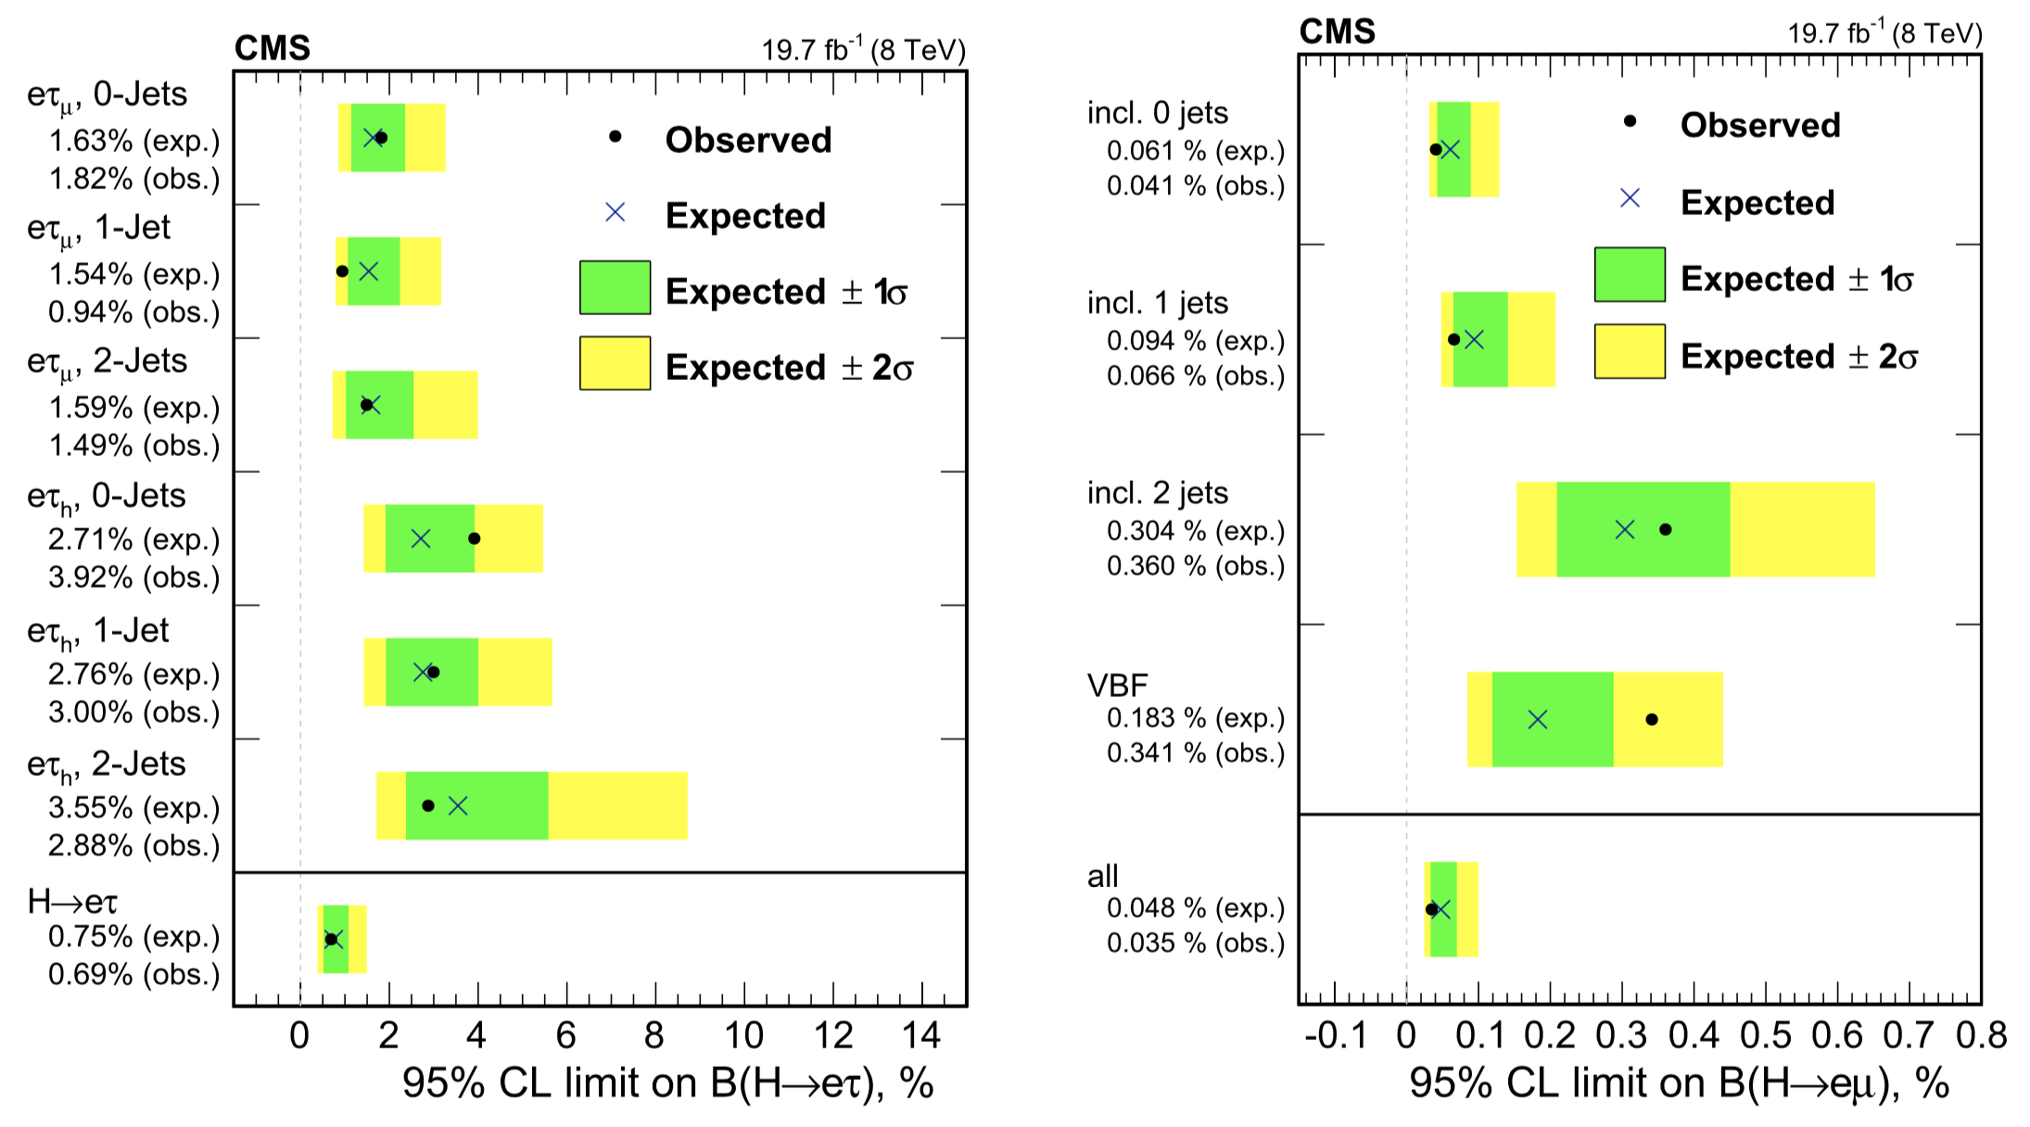
Additional CMS analyses (8 TeV 20 fb⁻¹)

Slide 18
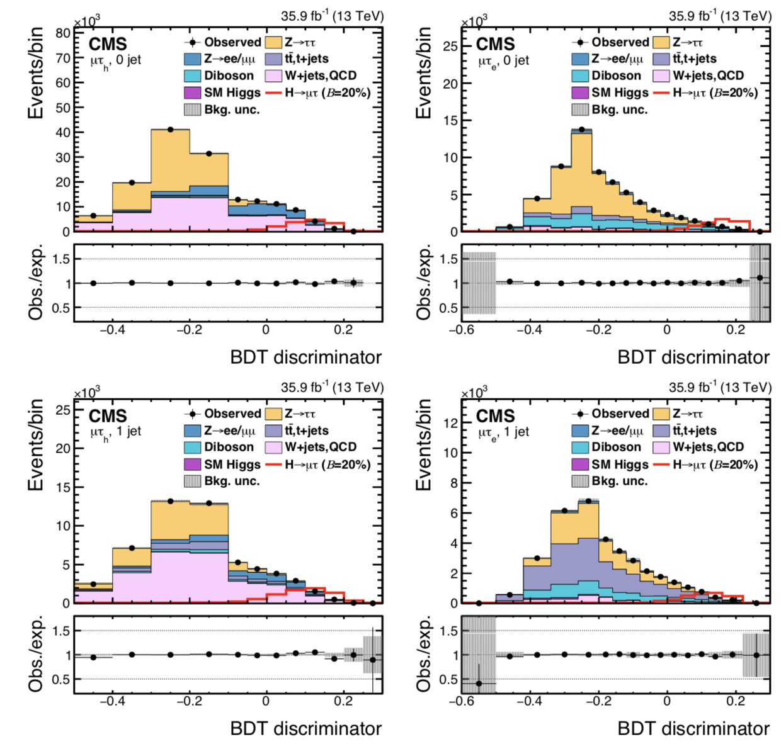
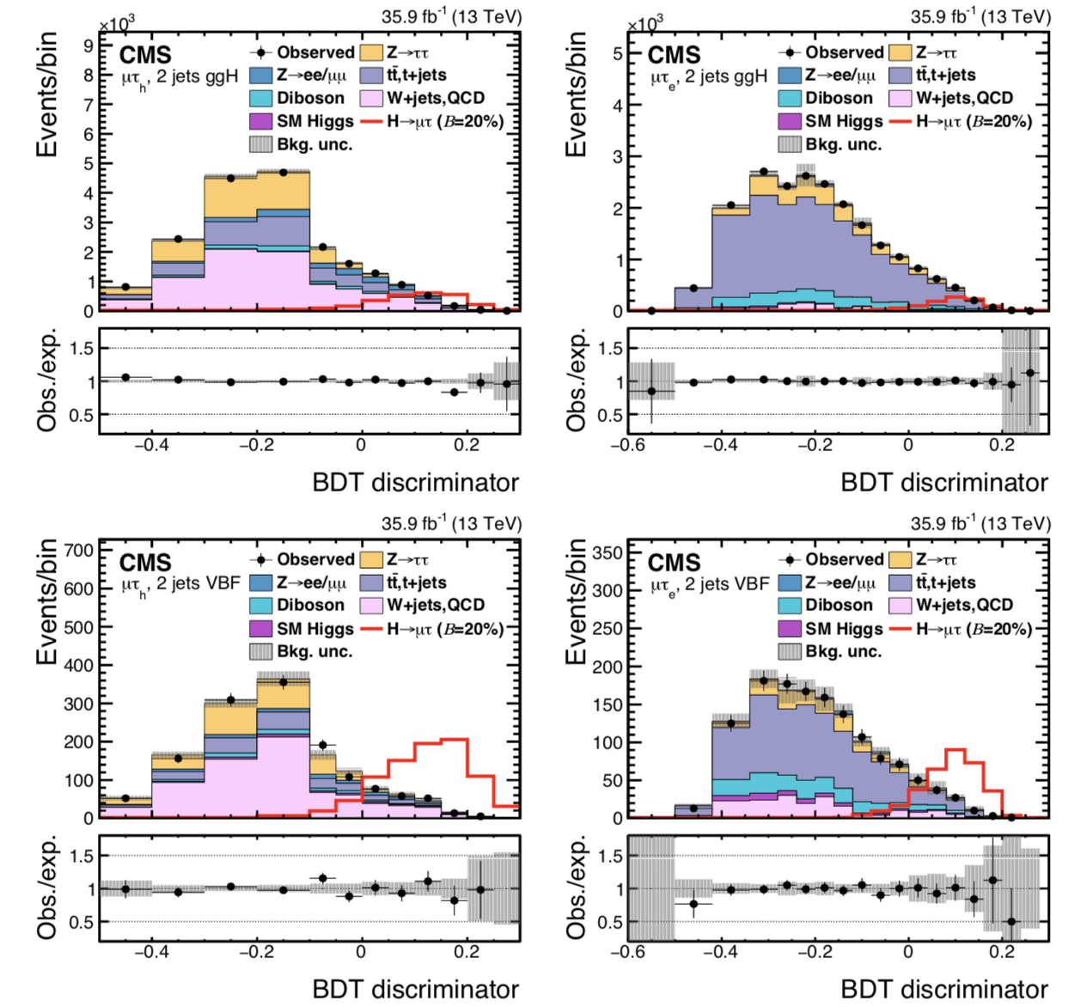
Sophisticated CMS analysis based on 13 TeV data:
Many categories and a Boosted Decision Tree classifier
arXiv:1712.07173

Slide 19
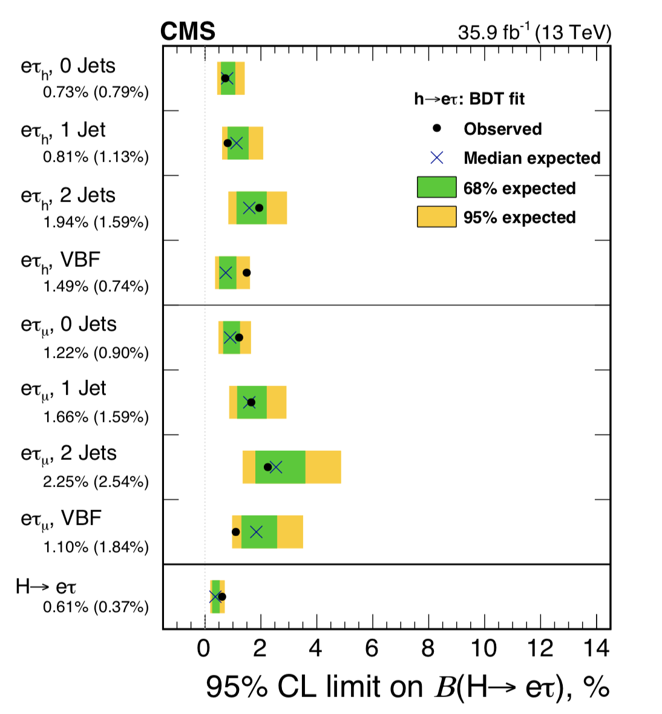
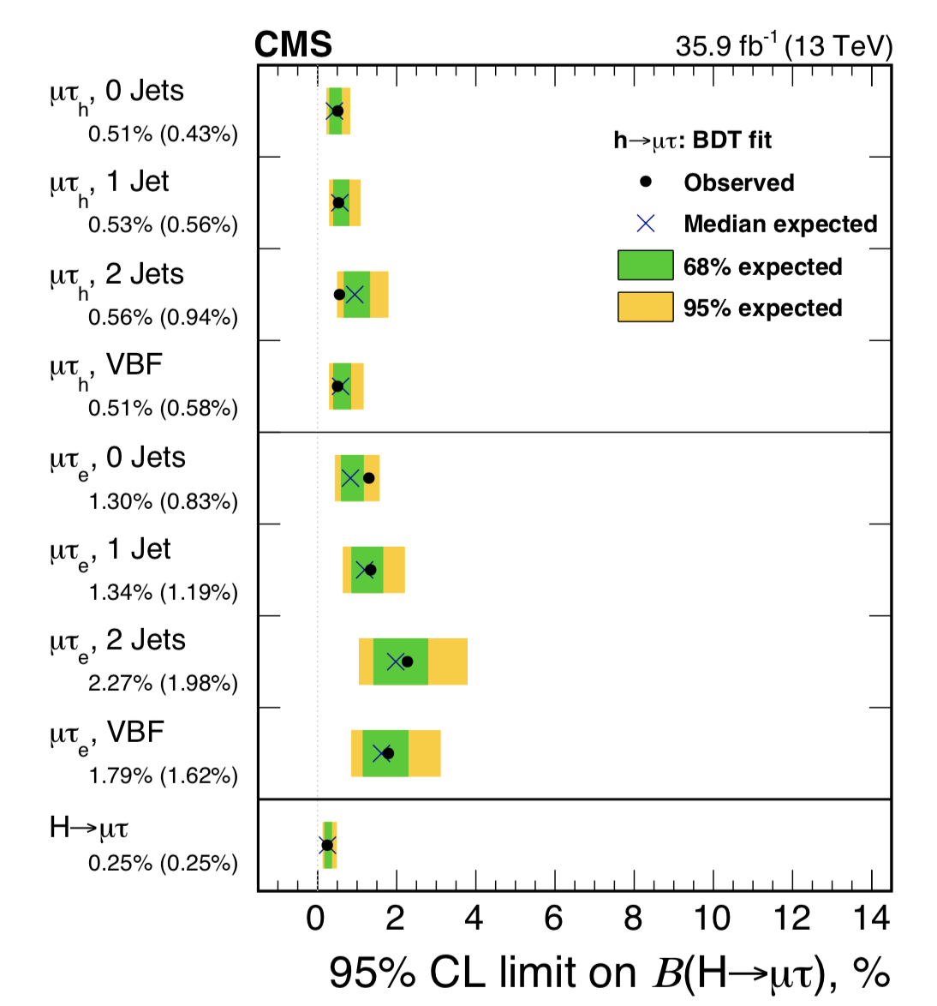
CMS results (13 TeV 36 fb⁻¹)
B(H→eτ) < 0.61%
B(H→μτ) < 0.25%
arXiv:1712.07173
excess not confirmed

Slide 20
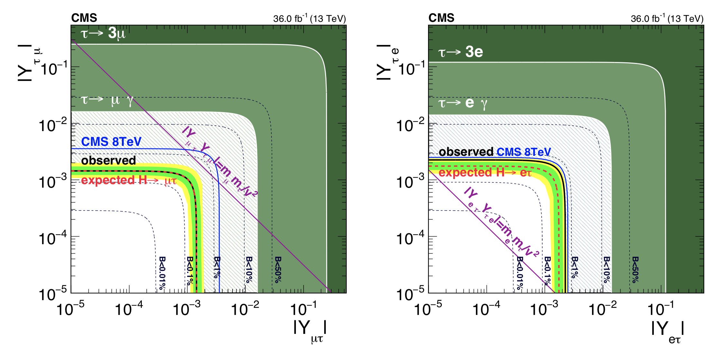
Limits on non-diagonal Yukawa couplings:

Slide 21
W decays: universal?
SM assumes that gauge couplings are universal.
This is not a necessary assumption.
LEP experiments put strong constraints on Z decays.
No real opportunity to improve.
W boson constraints are not as strong.
Are they the same? B(W→eν) B(W→μν) B(W→τν)

Slide 22
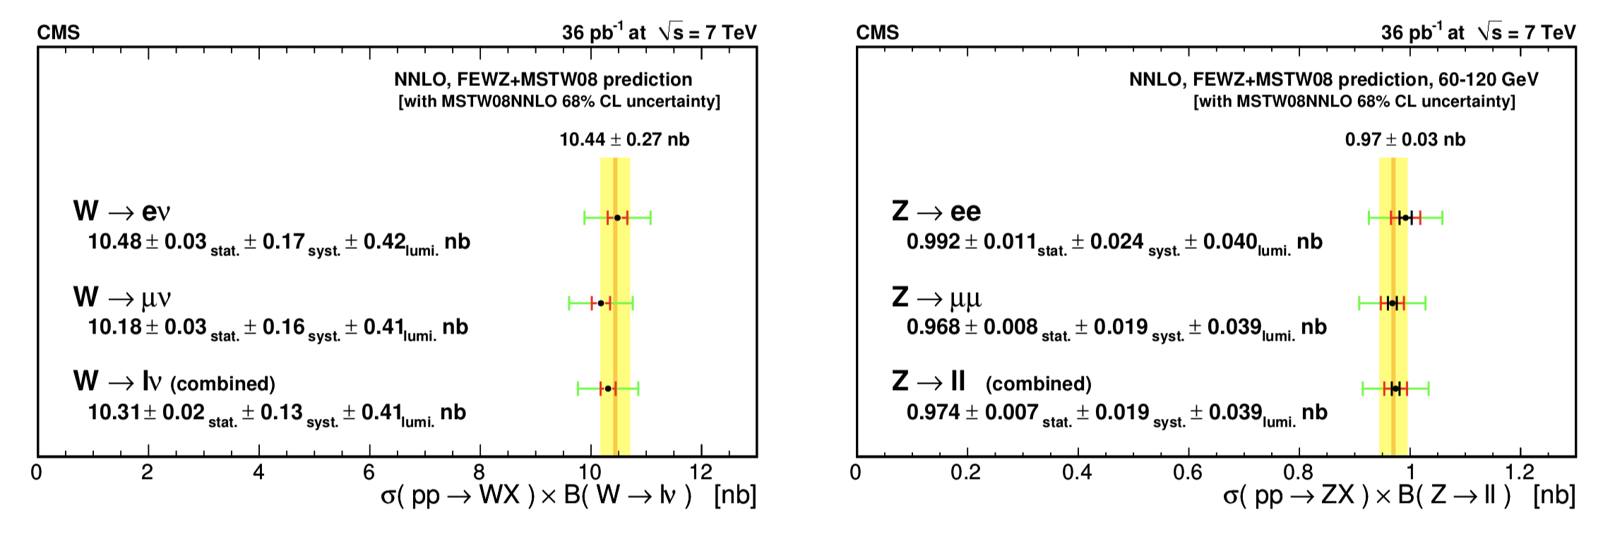
Very early indication from CMS (7 TeV 36 pb⁻¹)
Inclusive cross section measurements depend on branching fractions.

Slide 23
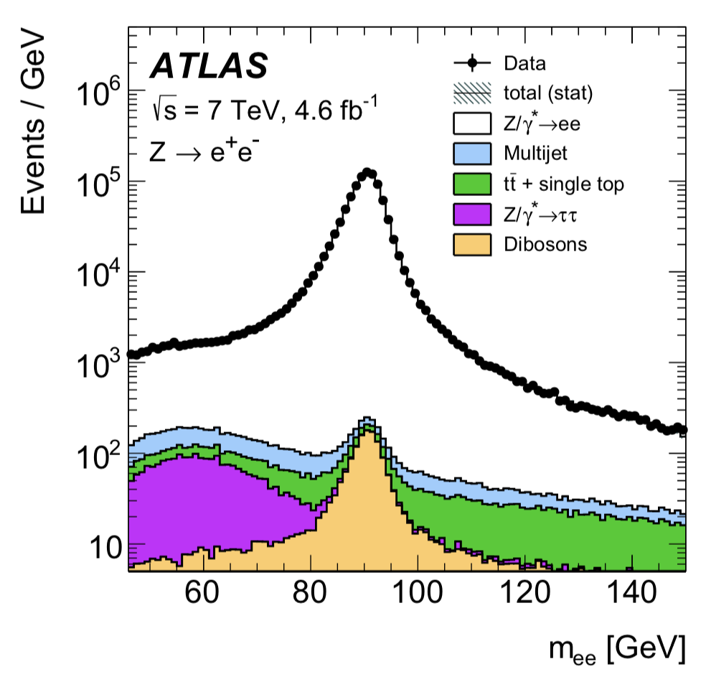
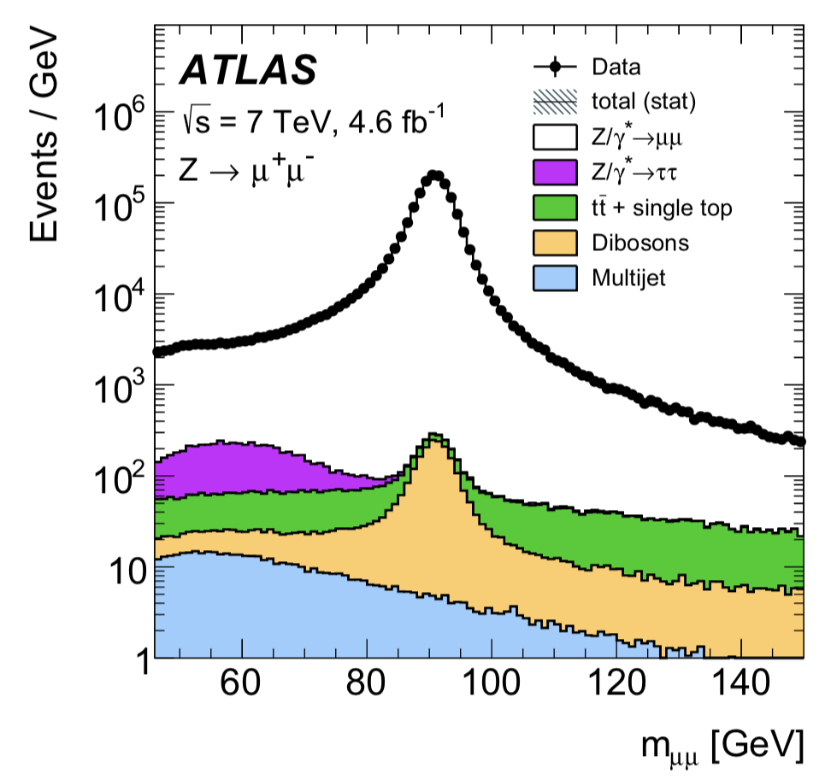
Reanalysis of early ATLAS data (7 TeV 4.6 fb⁻¹)
Eur. Phys. J. C77 (2017) 367
High yields
Excellent control over signals and backgrounds

Slide 24
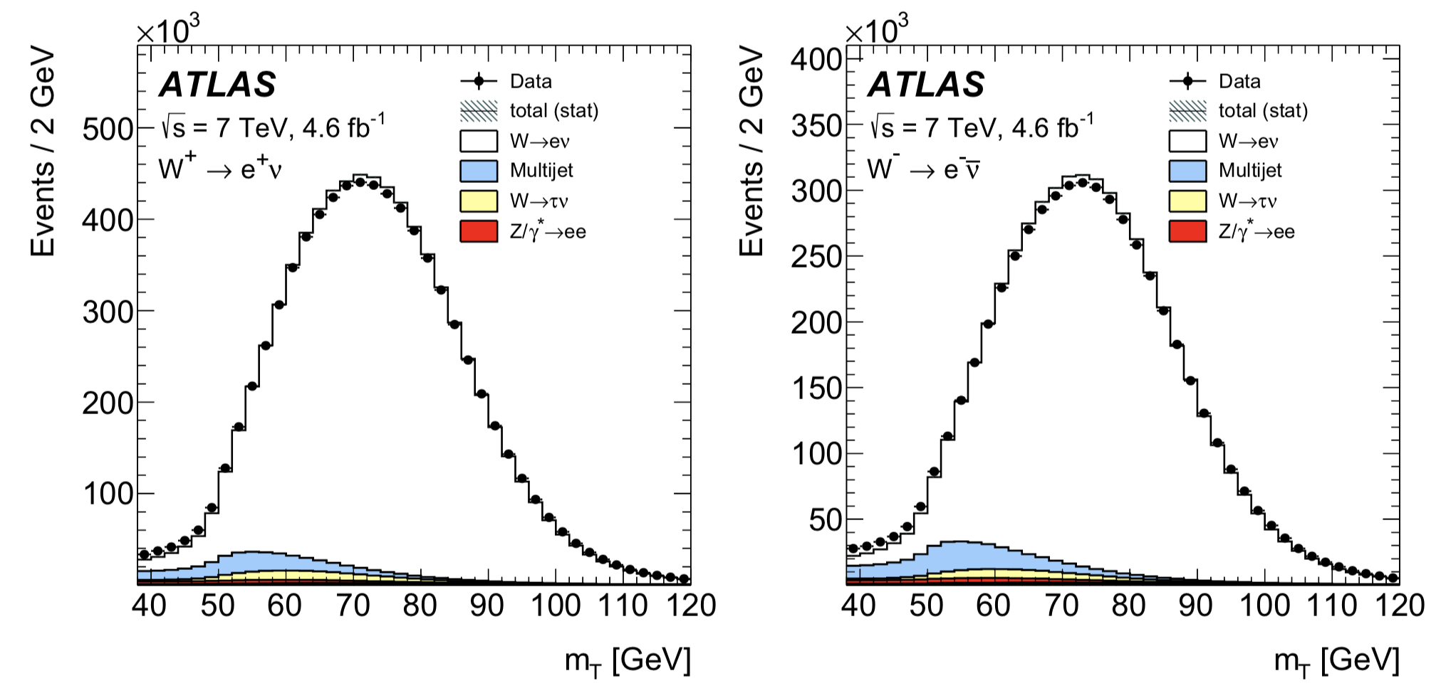
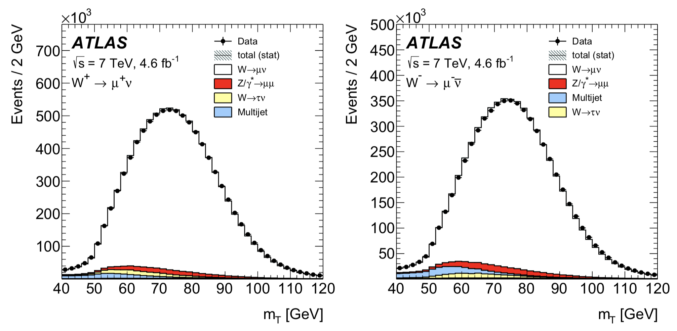
High purity
W⁺→eν
W⁻→eν
W⁺→μν
W⁻→μν

Slide 25
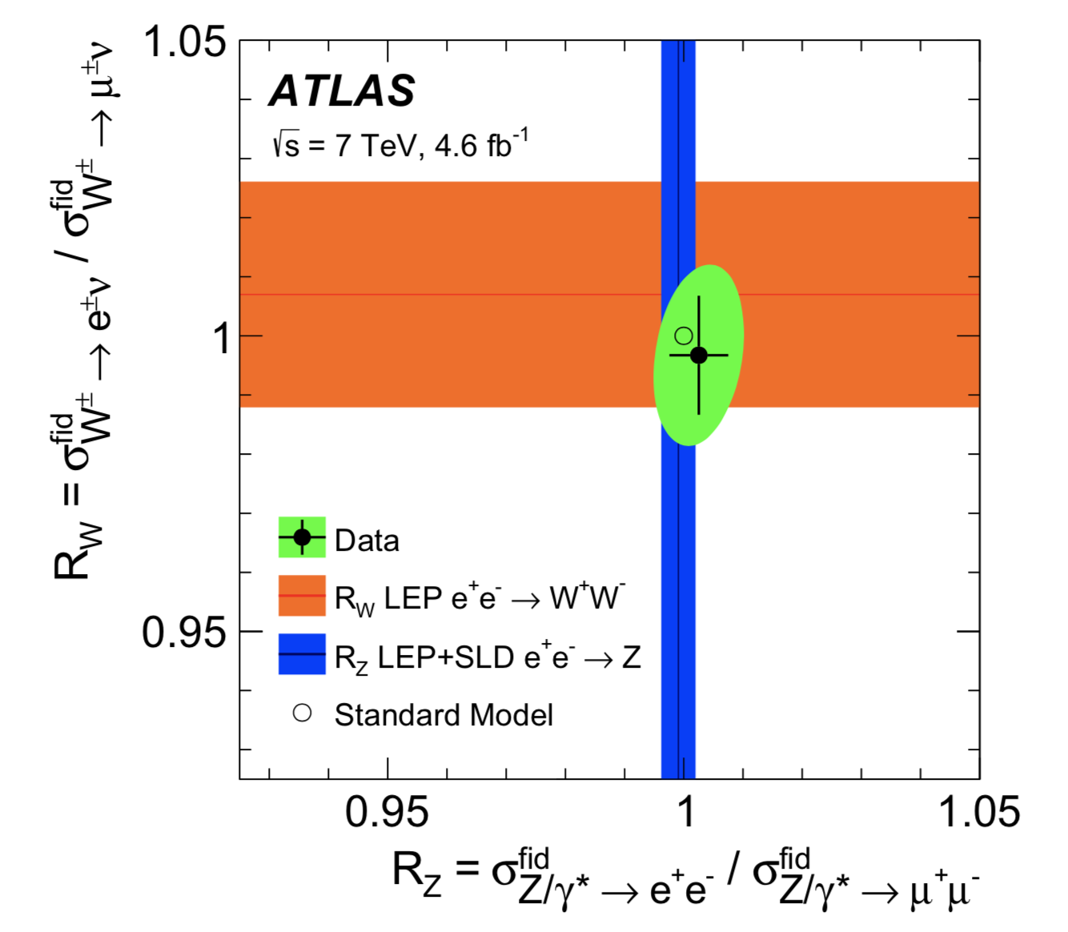
R_{W} = B(W→eν) / B(W→μν)
R_{W} = 0.997 +/- 0.010
LEP: 1.007 +/- 0.019
CDF: 1.018 +/- 0.025
LHCb: 1.020 +/- 0.019
R_{Z} = 1.0026 +/- 0.0050
LEP: 0.9991 +/- 0.0028

Slide 26
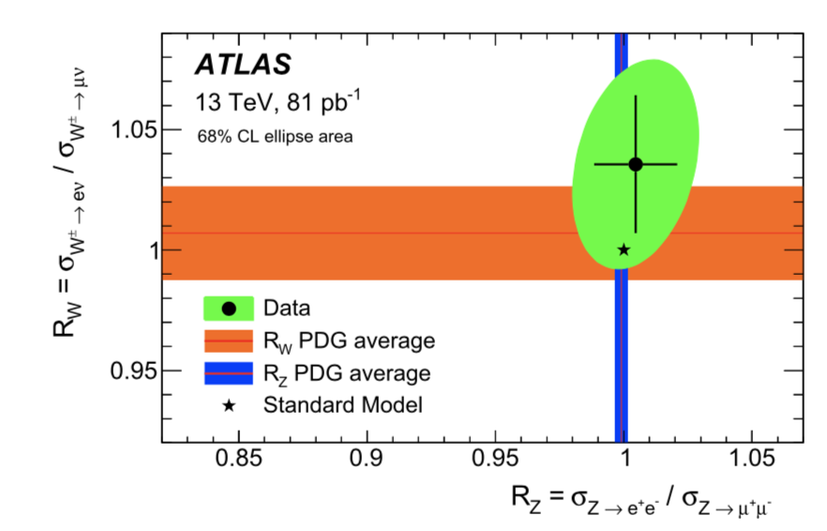
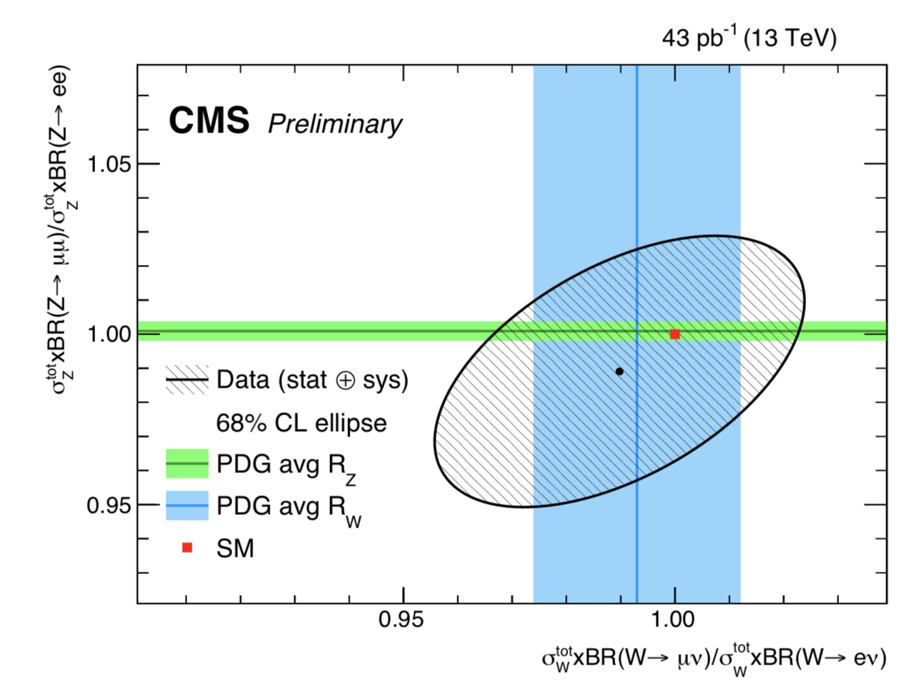

Slide 27
What about top decays?
Top quarks do not couple directly to leptons.
They decay by emitting a W boson, and we just tested W bosons.
The point is that there may be other, non-SM decays that themselves are not universal, leading to an apparent lepton flavor violation.
If this decay exists then top would produce more τ leptons than expected.
t → H⁺ b H⁺ → τ⁺ν

Slide 28
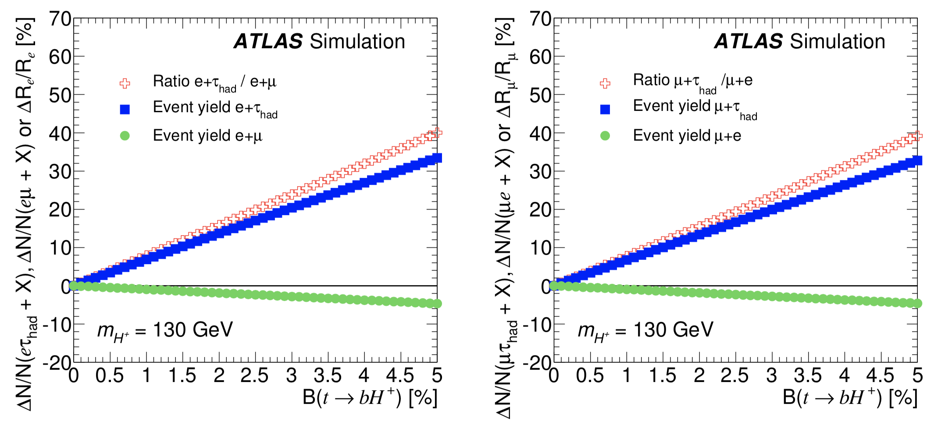
ATLAS search for charged Higgs (7 TeV 4.6 fb⁻¹)
JHEP03(2013)076
Look at double-semi-leptonic ttbar events.
Check the relative rates of (e&τ) and (e&μ) also (μ&τ) and (μ&e)

Slide 29
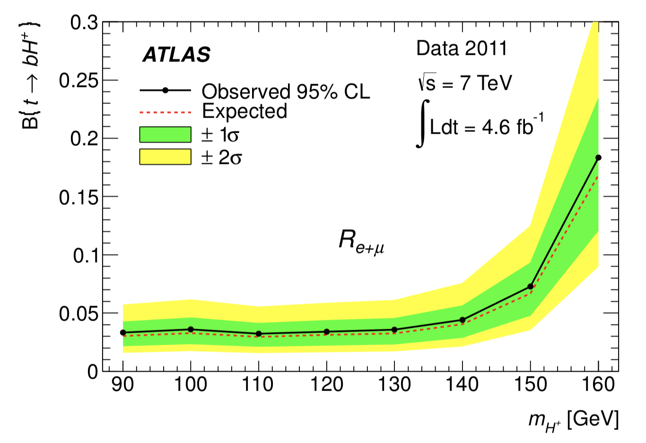
No signs of excess τs.
JHEP03(2013)076

Slide 30
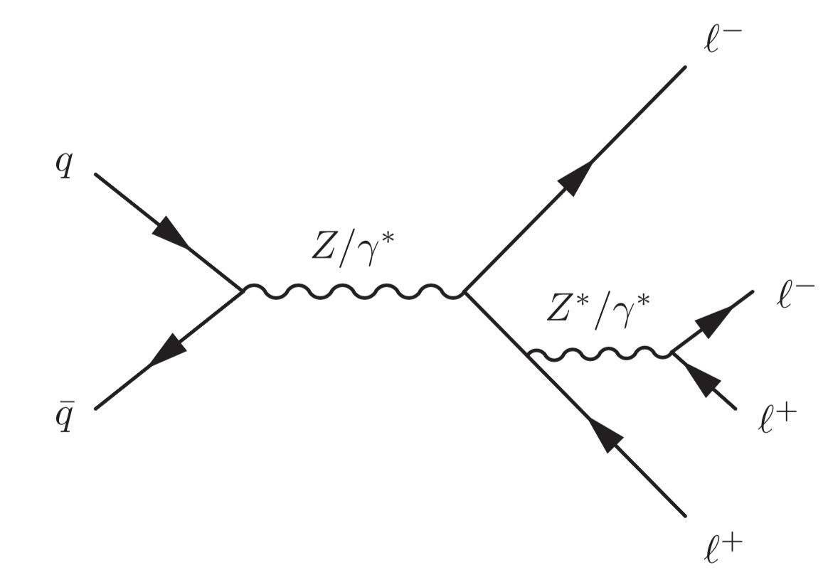
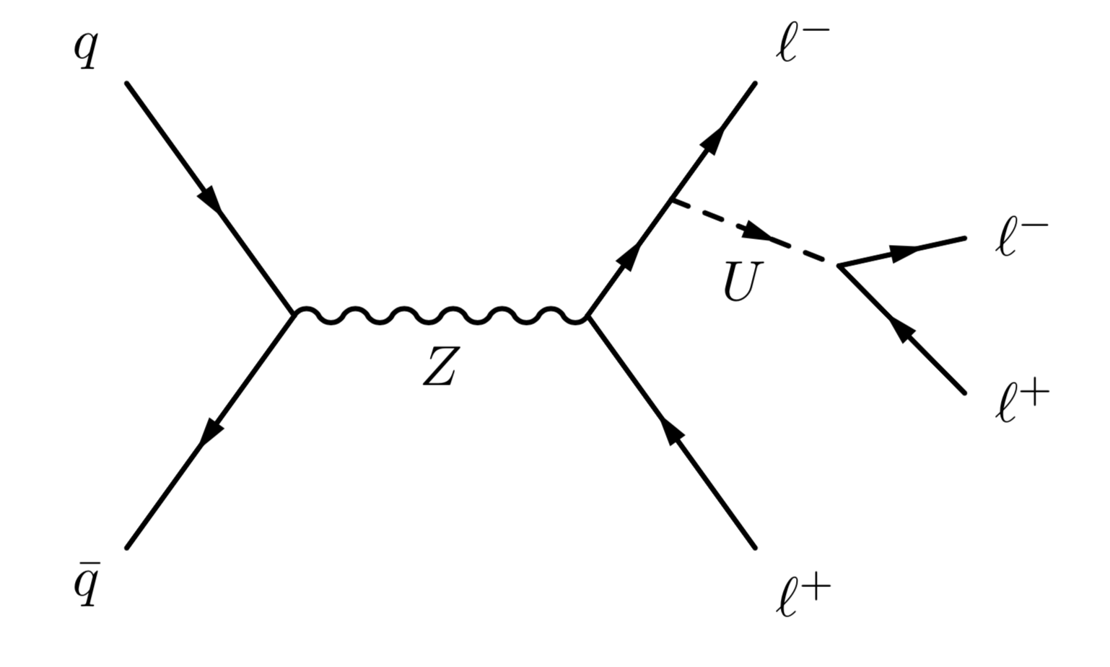
A last look at Z decays.
Z decays to 4 leptons are rare, but observable.
They were observed as part of the Higgs search in the mode H → Z Z* → 4 leptons (e or μ)
These decays provide a window onto light bosons that might have non-universal couplings.
A difference in eeee and μμμμ rates would signal new physics.

Slide 31
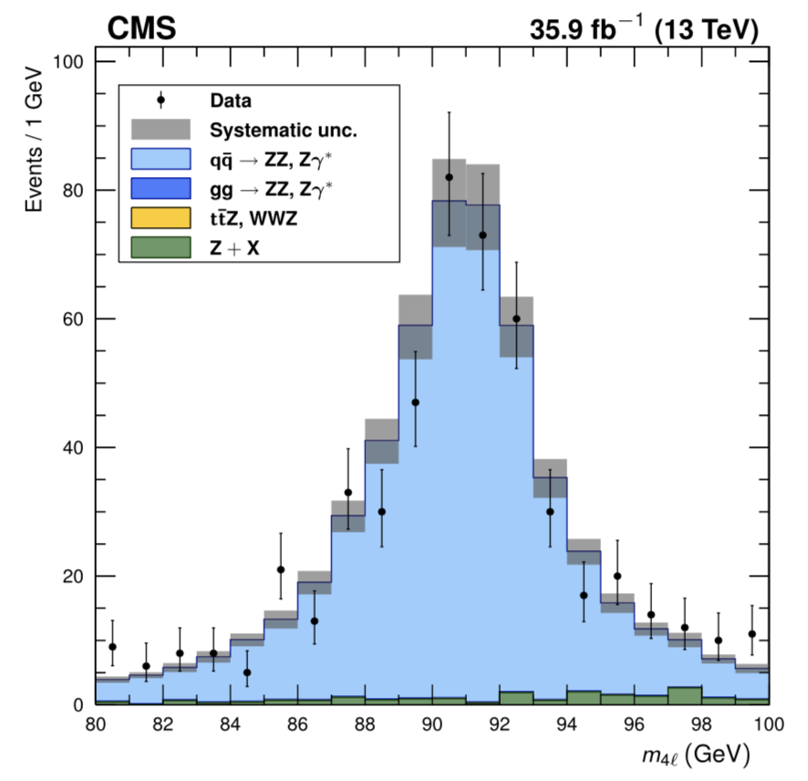
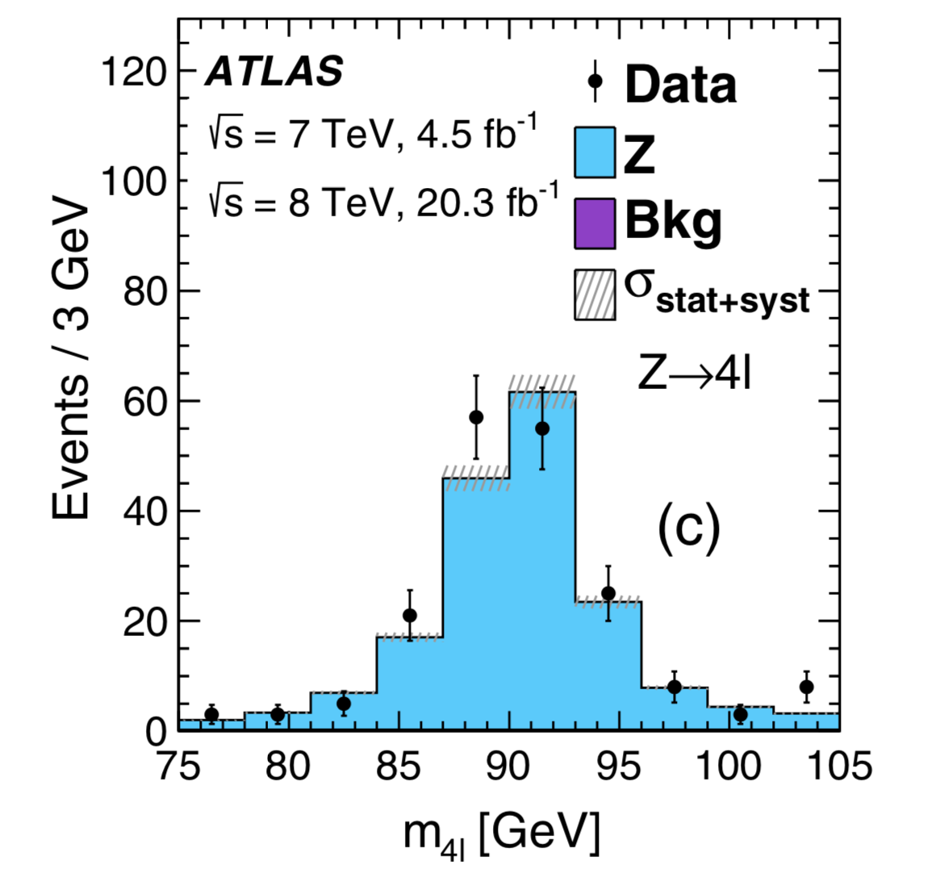

Slide 32
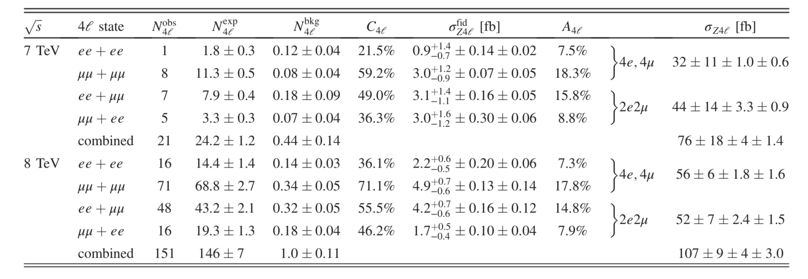
ATLAS measurement (7 TeV 4.6 fb⁻¹ and 8 TeV 20 fb⁻¹)

Slide 33
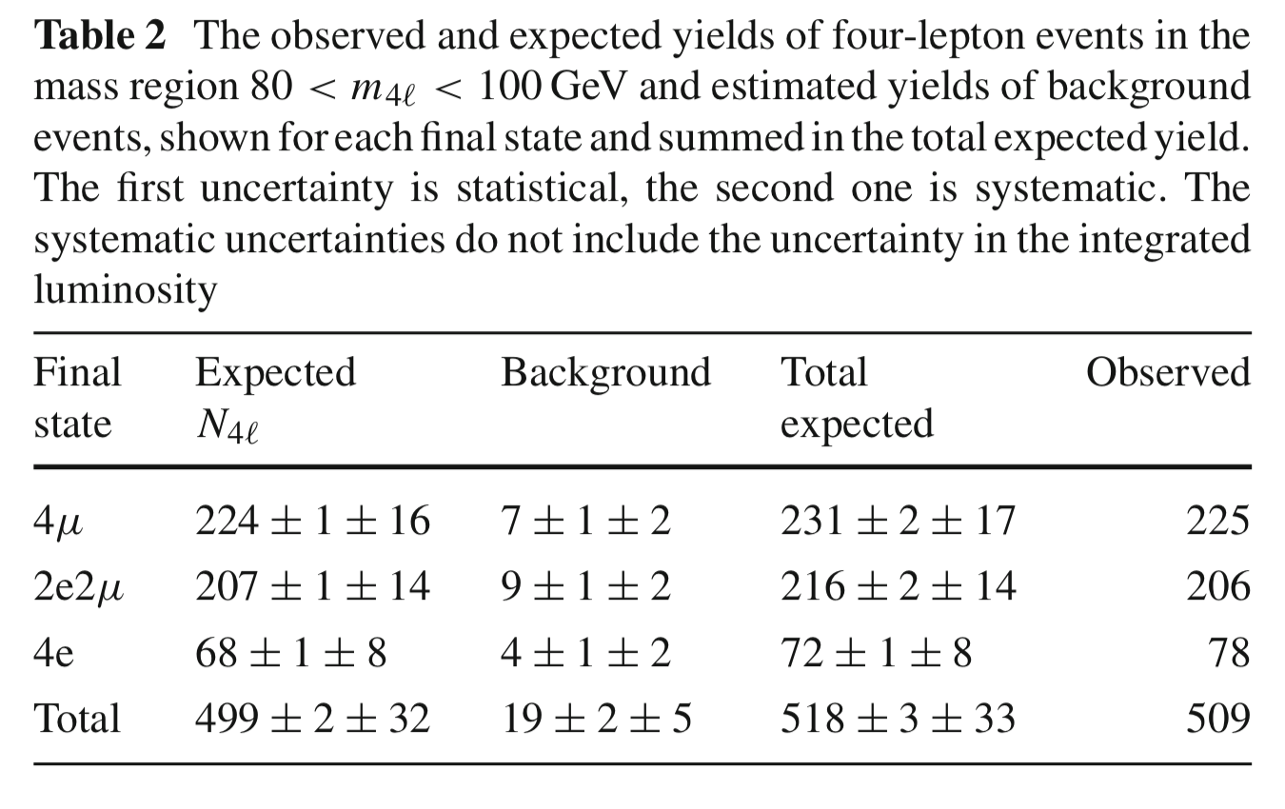
CMS data (13 TeV 36 fb⁻¹)

Slide 34
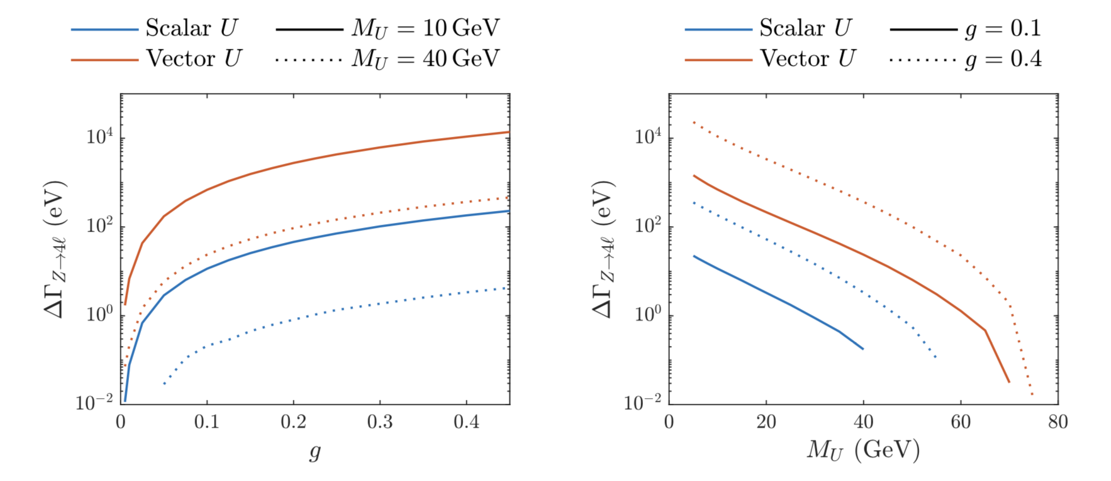
arXiv:1805.05791
Construct simple ad hoc model with an extra boson “U”

Slide 35
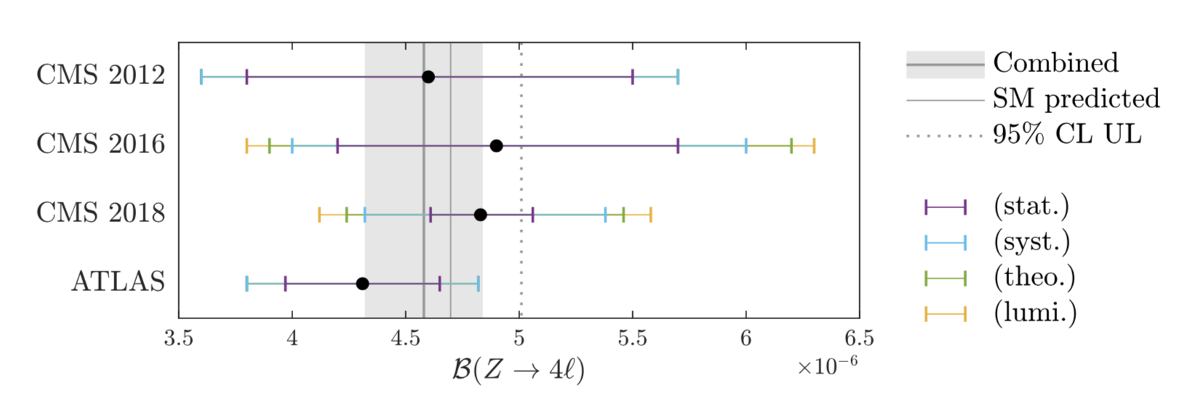
arXiv:1805.05791
Combine LHC measurements for better discriminating power.
combined value:
(By the way, the PDG got it wrong…)

Slide 36
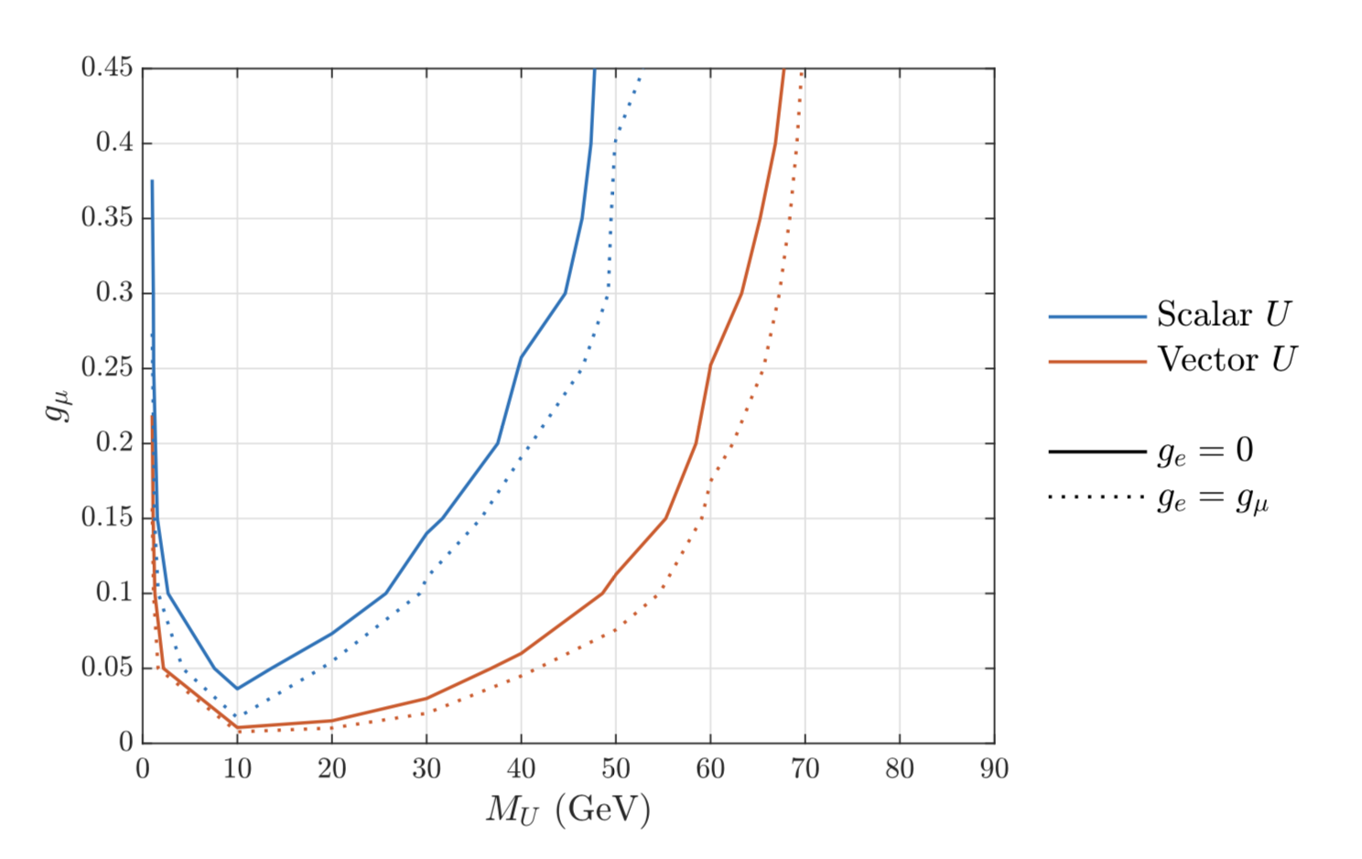
Excluded region for U bosons couplings to muons only.
arXiv:1805.05791

Slide 37
Closing Remarks:
LHC experiments can probe new territory for violations of lepton universality.
The nature of the probe tests different features of the SM: vertices, universal gauge couplings, off-diagonal Yukawa couplings
The exploration has been rather limited and most tests have used only a small fraction of existing LHC data.
Opportunities for bright ideas and careful work. The flavor sector is mysterious and a discovery would be momentous!

Slide 38
BACKUP SLIDES

Slide 39
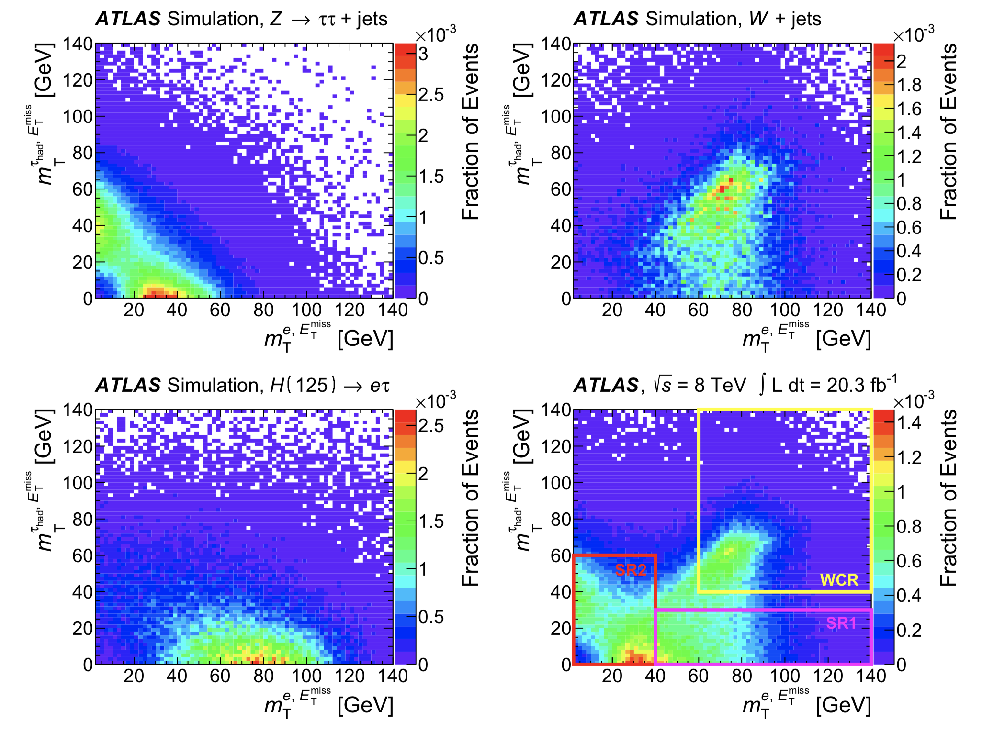

Slide 40
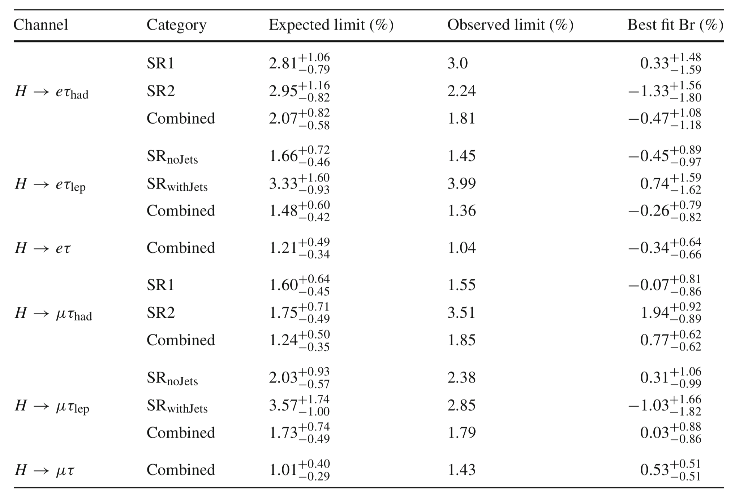

Slide 42
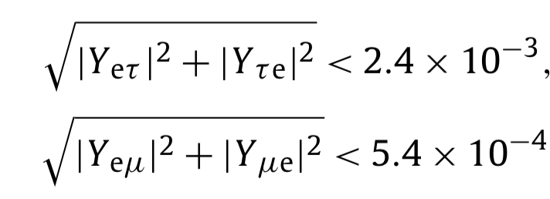

Slide 43
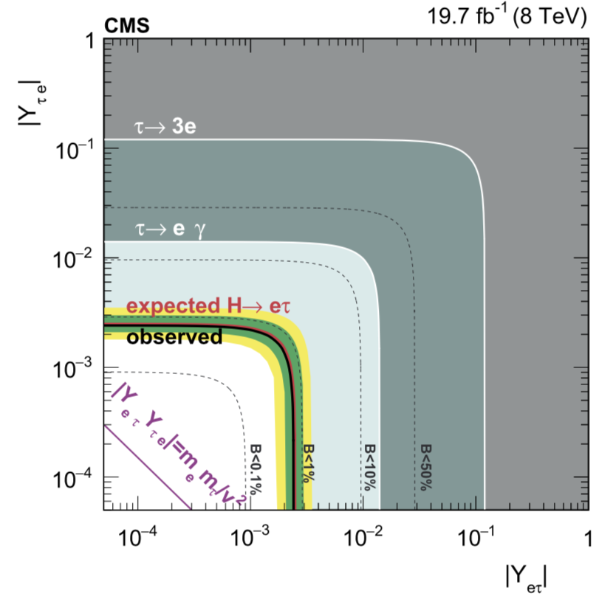
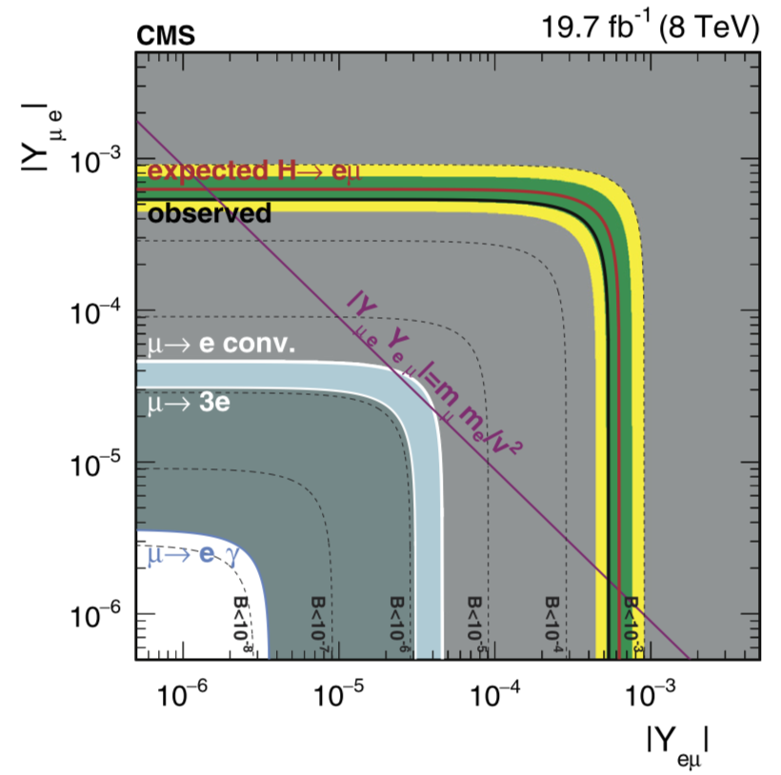

Slide 44
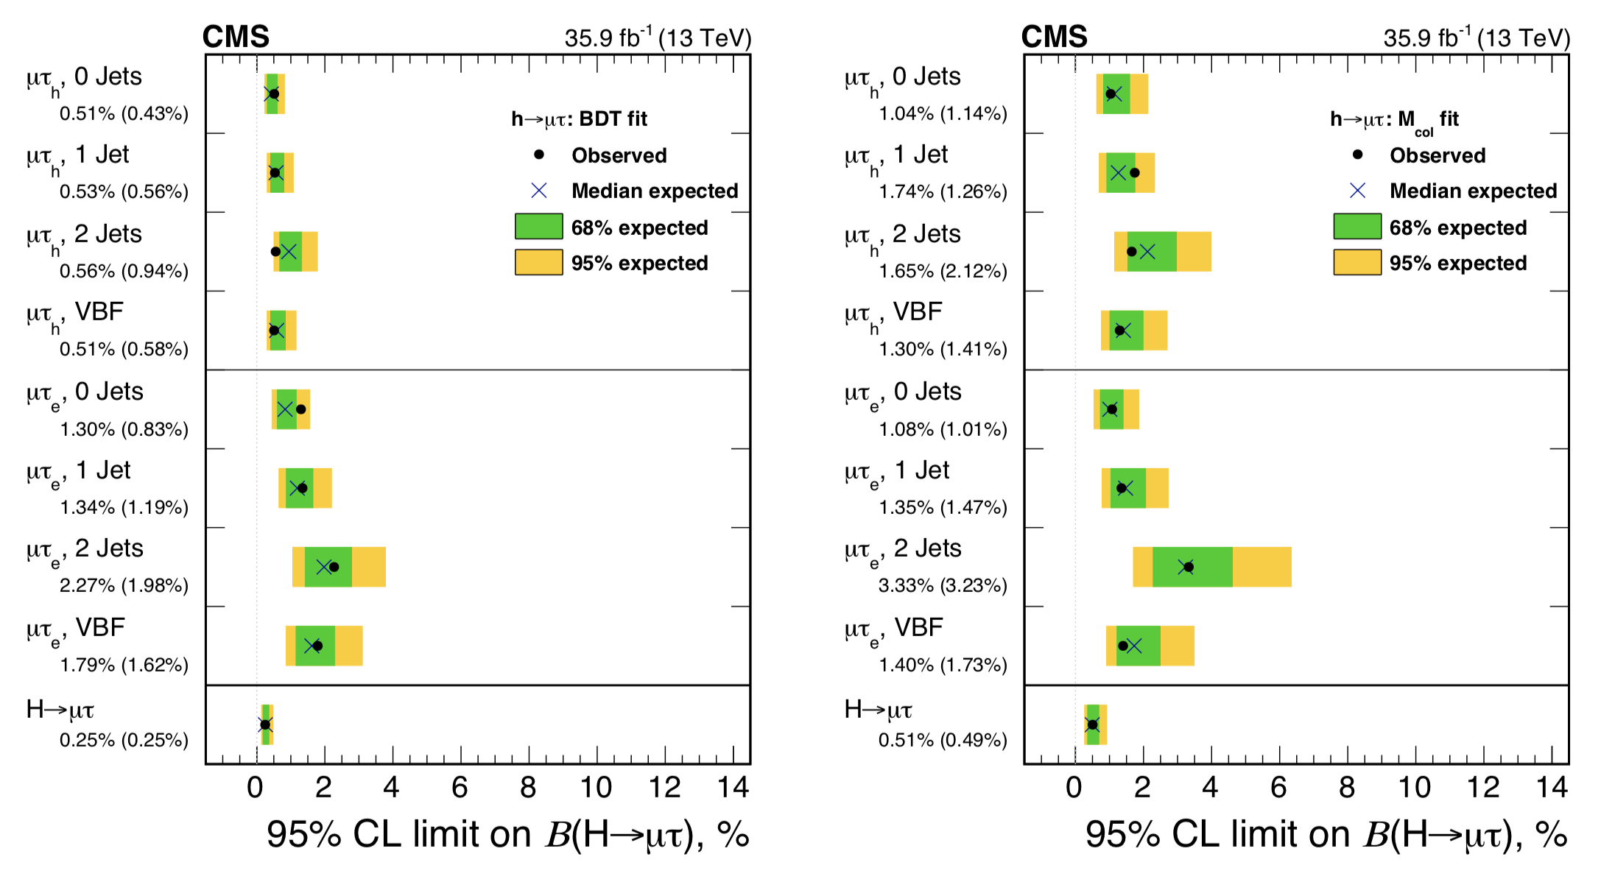

Slide 45
