Slide 1
Using Random Forests to Classify W⁺W⁻ and tt events
J. Lovelace Rainbolt, Thoth Gunter, Michael Schmitt
CIERA Pizza Discussion
Oct 20, 2014

Slide 2
Today I will tell you about a particle physics problem.
Why?
Because we are using a technique used by some people
in astronomy (and cosmology).
Our results pertain to a test case, not an actual result.
This is a step toward grander things (including some astrophysics)…

Slide 3
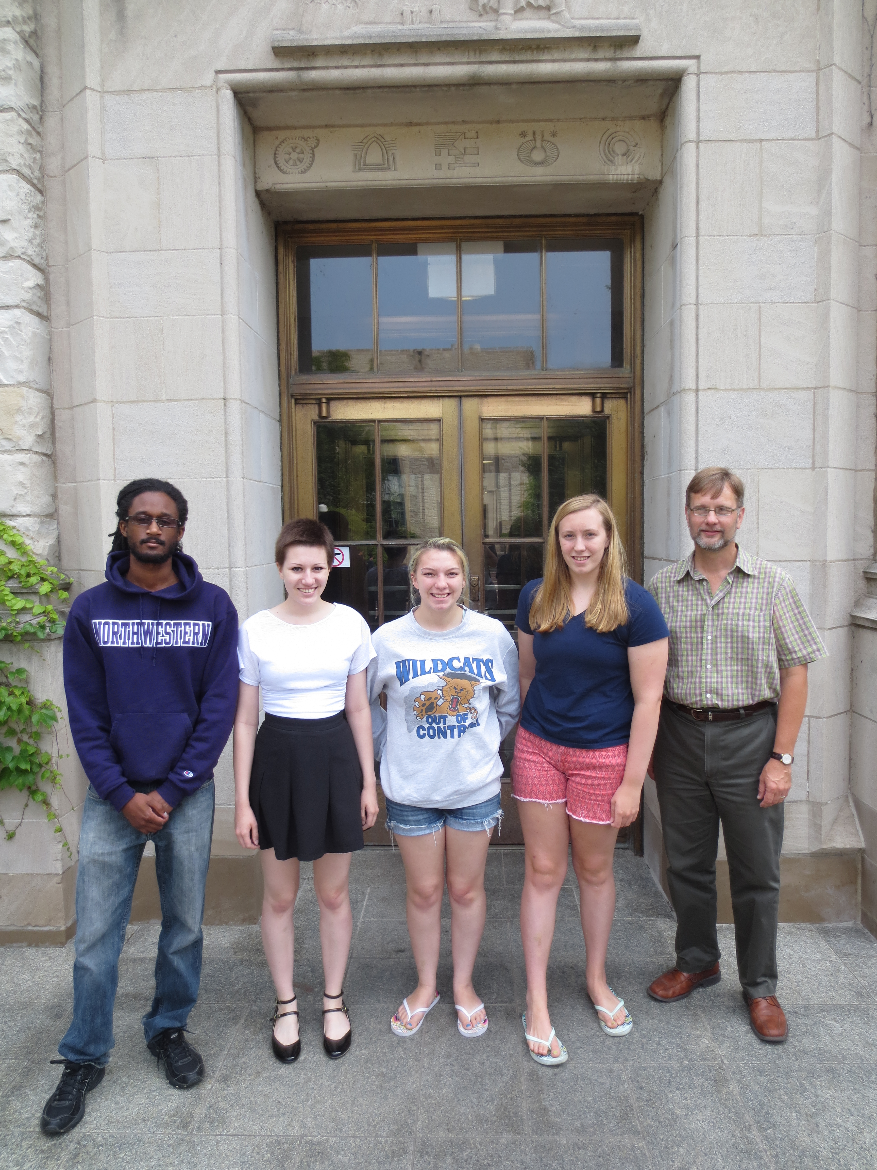

Slide 4
Current measurements of the W⁺W⁻ cross section are
mildly discrepant.
In principle this could be signs of new physics.
Also: the W⁺W⁻ process is the main, irreducible background
for an important Higgs decay mode.

Slide 5
image: blog.yhathq.com

Slide 6
color?
red
green
shape?
size?
pointy
round
tall
small
medium
red fir
red maple
pine tree
birch
bush
There is nothing particularly good about this particular tree.
It may have good, fair or poor performance.
One can easily come up with other trees with more or less equivalent performance.
A computer algorithm can come up with these trees.

Slide 7
source: Andrew Zisserman (Oxford)

Slide 8
source: Andrew Zisserman (Oxford)

Slide 9
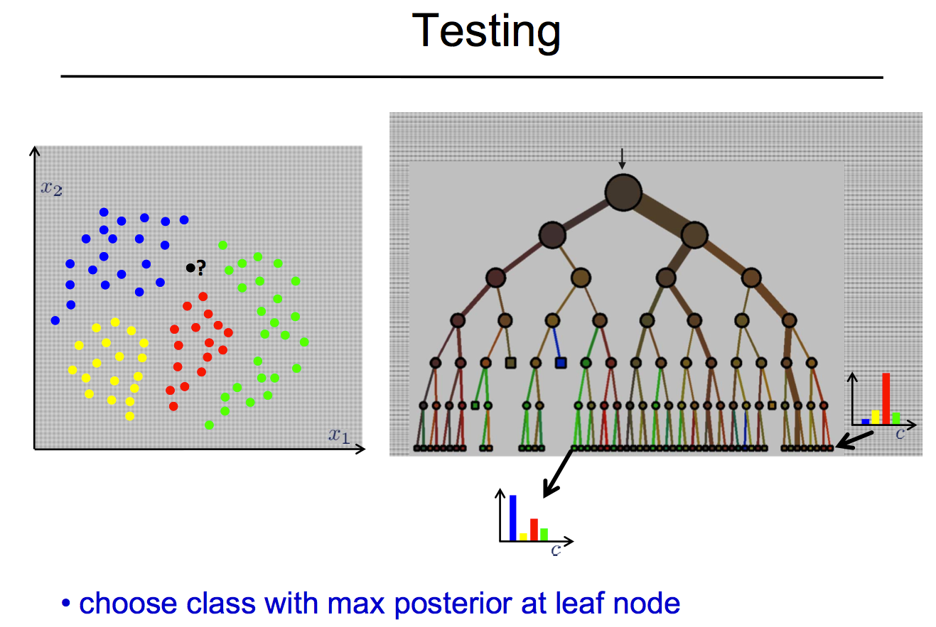
source: Andrew Zisserman (Oxford)

Slide 10
A random forest is a collection of binary decision trees.
The input data are randomized tree by tree. “bagging”
The features presented to a given tree are a random subset of the set of all features.
The arrangement of nodes is random.

Slide 11
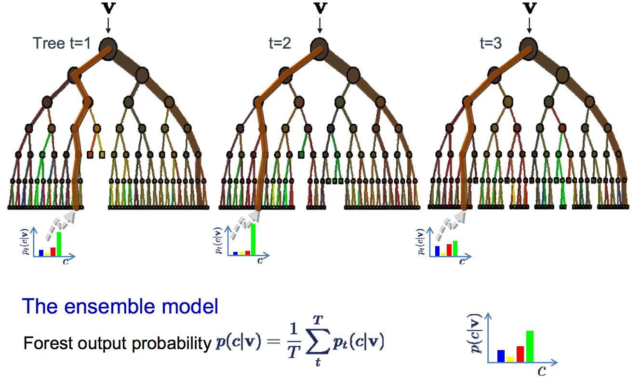
Take a suitable average of the results from all the trees.
source: Andrew Zisserman (Oxford)

Slide 12
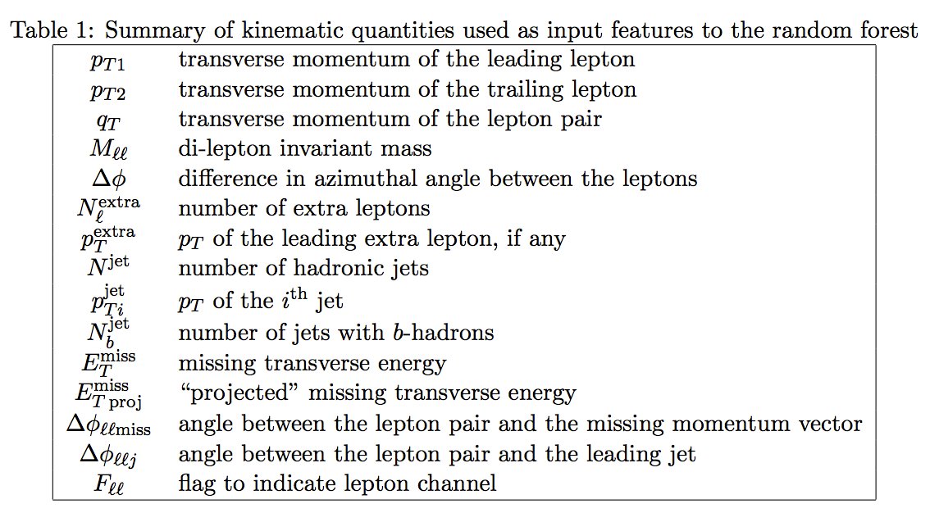

Slide 13
main background
signal
minor
background
Output of the Random Forest (Y)
Declare a minimum value of Y to select a sample of events.
We can select whatever cut suits our purpose.

Slide 14
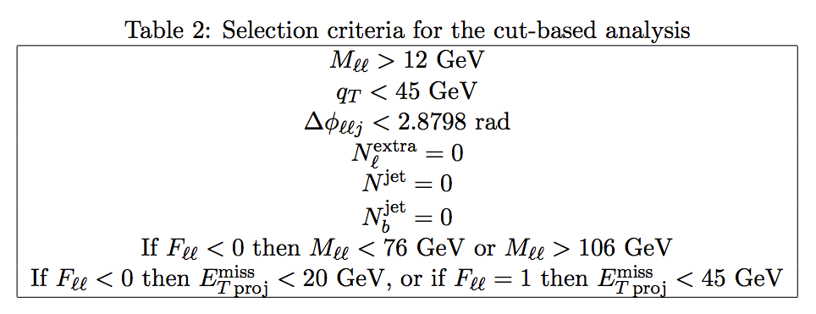
The Standard Cuts
This is a relatively simple analysis.
CMS Collab., Phys. Lett. B721 190 (2013)

Slide 15
ROC (Receiver Operator Curve)
(false positives)
better
(true positives)

Slide 16
Cross section (what we want to measure)
dependent on the cut on Y:
N selected WW and tt events
independent of the cut on Y:
acceptance
luminosity
dependent on the cut on Y:
efficiency
Figure of Merit: relative statistical uncertainty on the cross section
σ_{WW} and σ_{tt} depend on Y_{cut}

Slide 17
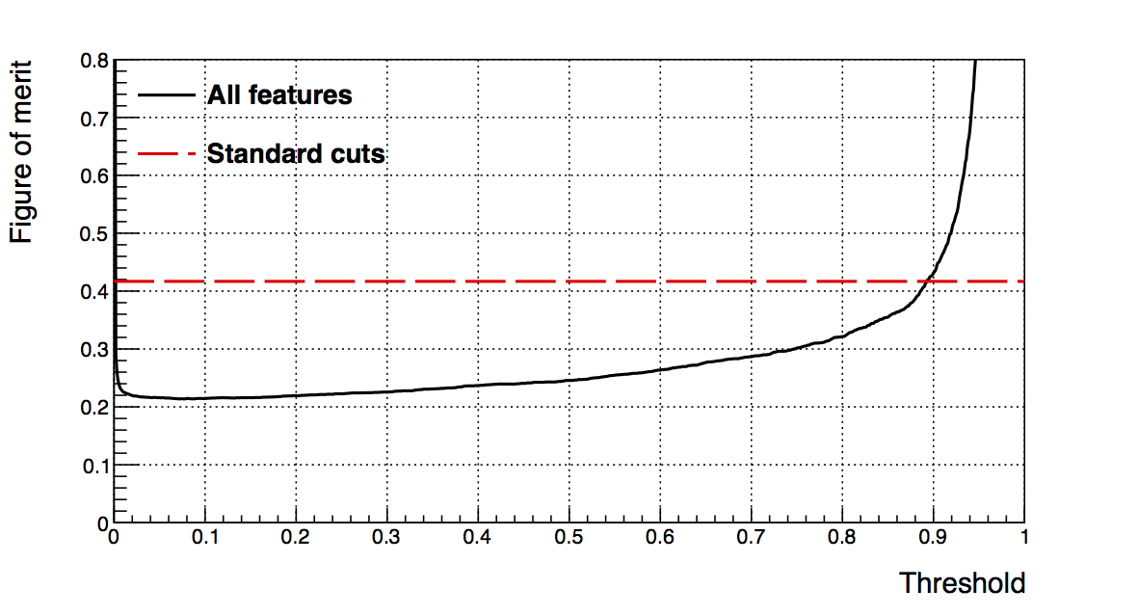
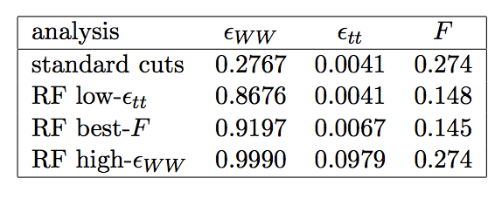
Y_{cut}
a factor two better!

Slide 18
Recall that the current values for σ_{WW} are “too high.”
is this causing trouble?
Jet rates are difficult to calculate precisely…

Slide 19
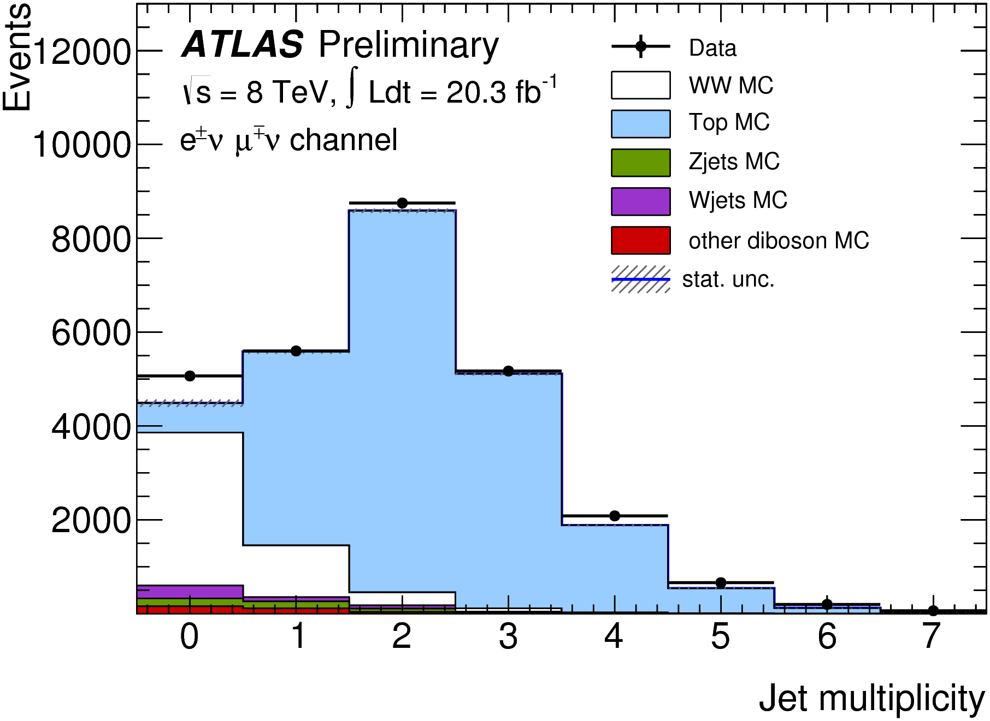

Slide 20
It would be great to see the N_{jet} distribution for WW only.
Surprisingly, we can, without incurring a major loss in
statistical power.
The RF makes use of the N_{jet} feature, for sure, but it is
much gentler on the distribution.
(Since at least some trees do not use N_{jet} then at least some
events with N_{jet} > 0 will be selected.)
In this particular case, we could do a good measurement
without hardly changing the N_{jet} distribution at all!

Slide 21
before
selection
after
selection
tt is greatly reduced,
but WW is hardly changed.

Slide 22
Other tests of the robustness of the RF
We shifted the missing transverse energy (MET) – a crucial feature – by 10% in the training but not in the test set. The impact on the efficiency ε_{WW} (aka the true positive rate) was quite small (5%). This is quite small given the extreme shift of 10%. The MET calibration is good to 2% or better.
We suppressed all information relating to MET for a randomly selected 10% of the events. For a normal analysis, this means an immediate loss of 10%. With the RF, however, the loss is only 2.4%. The implication is that incomplete data are still useful, which could have major consequences in particle physics and more so in astronomy & astrophysics.

Slide 23
Thank You!
J. Lovelace Rainbolt, Thoth Gunter, Michael Schmitt

