Slide 1
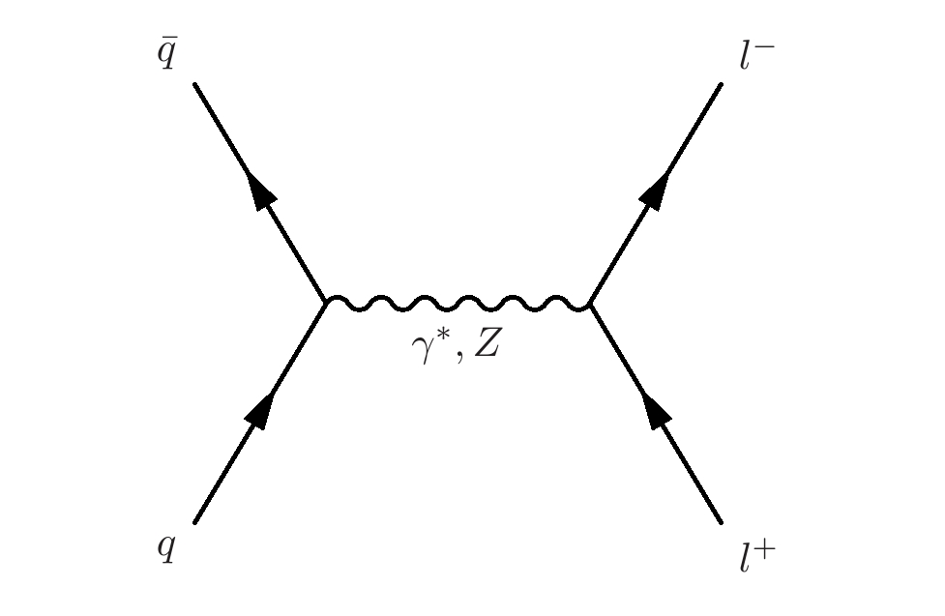
Vector Boson Production at CMS (and elsewhere)
Michael Schmitt (Northwestern University)
LOOPFEST 13: June 18, 2014

Slide 2
Topics
Inclusive W and Z cross sections
Drell-Yan production
Transverse momentum distributions
W charge asymmetry
W+c production
W + jets differential cross sections
W and Z + b jets

Slide 3
Inclusive W and Z production
Important benchmark process since turn-on in 2010.
Must master techniques for reconstructing W and Z bosons before one can do electroweak physics.
Starting point for constraints on parton distribution functions (PDFs).
Amazing progress has been made in the precision of the measurements.
Here is an illustration:
CMS: R = 10.54 ± 0.07 (stat) ± 0.08 (syst) ±0.16 (th)
ATLAS: R = 10.893 ± 0.079(stat) ± 0.110 (syst) ±0.116 (th)
7 TeV , 35 fb⁻¹
typical precision:
statistical uncertainty << 1%
experimental systematic uncertainty 1 – 1.5%
luminosity uncertainty 3 – 4 %

Slide 4
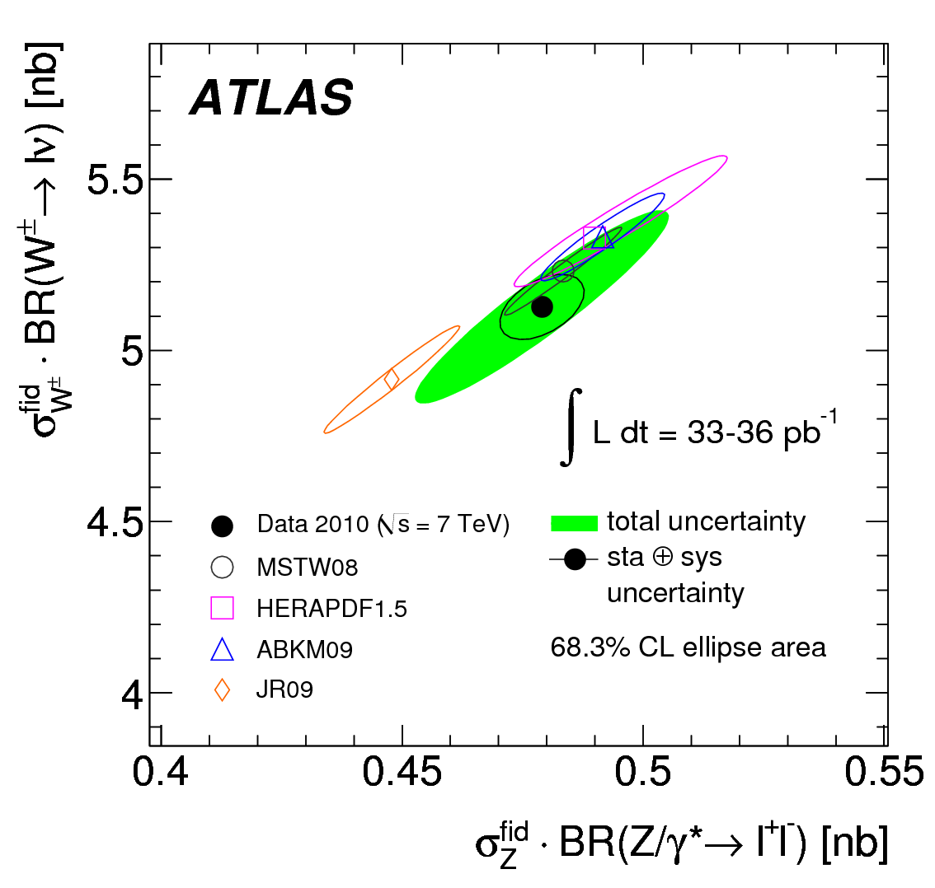
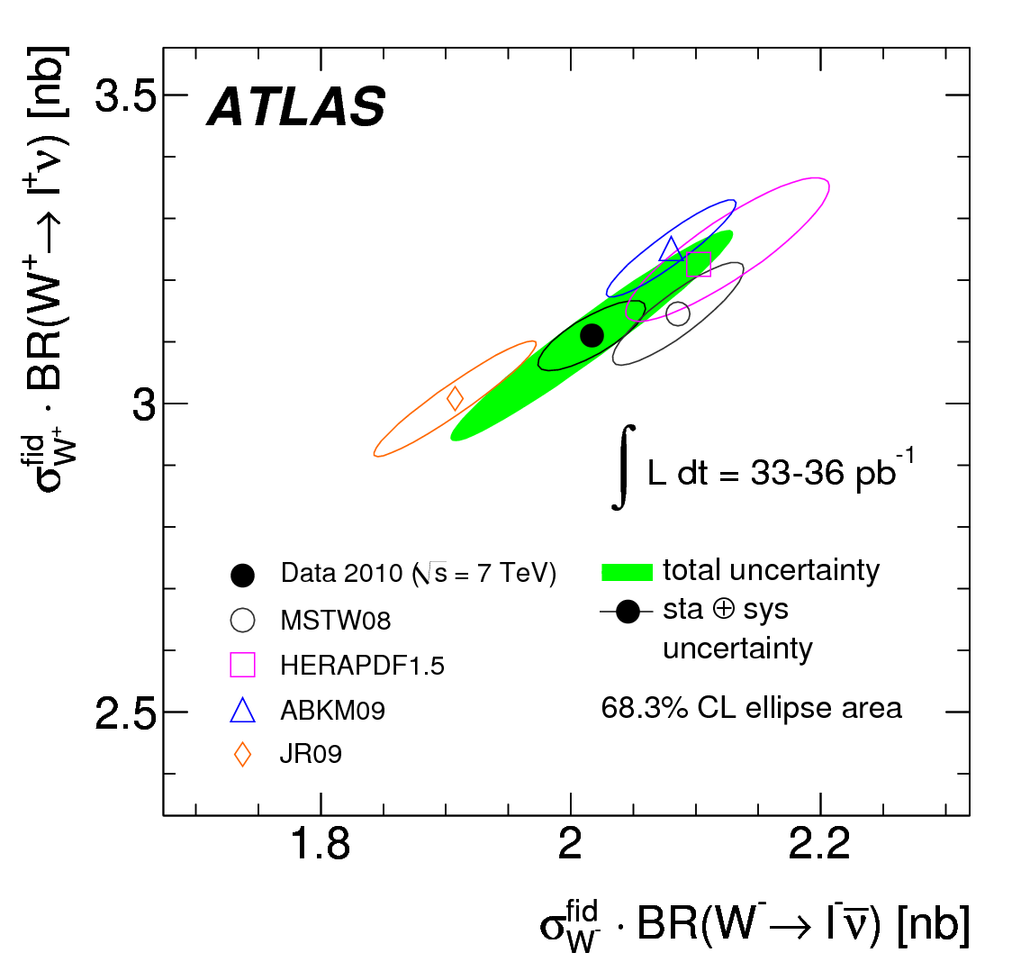
Direct comparison of data to theory predictions, displaying correlations:
W± vs. Z is relatively insensitive to PDFs (though depends on s-quark density) theoretical predictions are tightly packed together
W⁺ vs. W⁻ is sensitive to the d/u ratio at x ≈ 0.1 greater spread in theoretical predictions due to PDF differences
(fiducial)

Slide 5
(fiducial)
CMS have reported new measurements with 8 TeV data.
special running conditions to reduce pile-up
direct comparison to 7 TeV measurements is possible.
CMS 7 TeV: R = 10.54 ± 0.07 (stat) ± 0.17 (syst)
CMS 8 TeV: R = 13.26 ± 0.15 (stat) ± 0.21 (syst)
PRL 112 191802

Slide 6
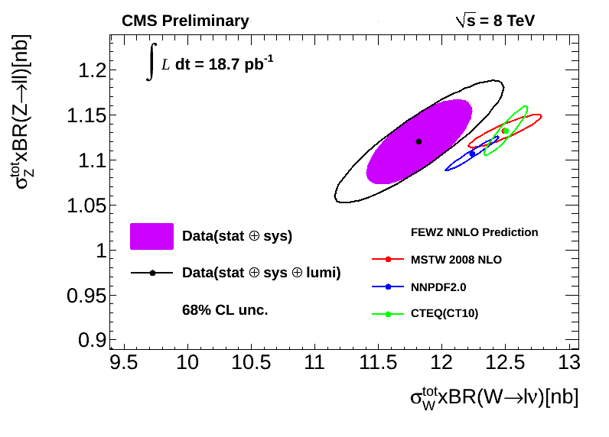
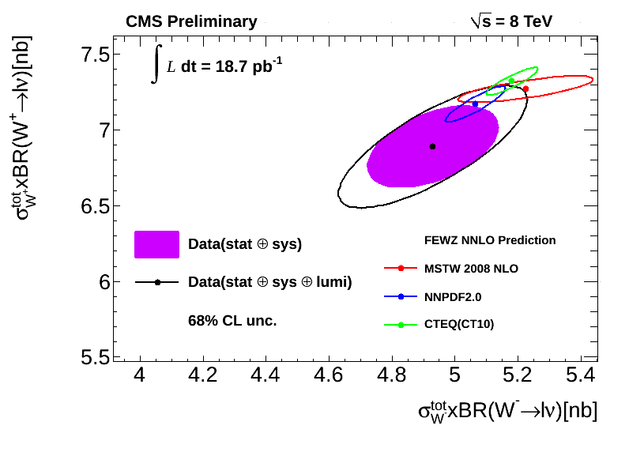
(total)
CMS have reported preliminary measurements with 8 TeV data.
special running conditions to reduce pile-up
direct comparison to 7 TeV measurements is possible.

Slide 7
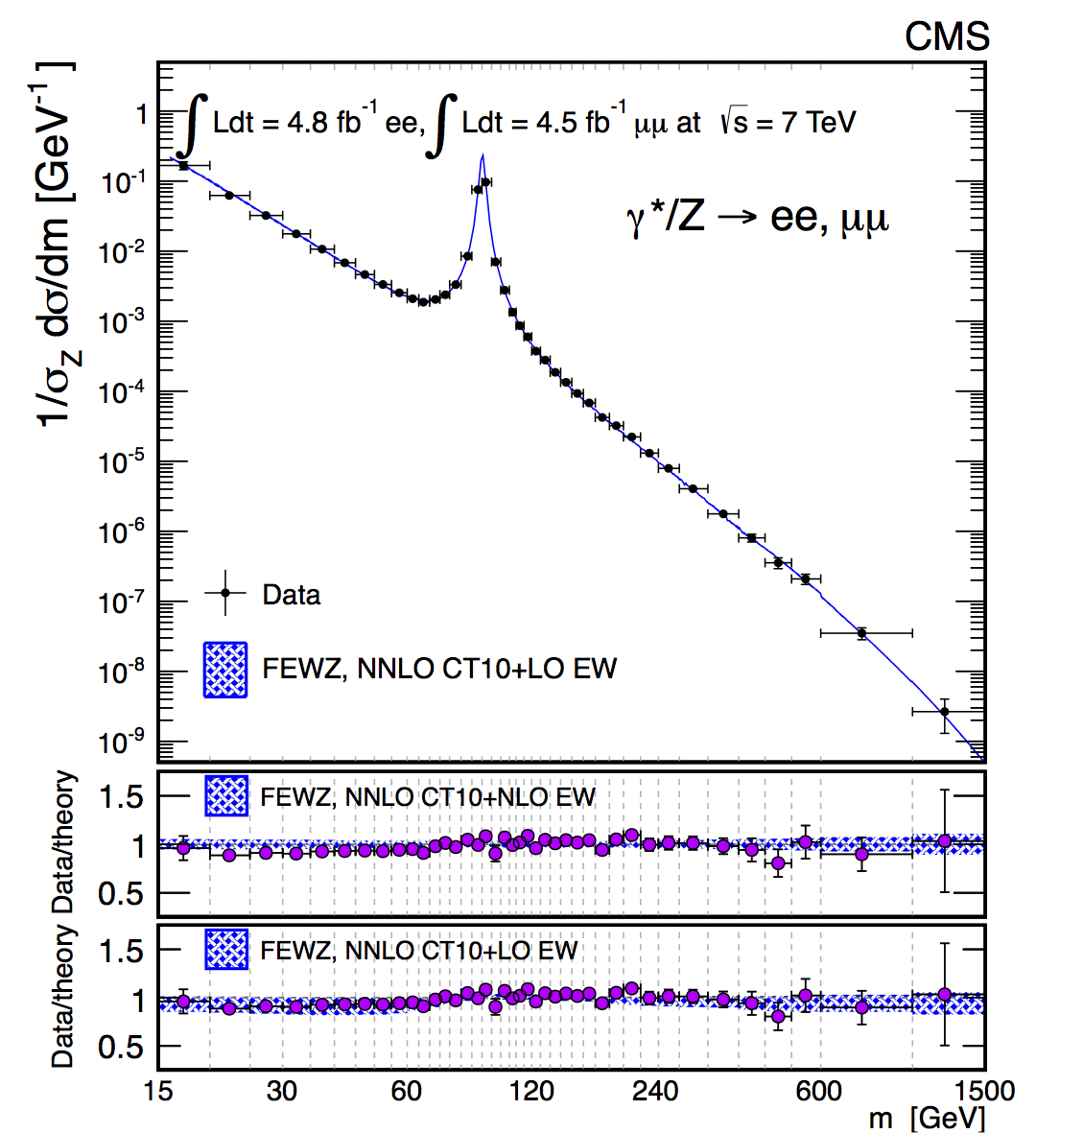
Drell-Yan Production
understood since the 1970s
40 years later, very precise measurements
wide range of mass: wide range of x → constrain PDFs
higher-order corrections needed → tests of theory are still relevant

Slide 8
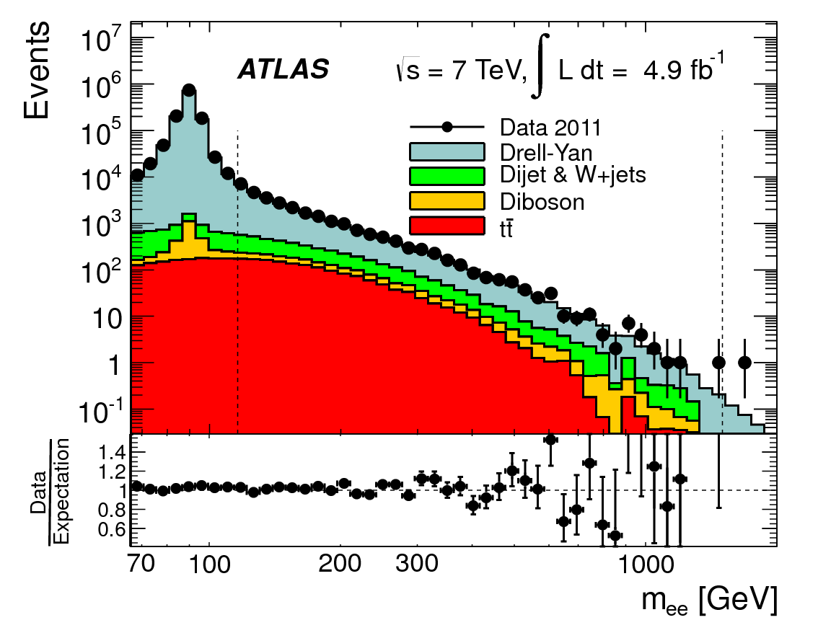
ATLAS published measurements of high-mass Drell-Yan:
high-mass region is amenable to pQCD calculations
note the
scale!
note the
scale!
Phys. Lett. B725 (2013) 223

Slide 9
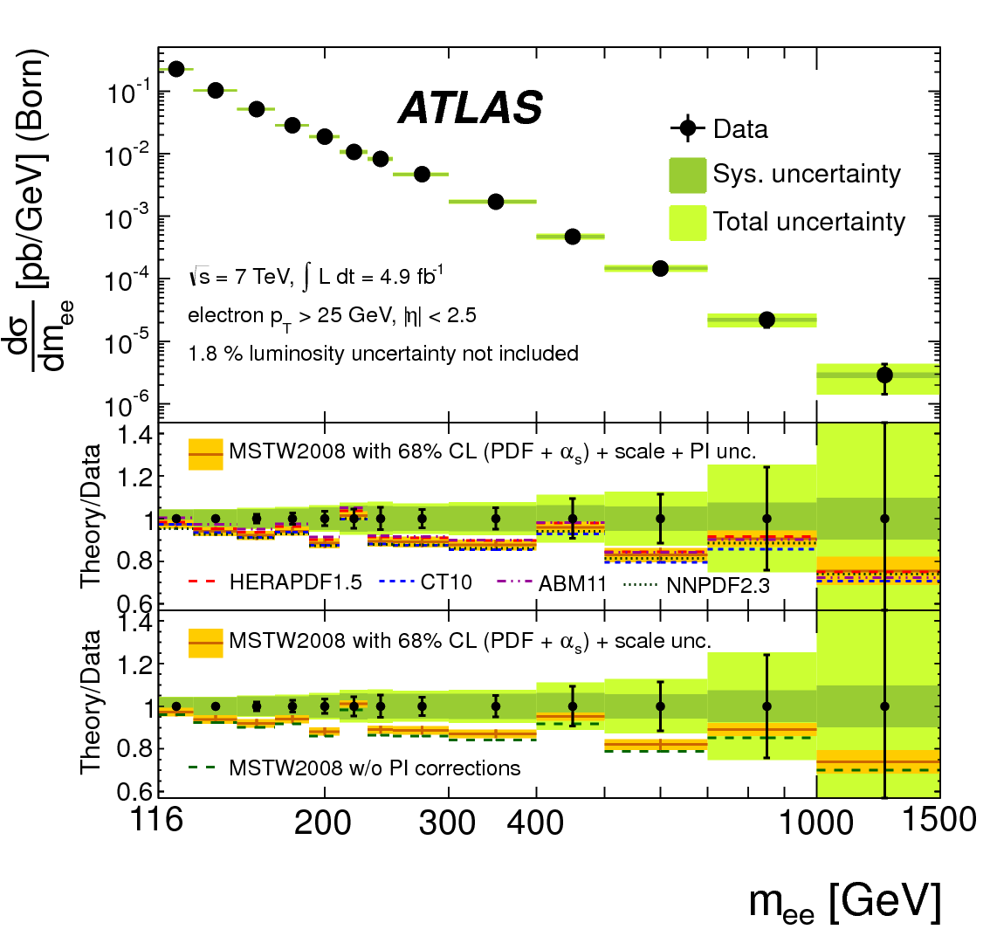
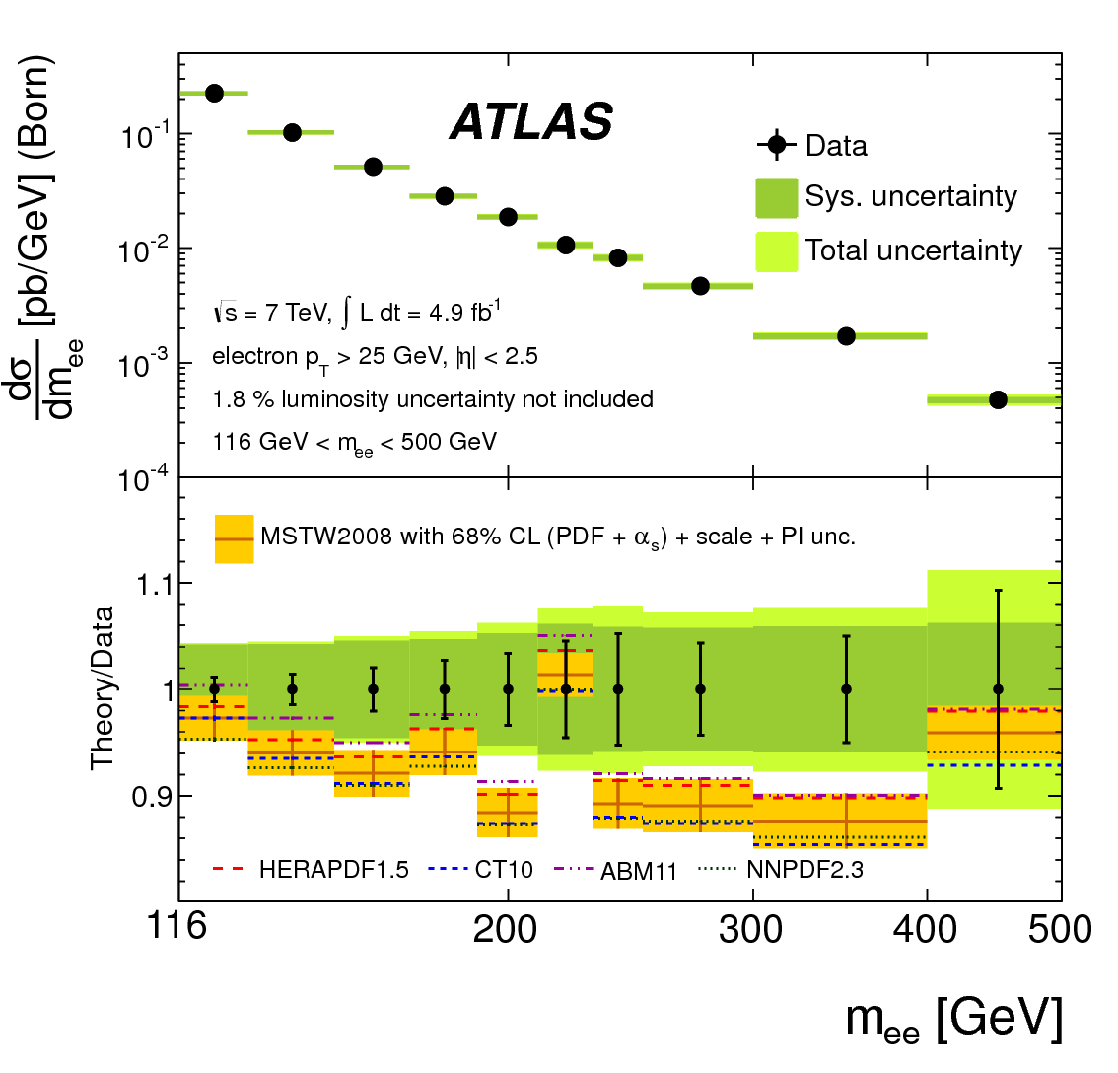
ATLAS published measurements of high-mass Drell-Yan:
high-mass region is amenable to pQCD calculations
sensitive to PDFs – even to q → q+γ splitting (a source of background)
agreement is adequate, though data show excess in 120 < M < 400 range.
Phys. Lett. B725 (2013) 223

Slide 10
CMS has published a double-differential cross section measurement:
The integrated mass distribution is measured in both μ⁺μ⁻ and e⁺e⁻ channels.
8 orders of
magnitude
2 orders of
magnitude
JHEP12 (2013) 030
(Combined e & μ plot shown earlier.)

Slide 11
CMS is publishing a double-differential cross section measurement:
There is enough data to measure dσ/dY in several bins of mass.
Even in this low mass bin,
experimental error bars
about same size as spread
coming from PDFs…
JHEP12 (2013) 030

Slide 12
CMS is publishing a double-differential cross section measurement:
There is enough data to measure dσ/dY in several bins of mass.
Tiny error bars for the Z peak
JHEP12 (2013) 030

Slide 13
CMS is publishing a double-differential cross section measurement:
There is enough data to measure dσ/dY in several bins of mass.
Same mass bin as ATLAS
JHEP12 (2013) 030

Slide 14
CMS is publishing a double-differential cross section measurement:
The lower mass bins show an interesting sensitivity to higher-order corrections:
NNLO
NLO
NLO
NNLO
JHEP12 (2013) 030

Slide 15
CMS is publishing a double-differential cross section measurement:
The lower mass bins show an interesting sensitivity to higher-order corrections:
Closer look at NLO vs NNLO
NLO
NNLO
JHEP12 (2013) 030

Slide 16
Transverse Momentum Distributions
Two regimes:
low – q_{T} : dominated by multi-gluon emission : essentially non-perturbative depends on details of showering scheme gives information on the underlying event two theoretical scales: q_{T} and M which can be very different angular variables – an experimental improvement
high – q_{T} : dominated by one or two hard parton emission: pQCD gluons in initial state start to be important matrix element calculations needed

Slide 17
PRD 85 032002 (2012)
CMS measurements at low and high q_{T} :
7 TeV
disagreement at low – q_{T} indicates need for tuning underlying event model
agreement at high – q_{T} is achieved with FEWZ at O(α²_{S}) …. and POWHEG/PYTHIA/Z2
See also ATLAS: PLB 725 (2013) 223

Slide 18
CMS preliminary measurements:
8 TeV
best overall agreement achieved with ResBos, which uses two scales (q_{T} & M)
agreement at high – q_{T} is achieved with FEWZ at O(α²_{S}) …. and POWHEG/PYTHIA/Z2*
SMP-12-025

Slide 19
CMS compares 7 TeV and 8 TeV directly:
CMS PAS SMP-12-025
Data seem to agree with the prediction from FEWZ but statistical uncertainties are large.

Slide 20
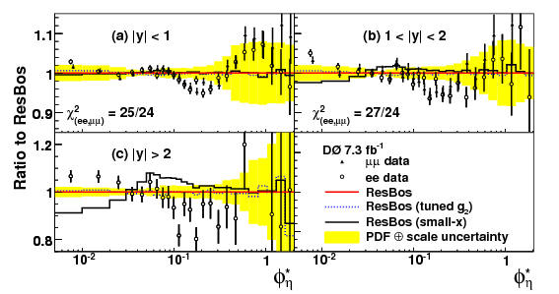
ATLAS has published measurements of a special angular variable:
where:
For a back-to-back configuration, the resolution of q_{T} is not very good.
The quantity φ∗_{η} depends only on the angles of the muon trajectories.
Roughly speaking,
φ∗_{η} → 0.1 corresponds to q_{T} → 10 GeV
The small – q_{T} region is better studied with φ∗_{η} .
PRL 106 122001 (2011)
D published the first study of φ∗_{η}
showing deviations from ResBos
predictions at moderate q_{T}.

Slide 21
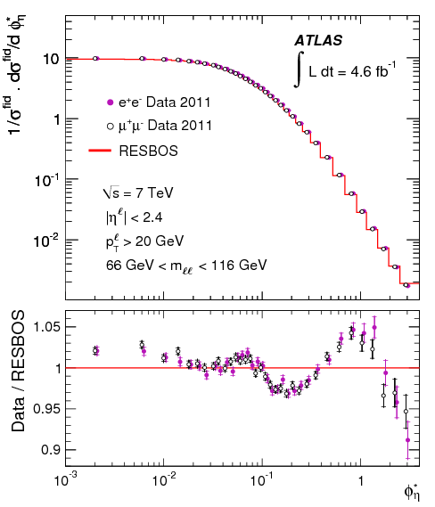
ATLAS has published measurements of a special angular variable:
Phys. Lett. B720 (2013) 32
ATLAS confirms trends seen by D
PRL 106 122001 (2011)
e⁺e⁻ and μ⁺μ⁻ agree very well

Slide 22
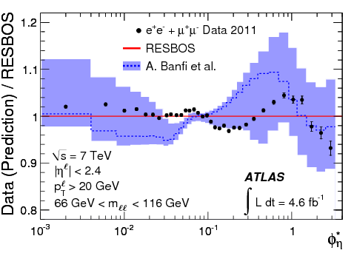
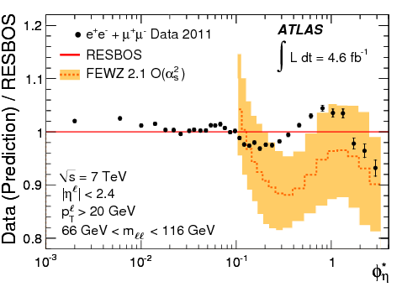
ATLAS comparisons to theoretical predictions:
Phys. Lett. B720 (2013) 32
Banfi et al. [Phys. Lett. B715 (2012) 152]
employ q_{T} – resummation technique
match to fixed-order calculation in MCFM
good results for LHC dσ/dq_{T} data
FEWZ (F. Petriello et al.)
fixed-order (α²_{S})
not good in non-perturbative regime
good agreement with other observables

Slide 23
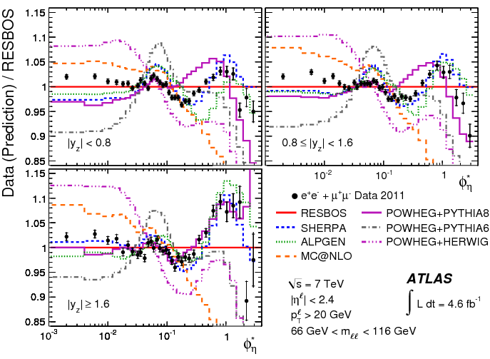
ATLAS comparisons to theoretical predictions in |Y| bins:
Phys. Lett. B720 (2013) 32
SHERPA does best
ALPGEN is OK

Slide 24
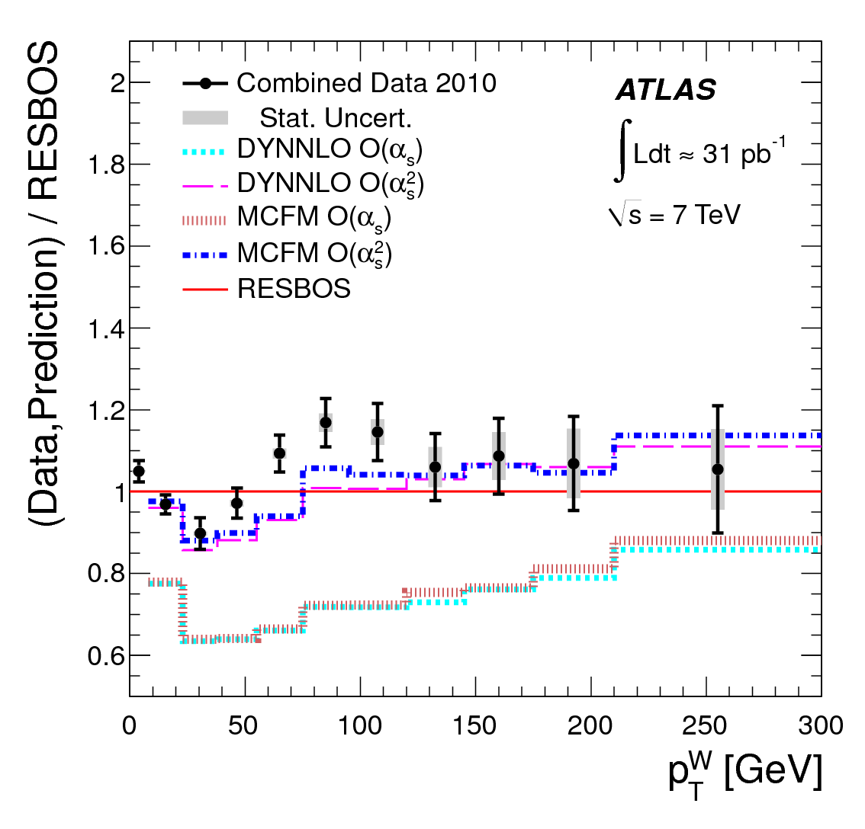
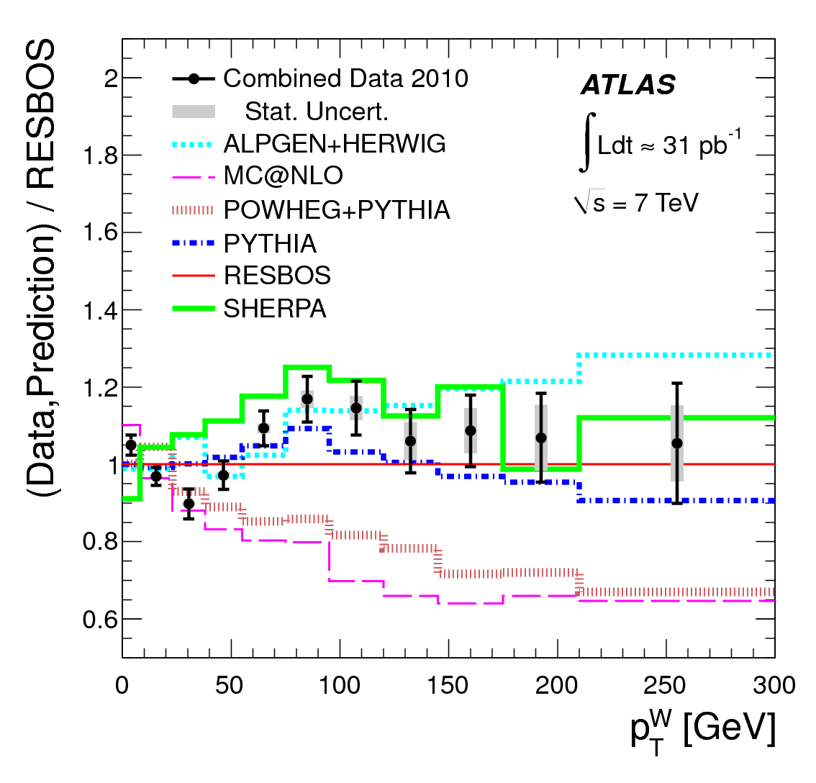
ATLAS have also measured the q_{T} distribution of W bosons:
PRD 85 012005 (2012)
O(α²_{S}) calculation is clearly needed.
SHERPA is OK
ALPGEN does best

Slide 25
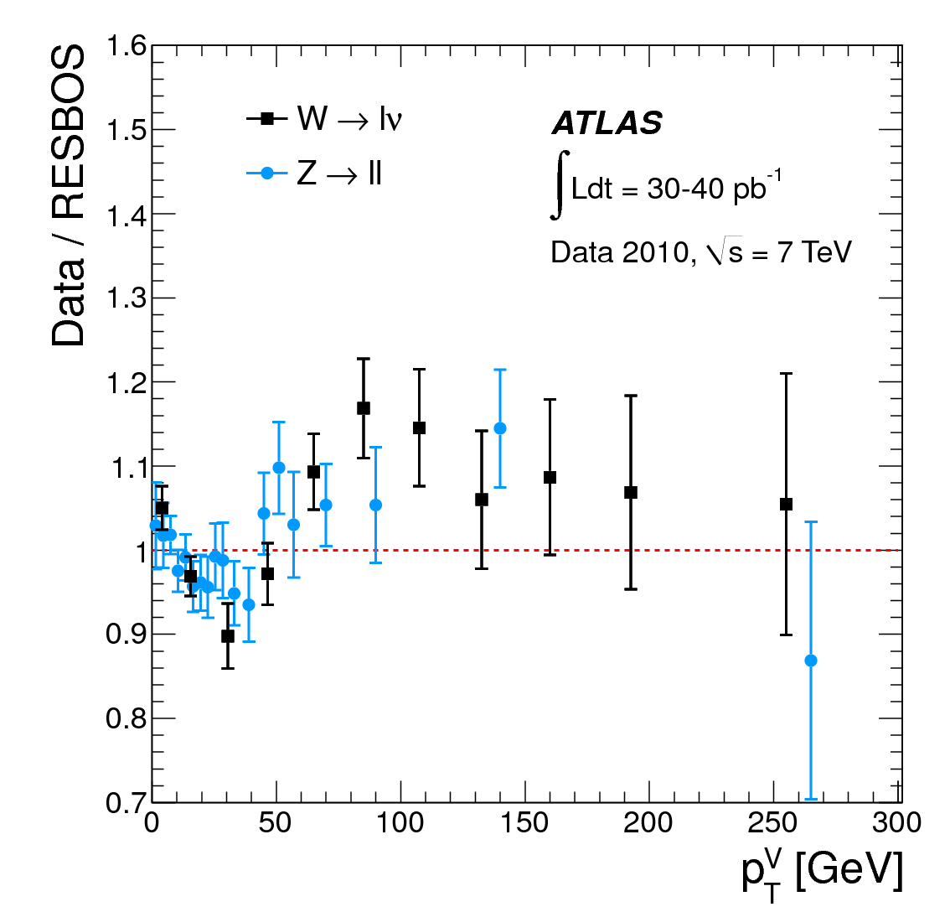
ATLAS have also measured the q_{T} distribution of W bosons:
PRD 85 012005 (2012)
Z clearly confirms the wiggles in the W distribution.

Slide 26
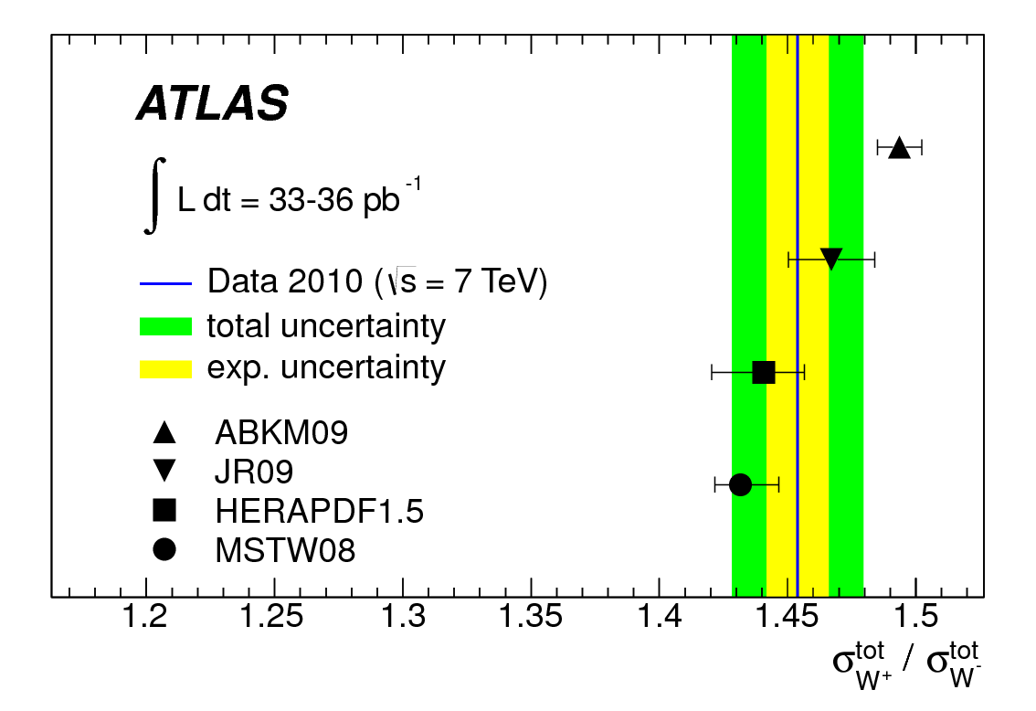
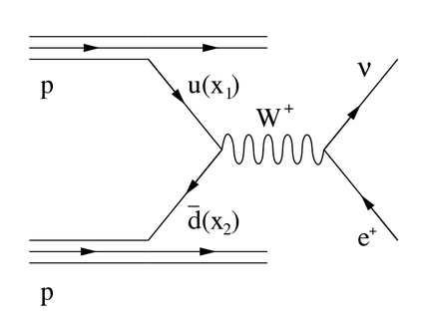
W Charge Asymmetry
More W⁺ are produced than W⁻ because u predominates over d. → possibility to constrain d/u ratio
The asymmetry will be more pronounced at larger Y_{W} (corresponds to larger x) → but Y_{W} is difficult to measure
We can use the lepton η instead of Y_{W} but the asymmetry is more complicated. → and very small errors means dealing with very difficult systematics

Slide 27
D have a new measurement:
There has been tension between CDF & D measurements.
Measurements from p pbar colliders are complimentary.
New D measurements are precise and do not agree with theory.
Interpretation: d/u should be increased.
Phys. Rev. D88 091102(R) (2013)

Slide 28
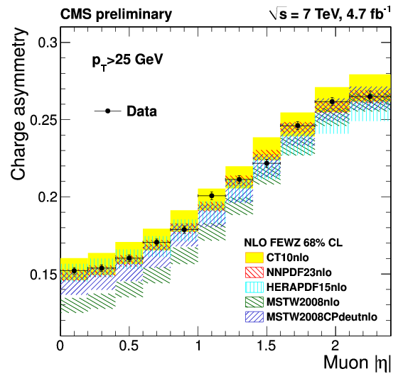
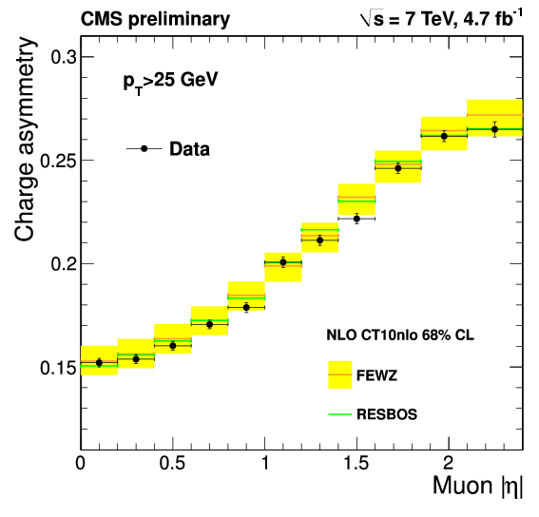
CMS have a new measurement:
arXiv:1312.6283
full data set at 7 TeV, muon channel, p_{T} > 25 GeV, and also p_{T} > 35 GeV
tremendous power to distinguish & constrain PDFs
MSTW2008CPdeut clearly improves upon MSTW2008 but not as good as CT10nlo
FEWZ and RESBOS are equally good at predicting the asymmetry.

Slide 29
LHCb have a made a very nice measurement in the far-forward region:
JHEP1206 (2012) 058
typical CMS & ATLAS region
more negative muons
than positive muons!

Slide 30
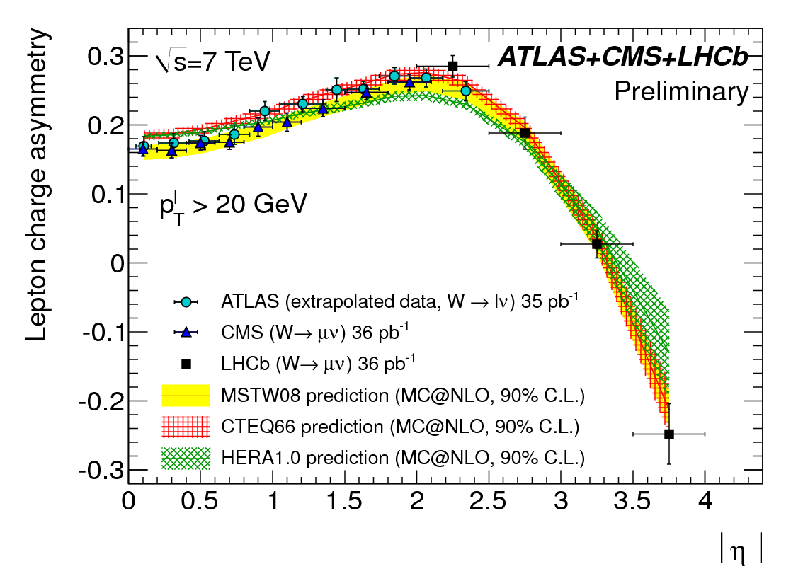
LHCb have a made a very nice measurement in the far-forward region:
JHEP1206 (2012) 058
typical CMS & ATLAS region
(illustrative – LHC working groups plan to do a formally correct combination)

Slide 31
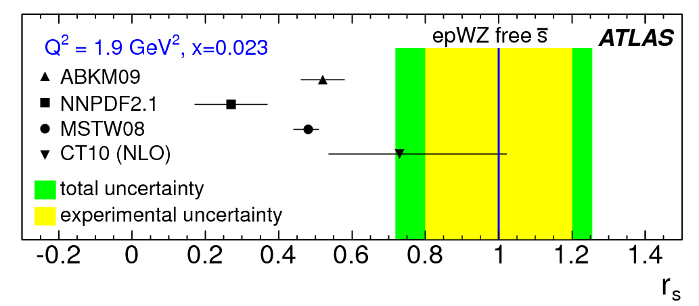
W + charm
A central question in PDFs: is SU(3)_{F} a good symmetry or bad?
xΣ = 2x(ubar+dbar+sbar) cannot be wholly determined by DIS (e.g. F₂)
ν-scattering probes s through W⁺s → c and W⁻sbar → cbar, but results can be difficult to interpret (c-fragmentation, nuclear corrections, etc.)
R_{W} = (W⁺+W⁻)/Z complements DIS b/c couplings are weak, not electromagnetic.
R_{W} is very well measured by ATLAS & CMS (& LHCb)
(e.g. due to s-quark mass)
PRL 109 12001 (2012)
ATLAS inferred relative size of s
from their cross section data:
HERA data + W/Z dσ/dY
flexible PDF parametrization allows s normalization free
quantify s/d contributions:

Slide 32
CMS have measured W+c which gives direct information about s(x).
examine the W⁻ c / W⁺ cbar asymmetry
d→c is Cabibbo-suppressed though d-quarks are relatively plentiful
s→c is Cabibbo-favored and makes a 3% contribution, depending on s(x)
dbar/d constrained by the W charge asymmetry
important to have smallest uncertainties possible
theoretically, ratio is not sensitive to higher-order corrections, but is sensitive to s(x)
reconstruct the charm jet three ways:
exclusive D-meson decays to charged particles
inclusive charm decays to muons
semi-inclusive D-meson decays
key feature: opposite-sign – same-sign (OS-SS) subtraction
removes backgrounds, and removes gluon splitting g → c cbar

Slide 33
CMS: W+c
arXiv:1310.1138 (subm.)
distinct asymmetry is observed & measured precisely (more than 3 s.d. from unity)
theoretical calculations agree well (especially CT10 & NNPDF23coll)
data seem to decline more rapidly with η but not really precise enough yet

Slide 34
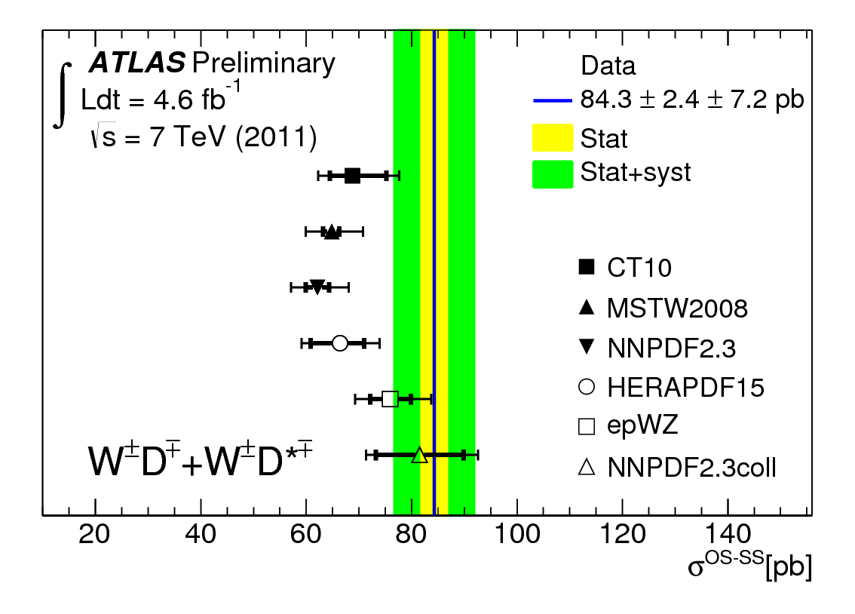
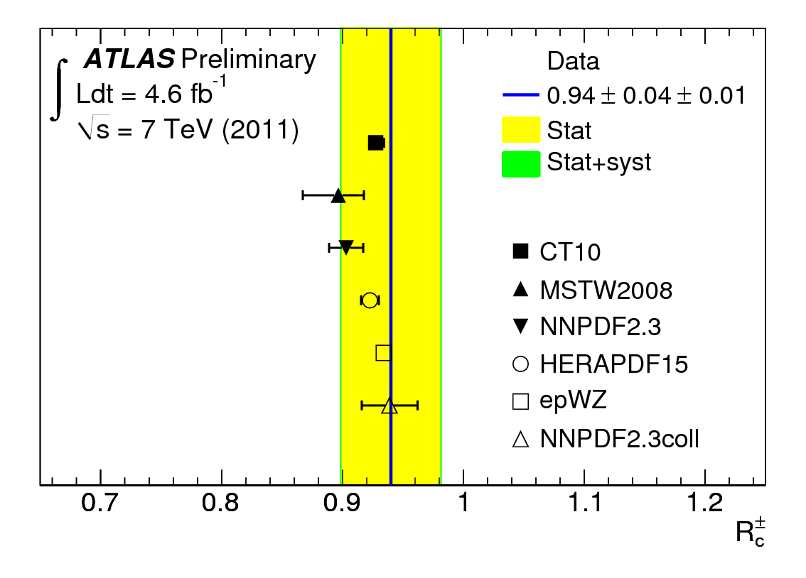
ATLAS has a preliminary measurement:
reconstruct exclusive D-mesons only (in many channels)
ATLAS-CONF-2013-045
conclusions are similar to what CMS found
not yet at the same precision

Slide 35
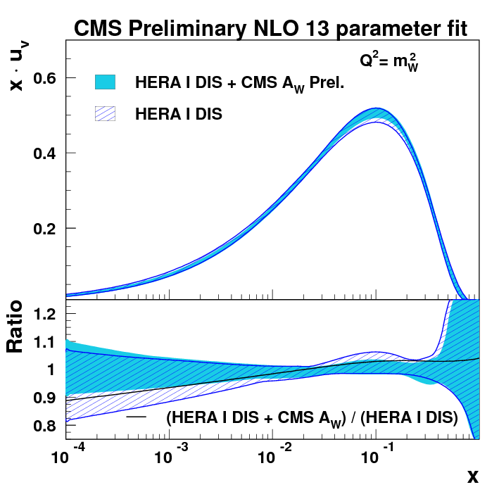
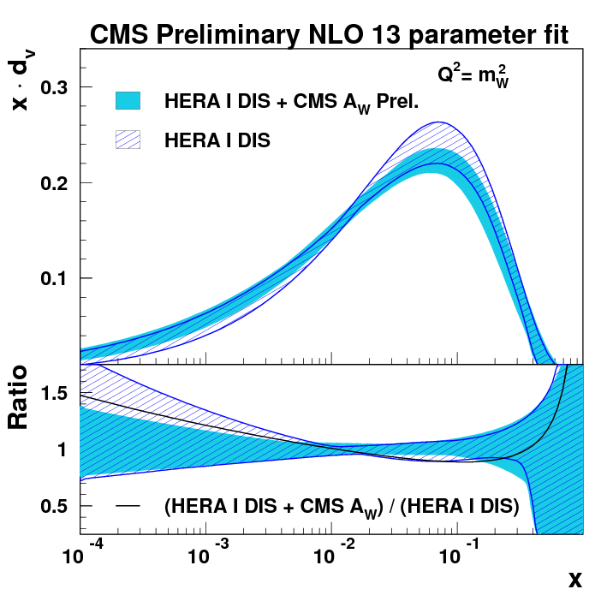
arXiv:1312.6283 (subm. to PRD)
CMS have carried out a QCD analysis to explore PDF constraints:
Use HERA DIS, CMS W asymmetry & CMS W+c data
Like ATLAS, consider fixed-s and free-s fits.
Notice that xd_{v}(x) is reduced. (D data want d/u increased.)

Slide 36
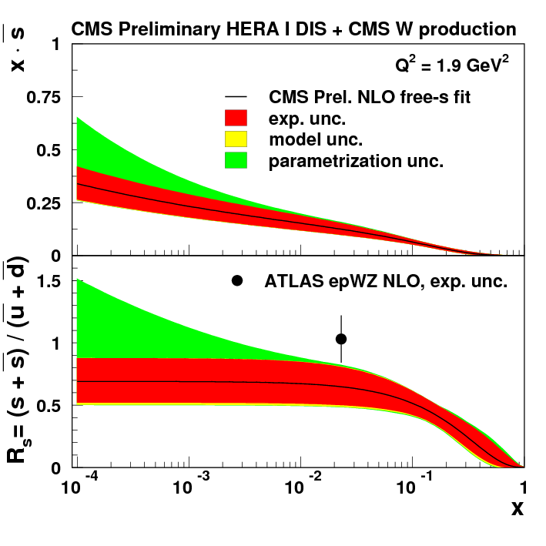
arXiv:1312.6283 (subm. to PRD)
CMS have carried out a QCD analysis to explore PDF constraints:
Maybe some tension between CMS & ATLAS results on s(x) ?
Use HERA DIS, CMS W asymmetry & CMS W+c data
Like ATLAS, consider fixed-s and free-s fits.

Slide 37
Vector bosons + jets

Slide 38
CMS PAS SMP-12-023
CMS preliminary results on differential cross sections of W + jets
all distributions unfolded and corrected to the particle level
small experimental errors allow real distinctions of theoretical models [NLO] BLACKHAT+SHERPA SHERPA MADGRAPH
A parallel analysis with Z + jets: CMS PAS SMP-12-017

Slide 39
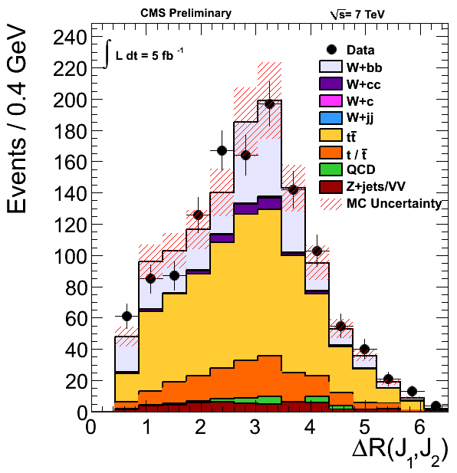
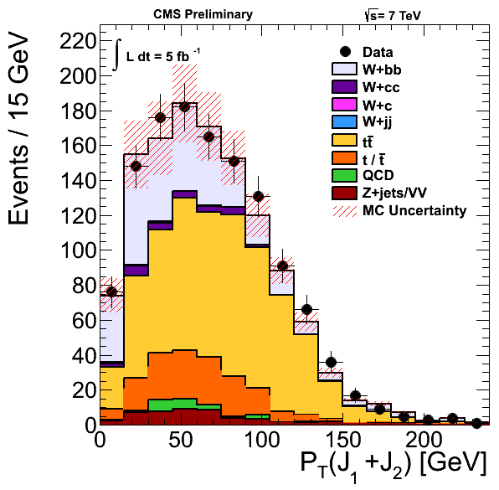
arXiv:1312.6608
CMS measurement of W + 2b jets
previous measurements show varying levels of agreement with theory
W + 1b, or nearly-collinear b-jets, present the worst difficulties
This analysis investigates exclusive 2 b-jet final state – complements prior studies
the b-jets are well separated from each other: ΔR > 0.5
NLO MCFM calculation adjusted for DPS and parton – particle differences
Standard Model:
MadGraph+Pythia

Slide 40
arXiv:1402.1521
CMS measurement of Z + 1b jet and Z + ≥2b jets
Z + 1b sensitive to b-quark content of the proton
Z + 2b (inclusive) test of QCD calculations
MADGRAPH and aMC@NLO:
4-flavor (4F) scheme with massive b-quarks
5-flavor (5F) scheme with massless b-quarks
careful unfolding of 1b and ≥2b samples
non-overlapping
5F predictions agree better with data than 4F predictions do.
MCFM at parton level does not agree with data well: not even Z+b/Z+j
MadGraph+Pythia

Slide 41
arXiv:1402.1521
CMS measurement of Z + 1b jet and Z + ≥2b jets

Slide 42
JHEP12 (2013) 039
Z + 2b jets : angular correlations
differential cross sections : angular separation between b hadrons & Z boson
special interest: angular correlations of the b hadrons
tree-level calculations allowing for many extra partons in the matrix elements: MADGRAPH ALPGEN SHERPA
four-flavor and five-flavor scheme
MCFM is NLO for 5F aMC@NLO is NLO
Comparisons done for ranges of Z boson p_{T}
illustration of how q-initiated and g-initiated processes can be distinguished:
simulation

Slide 43
JHEP12 (2013) 039
Z + 2b jets : angular correlations
ALPGEN with 4F does the best job describing the data
all generators agree with data well, for p_{T}^{Z} > 50 GeV

Slide 44
Conclusion
This summary is woefully incomplete – I regret I could not cover more.
Precision of the studies of vector boson production is unprecedented and will continue to improve.
Theoretical calculations (in the form of MC simulations) stand up well, in general, though clear discrepancies are visible in select kinematic distributions.
Thank you to the organizers & City Tech!

Slide 45
Extra Slides

Slide 46
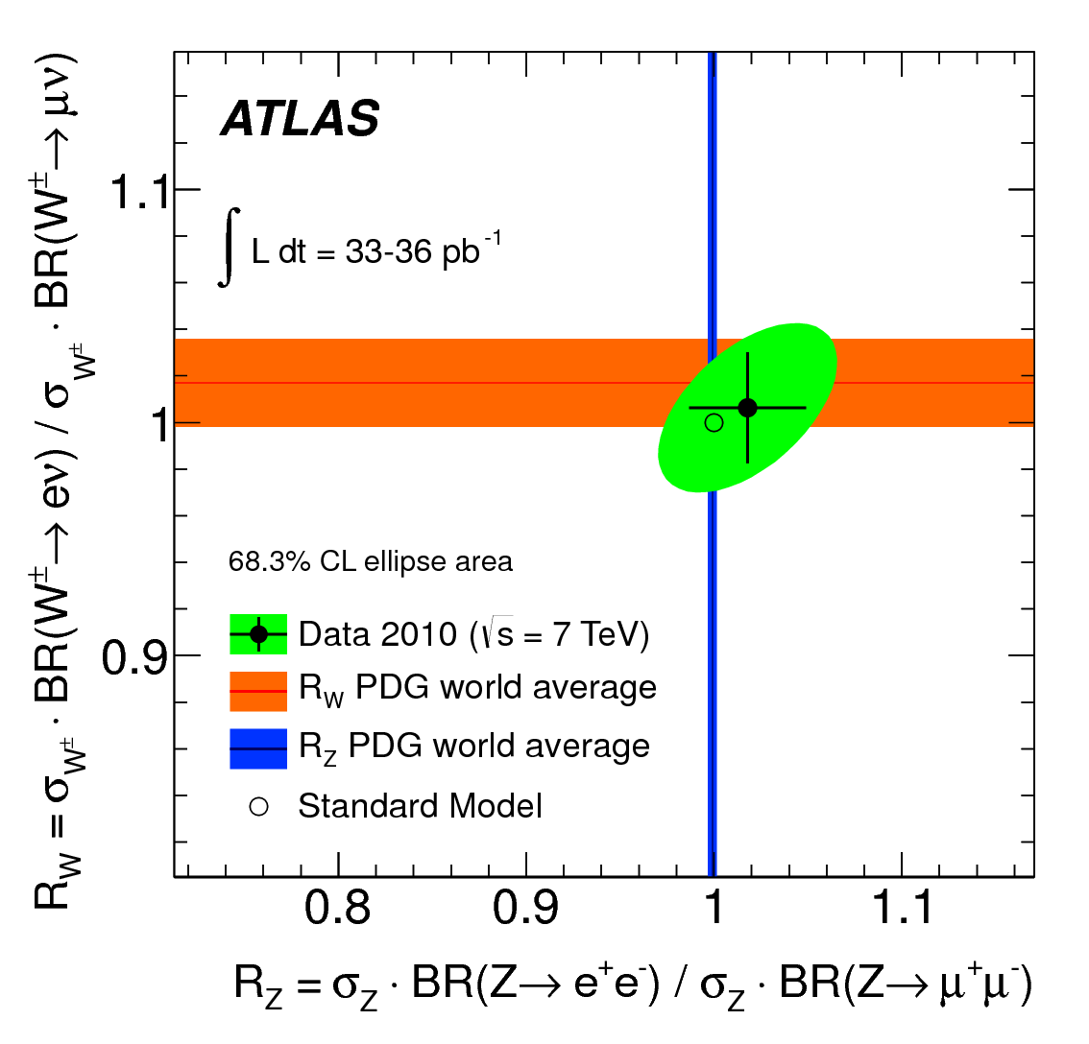
ATLAS reported a competitive test of lepton universality in W decays:
36 pb⁻¹ at 7 TeV
exploits the very
high precision of
the cross section
measurements
ATLAS:
PDG:

Slide 47
Rare Decay Process Z → 4 leptons
was observed at LEP in the mid-1990s.
Example: L3 reported 43 events for e, μ and τ.
Phys.Lett. B321 (1994) 283
The “second pair” of leptons come mainly from virtual photon exchange.

Slide 48
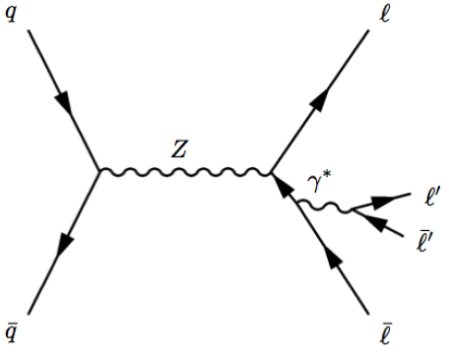
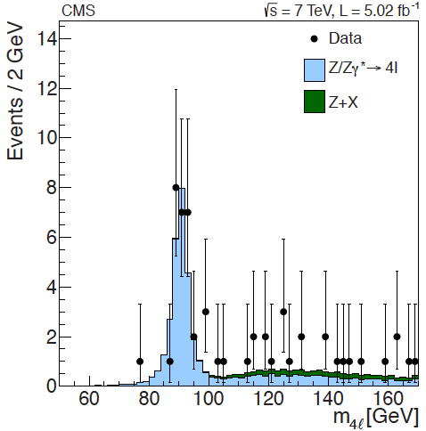
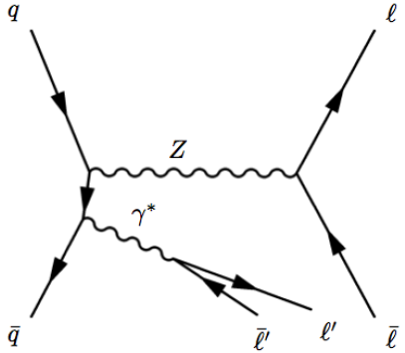
CMS reported observation of Z → 4l in the context of the Higgs search.
28 events in peak
main goal: measure mass resolution
normalize to Z → μ⁺μ⁻ signal and infer:
SM value: note: !

Slide 49
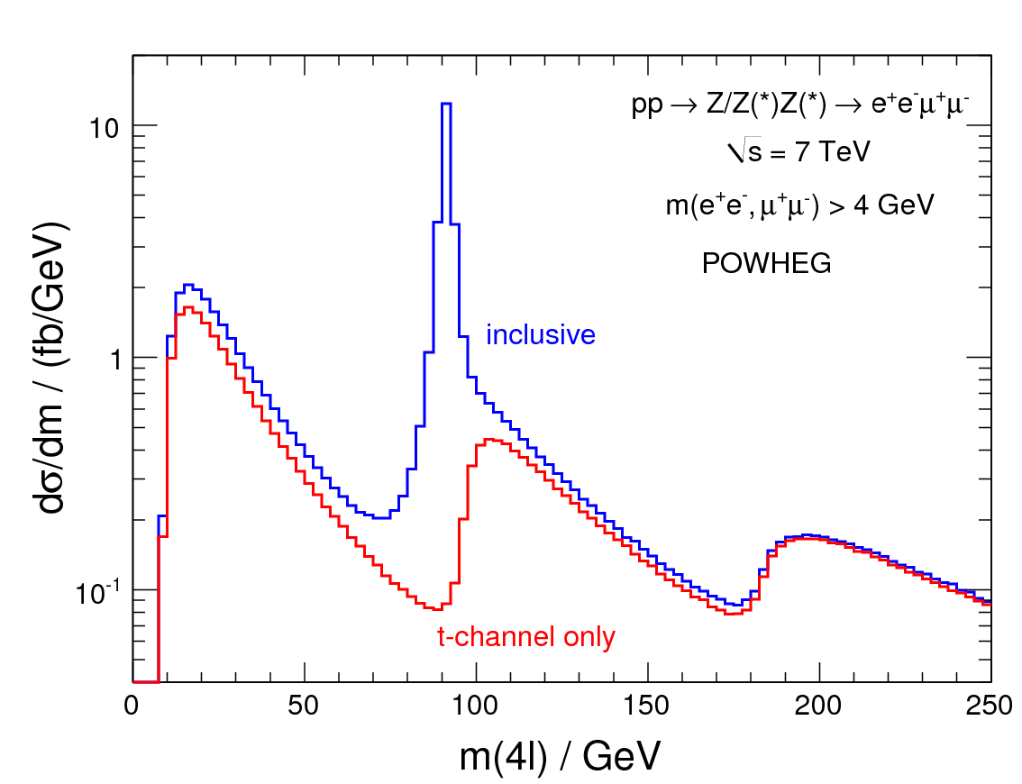
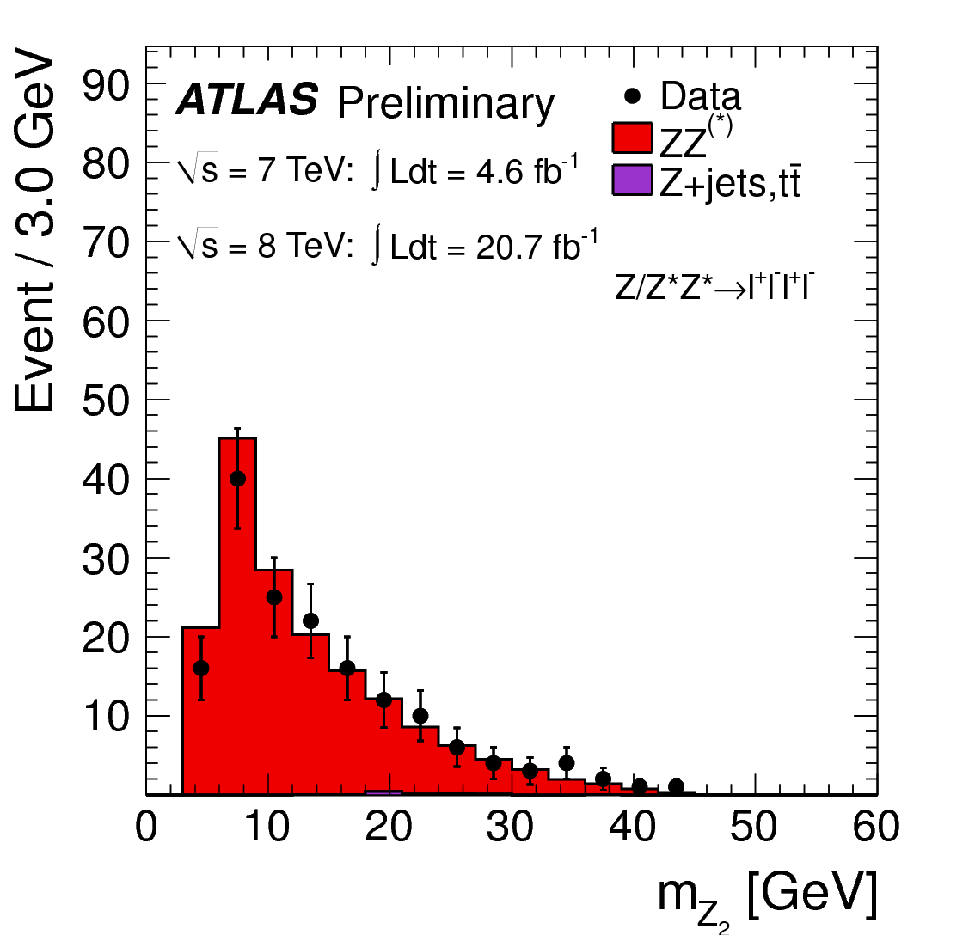
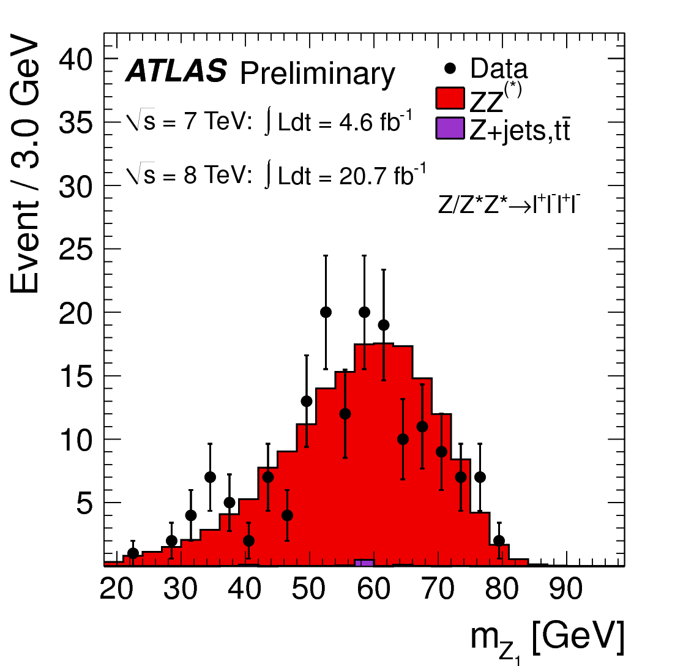
ATLAS Z → 4l signal from 7 TeV & 8 TeV
interesting structure in t-channel
contributes 8% under Z-peak
dominates above ZZ threshold
more than 160 candidates selected
normalize to theoretical Z cross section:

Slide 50
Forward-Backward Asymmetry and sin²θ_{W}
well-known tension between “leptonic” and “hadronic” asymmetry measurements.
lead to two very different values for sin²θ_{W}
two most precise values differ by more than 3σ
used to be a problem for estimating the SM Higgs mass.
Clearly, a new measurements with an uncertainty of 0.0002 or better would be very useful.
Phys. Rep. 427 (2006) 257

Slide 51
CMS reported the first measurement of sin²θ_{W} at the LHC:
innovative: make full use of the Drell-Yan leading-order matrix element (in the past people used only A_{FB})
A_{FB} is relatively weak at a pp collider because there is no clear “forward” direction - one resolves the q direction on a statistical basis: - the longitudinal direction of the Z indicates the likely q direction.
The use of the full matrix element squeezes the most information and helps deal with the forward/backward direction ambiguity (“dilution”)
Gain is about 20% with respect to A_{FB} alone.
This is a “demonstration” measurement.
5 fb⁻¹ at 7 TeV, μ⁺μ⁻ only
significant systematic uncertainty due to NLO corrections, momentum resolution and mis-alignment
speculate that systematic uncertainty could be pushed down to 0.0010?
Phys. Rev. D84 112002 (2011)

Slide 52
CMS did measure A_{FB} in an independent analysis:
combine e⁺e⁻ and μ⁺μ⁻
more than 1M events
subtract backgrounds, unfold (F and B separately), correct for dilution…
four bins of rapidity Y
any signs of a deviation at high M?
Phys. Lett. B718 (2013) 752

Slide 53
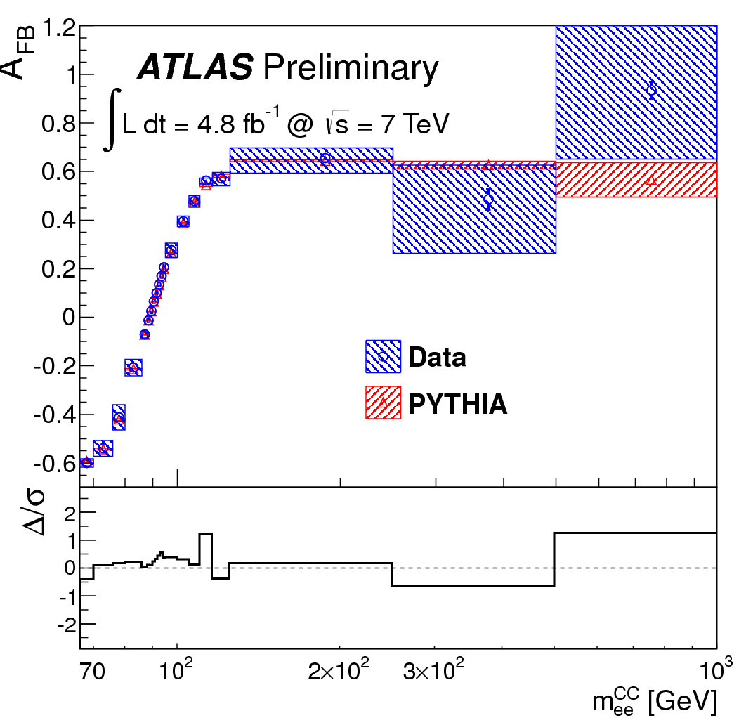
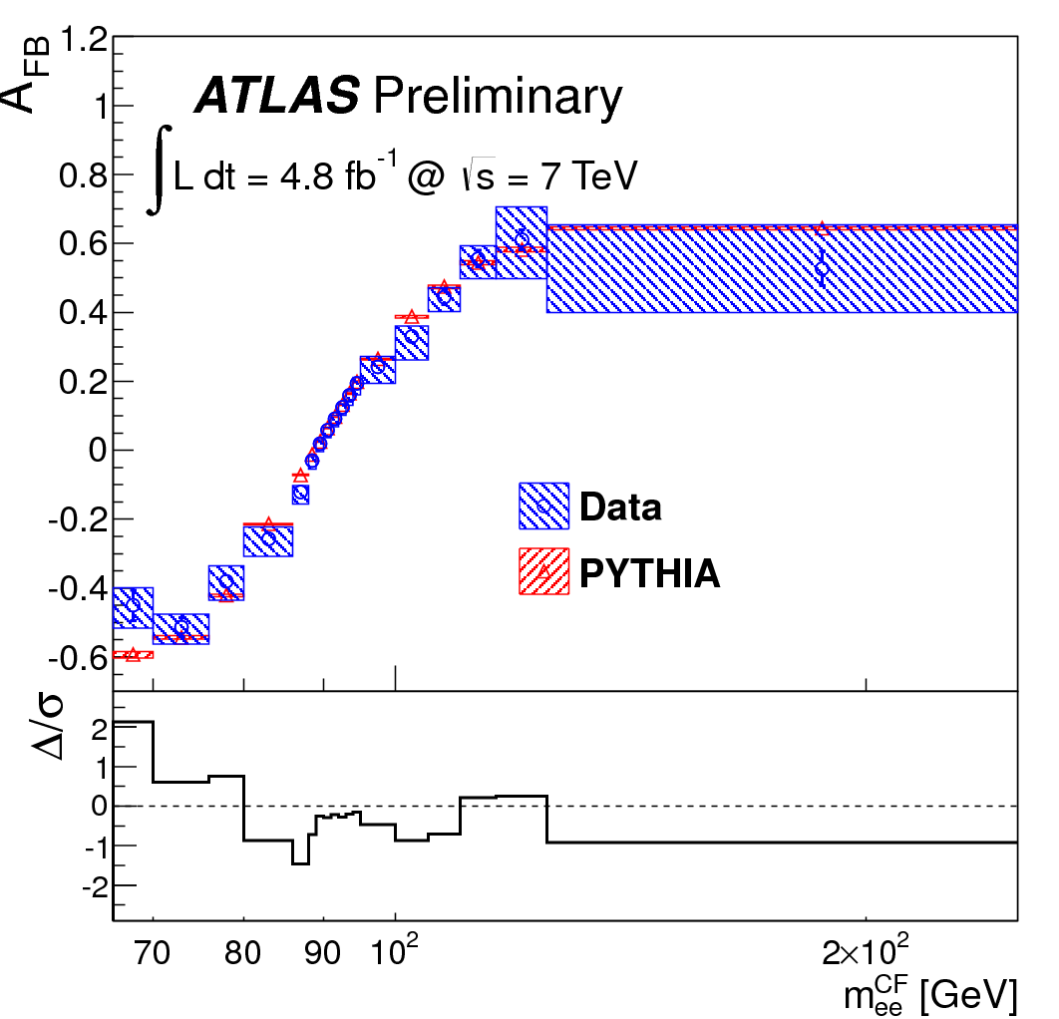
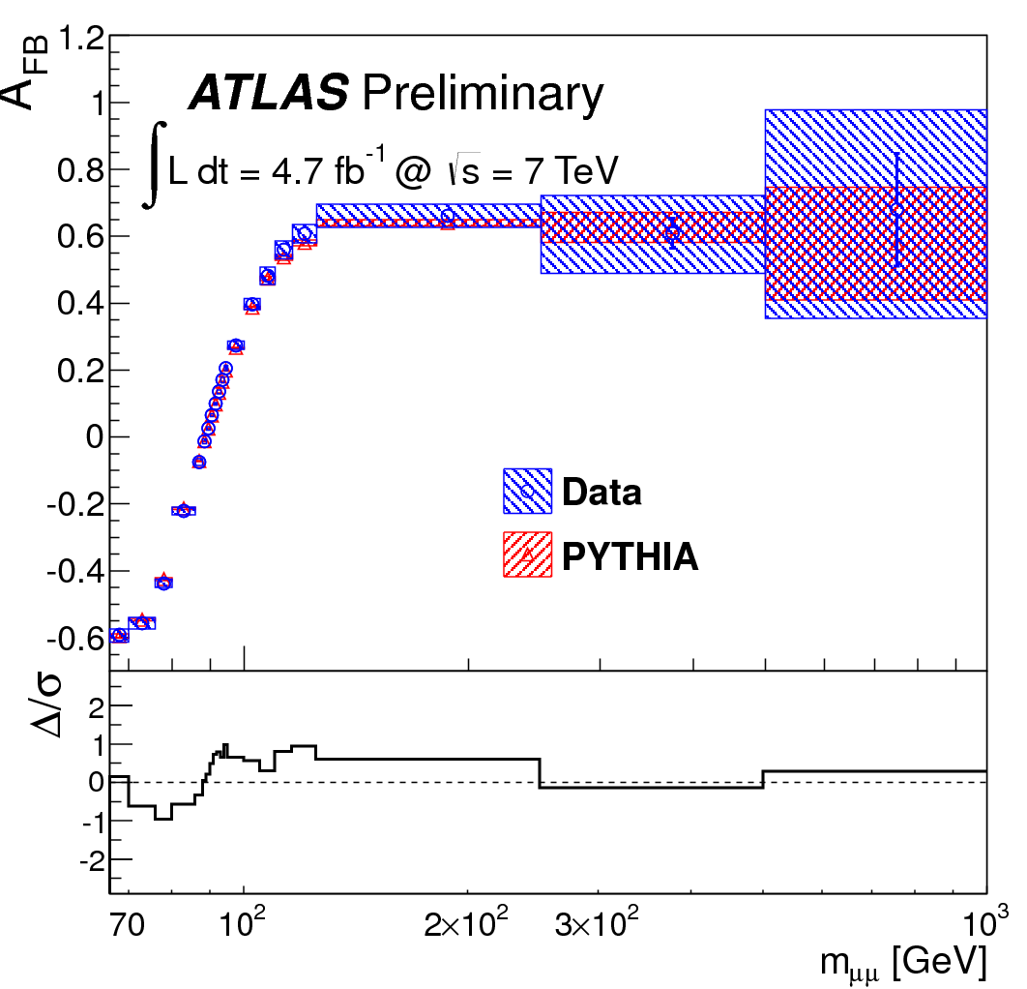
ATLAS-CONF-2013-043
New preliminary ATLAS measurement of A_{FB} and sin²θ_{W}
same approach as CMS and the Tevatron experiments
5 fb⁻¹ at 7 TeV, both e⁺e⁻ and μ⁺μ⁻
unfold and correct
CC
CF
μμ
not-quite-perfect agreement…

Slide 54
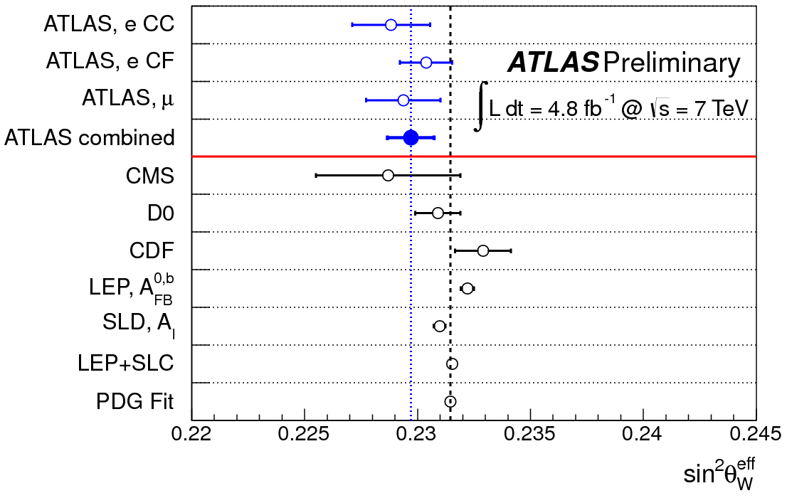
ATLAS-CONF-2013-043
New preliminary ATLAS measurement of A_{FB} and sin²θ_{W}

