Slide 1
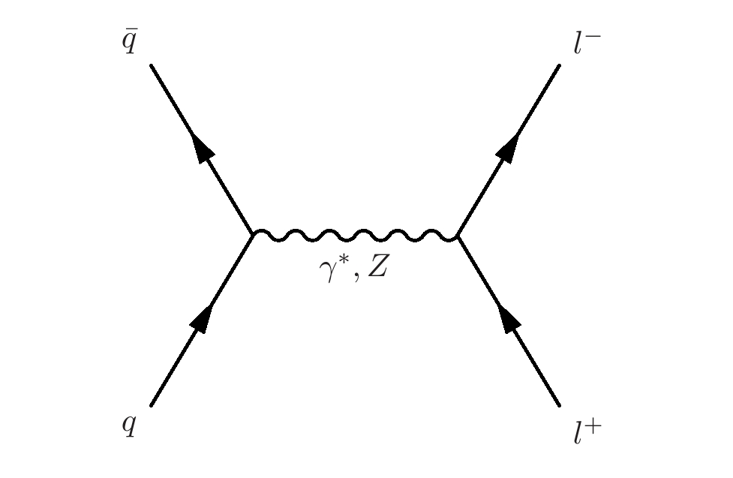
Electroweak Physics at the LHC
Where are we now?
Michael Schmitt (Northwestern University)
WNL Conference; June 6, 2014

Slide 2
Introduction
“Have a bias toward action – let’s see something happen now.
You can break that plan into small steps and take the first step right away.”
- Indira Gandhi
Inclusive W and Z cross sections
Rare Z → 4lepton decays
Drell-Yan production
Transverse momentum distributions
W charge asymmetry
W+c production
Forward-backward asymmetry and sin²θ_{W}
di-Boson production and anomalous couplings

Slide 3
Inclusive W and Z production
Important benchmark process since turn-on in 2010.
Must master techniques for reconstructing W and Z bosons before one can do electroweak physics.
Starting point for constraints on parton distribution functions (PDFs).
Amazing progress has been made in the precision of the measurements.
Here is an illustration:
CMS: R = 10.54 ± 0.07 (stat) ± 0.08 (syst) ±0.16 (th)
ATLAS: R = 10.893 ± 0.079(stat) ± 0.110 (syst) ±0.116 (th)
7 TeV , 35 fb⁻¹
typical precision:
statistical uncertainty << 1%
experimental systematic uncertainty 1 – 1.5%
luminosity uncertainty 3 – 4 %

Slide 4
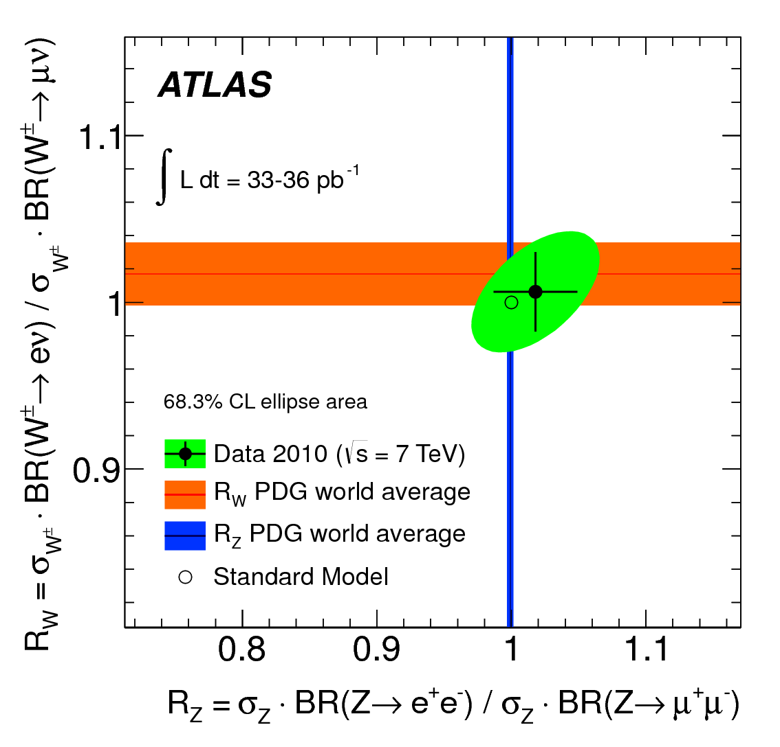
ATLAS reported a competitive test of lepton universality in W decays:
36 pb⁻¹ at 7 TeV
exploits the very
high precision of
the cross section
measurements
ATLAS:
PDG:

Slide 5
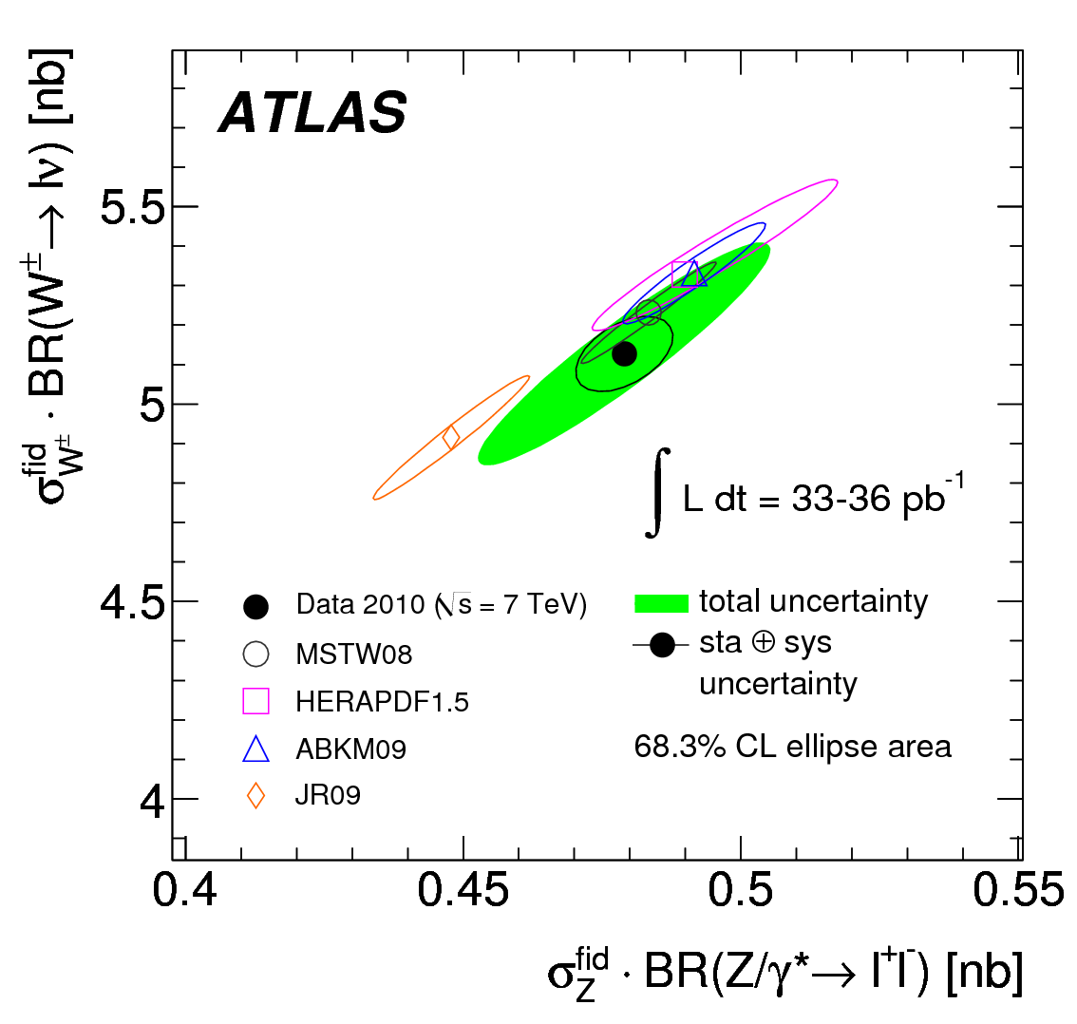
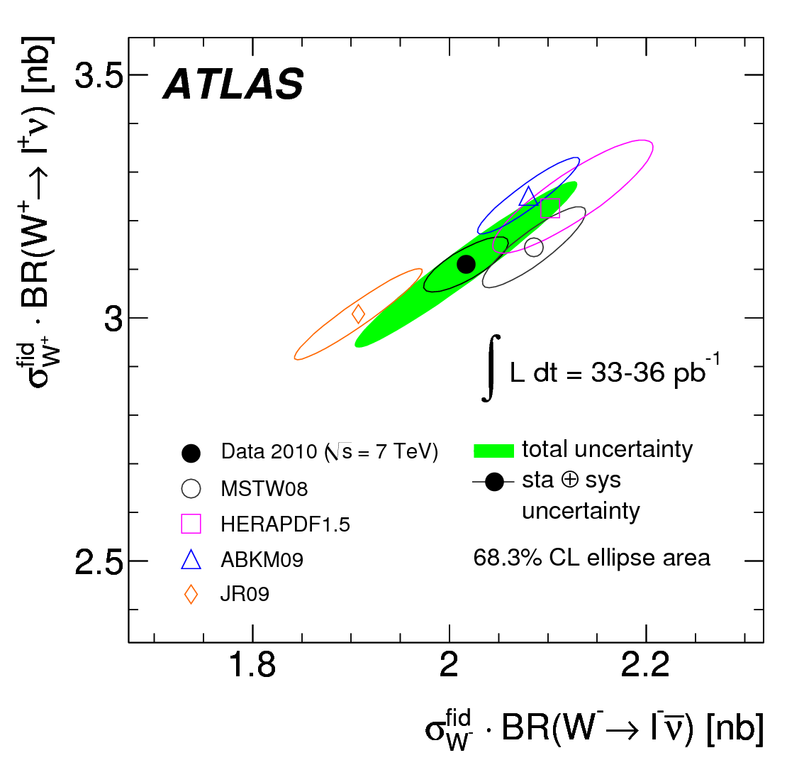
Direct comparison of data to theory predictions, displaying correlations:
W± vs. Z is relatively insensitive to PDFs (though depends on s-quark density) theoretical predictions are tightly packed together
W⁺ vs. W⁻ is sensitive to the d/u ratio at x ≈ 0.1 greater spread in theoretical predictions due to PDF differences
(fiducial)

Slide 6
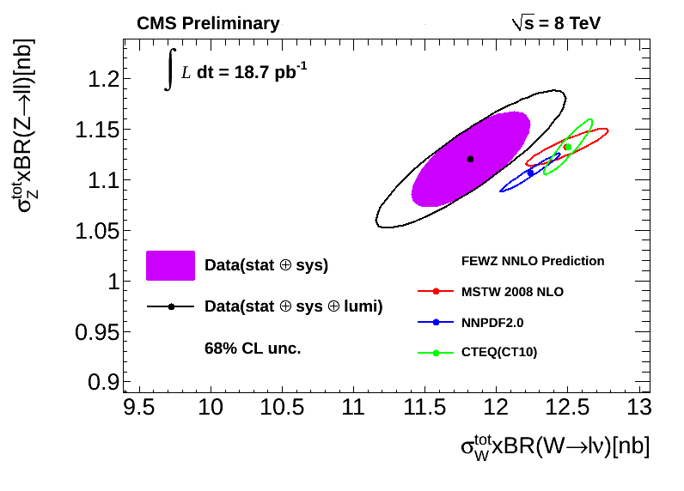
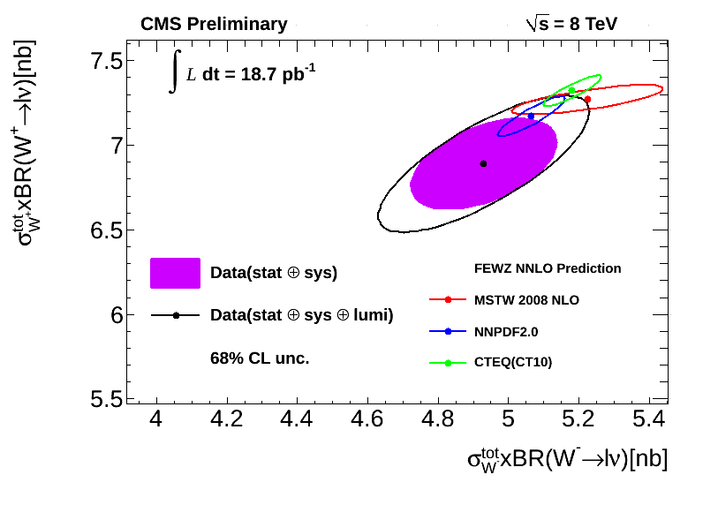
(total)
CMS have reported preliminary measurements with 8 TeV data.
special running conditions to reduce pile-up
direct comparison to 7 TeV measurements is possible.

Slide 7
(total)
CMS have reported preliminary measurements with 8 TeV data.
special running conditions to reduce pile-up
direct comparison to 7 TeV measurements is possible.

Slide 8
Rare Decay Process Z → 4 leptons
was observed at LEP in the mid-1990s.
Example: L3 reported 43 events for e, μ and τ.
Phys.Lett. B321 (1994) 283
The “second pair” of leptons come mainly from virtual photon exchange.

Slide 9
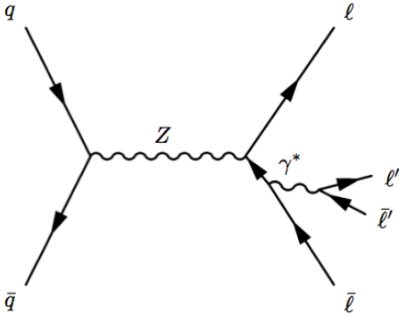
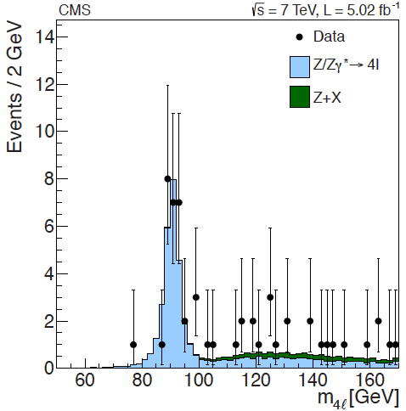
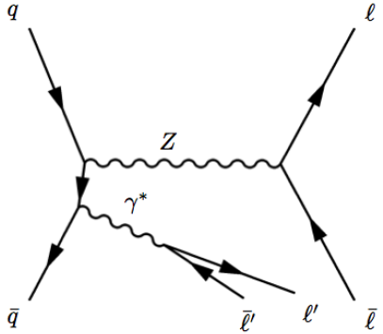
CMS reported observation of Z → 4l in the context of the Higgs search.
28 events in peak
main goal: measure mass resolution
normalize to Z → μ⁺μ⁻ signal and infer:
SM value: note: !

Slide 10
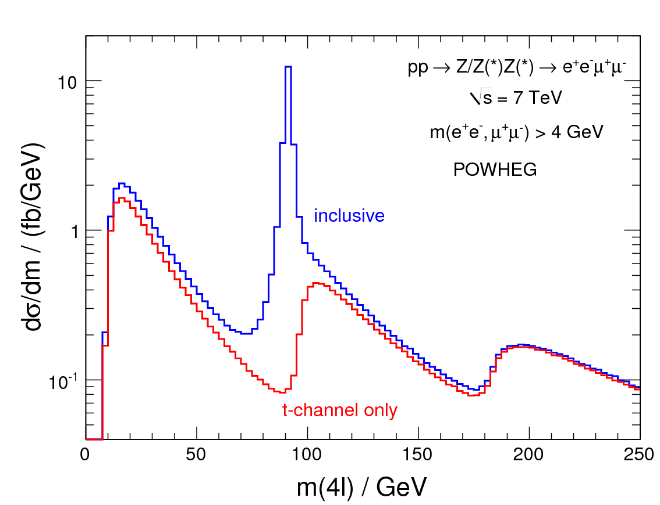
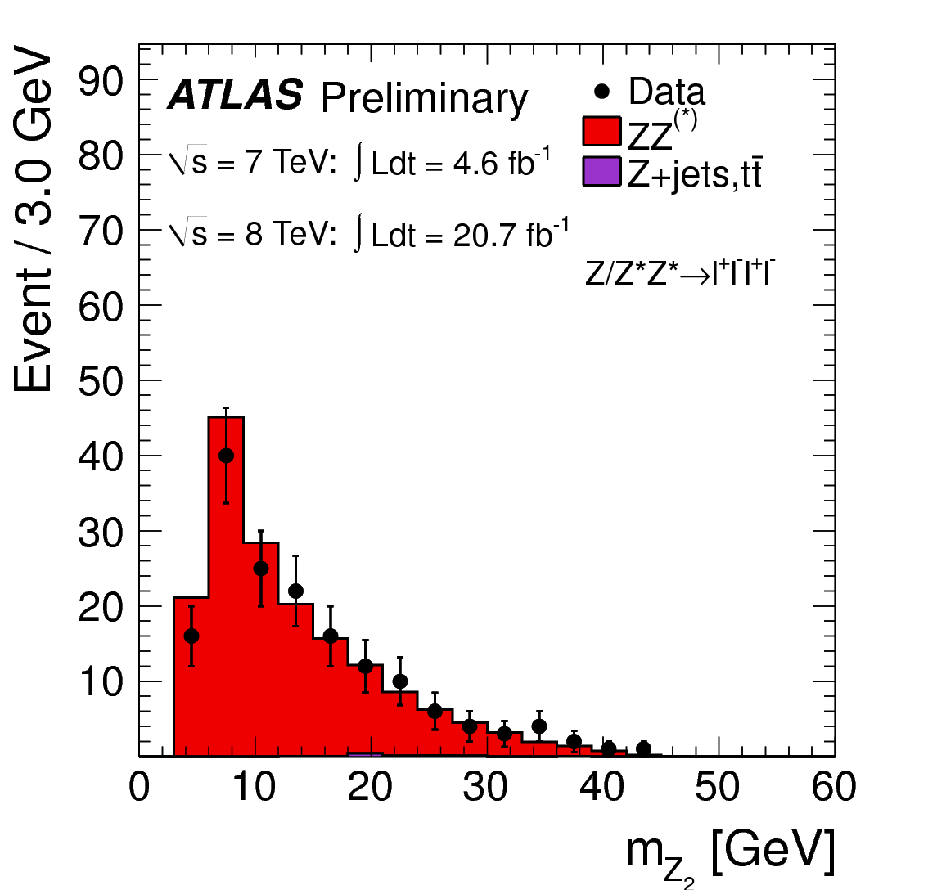
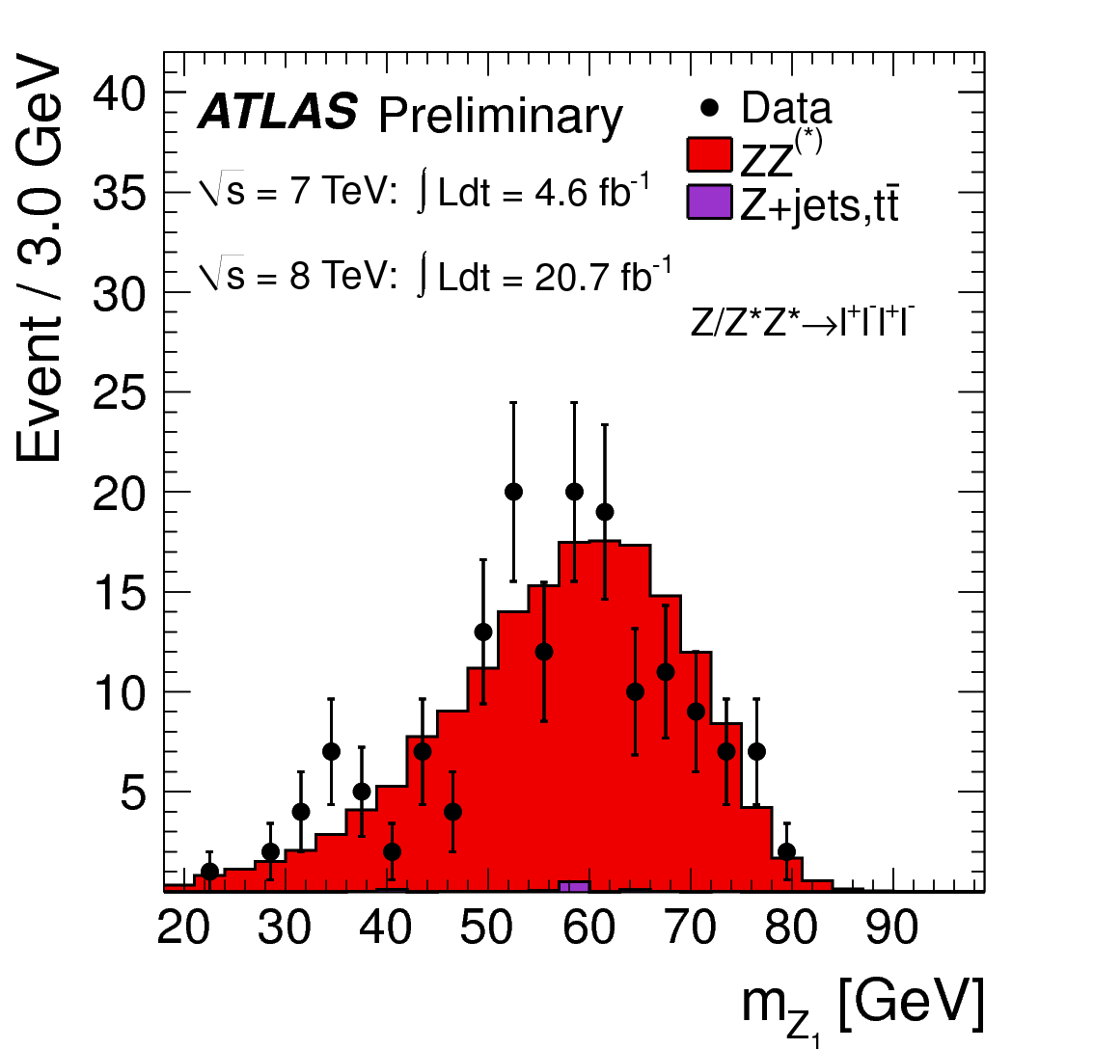
ATLAS Z → 4l signal from 7 TeV & 8 TeV
interesting structure in t-channel
contributes 8% under Z-peak
dominates above ZZ threshold
more than 160 candidates selected
normalize to theoretical Z cross section:

Slide 11
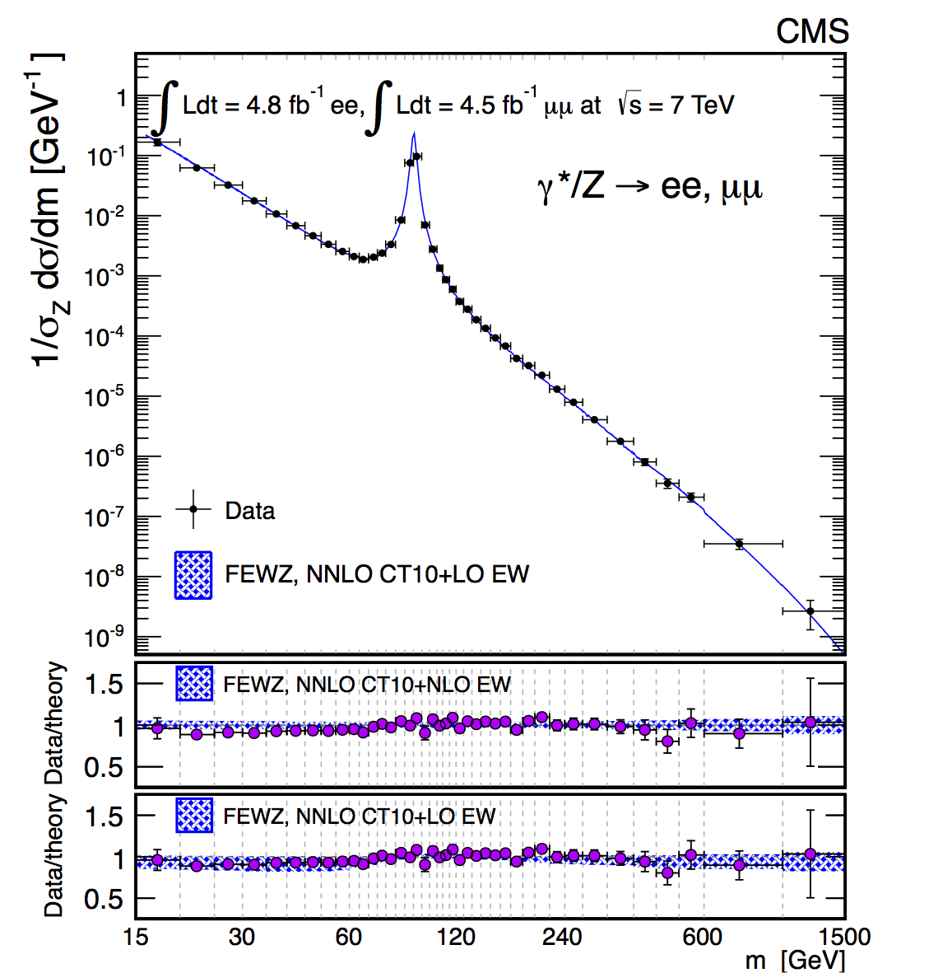
Drell-Yan Production
understood since the 1970s
40 years later, very precise measurements
wide range of mass: wide range of x → constrain PDFs
higher-order corrections needed → tests of theory are still relevant

Slide 12
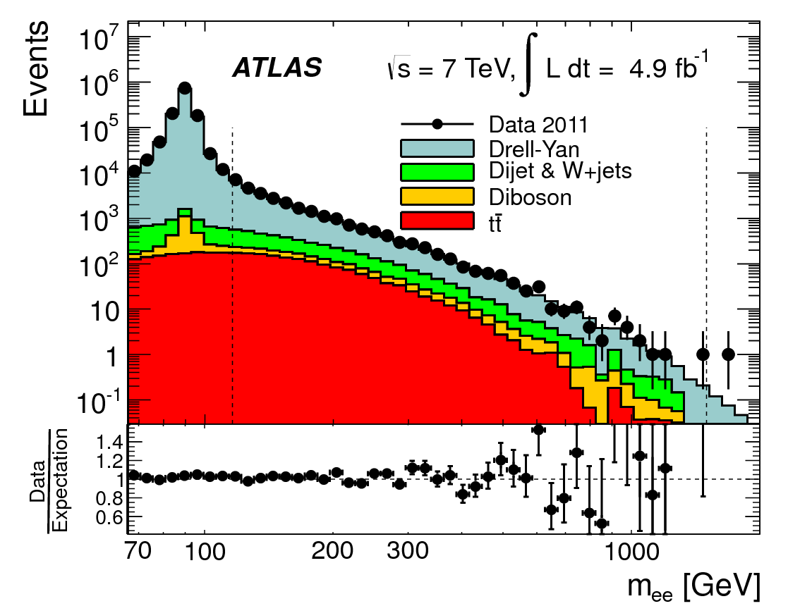
ATLAS published measurements of high-mass Drell-Yan:
high-mass region is amenable to pQCD calculations
note the
scale!
note the
scale!
Phys. Lett. B725 (2013) 223

Slide 13
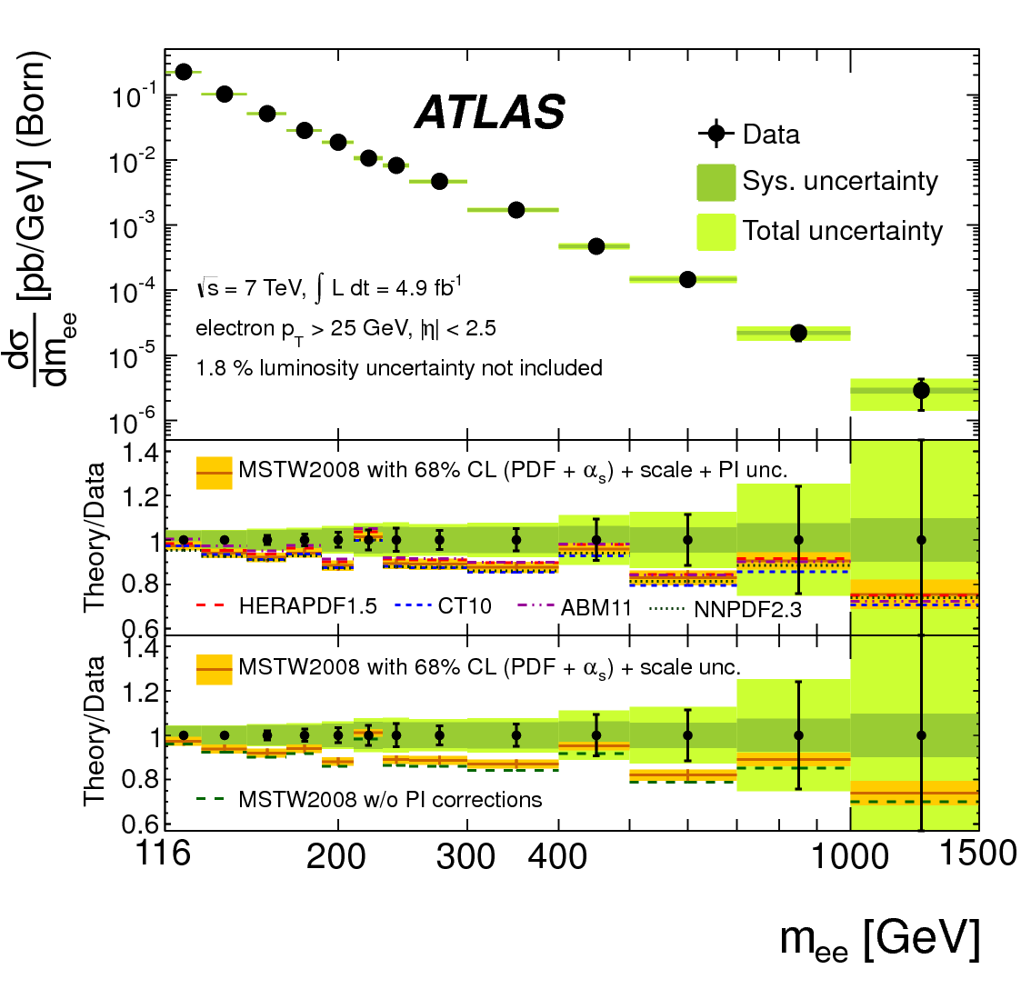
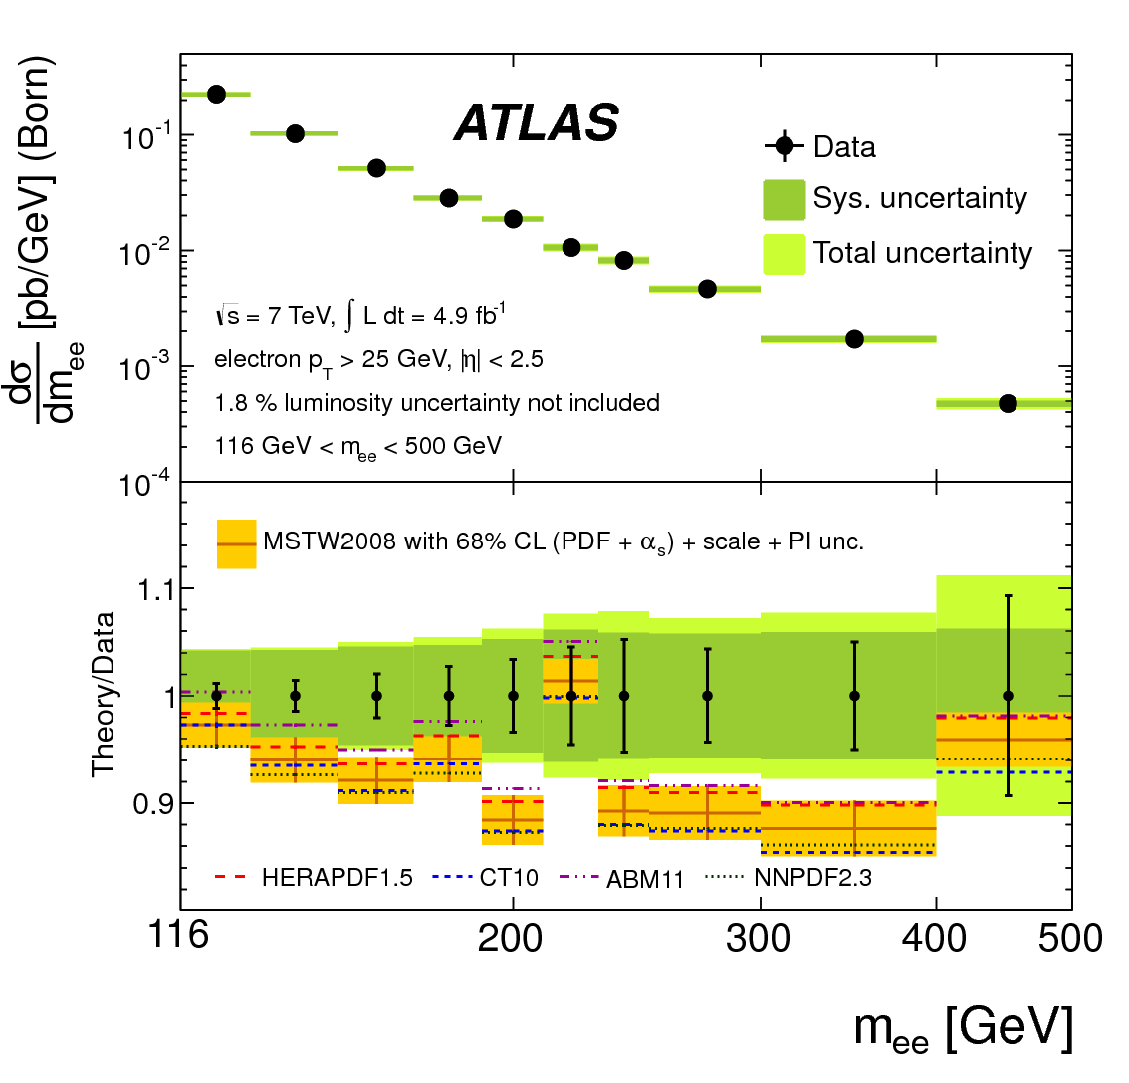
ATLAS published measurements of high-mass Drell-Yan:
high-mass region is amenable to pQCD calculations
sensitive to PDFs – even to q → q+γ splitting (a source of background)
agreement is adequate, though data show excess in 120 < M < 400 range.
Phys. Lett. B725 (2013) 223

Slide 14
CMS has published a double-differential cross section measurement:
The integrated mass distribution is measured in both μ⁺μ⁻ and e⁺e⁻ channels.
8 orders of
magnitude
2 orders of
magnitude
JHEP12 (2013) 030
(Combined e & μ plot shown earlier.)

Slide 15
CMS is publishing a double-differential cross section measurement:
There is enough data to measure dσ/dY in several bins of mass.
Even in this low mass bin,
experimental error bars
about same size as spread
coming from PDFs…
JHEP12 (2013) 030

Slide 16
CMS is publishing a double-differential cross section measurement:
There is enough data to measure dσ/dY in several bins of mass.
Tiny error bars for the Z peak
JHEP12 (2013) 030

Slide 17
CMS is publishing a double-differential cross section measurement:
There is enough data to measure dσ/dY in several bins of mass.
Same mass bin as ATLAS
JHEP12 (2013) 030

Slide 18
CMS is publishing a double-differential cross section measurement:
The lower mass bins show an interesting sensitivity to higher-order corrections:
NNLO
NLO
NLO
NNLO
JHEP12 (2013) 030

Slide 19
CMS is publishing a double-differential cross section measurement:
The lower mass bins show an interesting sensitivity to higher-order corrections:
Closer look at NLO vs NNLO
NLO
NNLO
JHEP12 (2013) 030

Slide 20
Transverse Momentum Distributions
Two regimes:
low – q_{T} : dominated by multi-gluon emission : essentially non-perturbative depends on details of showering scheme gives information on the underlying event two theoretical scales: q_{T} and M which can be very different angular variables – an experimental improvement
high – q_{T} : dominated by one or two hard parton emission: pQCD gluons in initial state start to be important matrix element calculations needed

Slide 21
PRD 85 032002 (2012)
CMS measurements at low and high q_{T} :
7 TeV
disagreement at low – q_{T} indicates need for tuning underlying event model
agreement at high – q_{T} is achieved with FEWZ at O(α²_{S}) …. and POWHEG/PYTHIA/Z2
See also ATLAS: PLB 725 (2013) 223

Slide 22
CMS preliminary measurements:
8 TeV
best overall agreement achieved with ResBos, which uses two scales (q_{T} & M)
agreement at high – q_{T} is achieved with FEWZ at O(α²_{S}) …. and POWHEG/PYTHIA/Z2*
SMP-12-025

Slide 23
CMS compares 7 TeV and 8 TeV directly:
SMP-12-025
Data seem to agree with the prediction from FEWZ but statistical uncertainties are large.

Slide 24
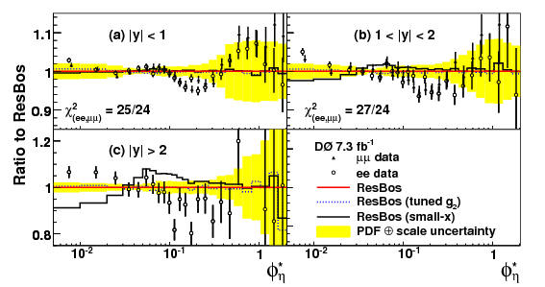
ATLAS has published measurements of a special angular variable:
where:
For a back-to-back configuration, the resolution of q_{T} is not very good.
The quantity φ∗_{η} depends only on the angles of the muon trajectories.
Roughly speaking,
φ∗_{η} → 0.1 corresponds to q_{T} → 10 GeV
The small – q_{T} region is better studied with φ∗_{η} .
PRL 106 122001 (2011)
D published the first study of φ∗_{η}
showing deviations from ResBos
predictions at moderate q_{T}.

Slide 25
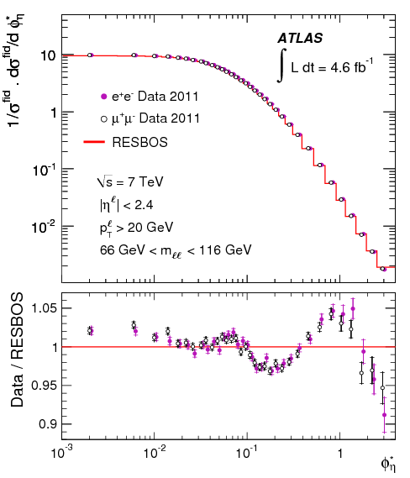
ATLAS has published measurements of a special angular variable:
Phys. Lett. B720 (2013) 32
ATLAS confirms trends seen by D
PRL 106 122001 (2011)
e⁺e⁻ and μ⁺μ⁻ agree very well

Slide 26
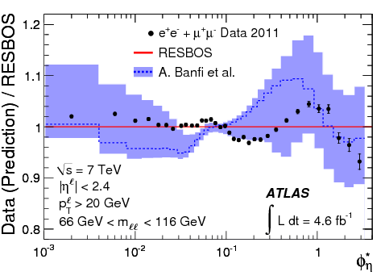
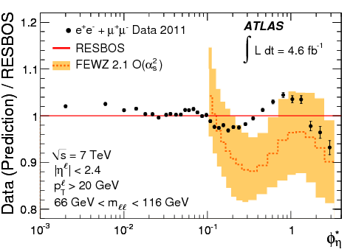
ATLAS comparisons to theoretical predictions:
Phys. Lett. B720 (2013) 32
Banfi et al. [Phys. Lett. B715 (2012) 152]
employ q_{T} – resummation technique
match to fixed-order calculation in MCFM
good results for LHC dσ/dq_{T} data
FEWZ (F. Petriello et al.)
fixed-order (α²_{S})
not good in non-perturbative regime
good agreement with other observables

Slide 27
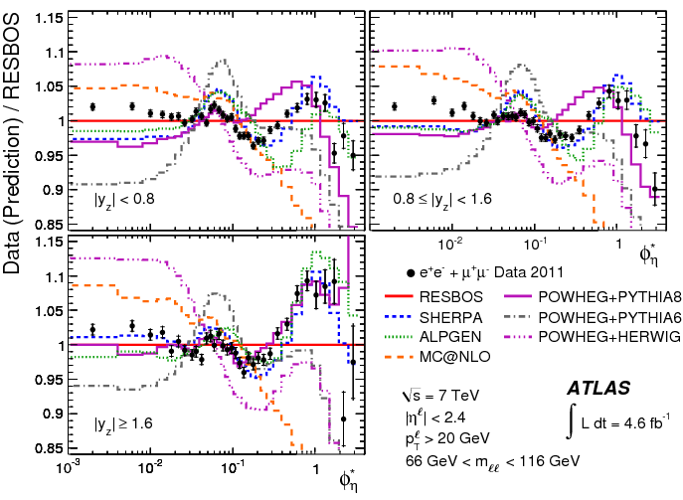
ATLAS comparisons to theoretical predictions in |Y| bins:
Phys. Lett. B720 (2013) 32
SHERPA does best
ALPGEN is OK

Slide 28
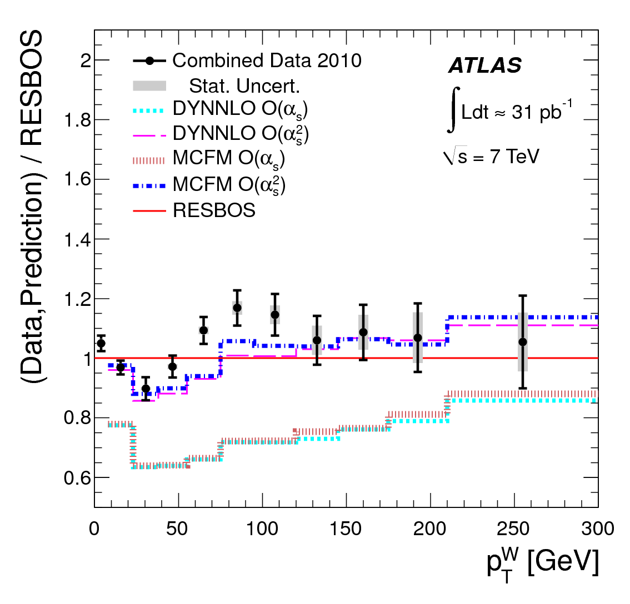
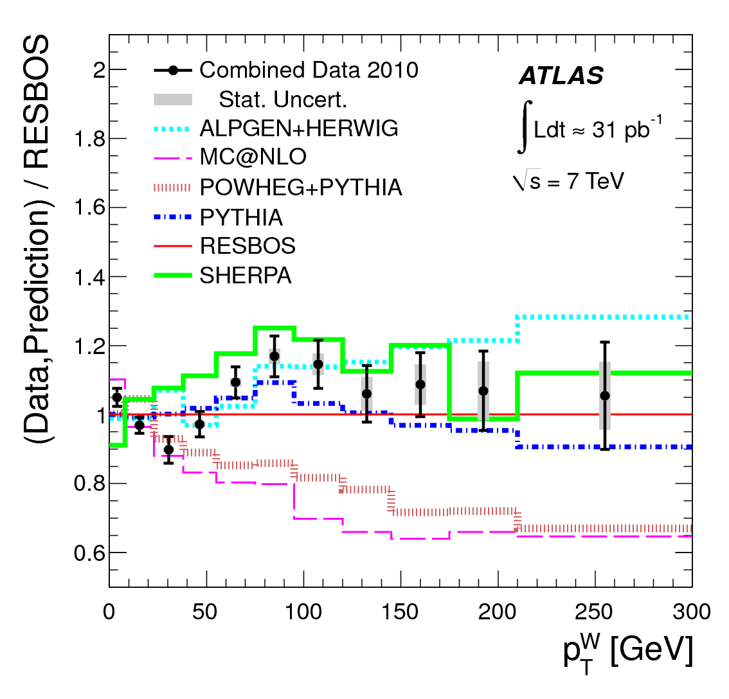
ATLAS have also measured the q_{T} distribution of W bosons:
PRD 85 012005 (2012)
O(α²_{S}) calculation is clearly needed.
SHERPA is OK
ALPGEN does best

Slide 29
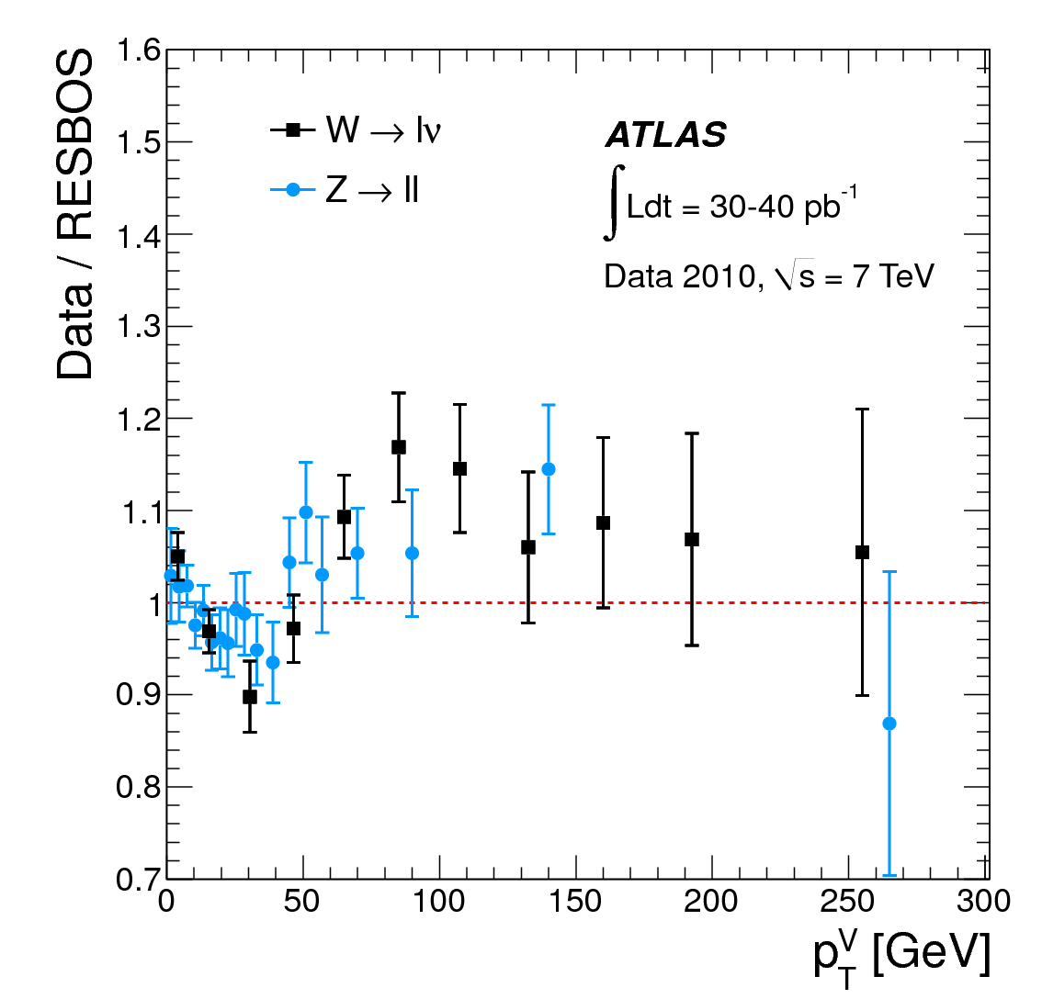
ATLAS have also measured the q_{T} distribution of W bosons:
PRD 85 012005 (2012)
Z clearly confirms the wiggles in the W distribution.

Slide 30
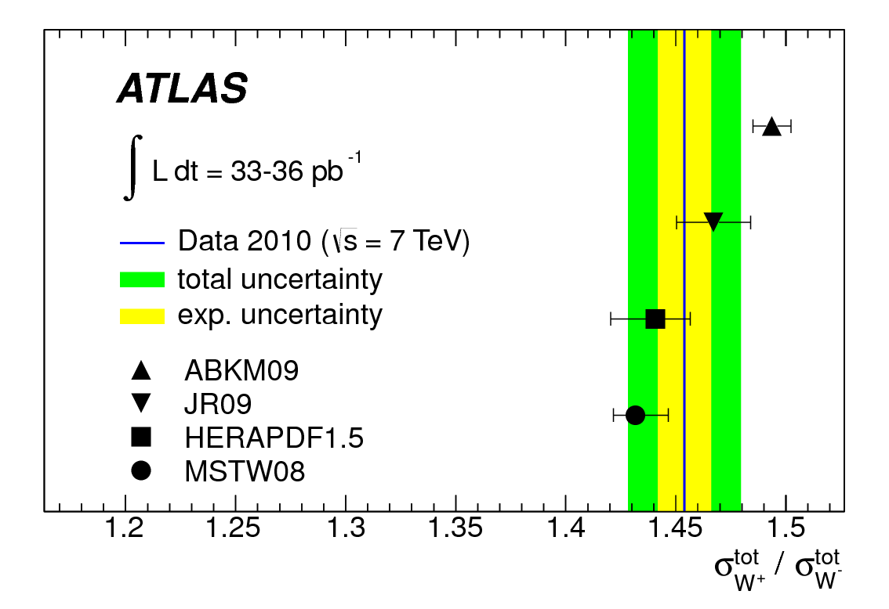
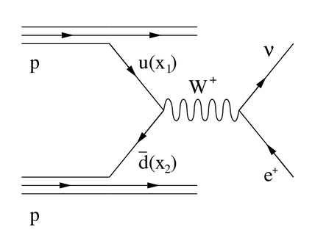
W Charge Asymmetry
More W⁺ are produced than W⁻ because u predominates over d. → possibility to constrain d/u ratio
The asymmetry will be more pronounced at larger Y_{W} (corresponds to larger x) → but Y_{W} is difficult to measure
We can use the lepton η instead of Y_{W} but the asymmetry is more complicated. → and very small errors means dealing with very difficult systematics

Slide 31
D have a new measurement:
There has been tension between CDF & D measurements.
Measurements from p pbar colliders are complimentary.
New D measurements are precise and do not agree with theory.
Interpretation: d/u should be increased.
Phys. Rev. D88 091102(R) (2013)

Slide 32
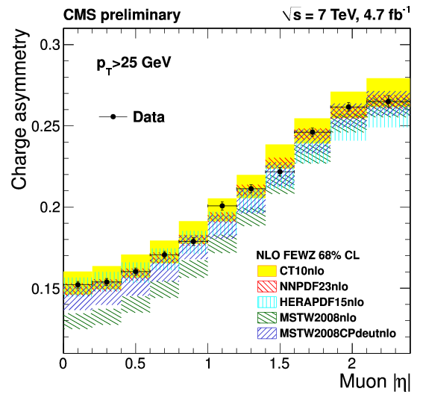
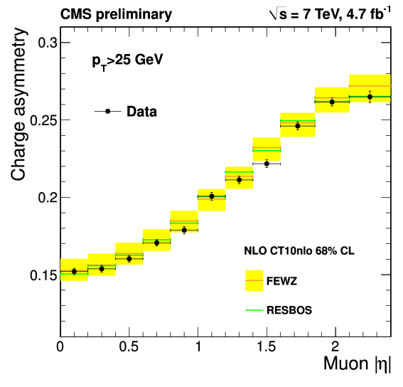
CMS have a new measurement:
arXiv:1312.6283 (submitted)
full data set at 7 TeV, muon channel, p_{T} > 25 GeV, and also p_{T} > 35 GeV
tremendous power to distinguish & constrain PDFs
MSTW2008CPdeut clearly improves upon MSTW2008 but not as good as CT10nlo
FEWZ and RESBOS are equally good at predicting the asymmetry.

Slide 33
LHCb have a made a very nice measurement in the far-forward region:
JHEP1206 (2012) 058
typical CMS & ATLAS region
more negative muons
than positive muons!

Slide 34
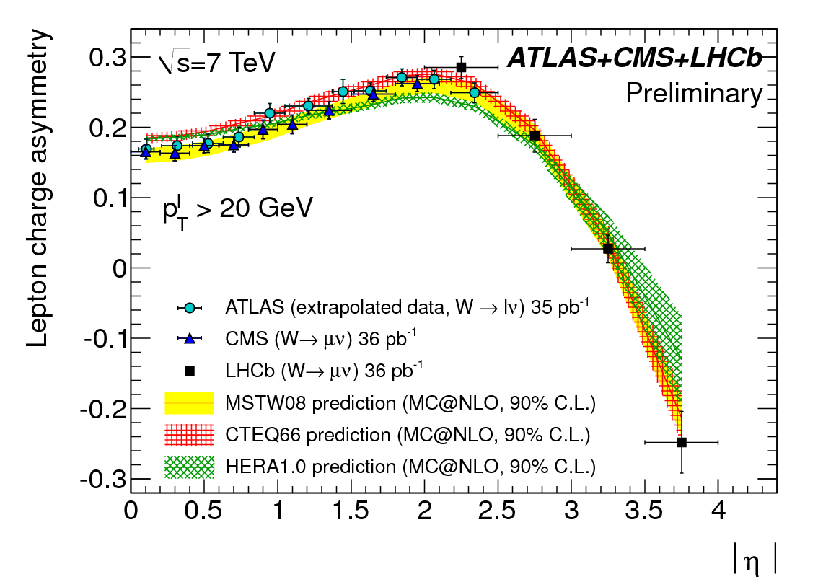
LHCb have a made a very nice measurement in the far-forward region:
JHEP1206 (2012) 058
typical CMS & ATLAS region
(illustrative – LHC working groups plan to do a formally correct combination)

Slide 35
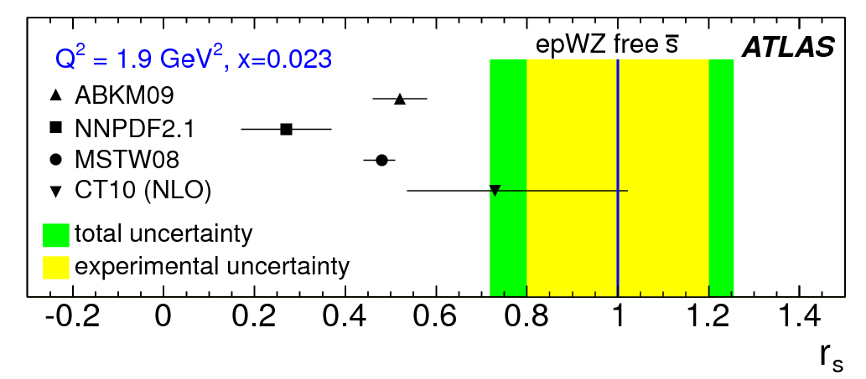
W + charm
A central question in PDFs: is SU(3)_{F} a good symmetry or bad?
xΣ = 2x(ubar+dbar+sbar) cannot be wholly determined by DIS (e.g. F₂)
ν-scattering probes s through W⁺s → c and W⁻sbar → cbar, but results can be difficult to interpret (c-fragmentation, nuclear corrections, etc.)
R_{W} = (W⁺+W⁻)/Z complements DIS b/c couplings are weak, not electromagnetic.
R_{W} is very well measured by ATLAS & CMS (& LHCb)
(e.g. due to s-quark mass)
PRL 109 12001 (2012)
ATLAS inferred relative size of s
from their cross section data:
HERA data + W/Z dσ/dY
flexible PDF parametrization allows s normalization free
quantify s/d contributions:

Slide 36
CMS have measured W+c which gives direct information about s(x).
examine the W⁻ c / W⁺ cbar asymmetry
d→c is Cabibbo-suppressed though d-quarks are relatively plentiful
s→c is Cabibbo-favored and makes a 3% contribution, depending on s(x)
dbar/d constrained by the W charge asymmetry
important to have smallest uncertainties possible
theoretically, ratio is not sensitive to higher-order corrections, but is sensitive to s(x)
reconstruct the charm jet three ways:
exclusive D-meson decays to charged particles
inclusive charm decays to muons
semi-inclusive D-meson decays
key feature: opposite-sign – same-sign (OS-SS) subtraction
removes backgrounds, and removes gluon splitting g → c cbar

Slide 37
CMS: W+c
arXiv:1310.1138 (subm.)
distinct asymmetry is observed & measured precisely (more than 3 s.d. from unity)
theoretical calculations agree well (especially CT10 & NNPDF23coll)
data seem to decline more rapidly with η but not really precise enough yet

Slide 38
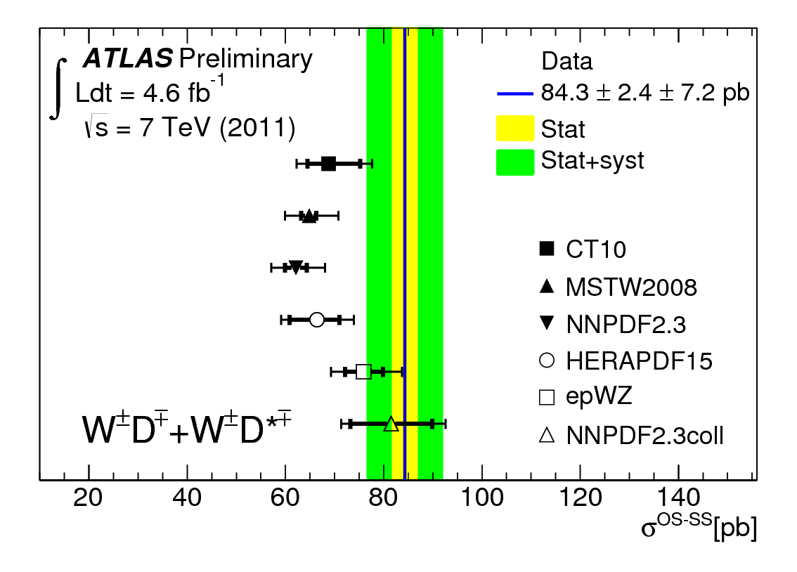
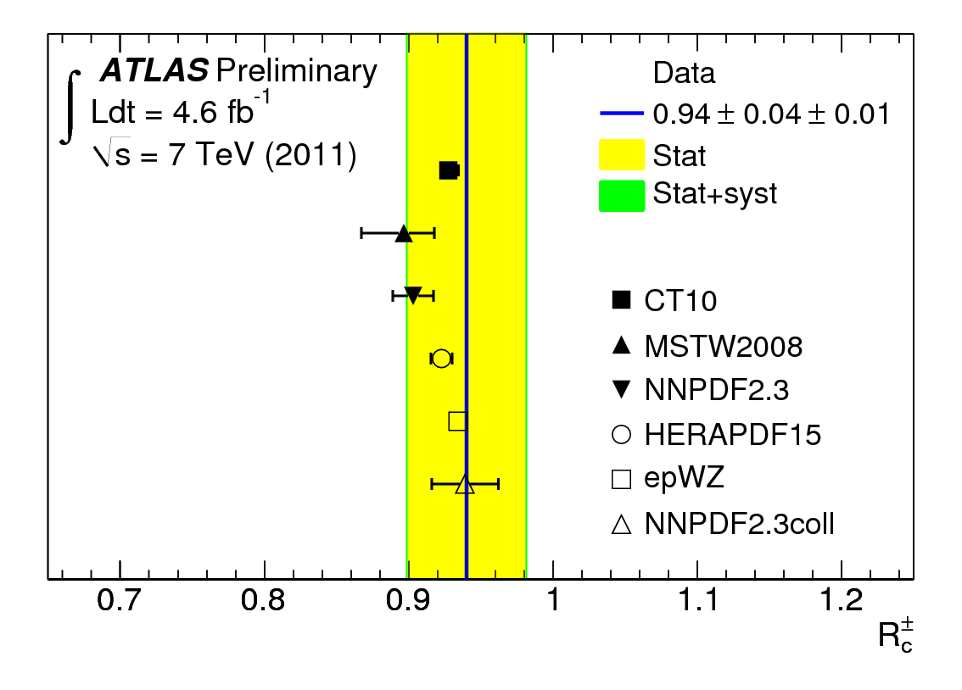
ATLAS has a preliminary measurement:
reconstruct exclusive D-mesons only (in many channels)
ATLAS-CONF-2013-045
conclusions are similar to what CMS found
not yet at the same precision

Slide 39
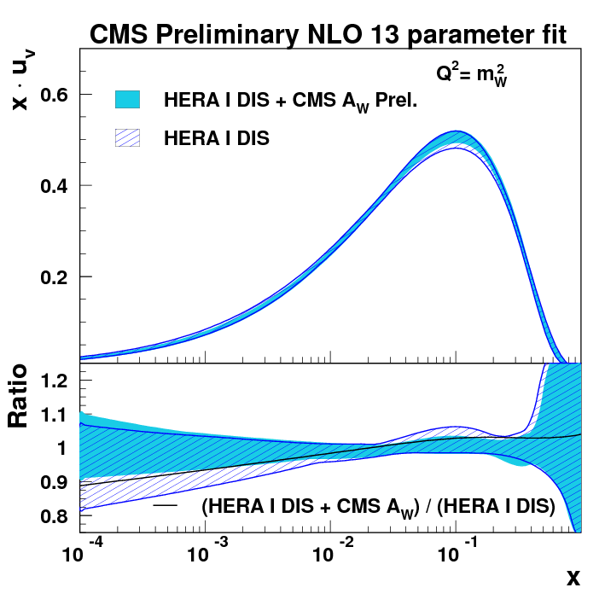
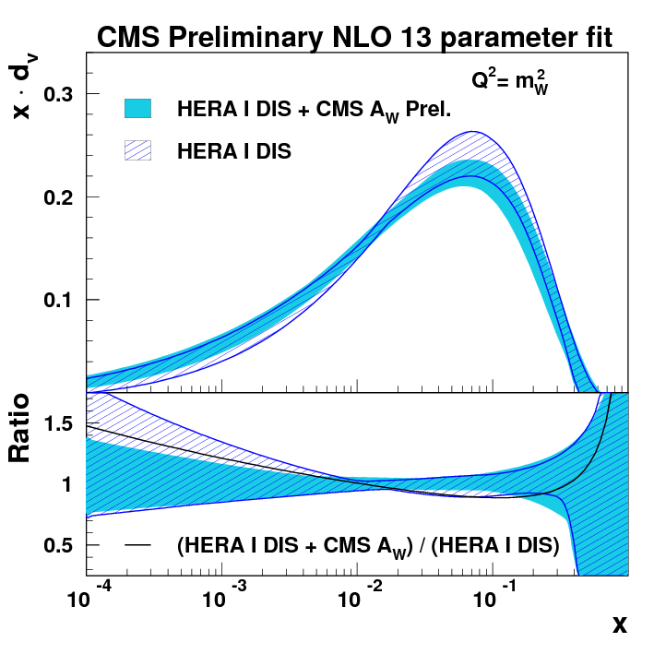
arXiv:1312.6283 (subm. to PRD)
CMS have carried out a QCD analysis to explore PDF constraints:
Use HERA DIS, CMS W asymmetry & CMS W+c data
Like ATLAS, consider fixed-s and free-s fits.
Notice that xd_{v}(x) is reduced. (D data want d/u increased.)

Slide 40
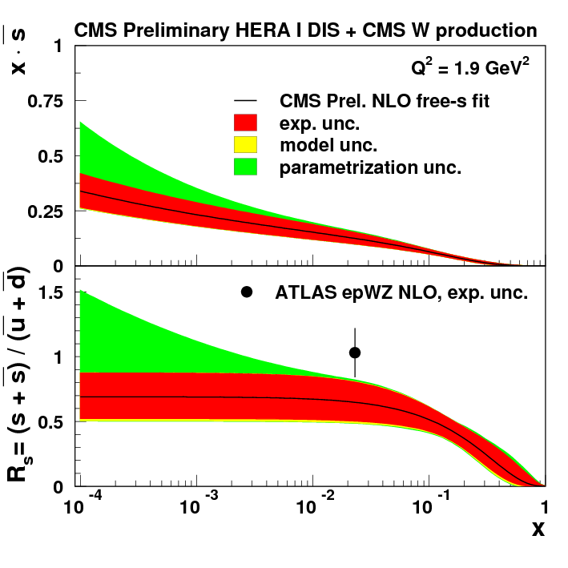
arXiv:1312.6283 (subm. to PRD)
CMS have carried out a QCD analysis to explore PDF constraints:
Maybe some tension between CMS & ATLAS results on s(x) ?
Use HERA DIS, CMS W asymmetry & CMS W+c data
Like ATLAS, consider fixed-s and free-s fits.

Slide 41
Forward-Backward Asymmetry and sin²θ_{W}
well-known tension between “leptonic” and “hadronic” asymmetry measurements.
lead to two very different values for sin²θ_{W}
two most precise values differ by more than 3σ
used to be a problem for estimating the SM Higgs mass.
Clearly, a new measurements with an uncertainty of 0.0002 or better would be very useful.
Phys. Rep. 427 (2006) 257

Slide 42
CMS reported the first measurement of sin²θ_{W} at the LHC:
innovative: make full use of the Drell-Yan leading-order matrix element (in the past people used only A_{FB})
A_{FB} is relatively weak at a pp collider because there is no clear “forward” direction - one resolves the q direction on a statistical basis: - the longitudinal direction of the Z indicates the likely q direction.
The use of the full matrix element squeezes the most information and helps deal with the forward/backward direction ambiguity (“dilution”)
Gain is about 20% with respect to A_{FB} alone.
This is a “demonstration” measurement.
5 fb⁻¹ at 7 TeV, μ⁺μ⁻ only
significant systematic uncertainty due to NLO corrections, momentum resolution and mis-alignment
speculate that systematic uncertainty could be pushed down to 0.0010?
Phys. Rev. D84 112002 (2011)

Slide 43
CMS did measure A_{FB} in an independent analysis:
combine e⁺e⁻ and μ⁺μ⁻
more than 1M events
subtract backgrounds, unfold (F and B separately), correct for dilution…
four bins of rapidity Y
any signs of a deviation at high M?
Phys. Lett. B718 (2013) 752

Slide 44
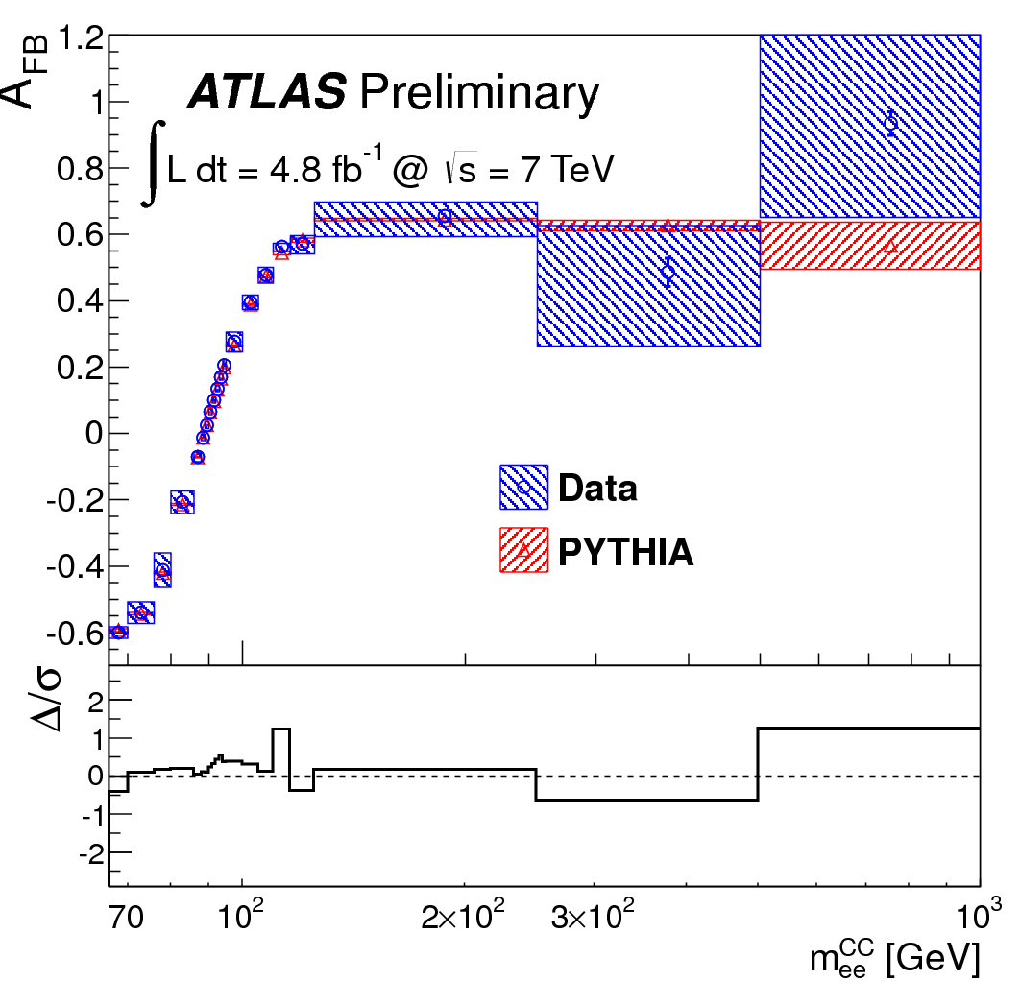
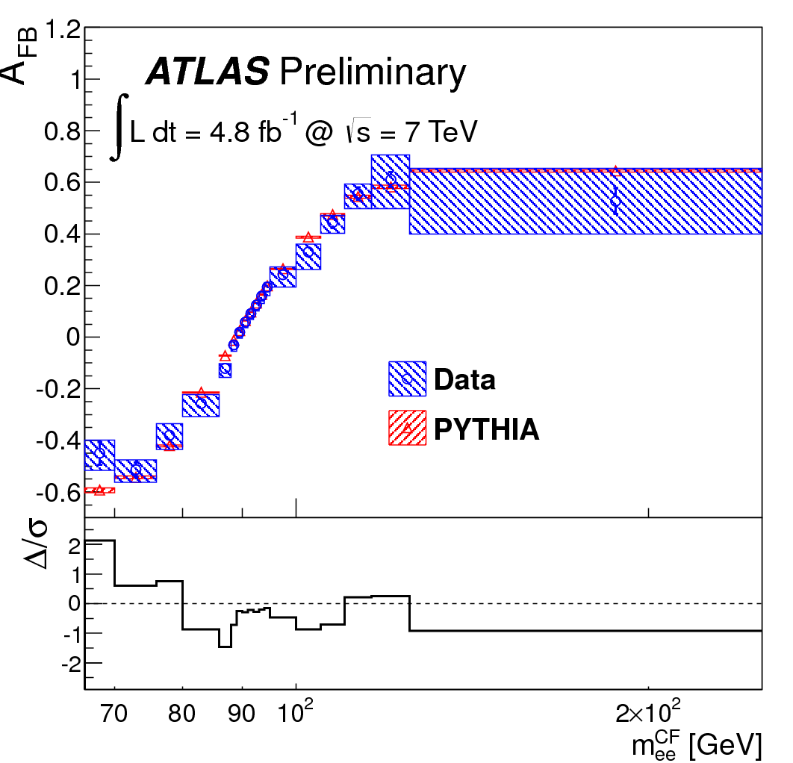
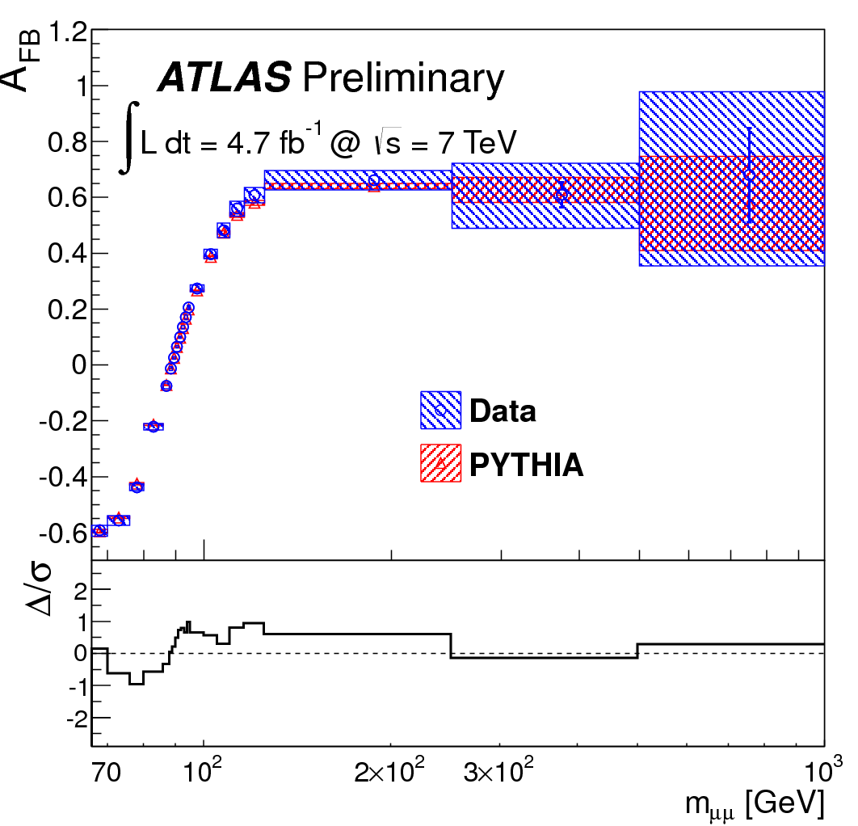
ATLAS-CONF-2013-043
New preliminary ATLAS measurement of A_{FB} and sin²θ_{W}
same approach as CMS and the Tevatron experiments
5 fb⁻¹ at 7 TeV, both e⁺e⁻ and μ⁺μ⁻
unfold and correct
CC
CF
μμ
not-quite-perfect agreement…

Slide 45
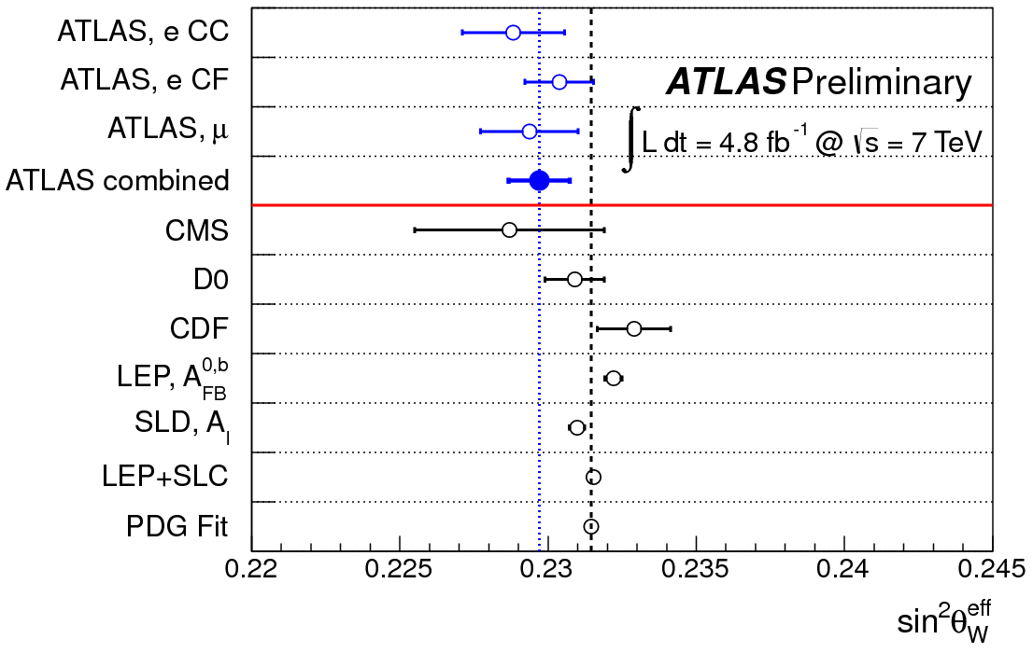
ATLAS-CONF-2013-043
New preliminary ATLAS measurement of A_{FB} and sin²θ_{W}

Slide 46
Di-boson Production and Triple-Gauge Couplings
In SM, non-Abelian SU(2) group implies weak-boson self-interactions.
Tree-level unitarity requires the SM values for triple-gauge couplings.
Good theoretical high-energy behavior is one of the successes of spontaneously-broken symmetries.
Any deviation in trilinear couplings disturbs the subtle cancelations in the interference of scattering amplitudes, leading to observable effects.
Nice demonstration
from LEP:
e⁺e⁻ → W⁺W⁻
Not unitary without
ZWW vertex.
Phys. Rep. 532 (2013) 119

Slide 47
Anomalous Vγ couplings
New Physics shows up through virtual effects: modification to TGCs.
These modifications are termed “anomalies” because the TGCs are fully determined in the SM.
Virtual effects arise when new particles are much heavier than the laboratory energy scale; they are not produced on mass shell.
Effective Lagrangian approach is appropriate.
If New Physics is weakly-coupled then deviations from SM will be linear in the fields.
Strongly-coupled interactions can also be considered but are not indicated by the known properties of the Higgs boson.
Ground rule: these radiative corrections to SM TGCs should be numerically small and not overwhelm the tree-level cross sections.

Slide 48
Anomalous couplings
New Physics shows up through virtual effects: modification to TGCs.
These modifications are termed “anomalies” because the TGCs are fully determined in the SM.
Virtual effects arise when new particles are much heavier than the laboratory energy scale; they are not produced on mass shell.
Effective Lagrangian approach is appropriate.
If New Physics is weakly-coupled then deviations from SM will be linear in the fields.
Strongly-coupled interactions can also be considered but are not indicated by the known properties of the Higgs boson.
Ground rule: these radiative corrections to SM TGCs should be numerically small and not overwhelm the tree-level cross sections.
Any anomalous TGC will destroy unitarity.
In the past, people introduced ad hoc form factors.
This should happen when close to producing new particle on shell.
Effective Lagrangians are not meant to control unitarity close to resonances.
LHC Collaborations are moving away from form factors.

Slide 49
Wγ and Zγ Production
largest and cleanest yields
direct access to Vγ vertices (V = W, Z)
ISR FSR TGC
reconstruct W → eν and μν ; Z → ee, μμ, νν .
photon is isolated and energetic
an anomalous VVγ coupling would lead to an excess of photons at high p_{T}
ATLAS performs analysis in N_{jet} = 0 “exclusive” channel – increases sensitivity

Slide 50
CMS Vγ cross section measurements:
arXiv:1308.6832 (subm. PRD)
Notice that Wγ values are slightly high, while Zγ values are exactly as predicted…

Slide 51
Compare CMS & ATLAS Vγ cross section measurements:
ATLAS
Phys. Rev. D87 112003 (2013)
channel | ratio data/theory
W γ | 1.41 ± 0.22
Z γ (l⁺l⁻) | 1.11 ± 0.10
Z γ (νν) | 0.85 ± 0.17
CMS
arXiv:1308.6832 (subm. PRD)
channel | ratio data/theory
W γ | 1.16 ± 0.14
Z γ (l⁺l⁻) | 0.98 ± 0.07
Z γ (νν) | 0.96 ± 0.28
similar trend in both sets of measurements – but not significant according to the errors
total error precludes claiming any anomaly, but
ATLAS main systematic uncertainty is photon efficiency: 6%
CMS main uncertainty is bg estimate (10%) and signal modeling (5%)
treatment of systematic uncertainties is very different – working together will be fruitful

Slide 52
Compare CMS & ATLAS Vγ cross section measurements:
ATLAS
Phys. Rev. D87 112003 (2013)
channel | ratio data/theory
W γ | 1.41 ± 0.22
Z γ (l⁺l⁻) | 1.11 ± 0.10
Z γ (νν) | 0.85 ± 0.17
CMS
arXiv:1308.6832 (subm. PRD)
channel | ratio data/theory
W γ | 1.16 ± 0.14
Z γ (l⁺l⁻) | 0.98 ± 0.07
Z γ (νν) | 0.96 ± 0.28
Ratio (Wγ/Zγ) is
5.8 ± 0.1 [MCFM]
6.9 ± 0.5 [CMS]
similar trend in both sets of measurements – but not significant according to the errors
total error precludes claiming any anomaly, but
ATLAS main systematic uncertainty is photon efficiency: 6%
CMS main uncertainty is bg estimate (10%) and signal modeling (5%)
treatment of systematic uncertainties is very different – working together will be fruitful

Slide 53
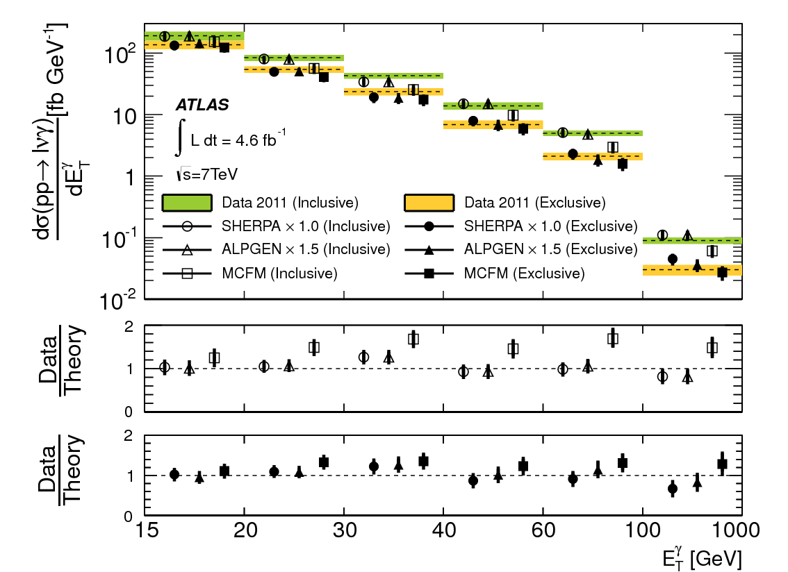
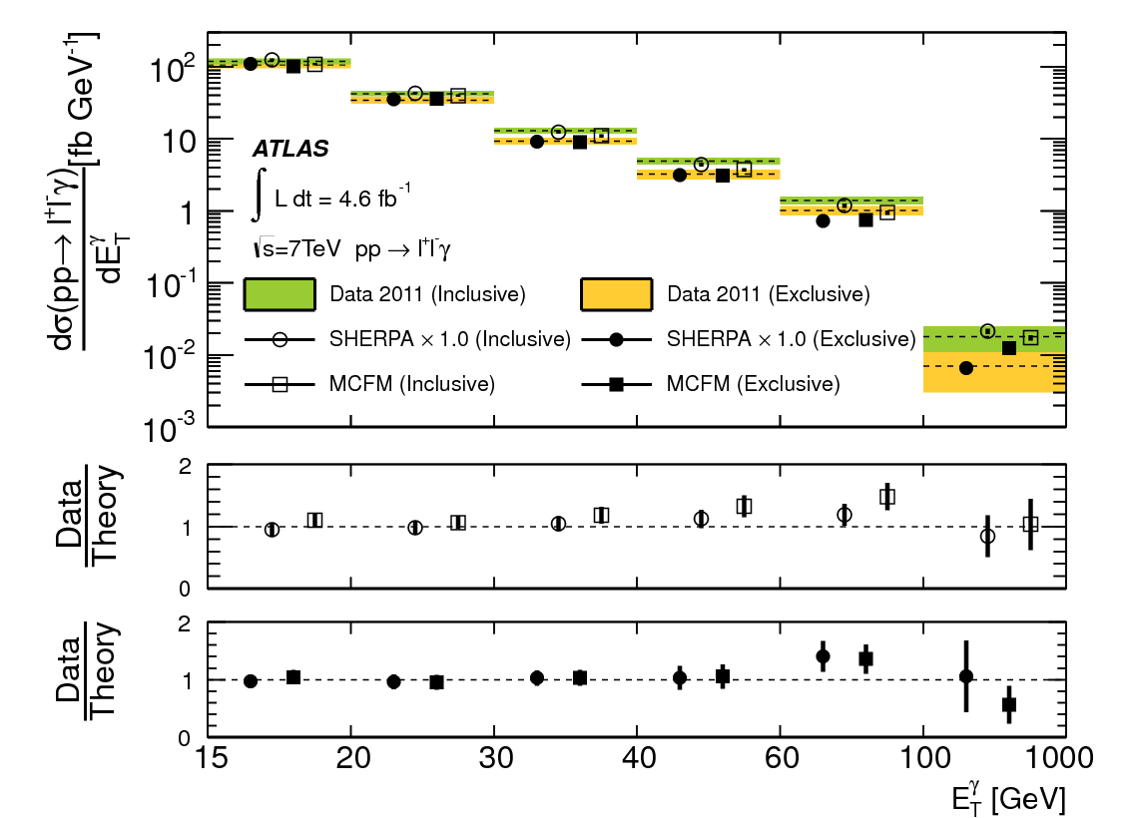
ATLAS Vγ cross section measurements:
Phys. Rev. D87 112003 (2013)
Note the theoretical predictions have been renormalized.
These plots compare the shape of the photon p_{T} spectrum.
Green “inclusive” means any number of jets Orange “exclusive” means no jets.
Theory reproduces the distributions within errors.
[ATLAS reports other measurements: N_{jets} , Vγ invariant mass]

Slide 54
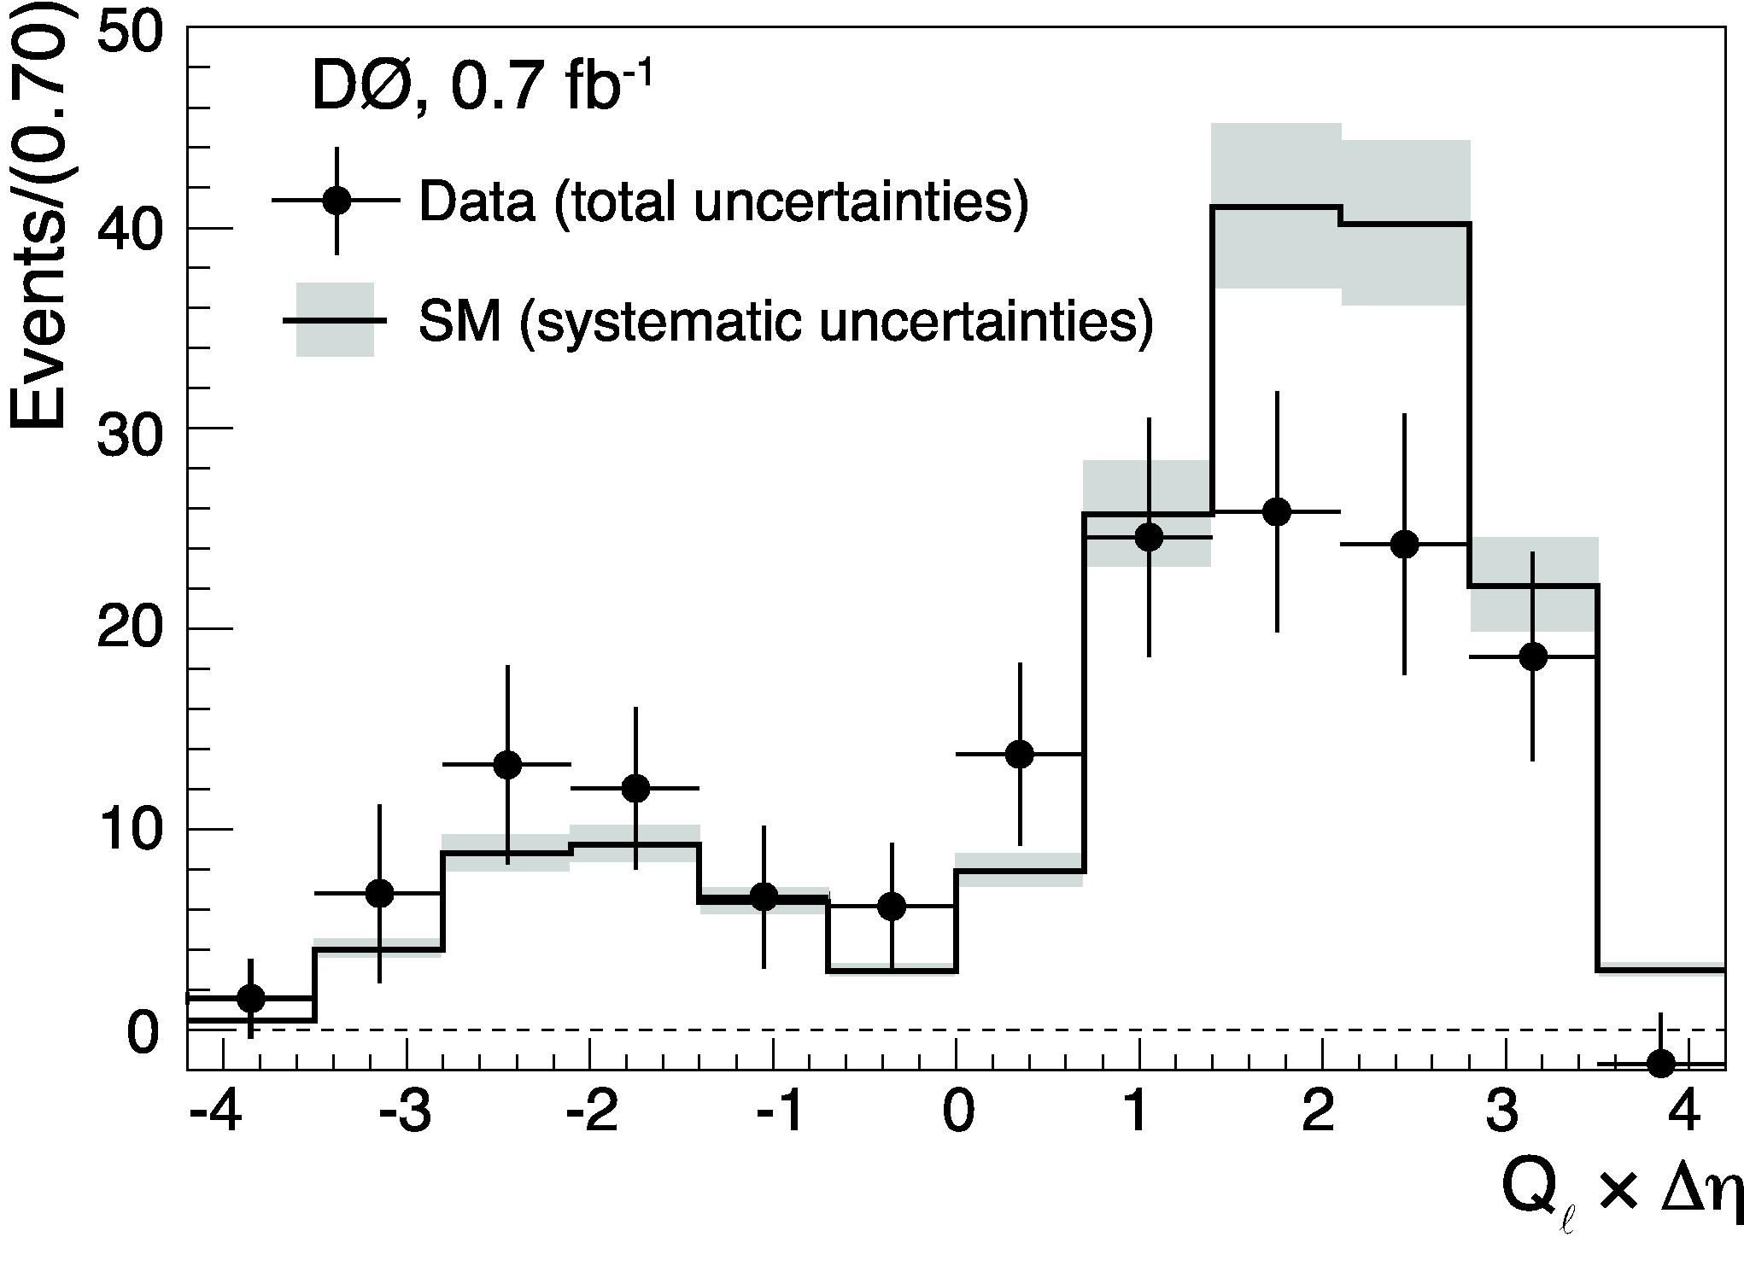
CMS investigated the “radiation zero”
ISR FSR (a)TGC
Three diagrams interfere to give zero amplitude for certain kinematic configurations.
First observed by D Collaboration (2008).
Since 3rd amplitude depends on TGC, an anomalous value will remove the zero.
In practice, detector resolution smears the point of zero amplitude, and one sees a dip.
Phys. Rev. Lett. 100 241805 (2008)

Slide 55
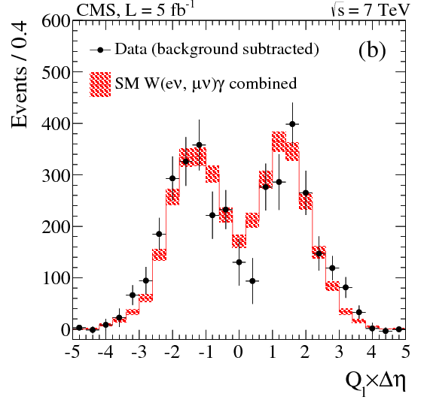
CMS investigated the “radiation zero”
ISR FSR (a)TGC
Three diagrams interfere to give zero amplitude for certain kinematic configurations.
First observed by D Collaboration (2008).
Since 3rd amplitude depends on TGC, an anomalous value will remove the zero.
In practice, detector resolution smears the point of zero amplitude, and one sees a dip.
arXiv:1308.6832 (subm. PRD)
Phys. Rev. Lett. 100 241805 (2008)

Slide 56
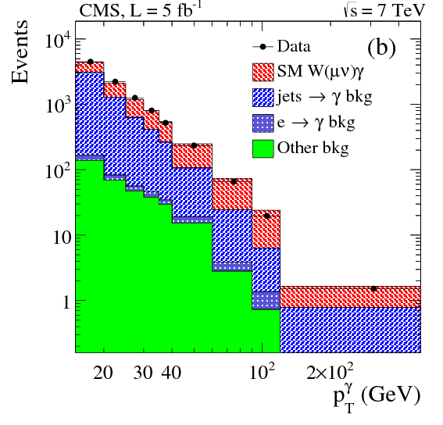
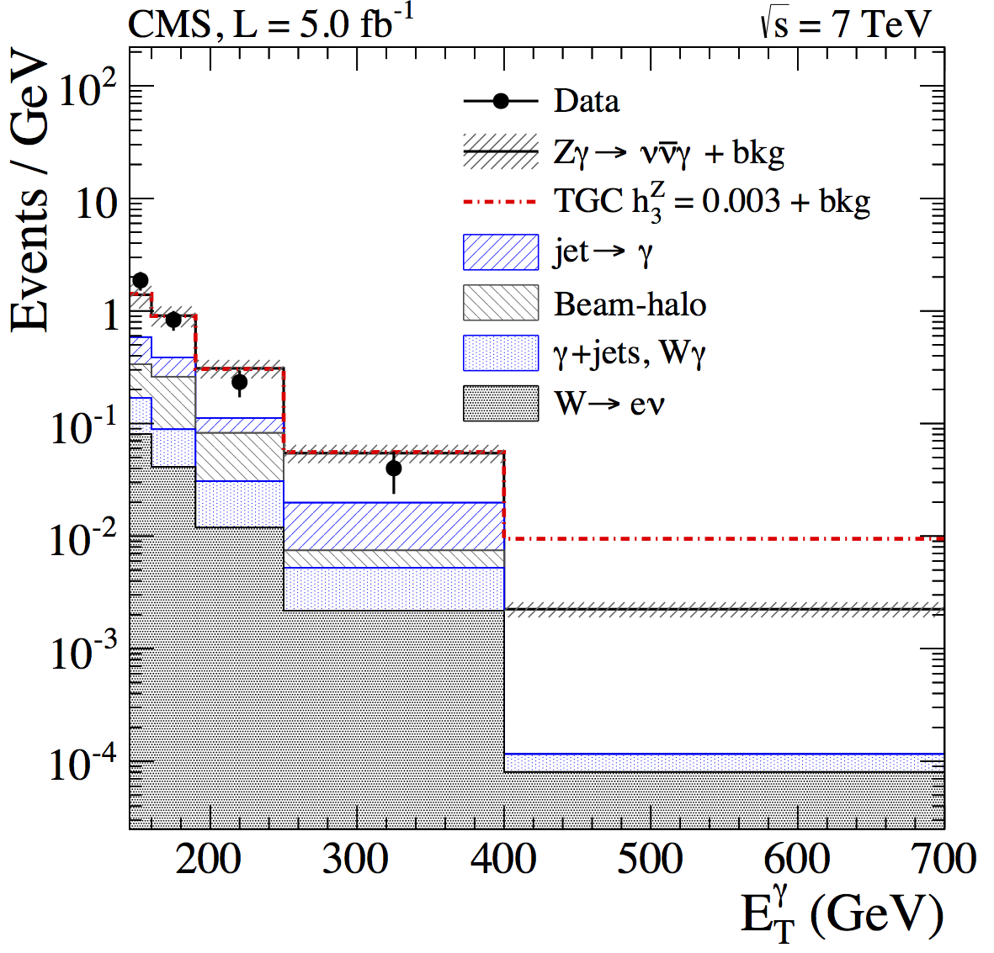
Anomalous Vγ couplings
Fit to p_{T} distribution (primarily of photon)

Slide 57
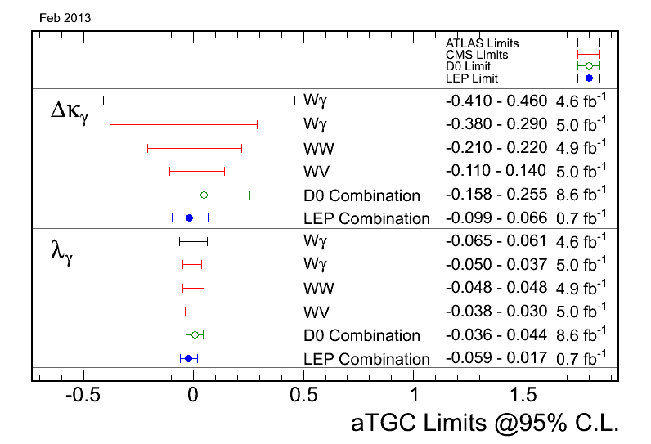
Anomalous Vγ couplings
parameters for deviations from SM values WWγ

Slide 58
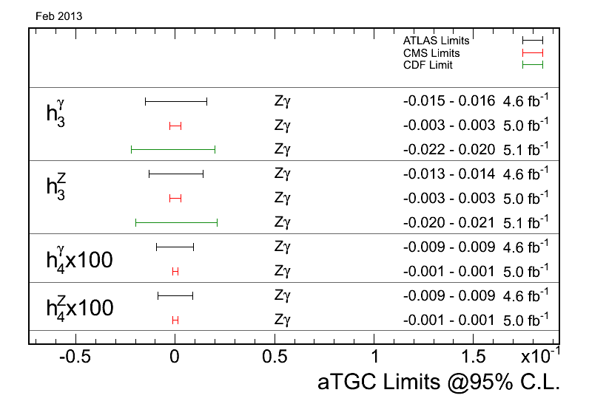
Anomalous Vγ couplings
parameters for deviations from SM values ZZγ

Slide 59
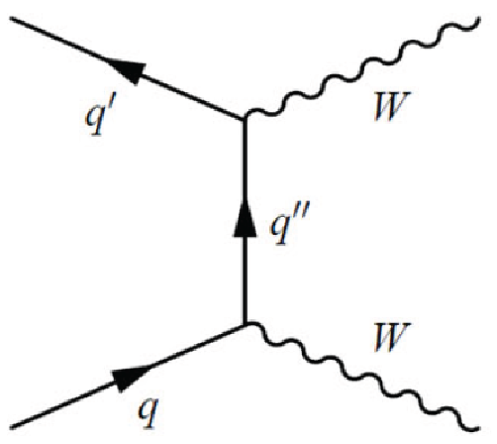
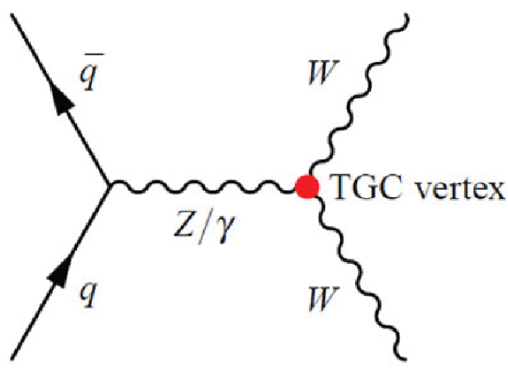
WW, WZ and ZZ Production
approach is conceptually the same as Vγ
clean samples based on leptonic decays (These channels are important in studies of the Higgs boson)
other channels with neutrinos or jets are less potent
anomalous TGC will appear at high p_{T}
fit the lepton p_{T} for the WW channel
fit the Z-boson p_{T} for the WZ channel

Slide 60
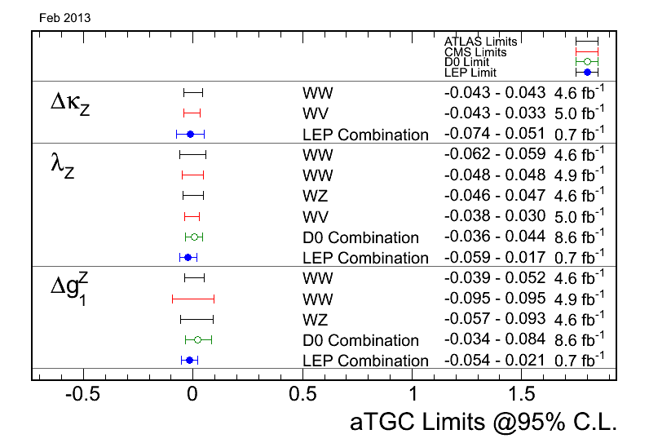
Anomalous WV couplings
parameters for deviations from SM values WWZ

Slide 61
Anomalous ZZ couplings
parameters for deviations from SM values ZZZ,ZZγ

Slide 62
Conclusion
This summary is woefully incomplete – I regret I could not cover more.
Nonetheless, the vista of Electroweak Physics at the LHC is grand, with many interlocking pieces and many puzzles to be solved.
Now, at the end of Run I, the LHC Collaborations should intensify their efforts on SM measurements and studies, for these will be a legacy for the future, and cannot be done elsewhere.
Many many thanks to the organizers!

Slide 63
Conclusion
This summary is woefully incomplete – I regret I could not cover more.
Nonetheless, the vista of Electroweak Physics at the LHC is grand, with many interlocking pieces and many puzzles to be solved.
Now, at the end of Run I, the LHC Collaborations should intensify their efforts on SM measurements and studies, for these will be a legacy for the future, and cannot be done elsewhere.
Many many thanks to the organizers!
“The creation of Physics is the shared heritage of all mankind.
East and West, North and South have equally participated in it.”
- Abdus Salam

