Slide 1
The Discovery of
THE HIGGS BOSON
Why is it Exciting?
Michael Schmitt
Staff Seminar
January 24, 2013

Slide 2


Slide 3
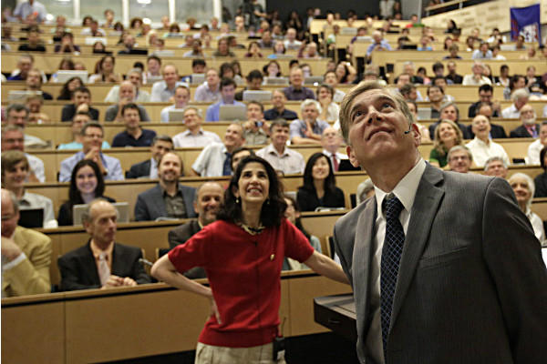

Slide 4
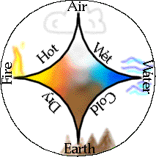
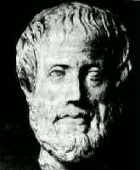
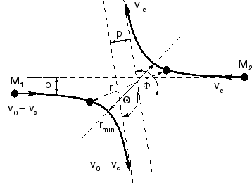
What is Particle Physics?
Aristotle believed the all the world was
made from four elements: Earth, Air, Water & Fire.
Today we know this is wrong.
We believe that matter is made of fundamental particles,
and we study the ways that they interact with each other.
This is particle physics.

Slide 5
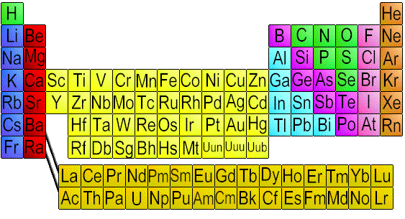
What are the Particles?
The Periodic Table of the elements helped chemists
elucidate the building blocks of compounds.

Slide 6
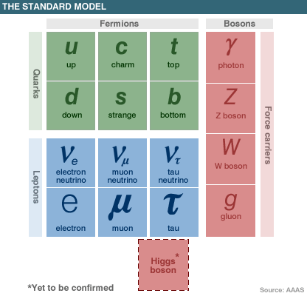
What are the Particles?
Our table of particles
has fewer entries.
There are “matter particles”
and “force particles.”
The Higgs Boson is in a
category all by itself.

Slide 7
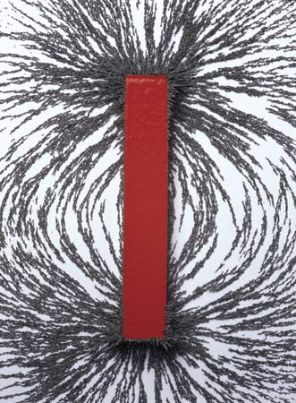
What are Fields?
Electric fields and magnetic fields
are common.
Fields mediate the forces between
the fundamental particles.
Four force carriers for three forces
(electromagnetic, weak & strong – not gravity).
The Higgs field is special – it gives mass.

Slide 8
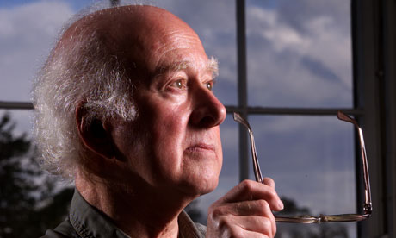
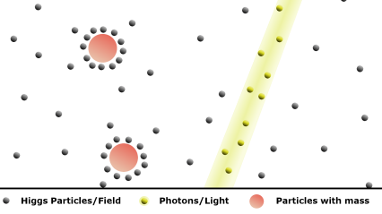
How does the Higgs give Mass?
This Higgs field is everywhere.
Most particles interact with the Higgs field.
These interactions give the particles mass.
Peter Higgs

Slide 9

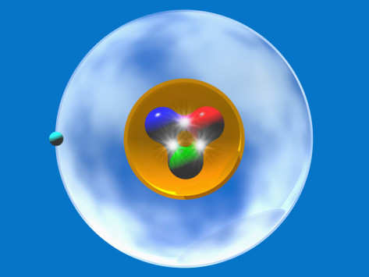
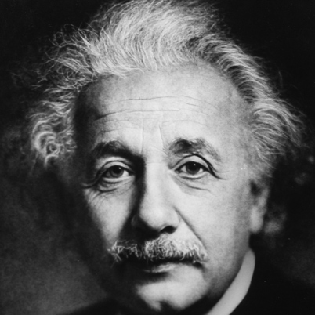
Is this All of the Mass?
The Higgs field gives mass to the
fundamental particles.
The Universe consists mainly of electrons, protons and
dark matter particles.
Protons consist of quarks that get their mass from Higgs,
but most of the mass of a proton comes from energy.
We don’t know where mass of dark matter comes from…

Slide 10
the atom
More about Mass
electron
An atom has a nucleus
made of protons and neutrons
and electrons in shells.
Without the Higgs field, the
electron would have no mass and
would not orbit around the nucleus.
So there would be no atom, and no “us” !
proton with quarks inside

Slide 11
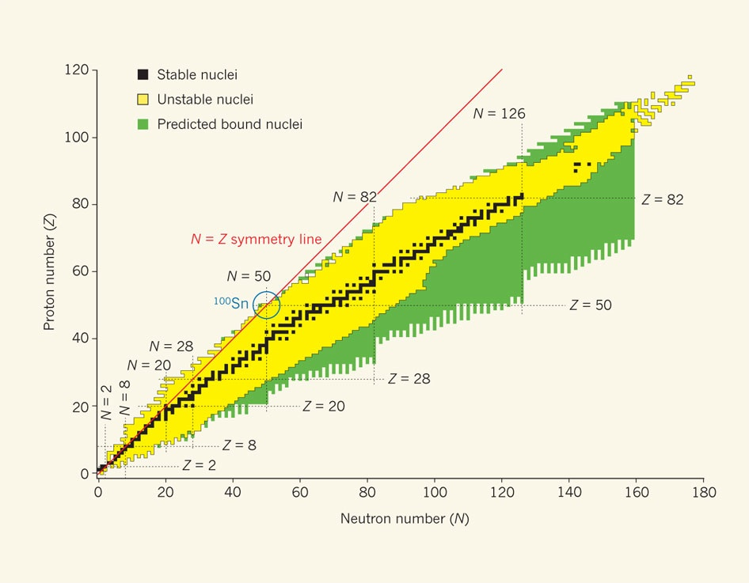
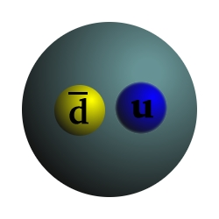
elements of Nature
More about Mass
Furthermore, complex nuclei
require pions to keep protons
and neutrons sticking together.
The pion’s mass is crucial for this “nuclear force.”
The quark masses are important
for the pion mass and other properties.
The Higgs boson gives the quarks their mass.
pion with quarks inside

Slide 12

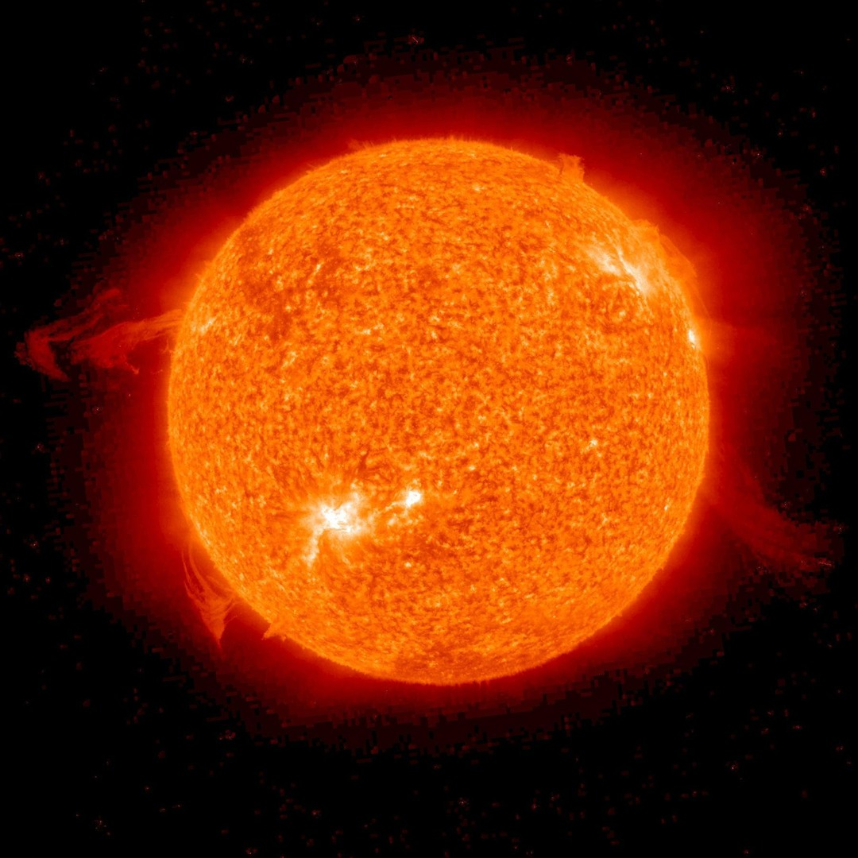
More about Pions and the Sun
The pions decay – their quarks annihilate.
Similar processes go on in the Sun.
The W bosons make this happen.
No Higgs,
No W bosons,
No nuclear fusion →
the Sun would be dead!

Slide 13
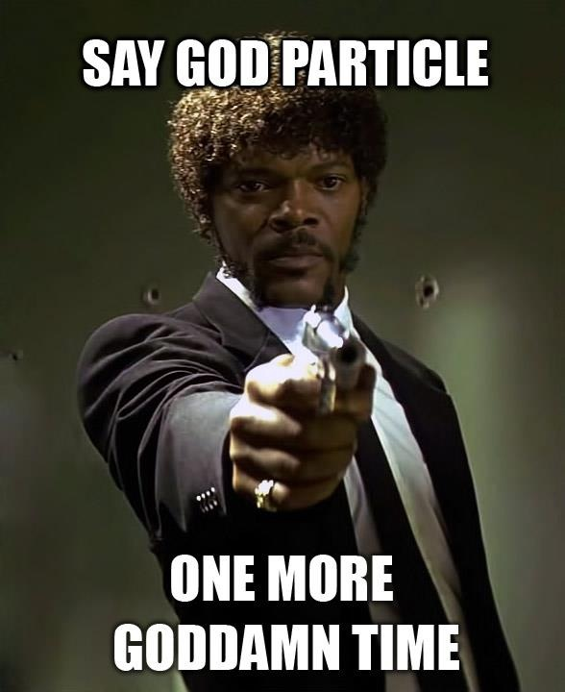

Slide 14

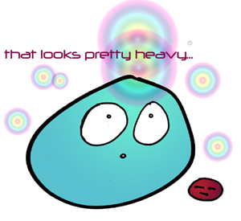
How do we see the Higgs Boson?
The Higgs particle is an excitation or perturbation of
the Higgs field.
We can cause this excitation
with energy.
High-energy collisions of protons will sometimes produce
a massive particle – like the Higgs boson.
p
energy → mass
p

Slide 15

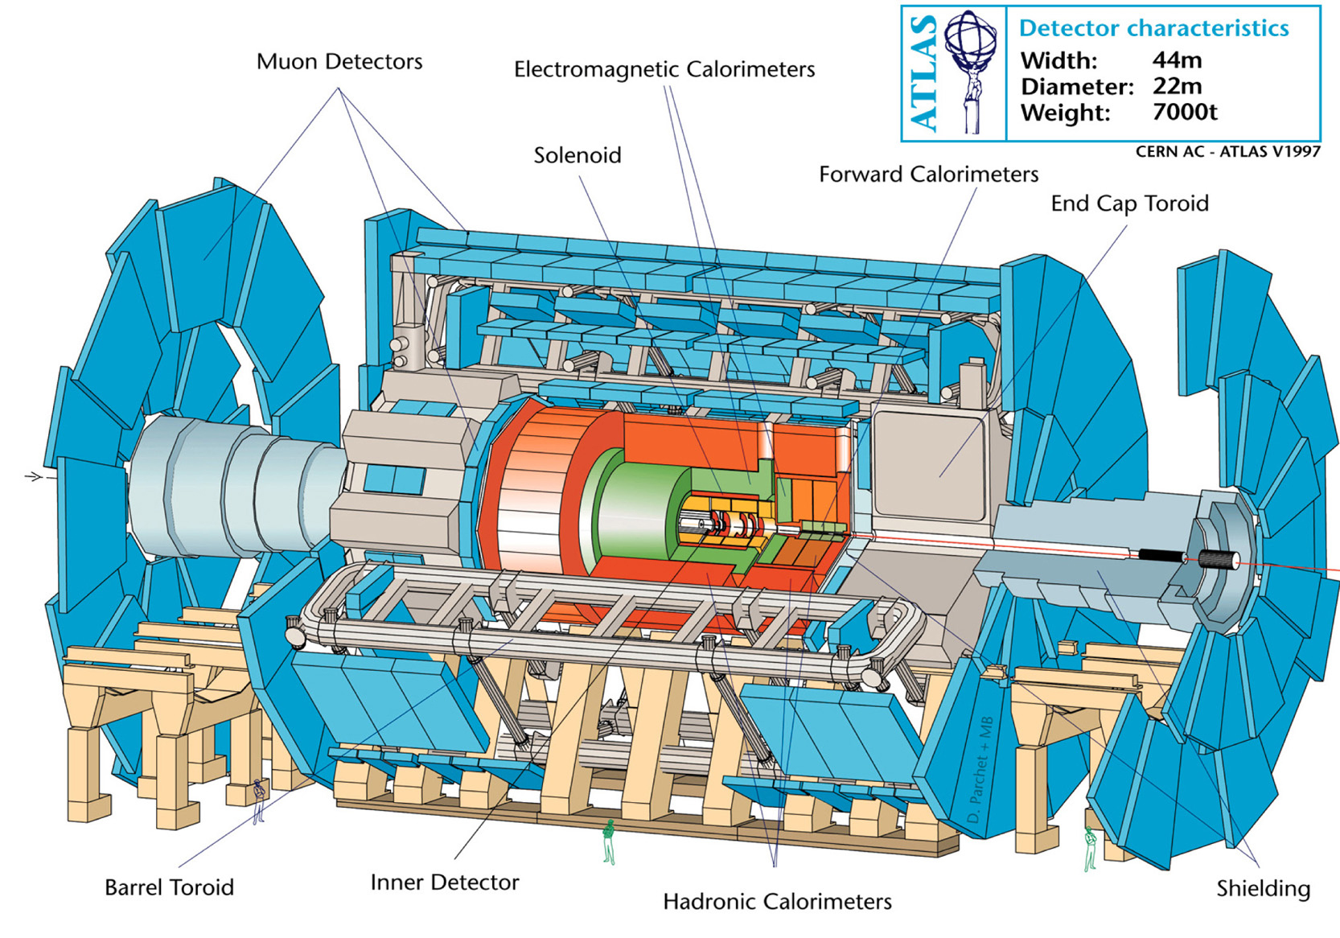
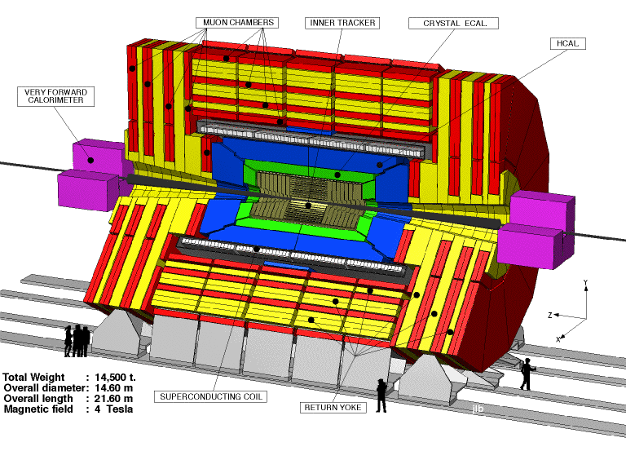

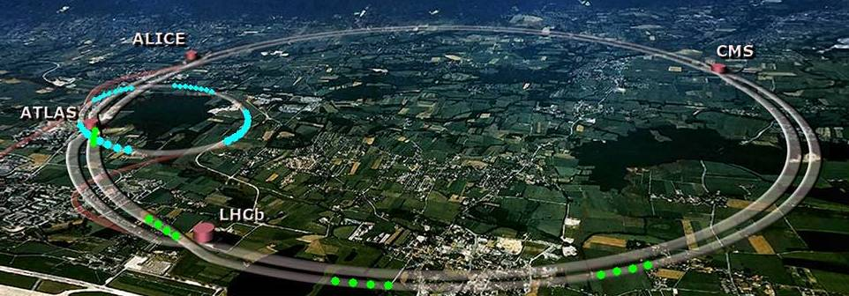
Where do we get such high energies?

Slide 16
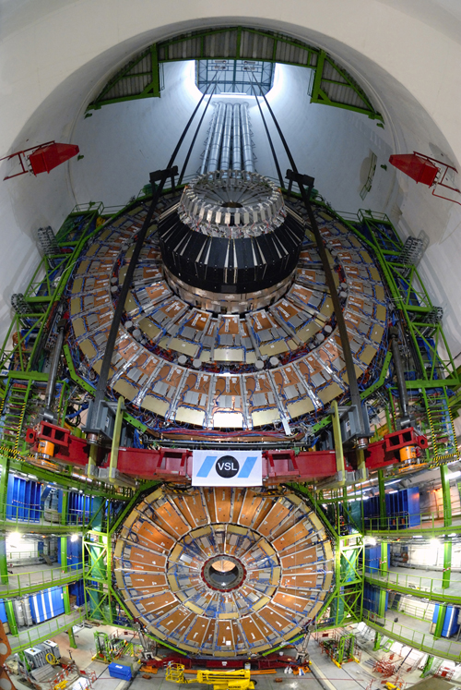
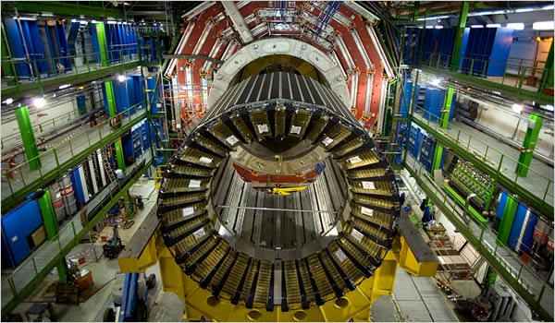
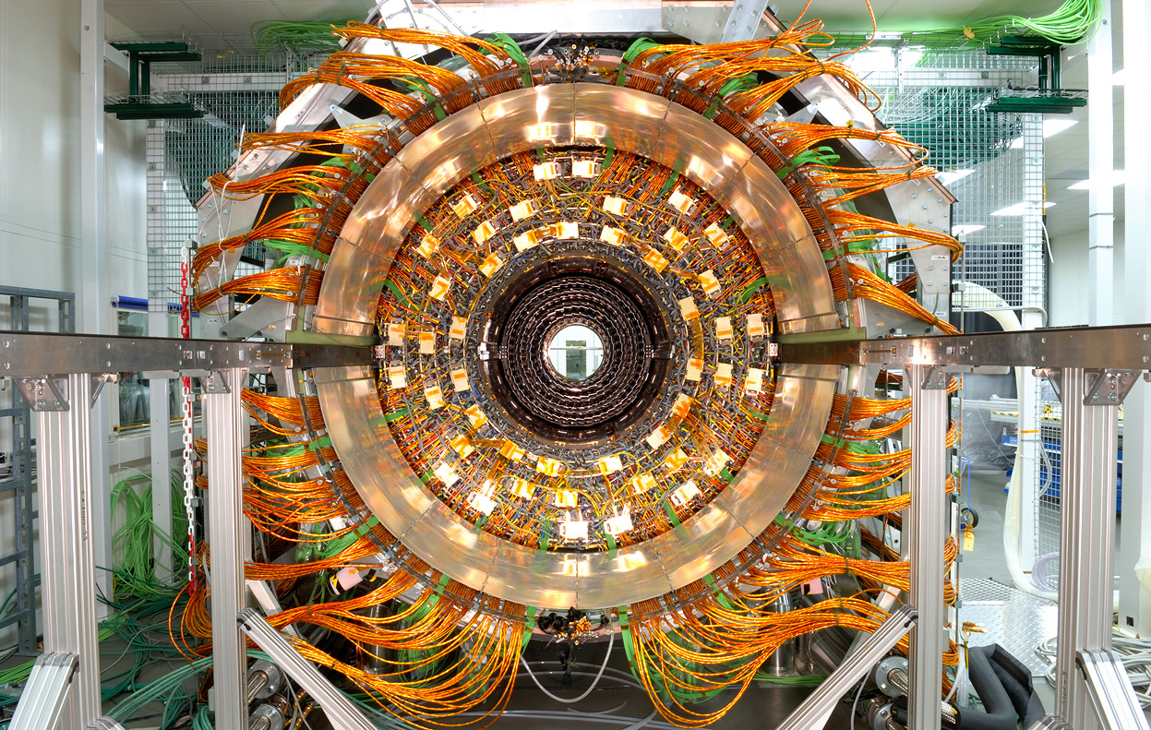
Significant Technical
Challenge
Northwestern Univ. @
Compact Muon Solenoid
Collaboration

Slide 17
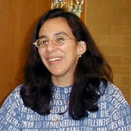









People from this
Department
and others…

Slide 18
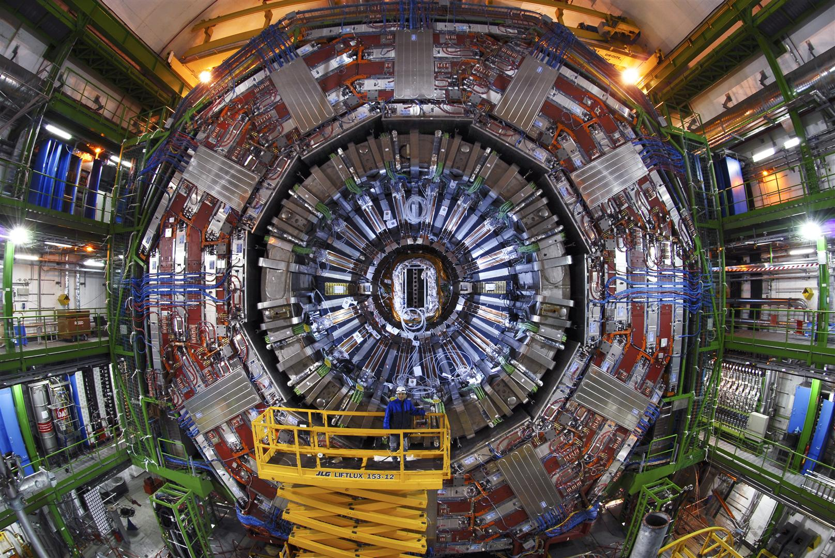
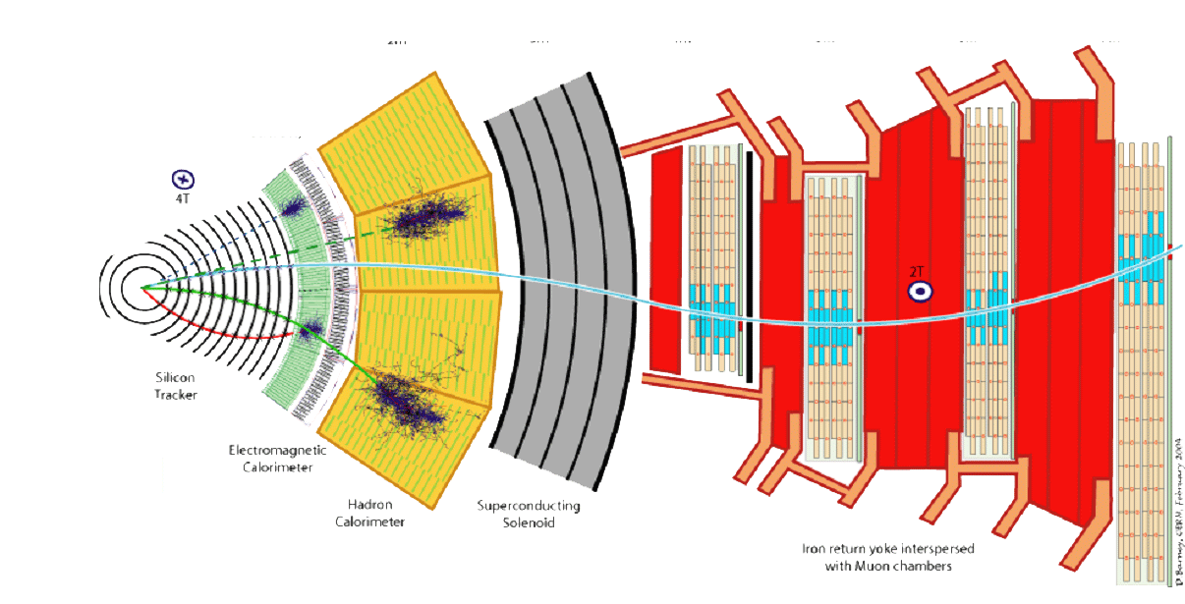
CMS detectors designed to find the Higgs

Slide 19
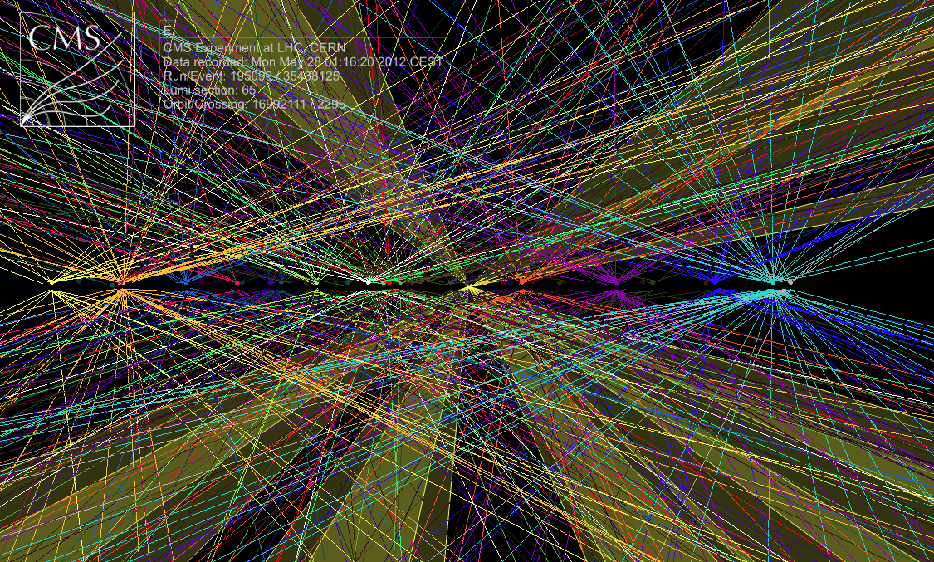
Common Collisions
Protons break into quarks & gluons
Quarks cannot be isolated
u
d
d
u
u
u
u
d
d
u
d
u
u
d
u
s
s
u
π⁺
π⁻
π⁻
π⁺
K⁺
K⁻

Slide 20
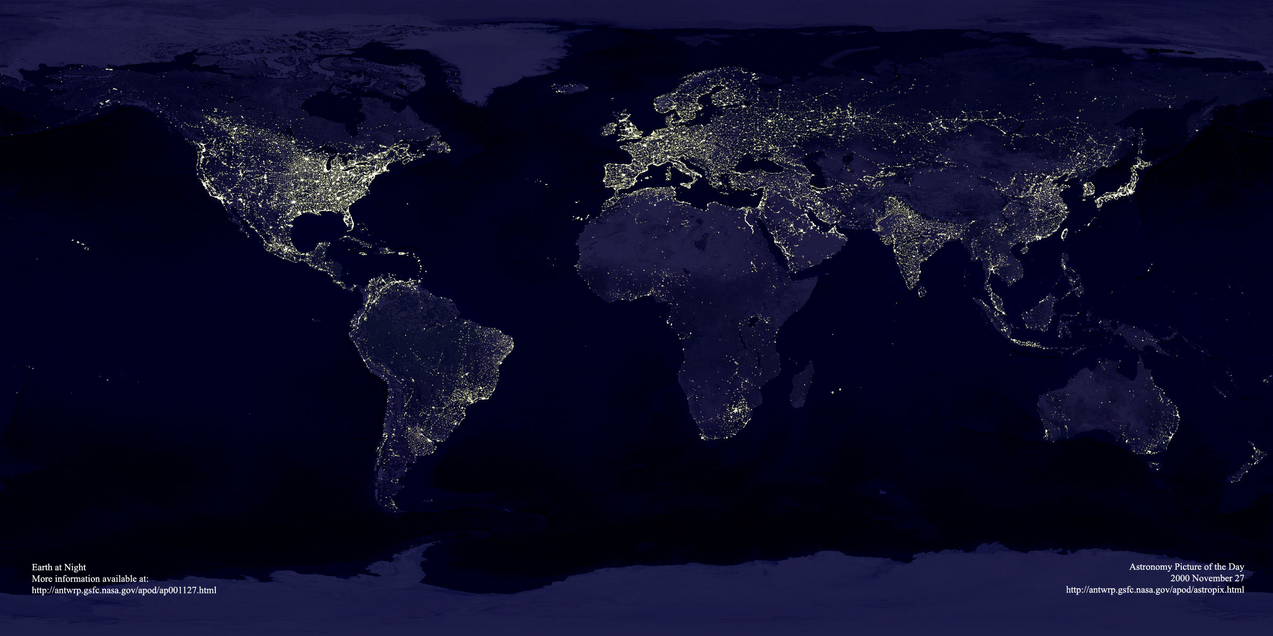

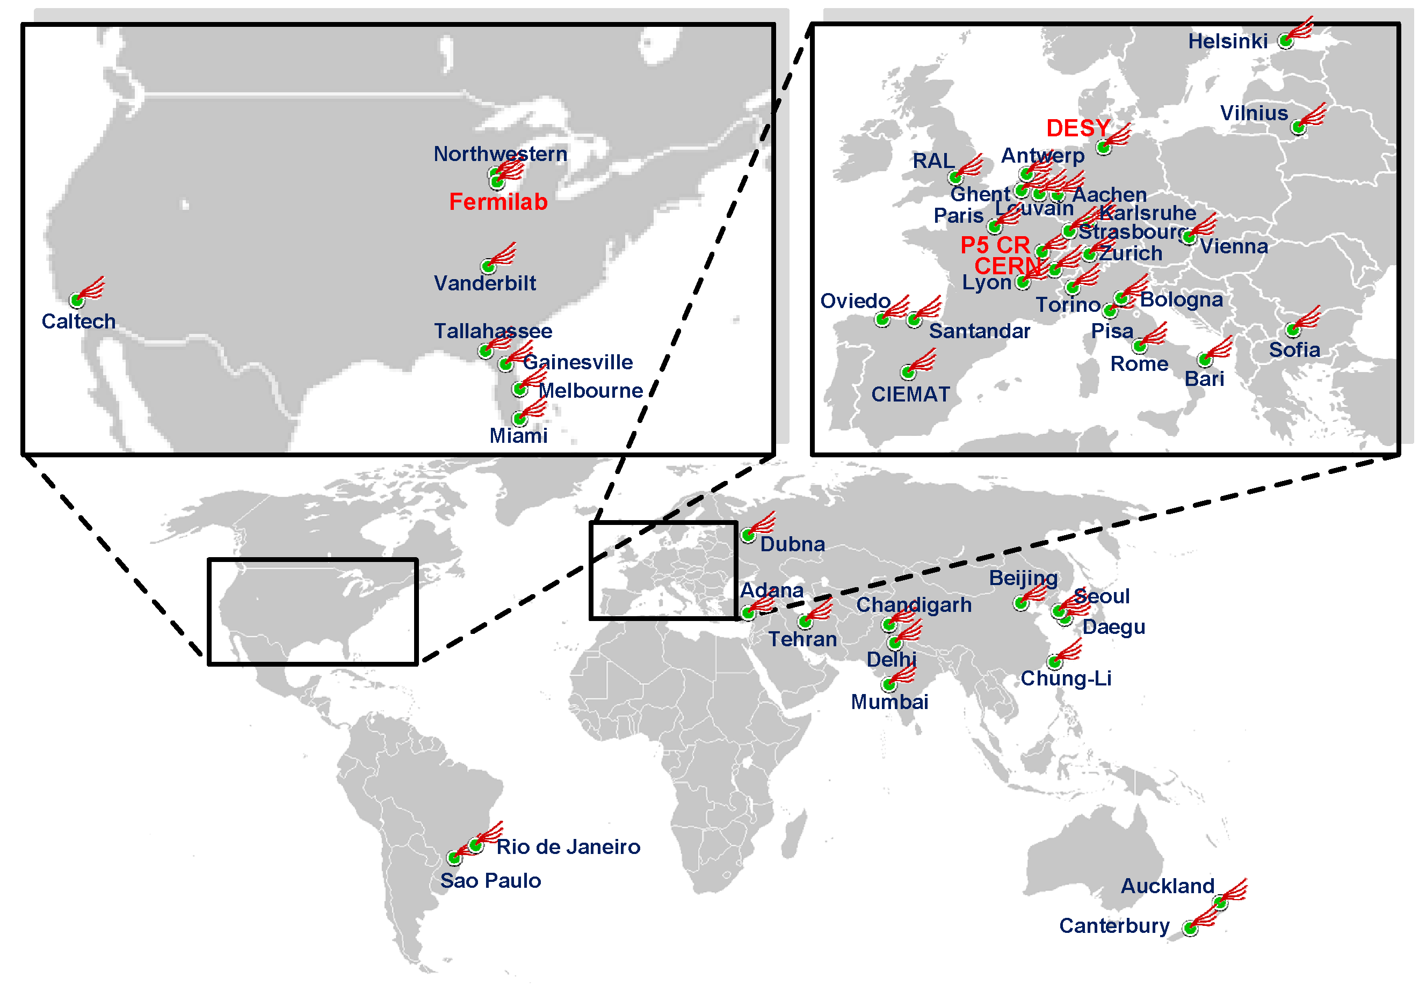
Efficient Higgs Search Possible due to
World-Wide Computer Grid
70
637
4306
538
22
87
55
27
10
Storage –
Raw recording
rate 0.1 – 1 GByte/sec
Accumulating data at 10-14 PetaBytes/year
~ 20 million CDs each year
Grids connects >100,000
Processors in 34 countries
Europe: 267 institutes, 4306 users Elsewhere: 208 institutes, 1632 users

Slide 21
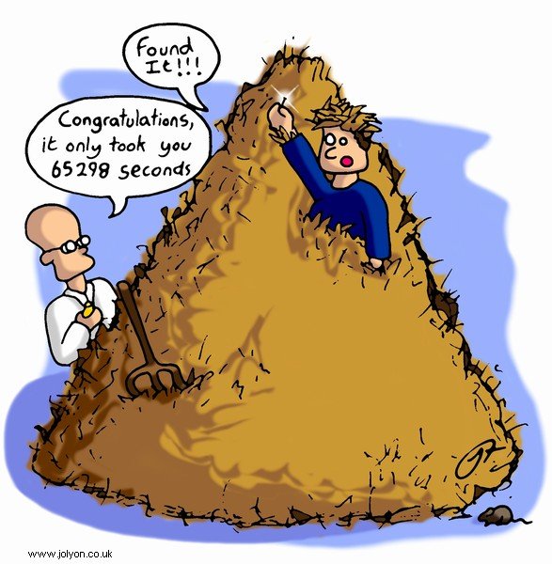
How are Higgs bosons detected in pp collisions?
First, keep in mind that out of:
1,000,000,000,000 pp collision
10,000,000 are interesting
100 is a Higgs
1 is a “clean” Higgs, look for:
  2 photon
  4 electron or muons
Congrats it only took
50 years

Slide 22
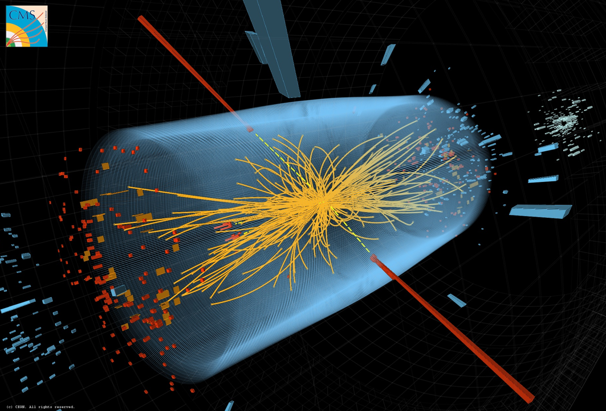
CMS γγ event

Slide 23
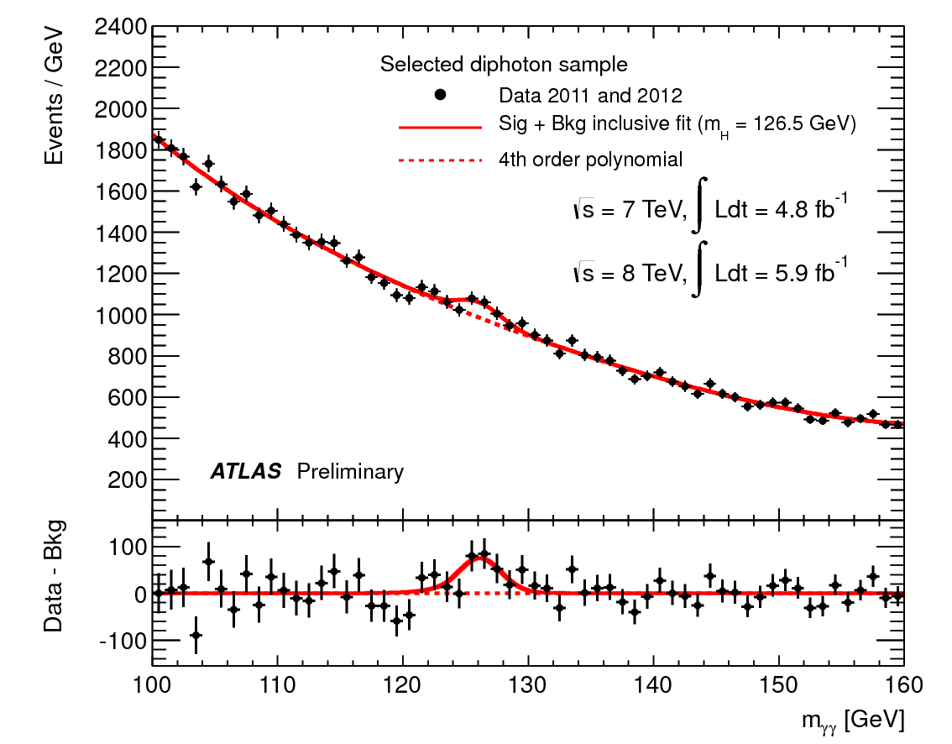
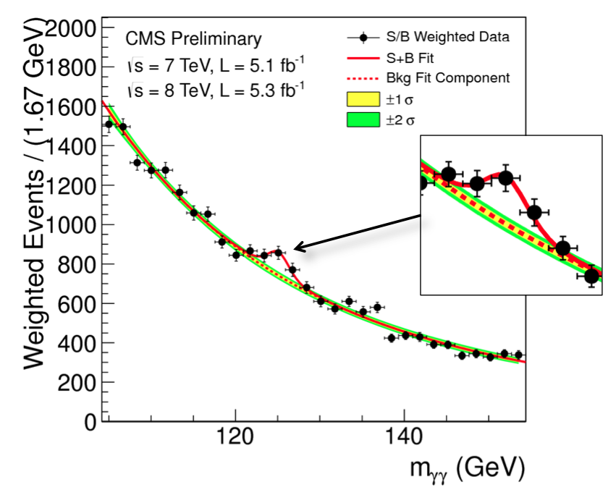
How do experimentalists identify a Higgs signal? Example #1

Slide 24
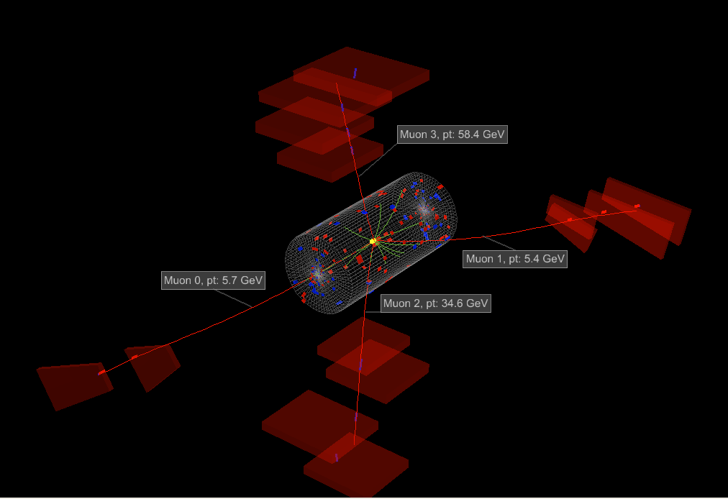
CMS ΖΖ event

Slide 25
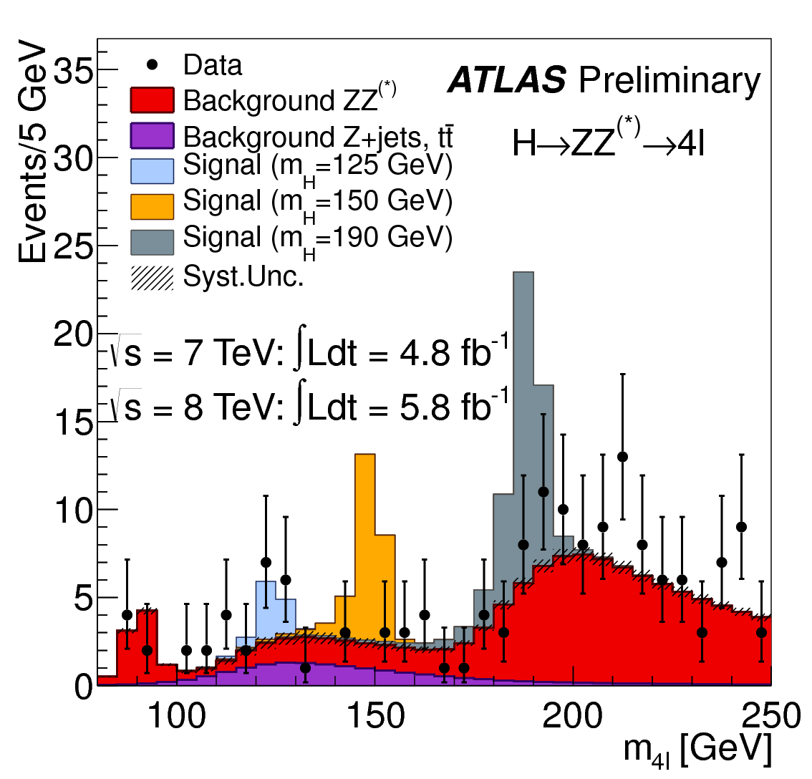
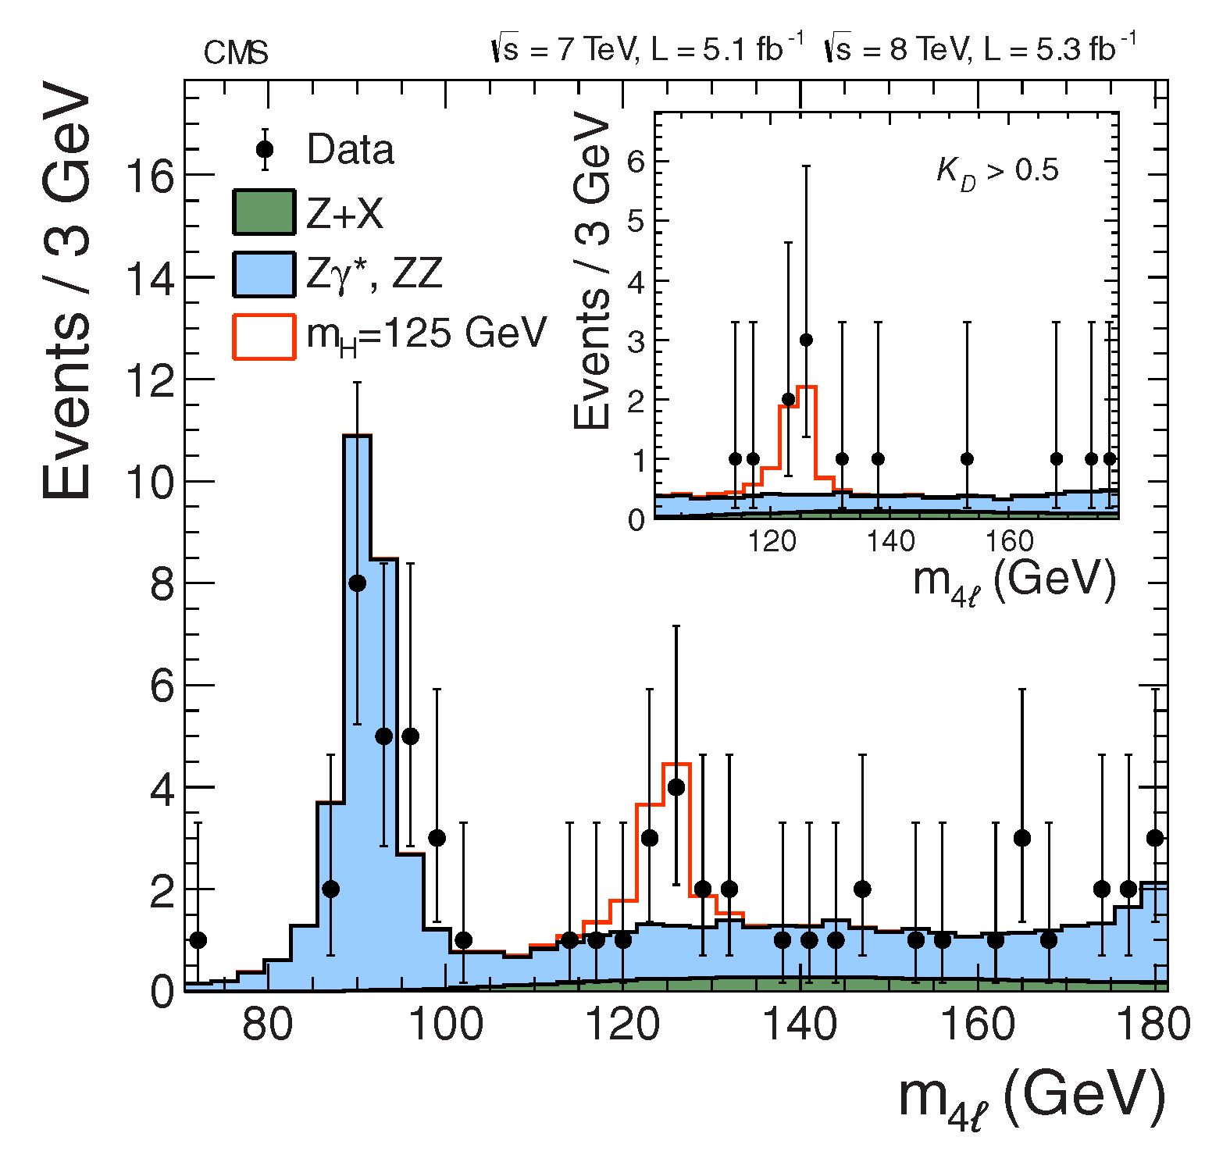
How do experimentalists identify a Higgs signal? Example #2

Slide 26
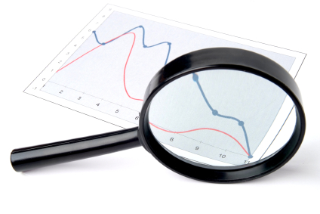

What comes Next??
First, we need to be sure that this bump is the Higgs.
We need to study the properties of this new particle.
If it is not quite as we expect, can we find other
new particles in the LHC data?
What facilities should we build
in the future?

Slide 27
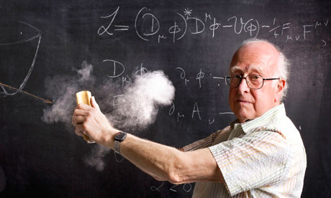

Why is the Higgs Discovery Exciting?

Slide 28
THANK YOU!!!

