Slide 1
THE HIGGS REVEALED On the Origin of Mass presented by The Society of Physics Students
panel speakers:
André de Gouvêa, Frank Petriello,
Michael Schmitt, Mayda Velasco

Slide 2
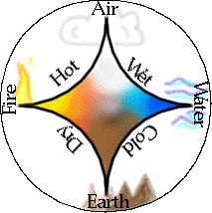
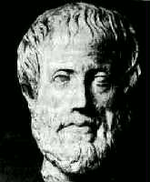
What is Particle Physics?
Aristotle believed the all the world was made from four elements: Earth, Air, Water & Fire.
Today we know this is wrong.
We believe that matter is made of fundamental particles, and we study the ways that they interact with each other.
This is particle physics.

Slide 3
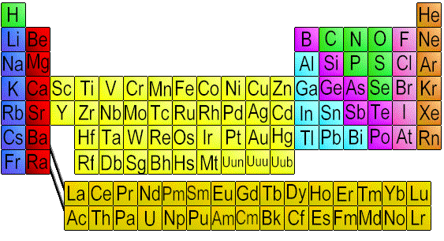
What are the Particles?
The Periodic Table of the elements helped chemists elucidate the building blocks of compounds.

Slide 4
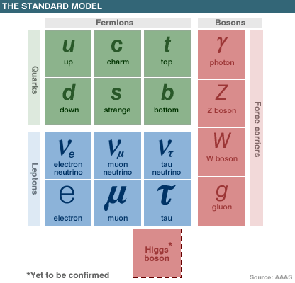
What are the Particles?
Our table of particles has fewer entries.
There are “matter particles” and “force particles.”
The Higgs Boson is in a category all by itself.

Slide 5
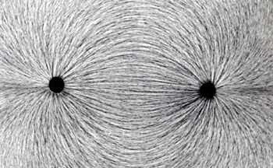
What are Fields?
Electric fields and magnetic fields are common.
Fields mediate the forces between the fundamental particles.
Four force carriers for three forces (electromagnetic, weak & strong – not gravity).
The Higgs field is special – it gives mass.

Slide 6
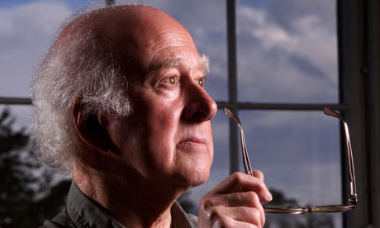
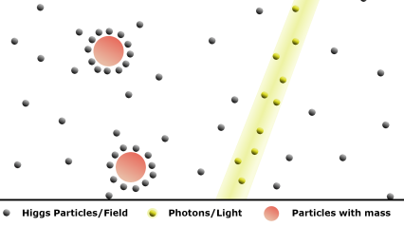
How does the Higgs give Mass?
This Higgs field is everywhere.
Most particles interact with the Higgs field.
These interactions give the particles mass.
Peter Higgs

Slide 7
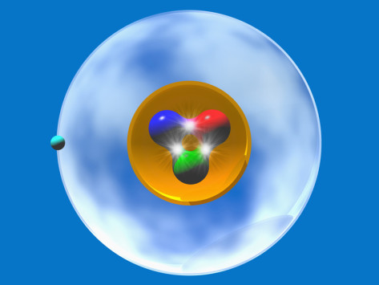
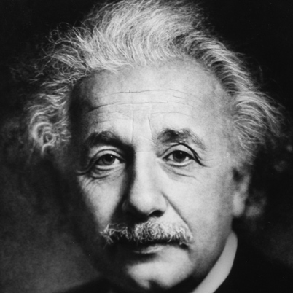
Is this All of the Mass?
The Higgs field gives mass to the fundamental particles.
The Universe consists mainly of electrons, protons and dark matter particles.
Protons consist of quarks that get their mass from Higgs, but most of the mass of a proton comes from energy.
We don’t know where mass of dark matter comes from…

Slide 8
How do we see the Higgs Boson?
The Higgs particle is an excitation or perturbation of the Higgs field.
We can cause this excitation with energy.
High-energy collisions of protons will sometimes produce a massive particle – like the Higgs boson.
p
energy → mass
p

Slide 9
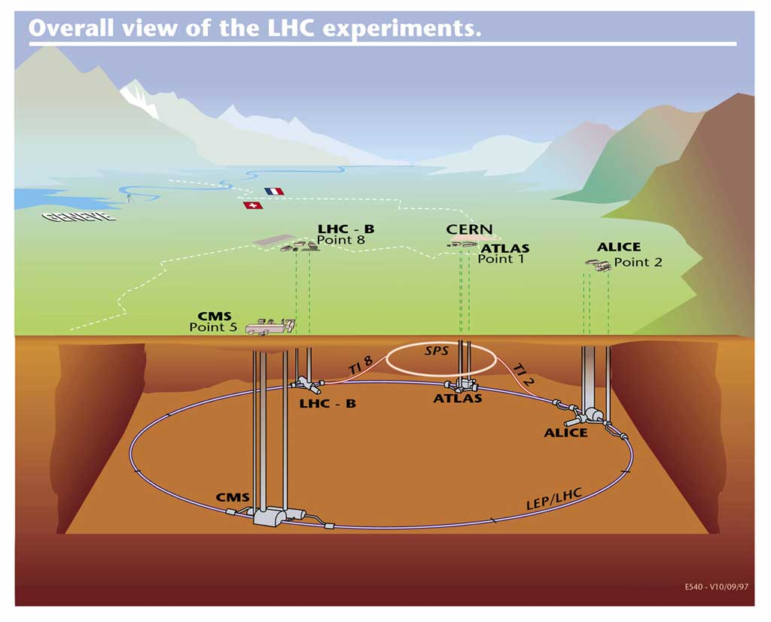
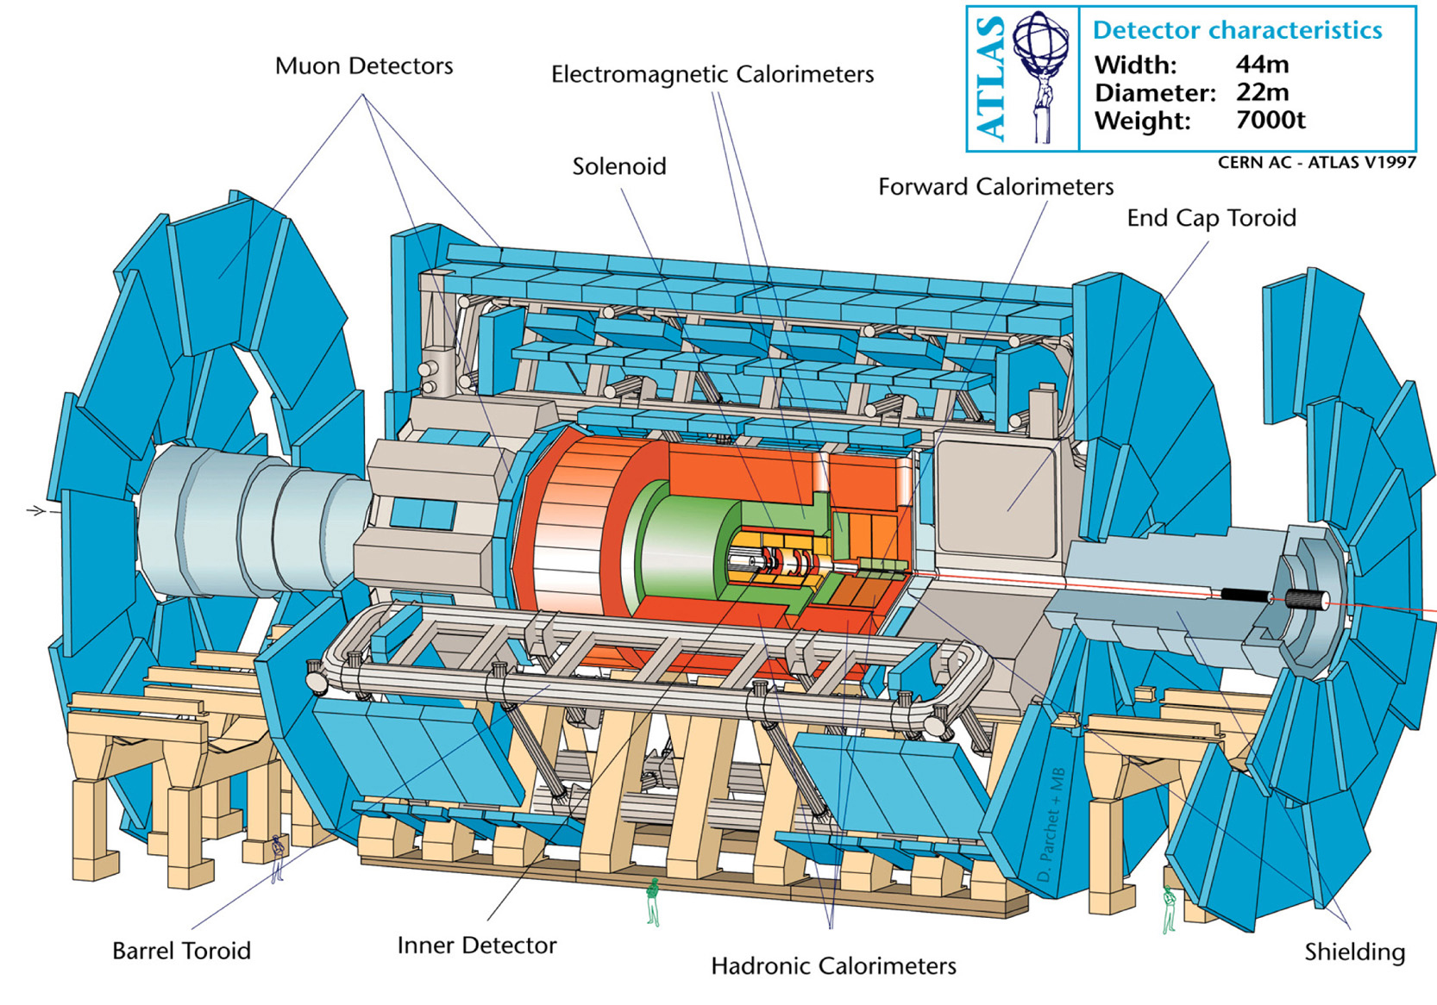
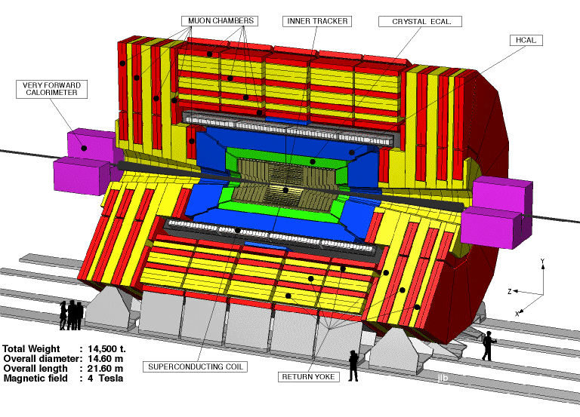
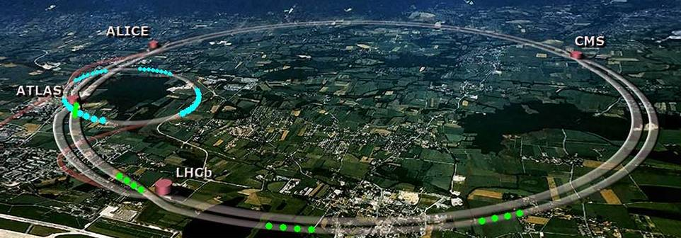
Where do we get such high energies?

Slide 10
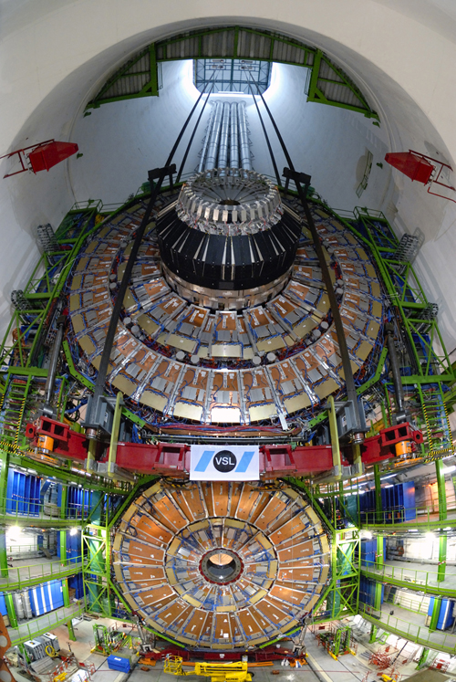
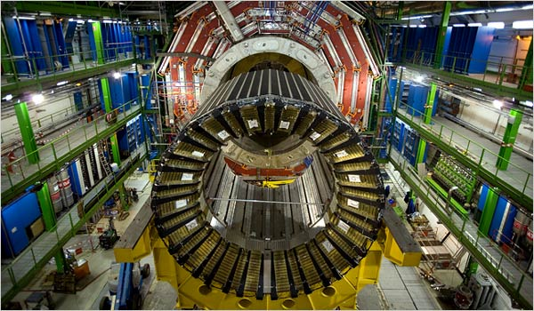
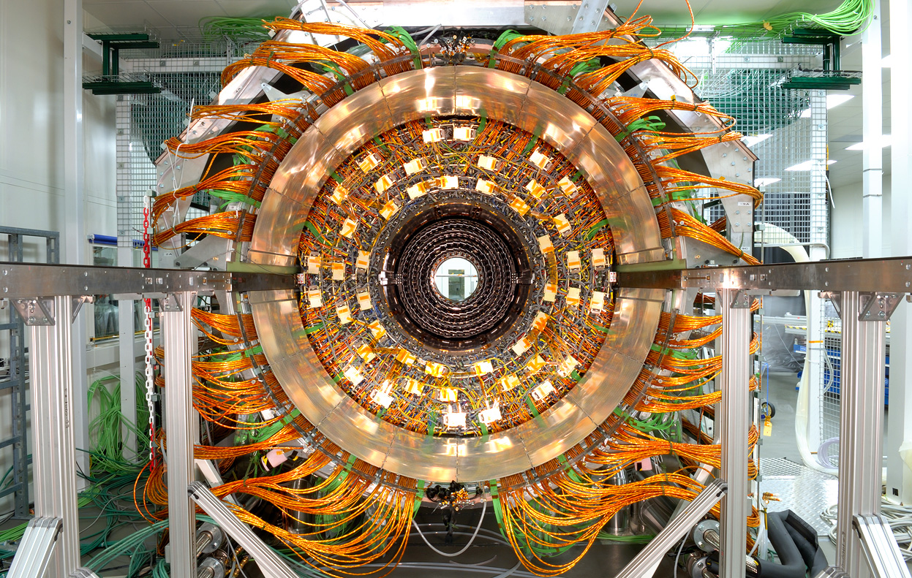
Significant Technical
Challenge
Northwestern Univ. @
Compact Muon Solenoid
Collaboration

Slide 11
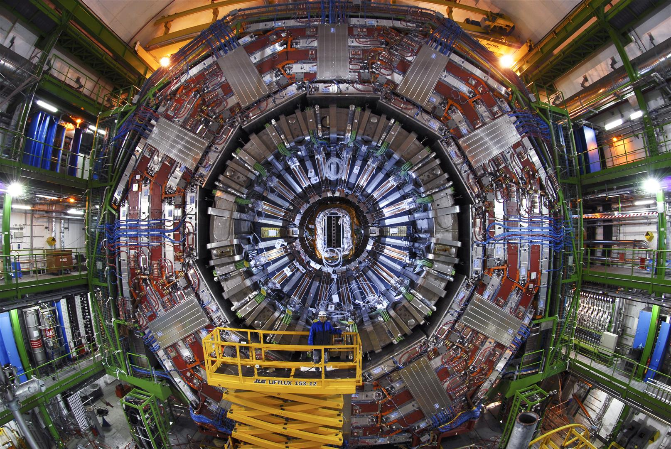
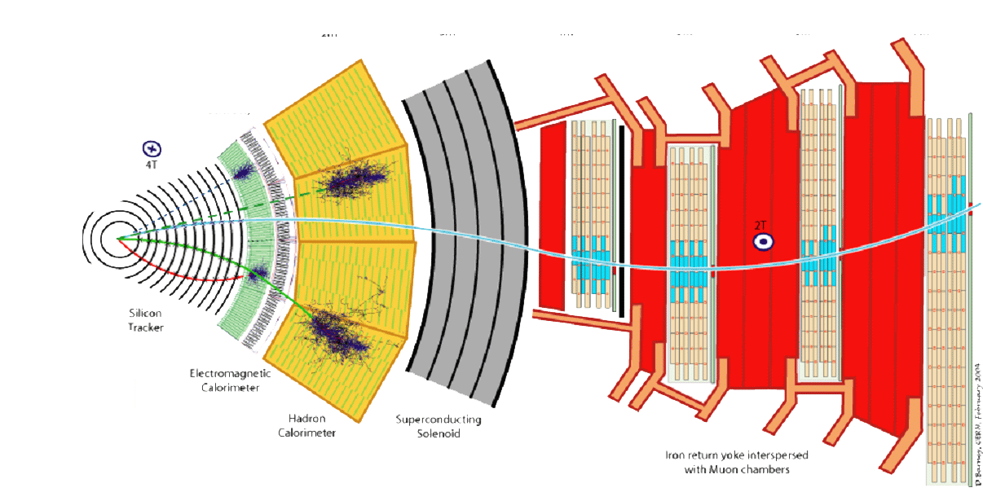
CMS detectors design to find the Higgs

Slide 12
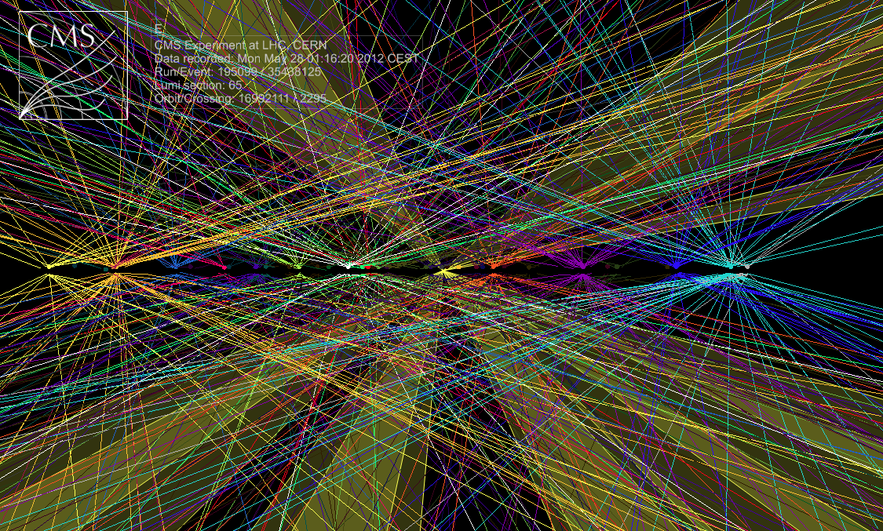
Common Collisions
Protons break into quarks & gluons
Quarks cannot be isolated
u
d
d
u
u
u
u
d
d
u
d
u
u
d
u
s
s
u
π⁺
π⁻
π⁻
π⁺
K⁺
K⁻

Slide 13
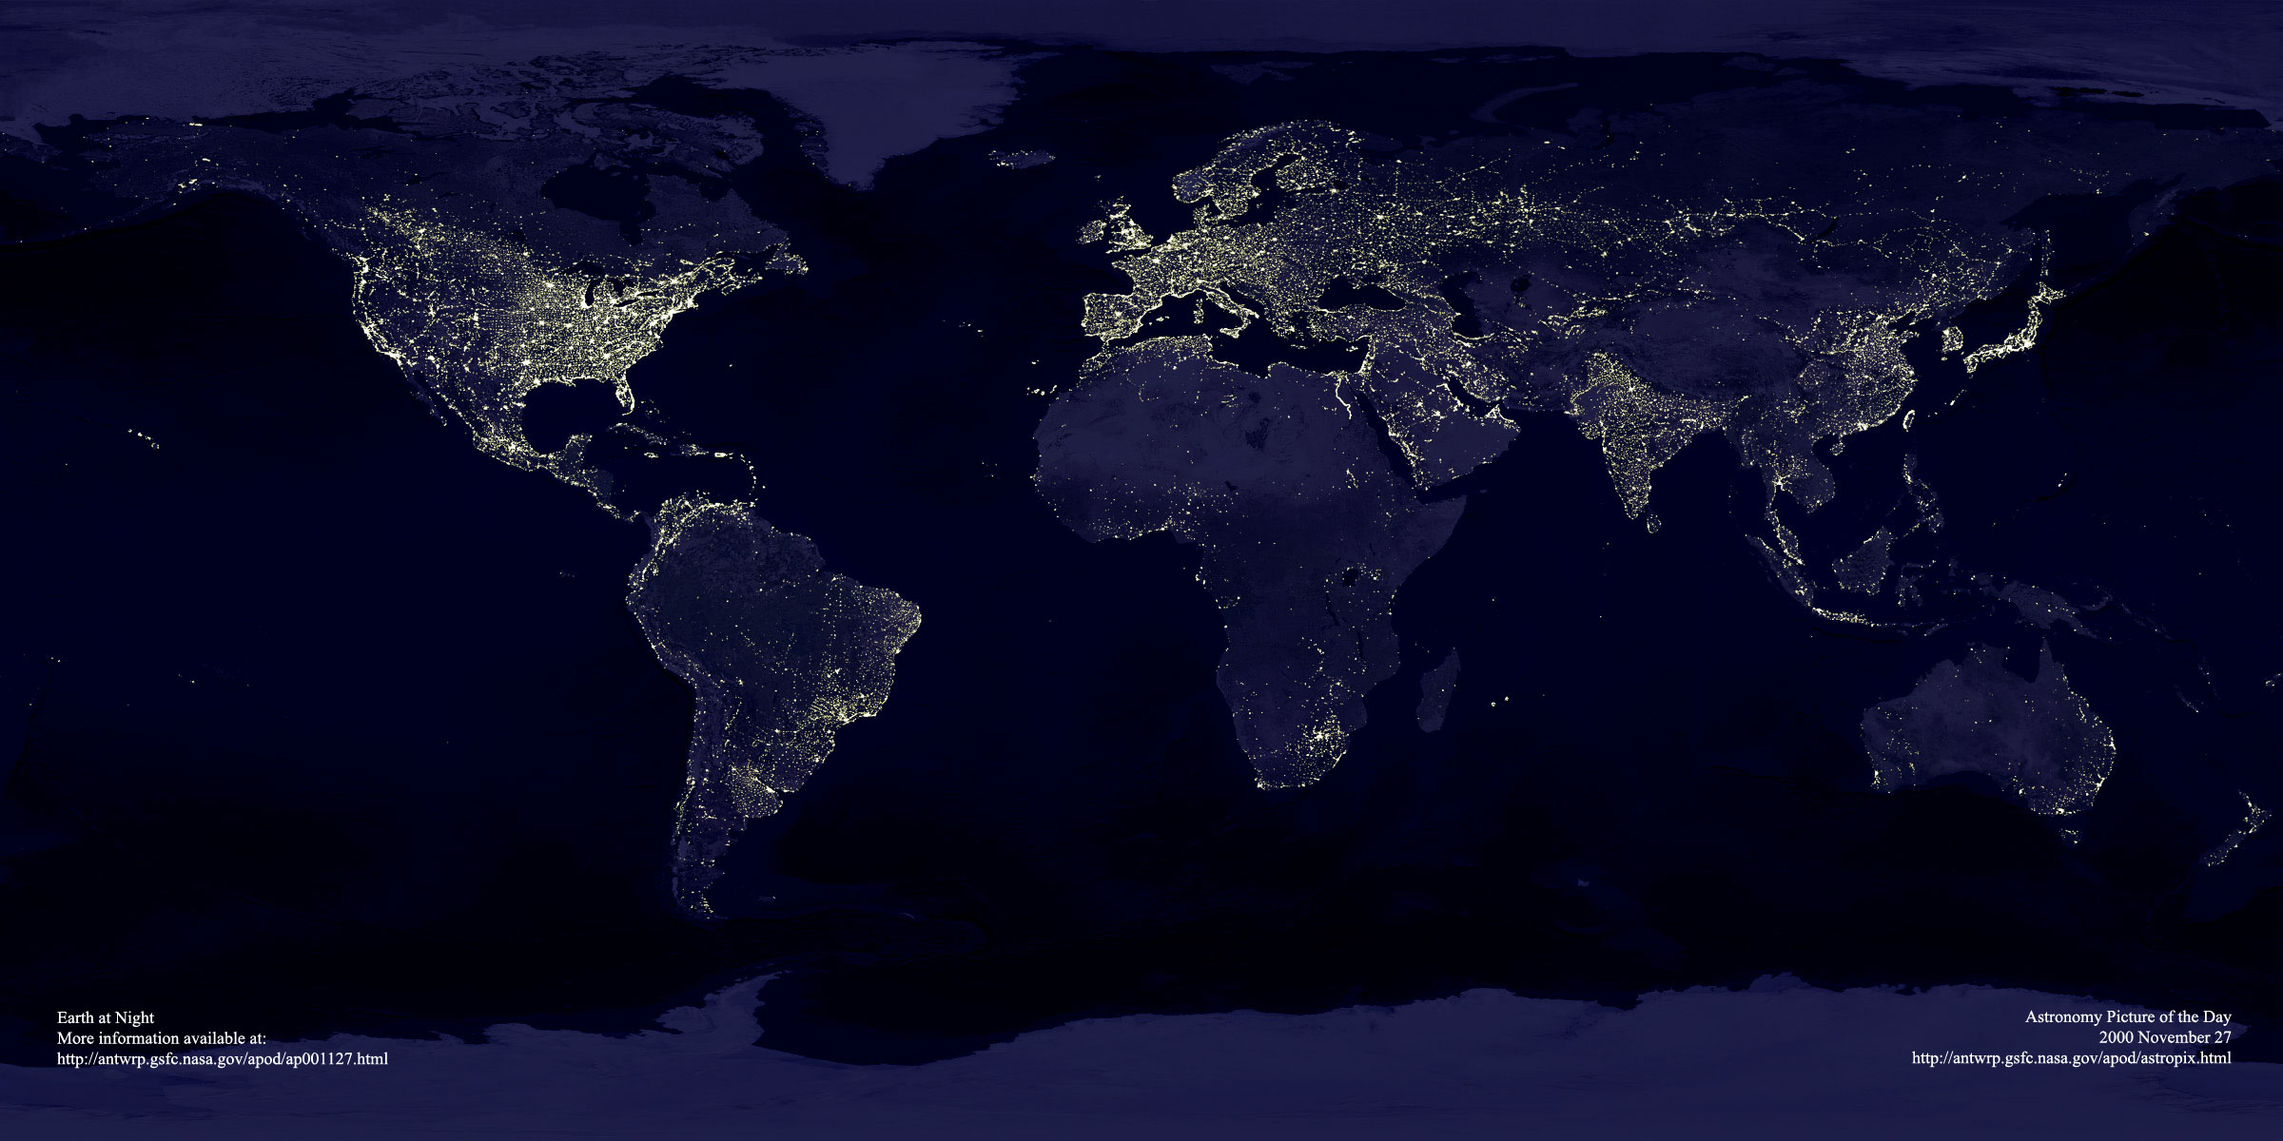
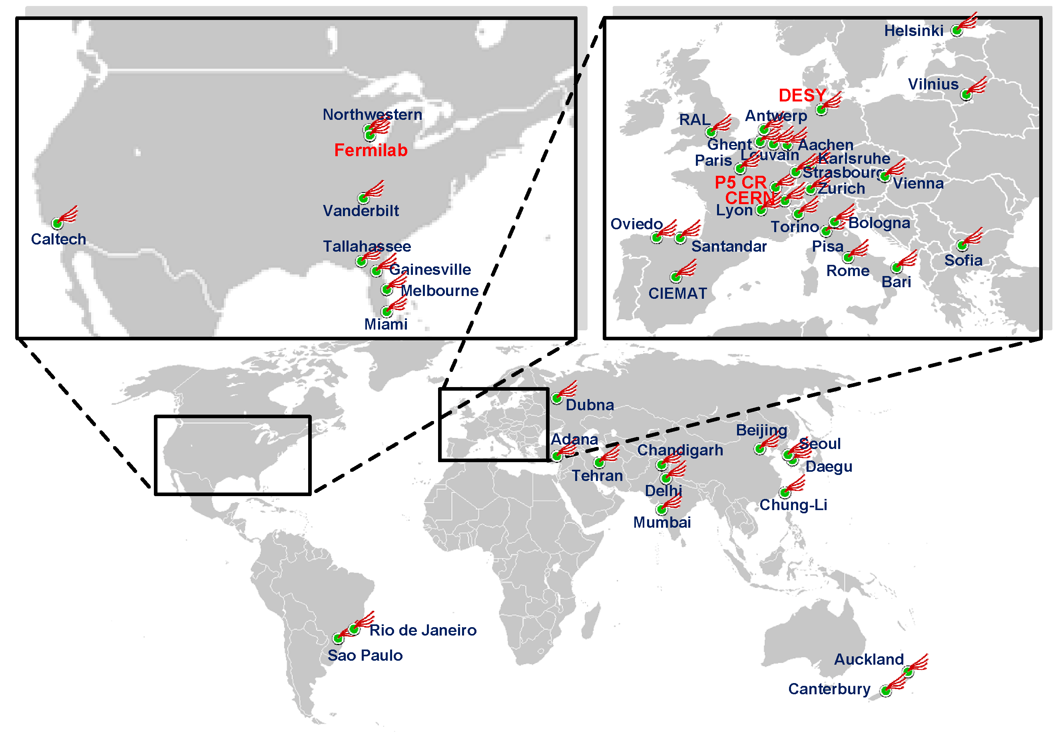
Efficient Higgs Search Possible due to
World-Wide Computer Grid
70
637
4306
538
22
87
55
27
10
Storage –
Raw recording
rate 0.1 – 1 GByte/sec
Accumulating data at 10-14 PetaBytes/year ~ 20 million CDs each year
Grids connects >100,000
Processors in 34 countries
Europe: 267 institutes, 4306 users Elsewhere: 208 institutes, 1632 users

Slide 14
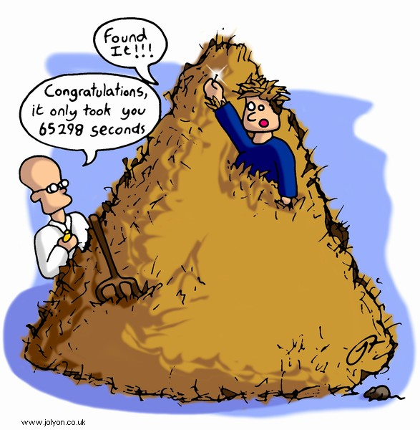
How are Higgs bosons detected in pp collisions?
First, keep in mind that out of:
1,000,000,000,000 pp collision
10,000,000 are interesting
100 is a Higgs
1 is a “clean” Higgs, look for:
2 photon
4 “electron” particle-type
Congrats it only took
50 years

Slide 15
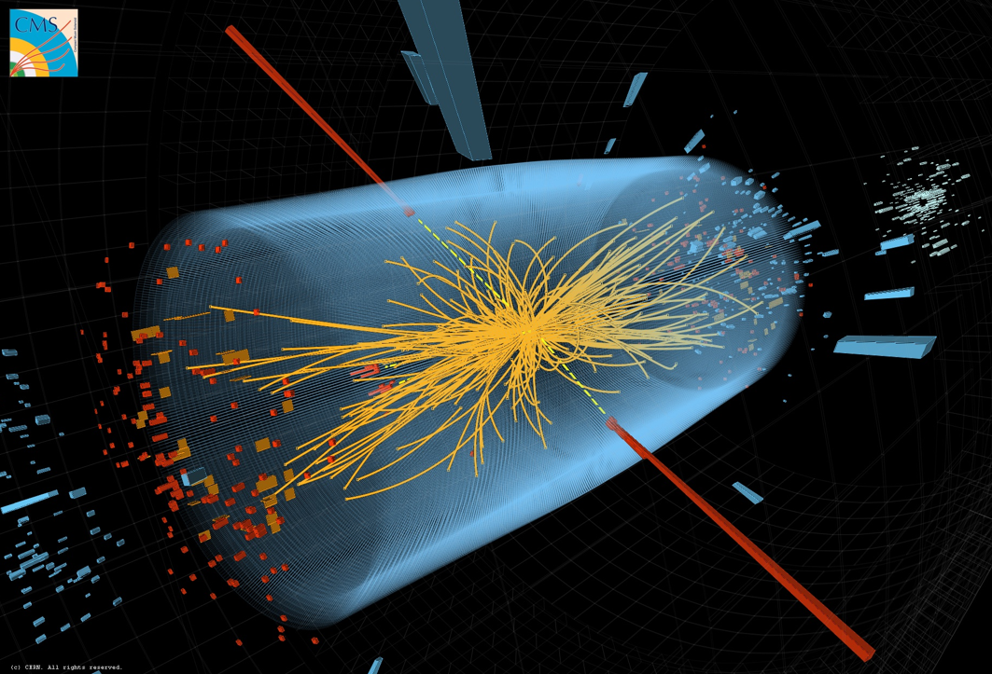
CMS γγ event

Slide 16
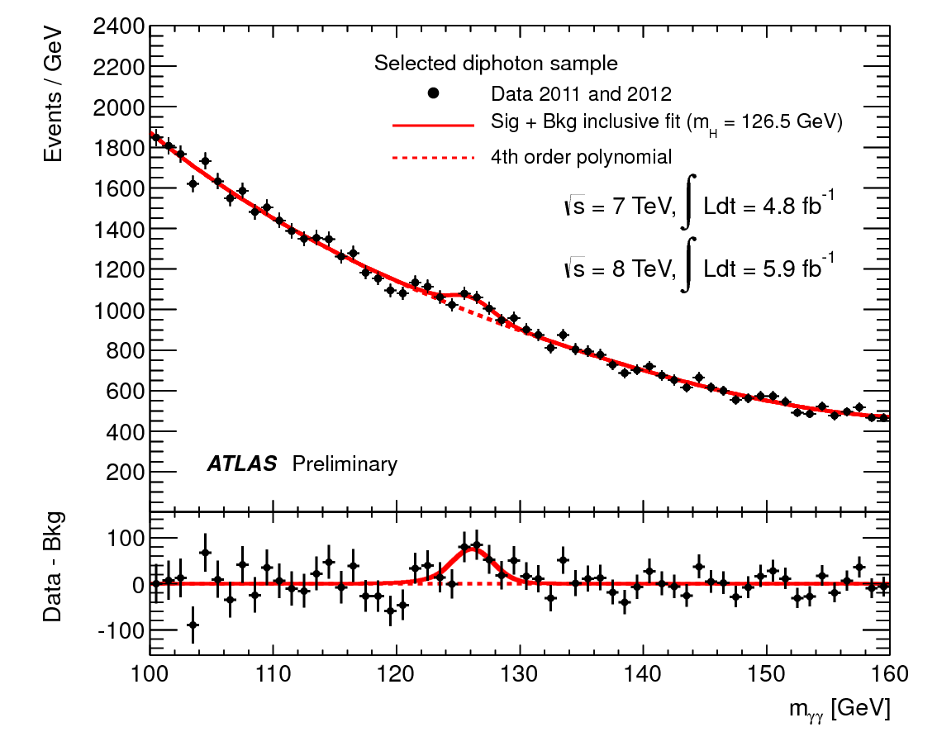
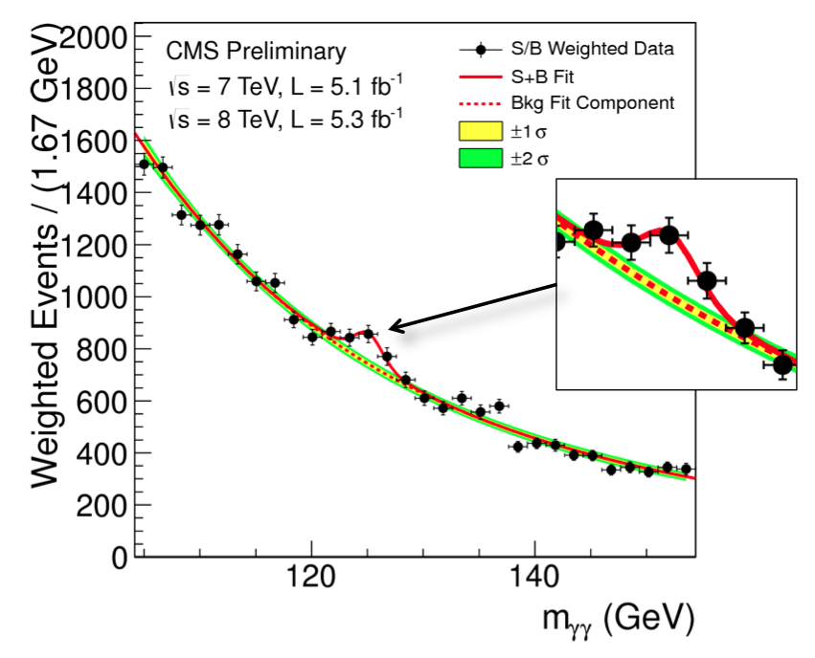
How do experimentalists identify a Higgs signal? Example #1

Slide 17
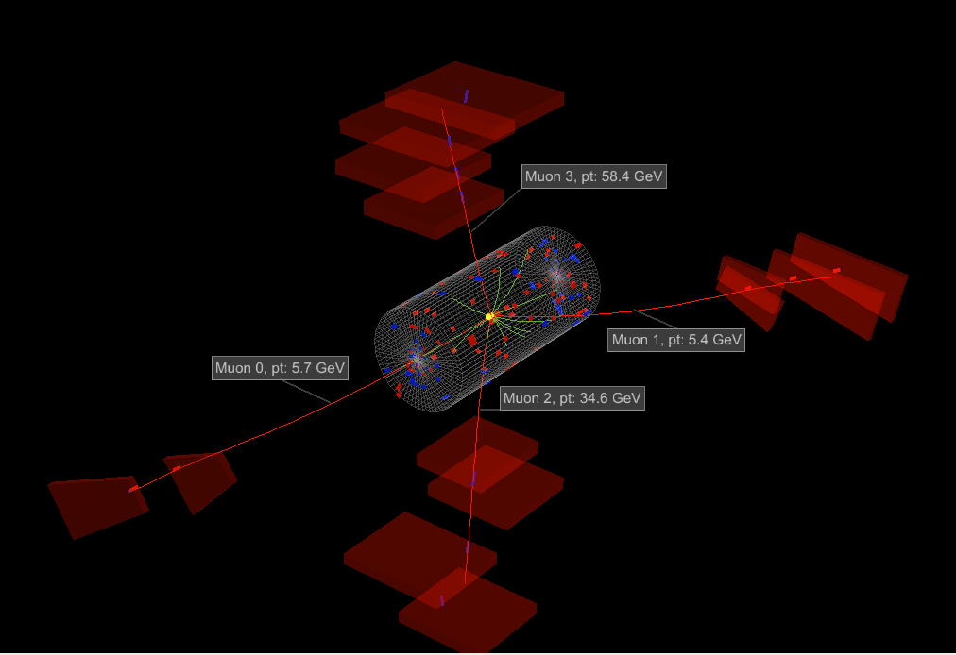
CMS ΖΖ event

Slide 18
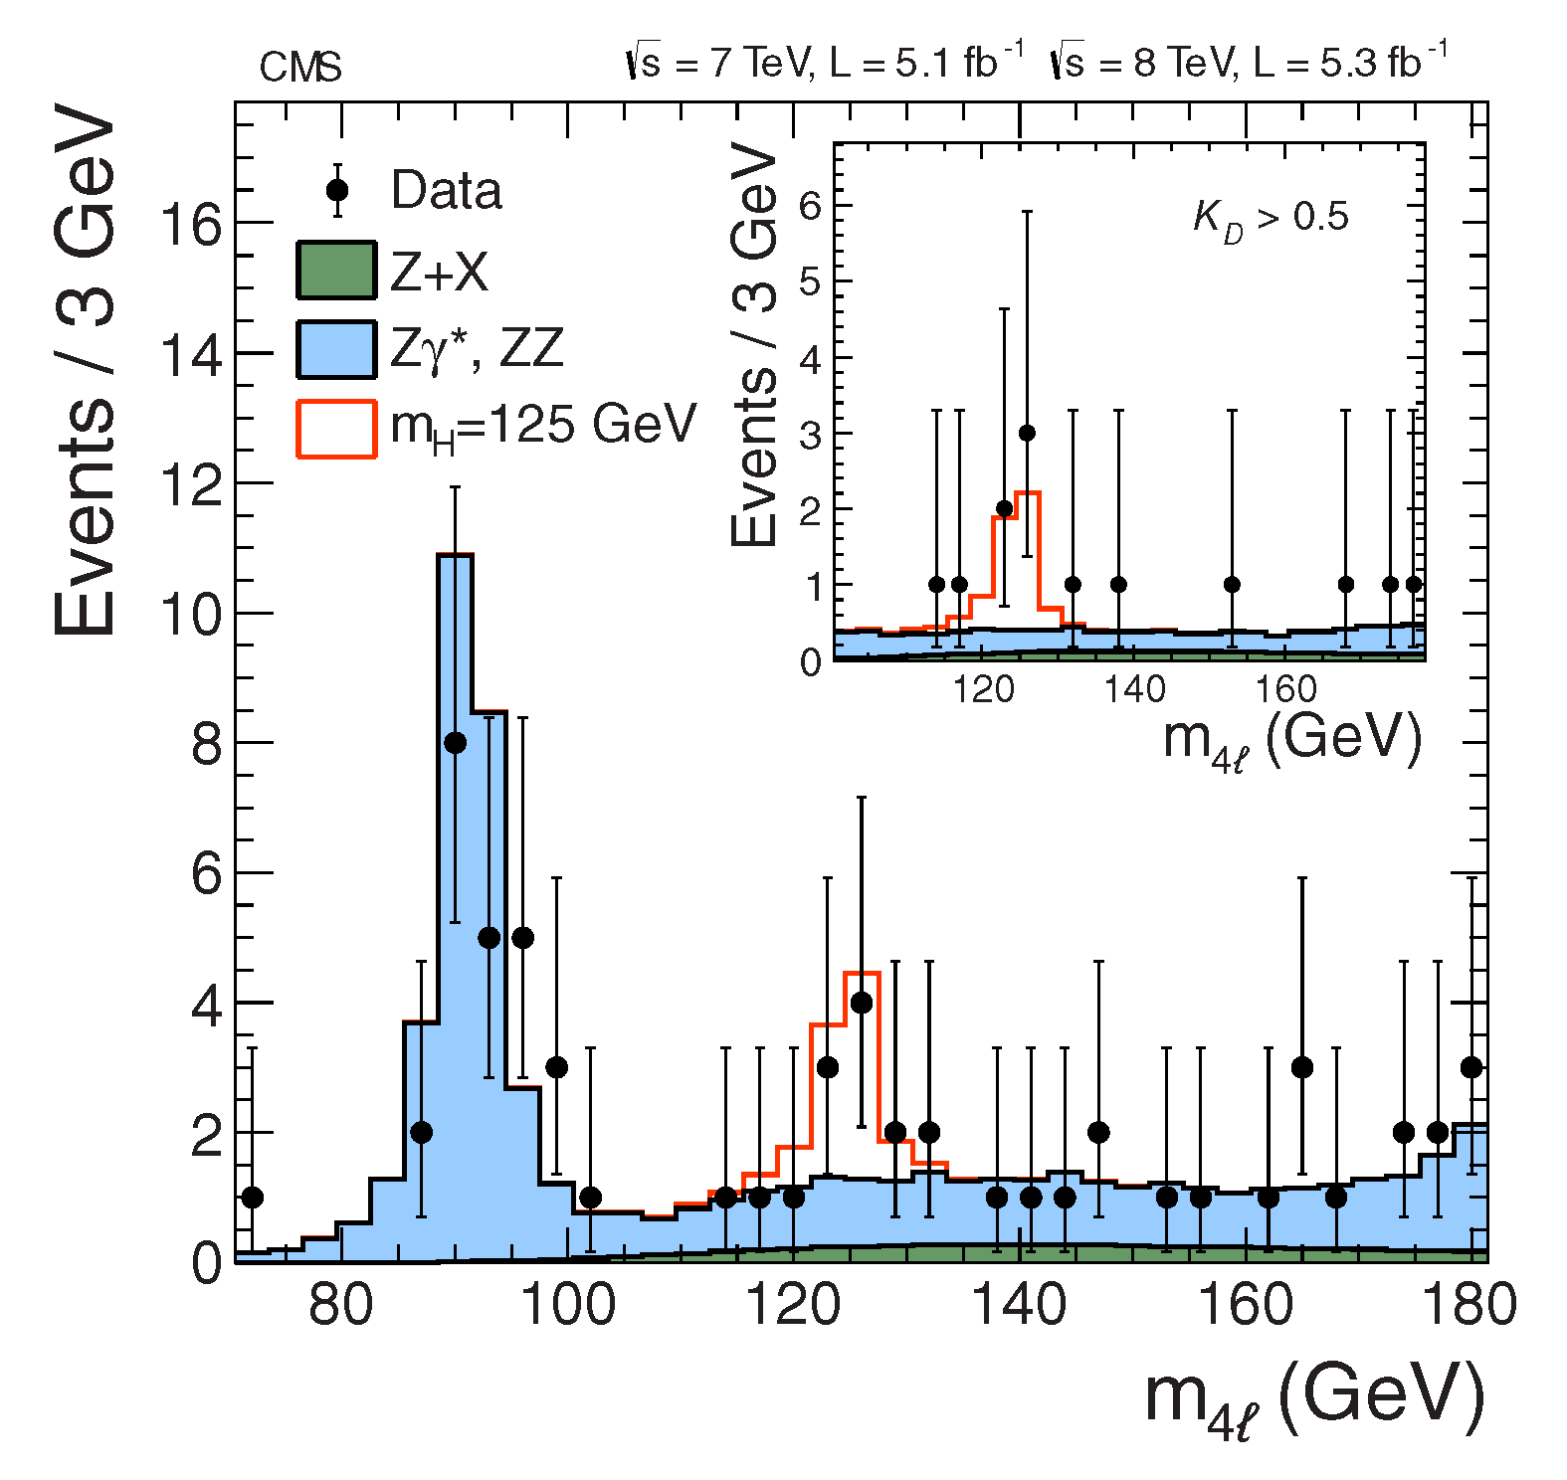
How do experimentalists identify a Higgs signal? Example #2

Slide 19
What comes Next??
First, we need to be sure that this bump is the Higgs.
We need to study the properties of this new particle.
If it is not quite as we expect, can we find other new particles in the LHC data?
What facilities should we build in the future?

