Slide 1
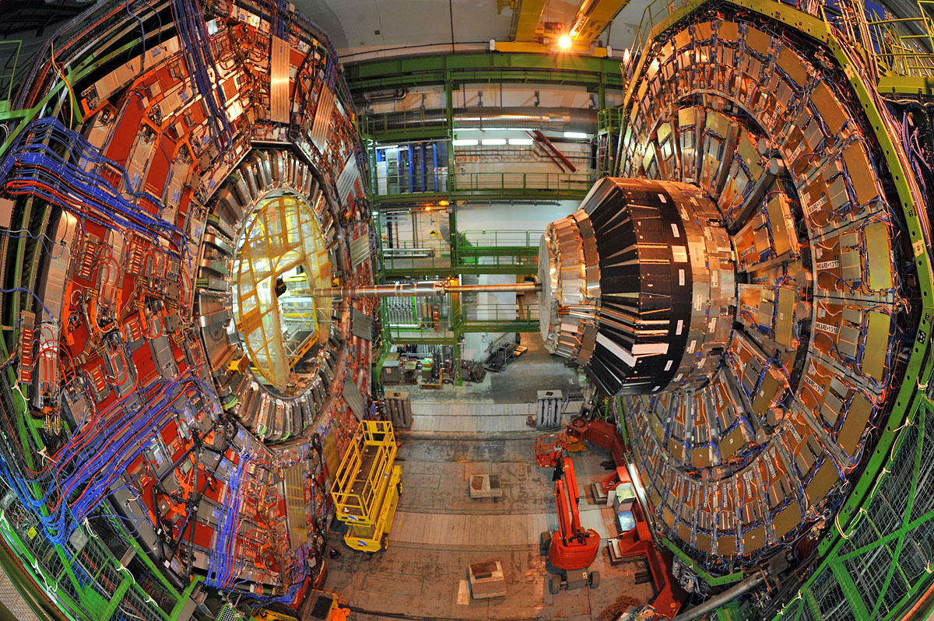
The Higgs Boson After Discovery
Michael Schmitt (Northwestern University)
Friday, October 28, 2012
4:00 pm
Tech L211

Slide 2
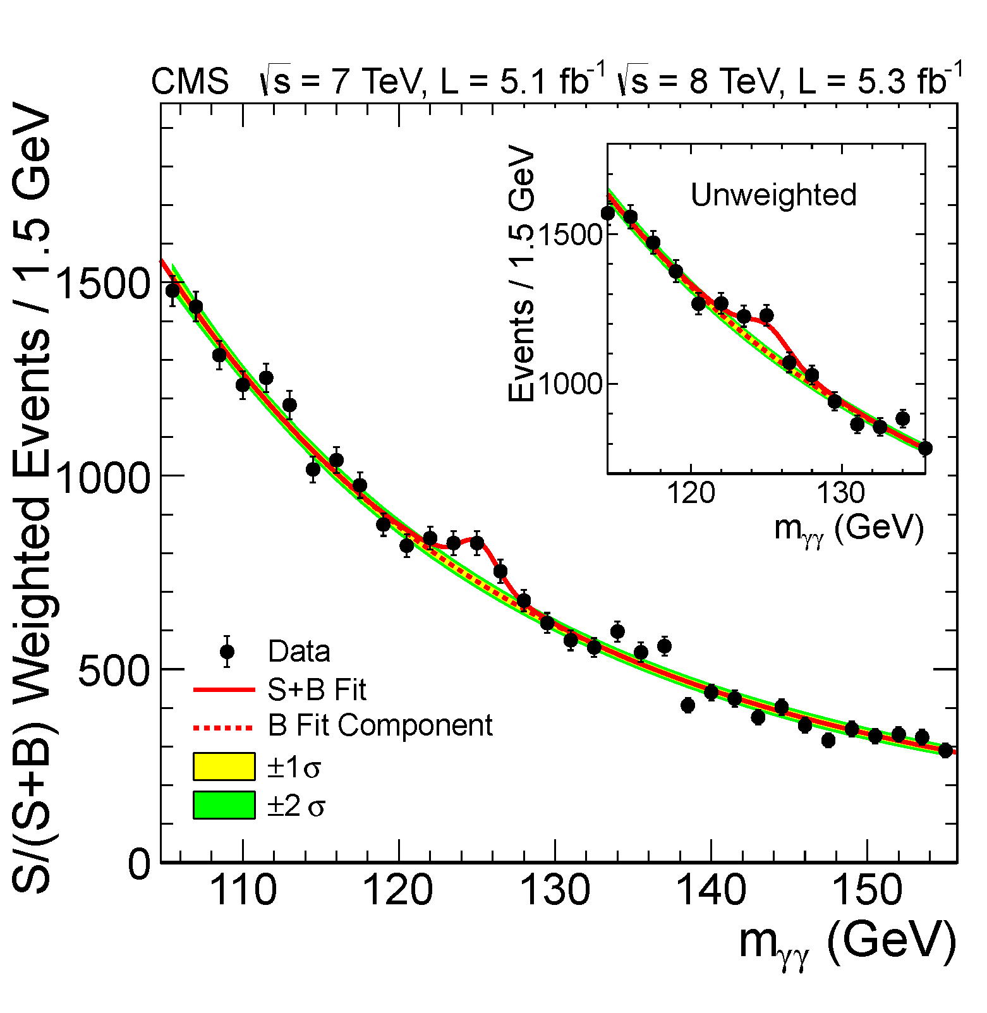
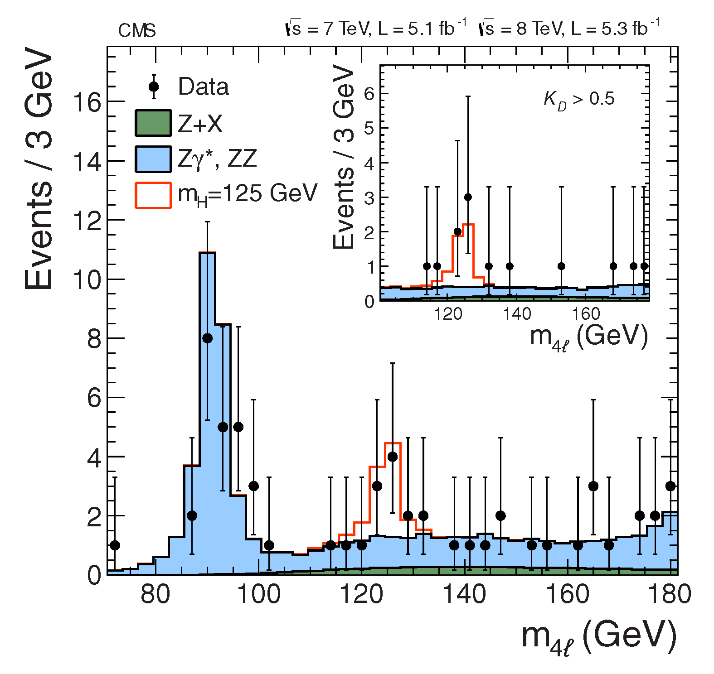
The Excitement: A new particle!
Phys. Lett. B716 (2012) 30-61

Slide 3
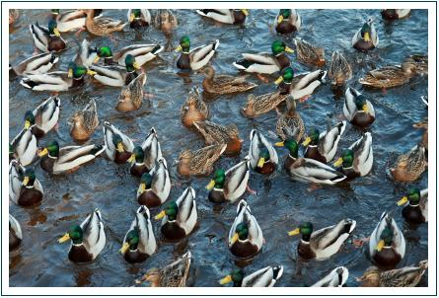
If it looks like a duck, and swims like a duck, and quacks like a duck, ….
Is it really a duck?

Slide 4
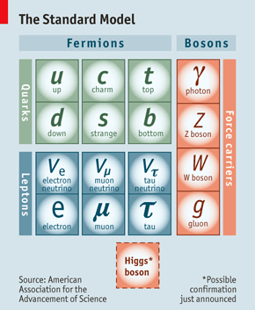
Is the new particle really the Higgs boson ?
We must ascertain its properties:
mass
spin
CP
couplings

Slide 5
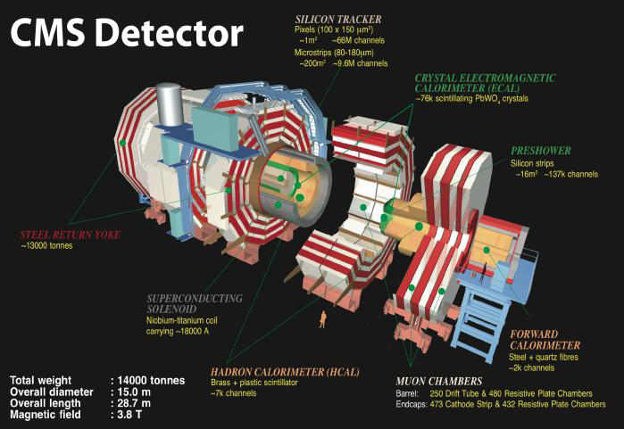

Slide 6
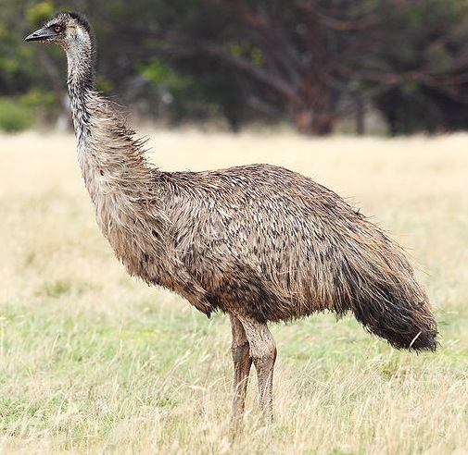
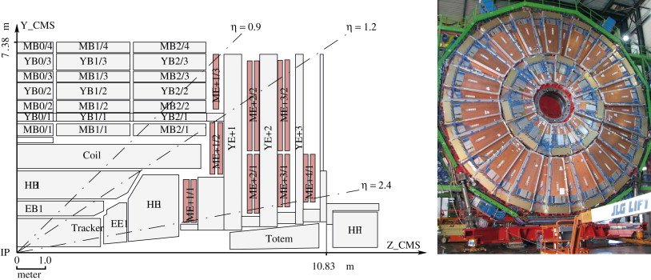
Endcap Muon Chambers (EMU):
Cathode Strip Chambers (CSCs)

Slide 7
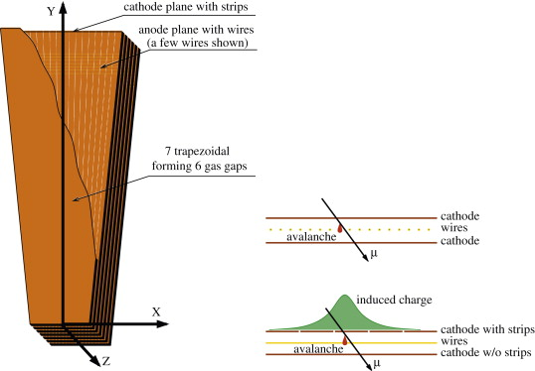
Endcap Muon Chambers:
Cathode Strip Chambers (CSCs)
6 layers of sensitive volume
cathode strips run radially
anode wires run azimuthally
chambers arranged in disks
strong magnetic field normal to the chamber

Slide 8
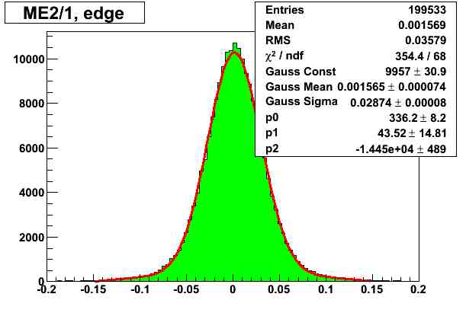
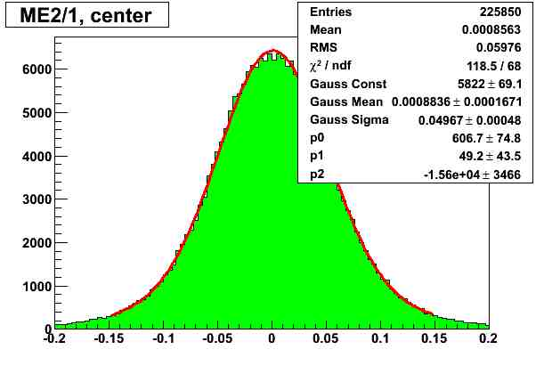
Endcap Muon Chambers:
J. Instrumentation 5 (2010) T03018
performance : spatial resolution
σ₁ = 322 μm
σ₂= 566 μm
per layer
per layer
position within the strip
position within the strip
near the edges: |strip coordinate| > 0.25
near the center: |strip coordinate| < 0.25
The resolution is better near the edges.
The resolution is worse near the center.
The resolution of a chamber can be estimated by
1/σ² (chamber) = 3/σ₁² + 3/σ₂²
in which case we have σ (ΜΕ2/1) = 161 μm.

Slide 9
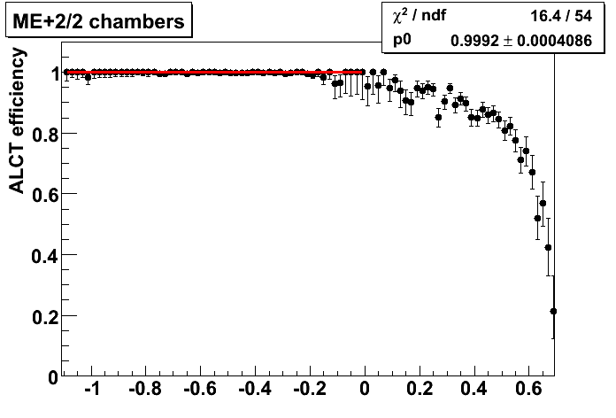
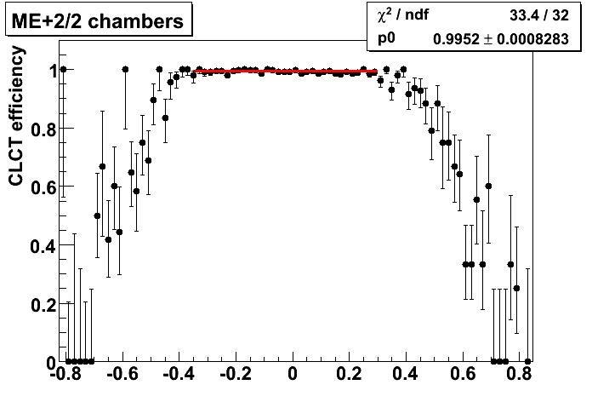
Endcap Muon Chambers:
J. Instrumentation 5 (2010) T03018
performance : trigger efficiency
These plots are made from all
good chambers in ME+2/2.
“Local dY/dZ” determines the angle
in the r-Z view, and “local dX/dZ”
determines the angle with respect
to a plan in r-Z (i.e., a fixed-φ plane).
Anode Local Charged Trigger:
efficiency > 99.9%
dY / dZ
A cut |dX/dZ| < 0.2 is made
when measuring ALCT efficiency,
and a cut dY/dZ < -0.1 is made
when measuring CLCT efficiency.
Cathode Local Charged Trigger:
efficiency > 99.5%
dX / dZ

Slide 10
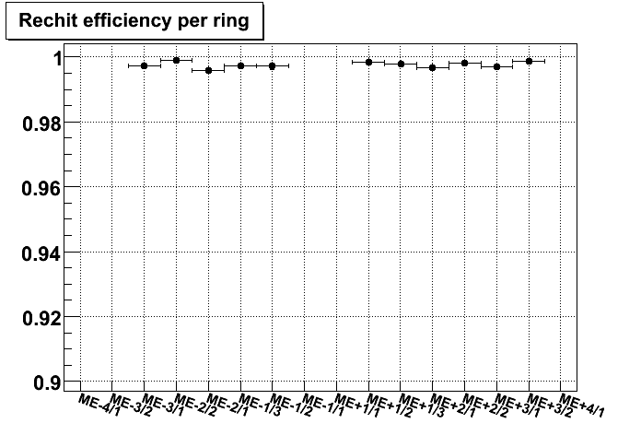
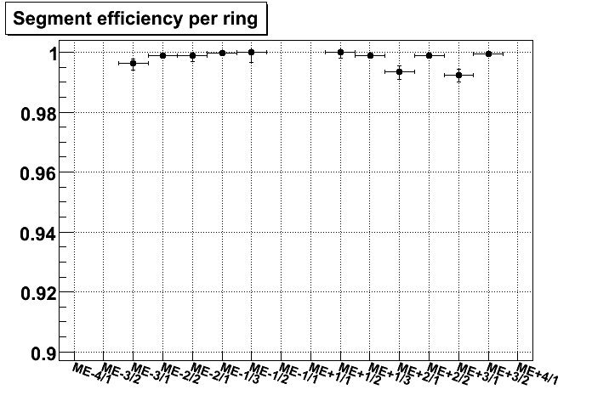
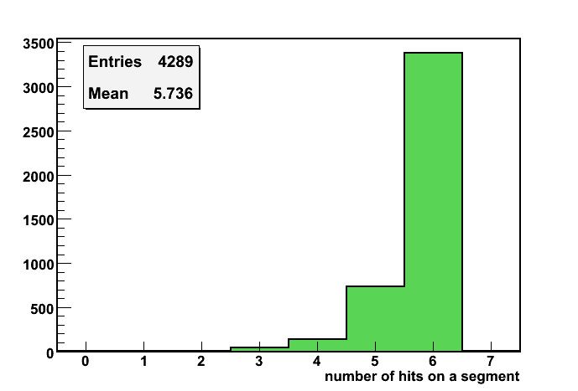
Endcap Muon Chambers:
J. Instrumentation 5 (2010) T03018
performance : reconstruction efficiency
Average measured efficiencies for each station/ring.
efficiency to obtain
a single hit in a layer
efficiency to obtain a track
segment in a chamber
A few chambers were
not working or were
unreachable using
cosmic ray muons,
and were excluded
from the averages.
number of hits
on a segment.
Maximum is 6.

Slide 11
Endcap Muon Chambers:
earliest accelerator-generated muons
LHC start-up: protons hit trace gas in beam pipe far to the left, p-atom collision causes showers, pions decay to muons
muons fly parallel to the beam pipe – perfect for the CSCs
trajectories are well reconstructed: slight bend due to CMS magnetic field

Slide 12
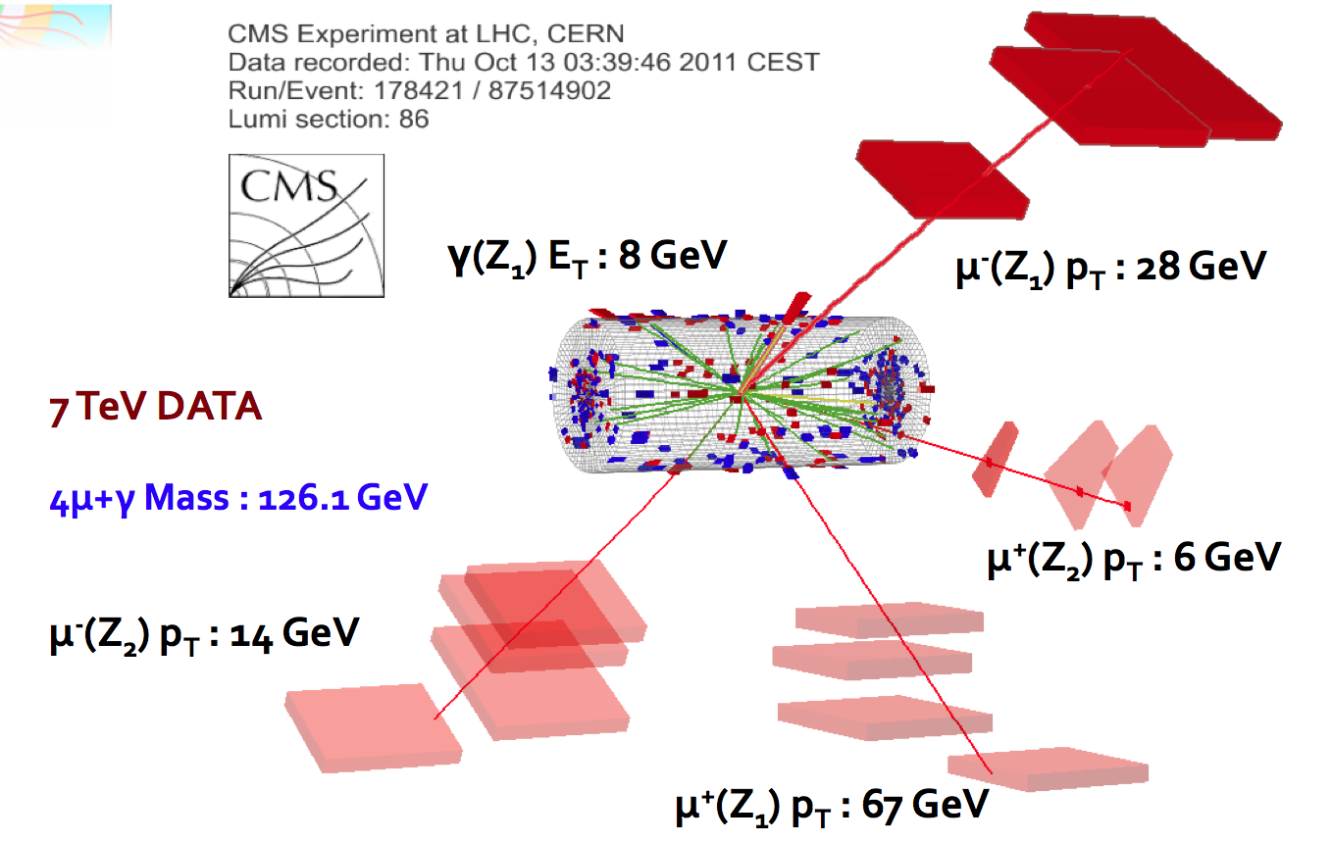
This is a candidate Higgs event:
more on this later...

Slide 13
J. High Energy Phys. 10 (2011) 007
Drell-Yan process:
quark + anti-quark annihilate
muon + anti-muon appear
intermediary is the Z boson, and/or the virtual photon γ∗
importance:
crucial benchmark for event analysis
quark & anti-quark momentum fractions (known as parton distribution function)
direct test of advanced (and difficult) theoretical calculations [→ F. Petriello & co.]
invariant mass of two muons

Slide 14
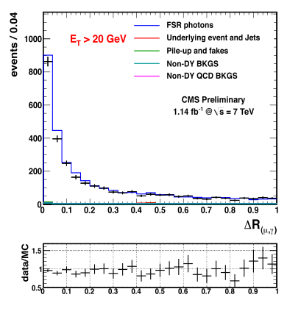
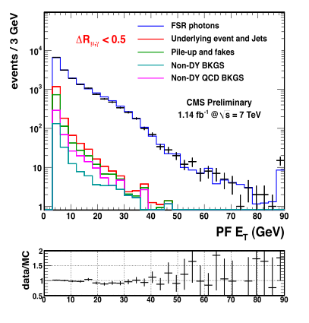
QED higher orders
(in prep.)
→ test higher-order corrections in detail

Slide 15
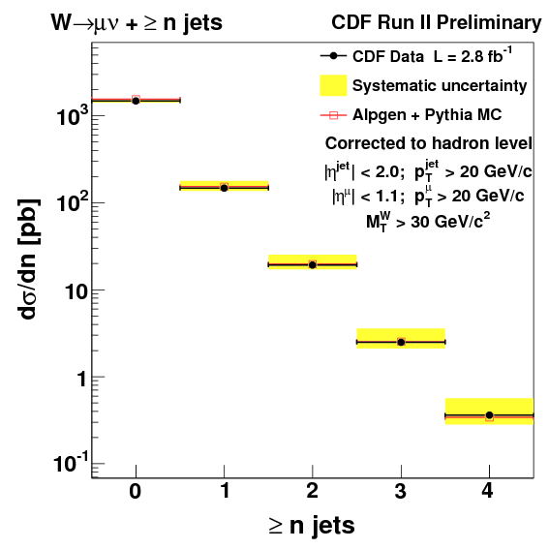
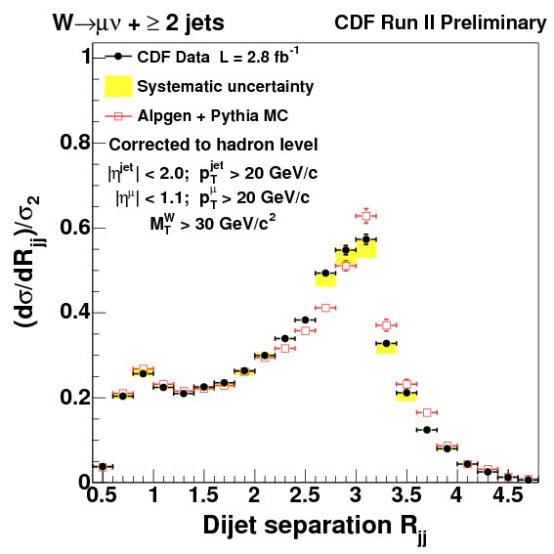
QCD higher orders
(in prep.)
→ test higher-order corrections in detail

Slide 16
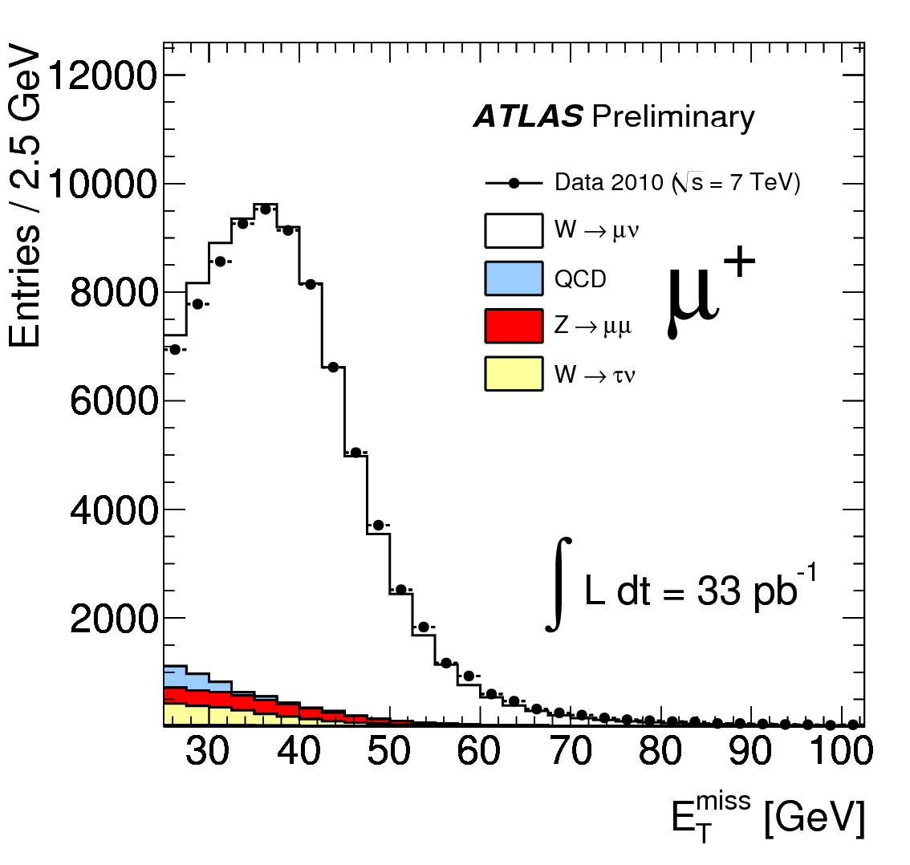
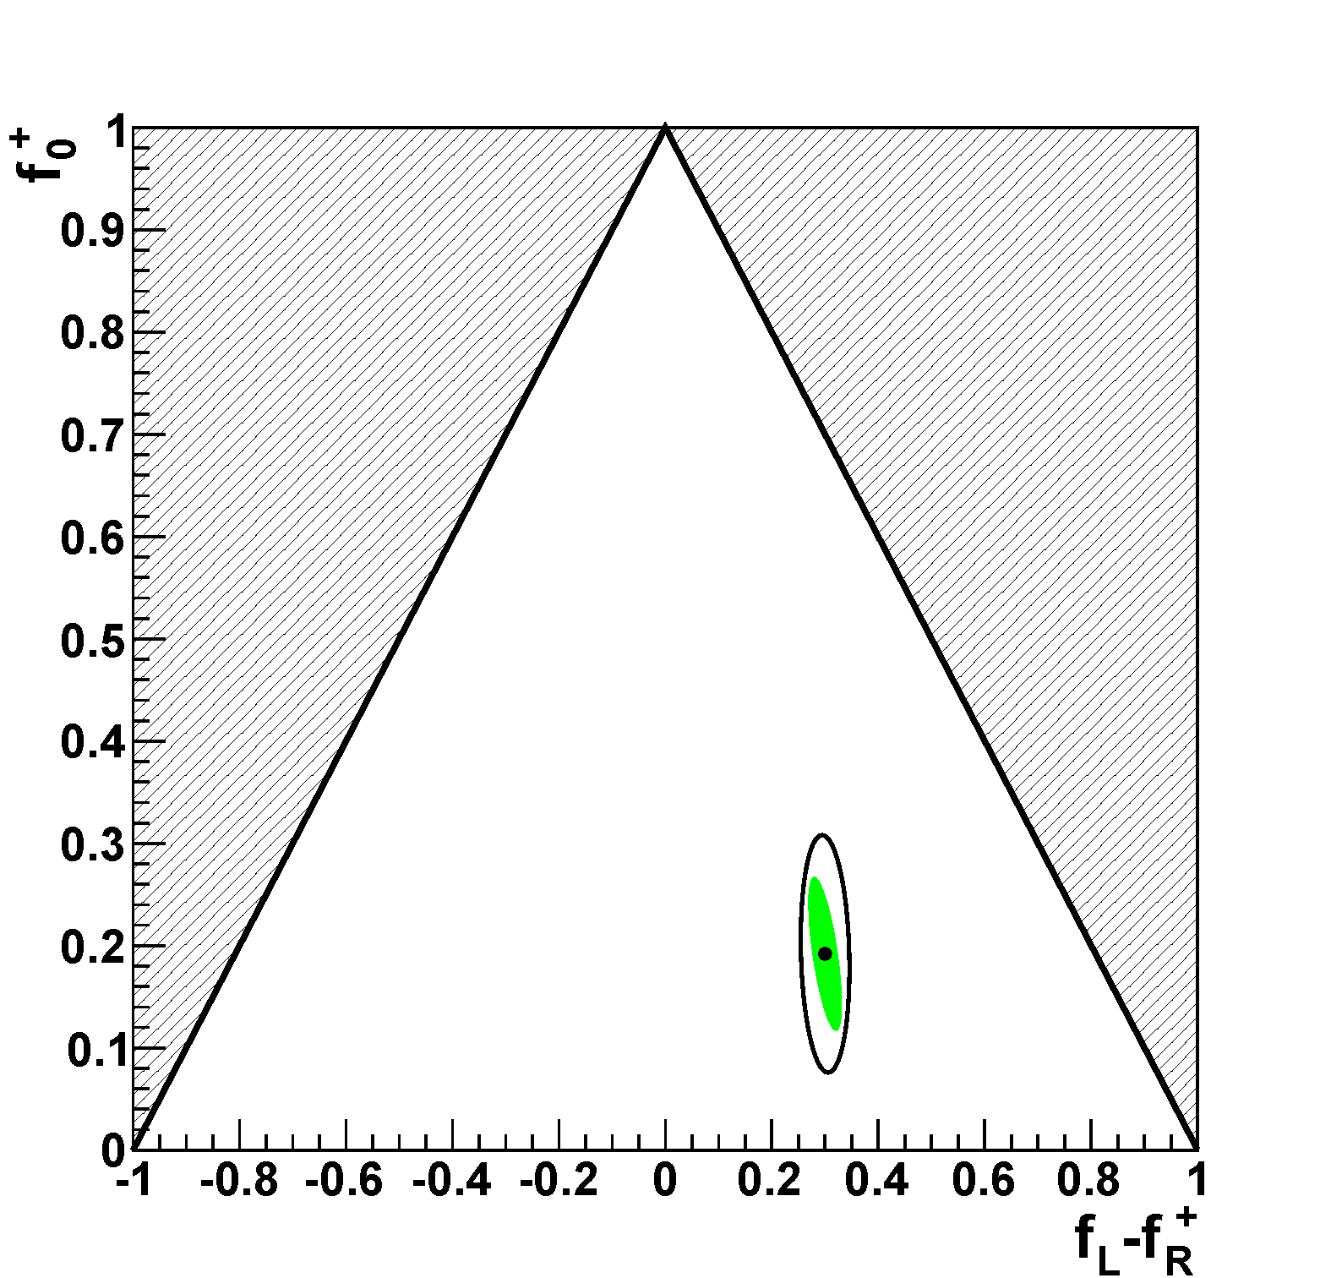
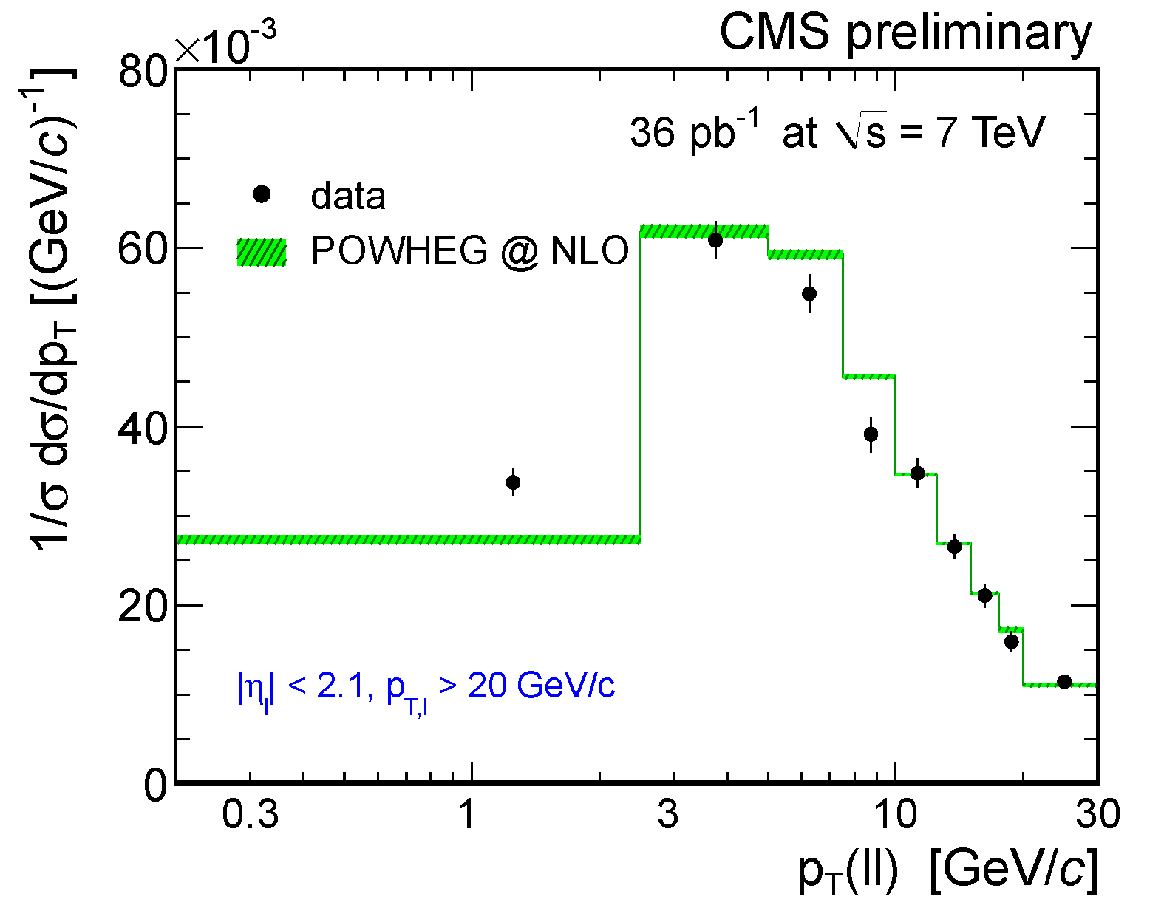
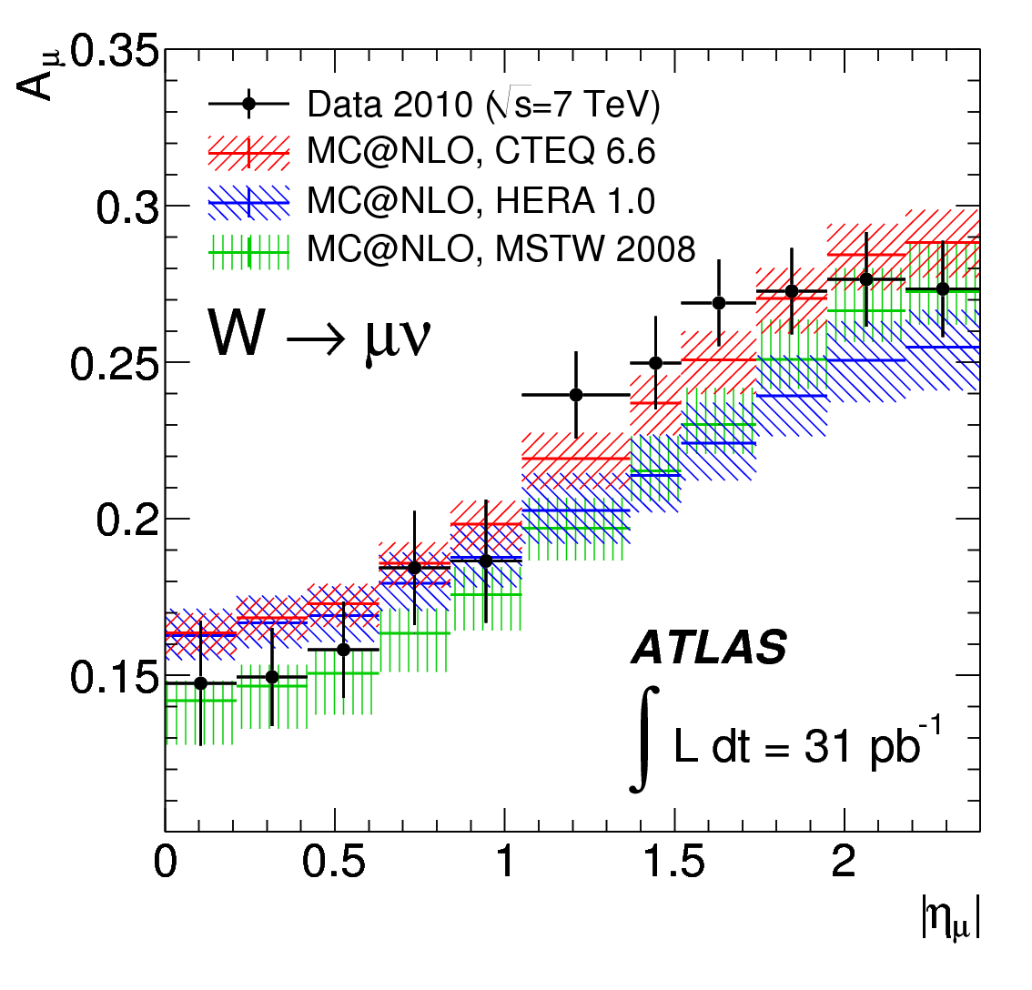
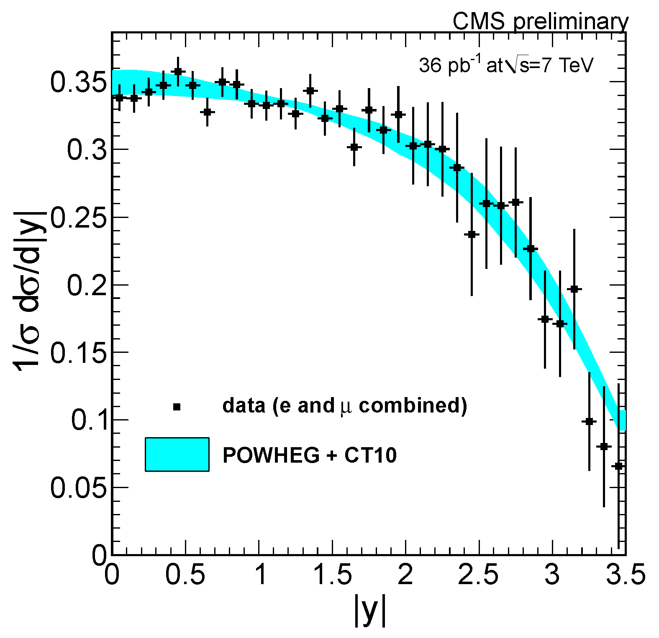
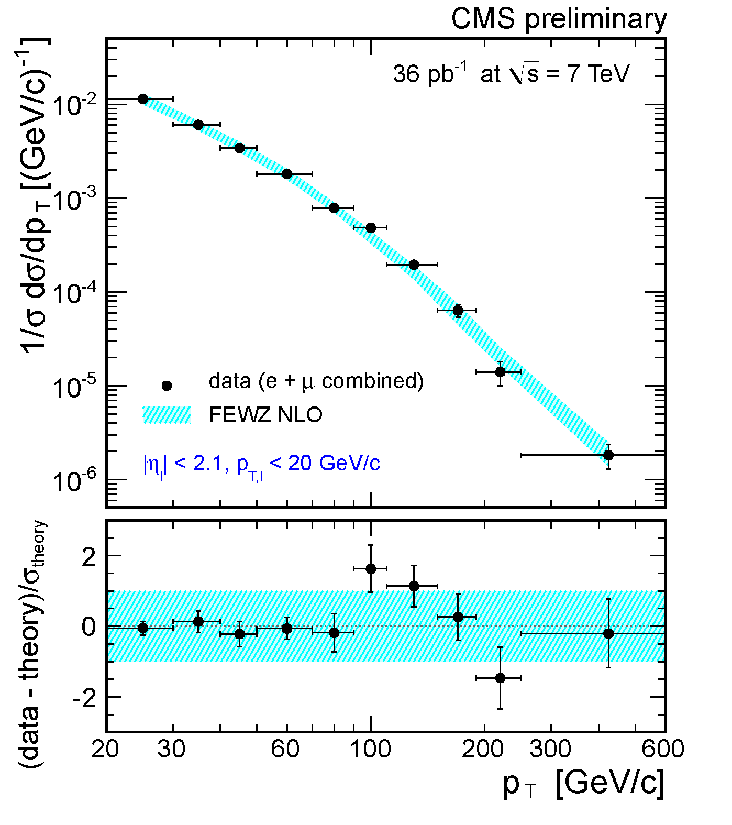
There are dozens of other
“electroweak” physics results
from CMS –
but there is not enough time
to discuss them…

Slide 17
Back to the Higgs boson!!

Slide 18
Could this be a fluctuation of the background?
invariant mass of two photons

Slide 19
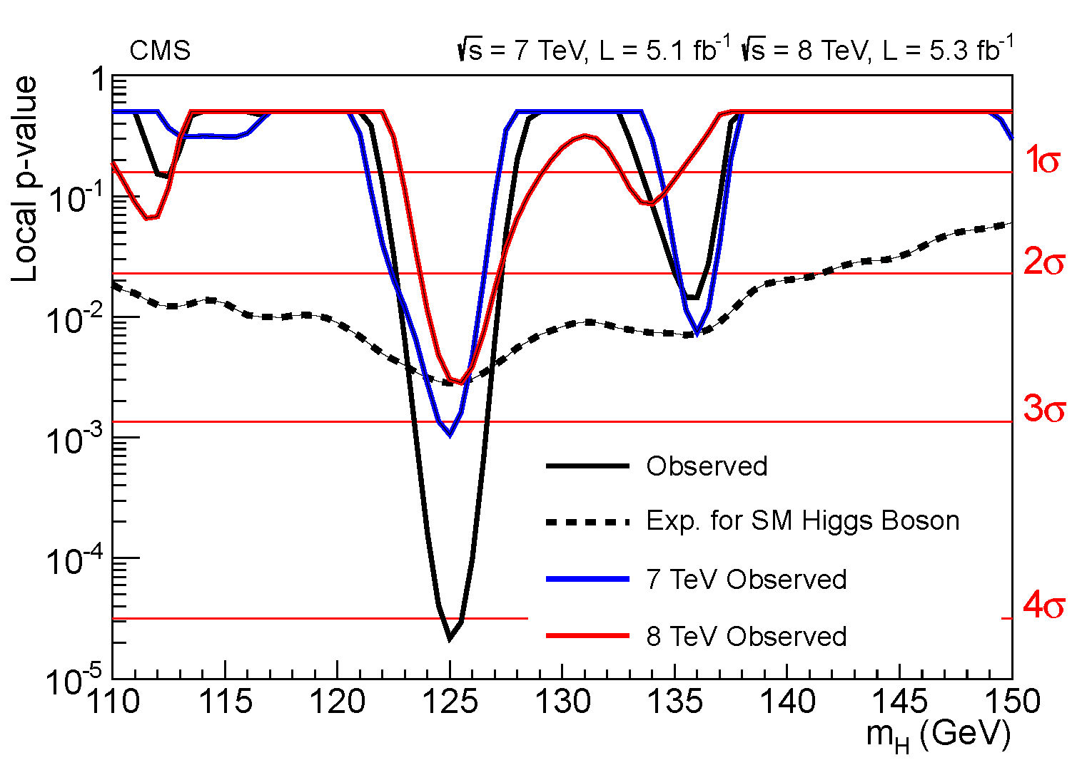
Could this be a fluctuation of the background?
The p-value tells us the probability that the
background fluctuations to see what is actually
observed – assuming no signal is present.
A small p-value means the bump is probably
not a fluctuation of the background.
Note: same peak
in two data sets.
hypothetical Higgs boson mass

Slide 20
This mode tells us a lot:
the new particle has charge zero
the new particle has no color charge
the new particle is not a fermion
the new particle is not spin-1
the effective coupling to gluons and photons is small

Slide 21
This is the
new peak!
This is an
old peak.
invariant mass of four leptons

Slide 22
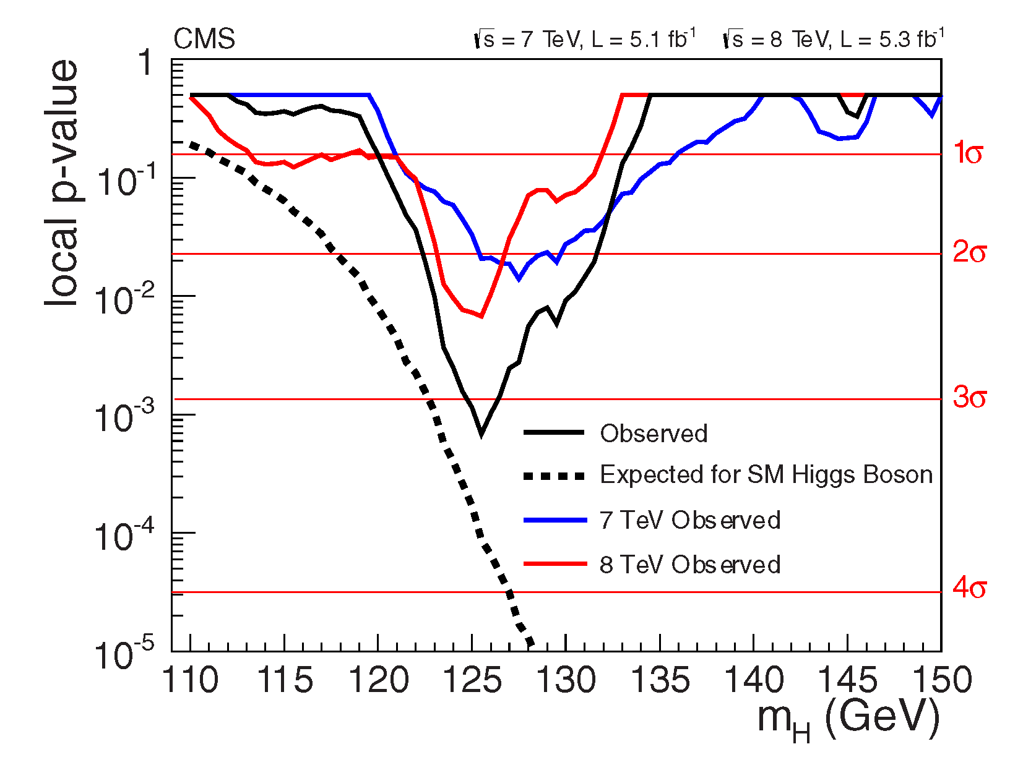
Two similar dips in the
p-values around 125 GeV
for two data samples.
hypothetical Higgs boson mass

Slide 23
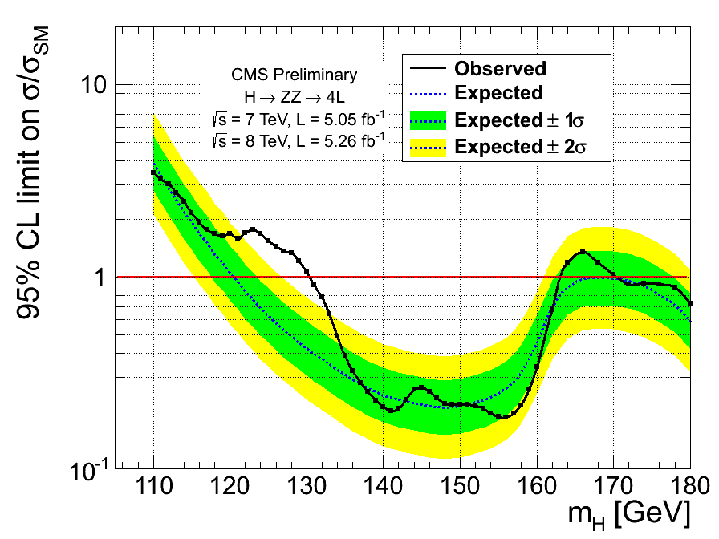
The data curve lies
outside the ±2σ band.
“The Brazil plot”
hypothetical Higgs boson mass

Slide 24
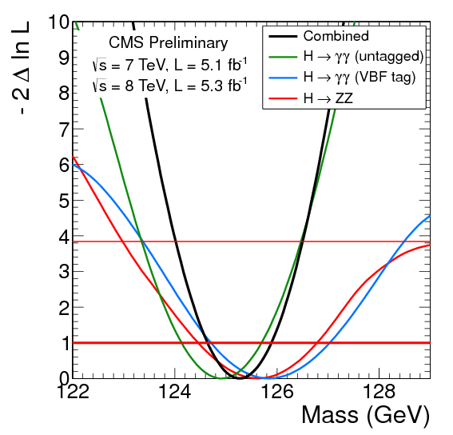
Mass Measurement:
(0.5%)
The two peaks (γγ and ZZ) appear at the same mass.
Hypothesize that they correspond to the same
particle and combine the mass information to
infer the mass of that particle…

Slide 25
Charge-Parity (CP):
Is it CP-even, CP-odd, or indefinite?
Can be inferred from angular distributions:
lepton pairs in H → ZZ
charged leptons in H → WW
forward jets in, e.g., H → γγ
polarization of H → ττ
Fascinating Possibility:
signal in γZ compared to γγ
pointed out by Kunal Kumar (NWU)
the main priority in Mayda’s group
A strong statistical separation demands more data –
-- the analysis is underway.
Expect > 3σ separation by early 2013.
See Ian Low’s talk next week for more on this subject.

Slide 26
Δφ
(beam line
into page)
azimuthal angle between leptons

Slide 27
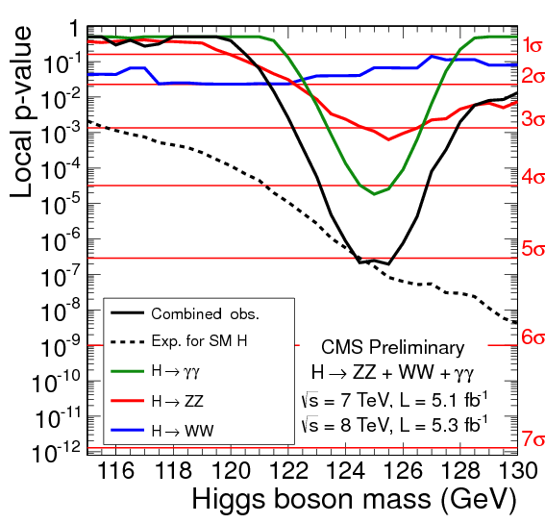
ZZ
γγ
WW mode
all
We cannot measure M_{WW}
because the ν energies
are not known, so the
p-value does not have a
narrow dip.

Slide 28
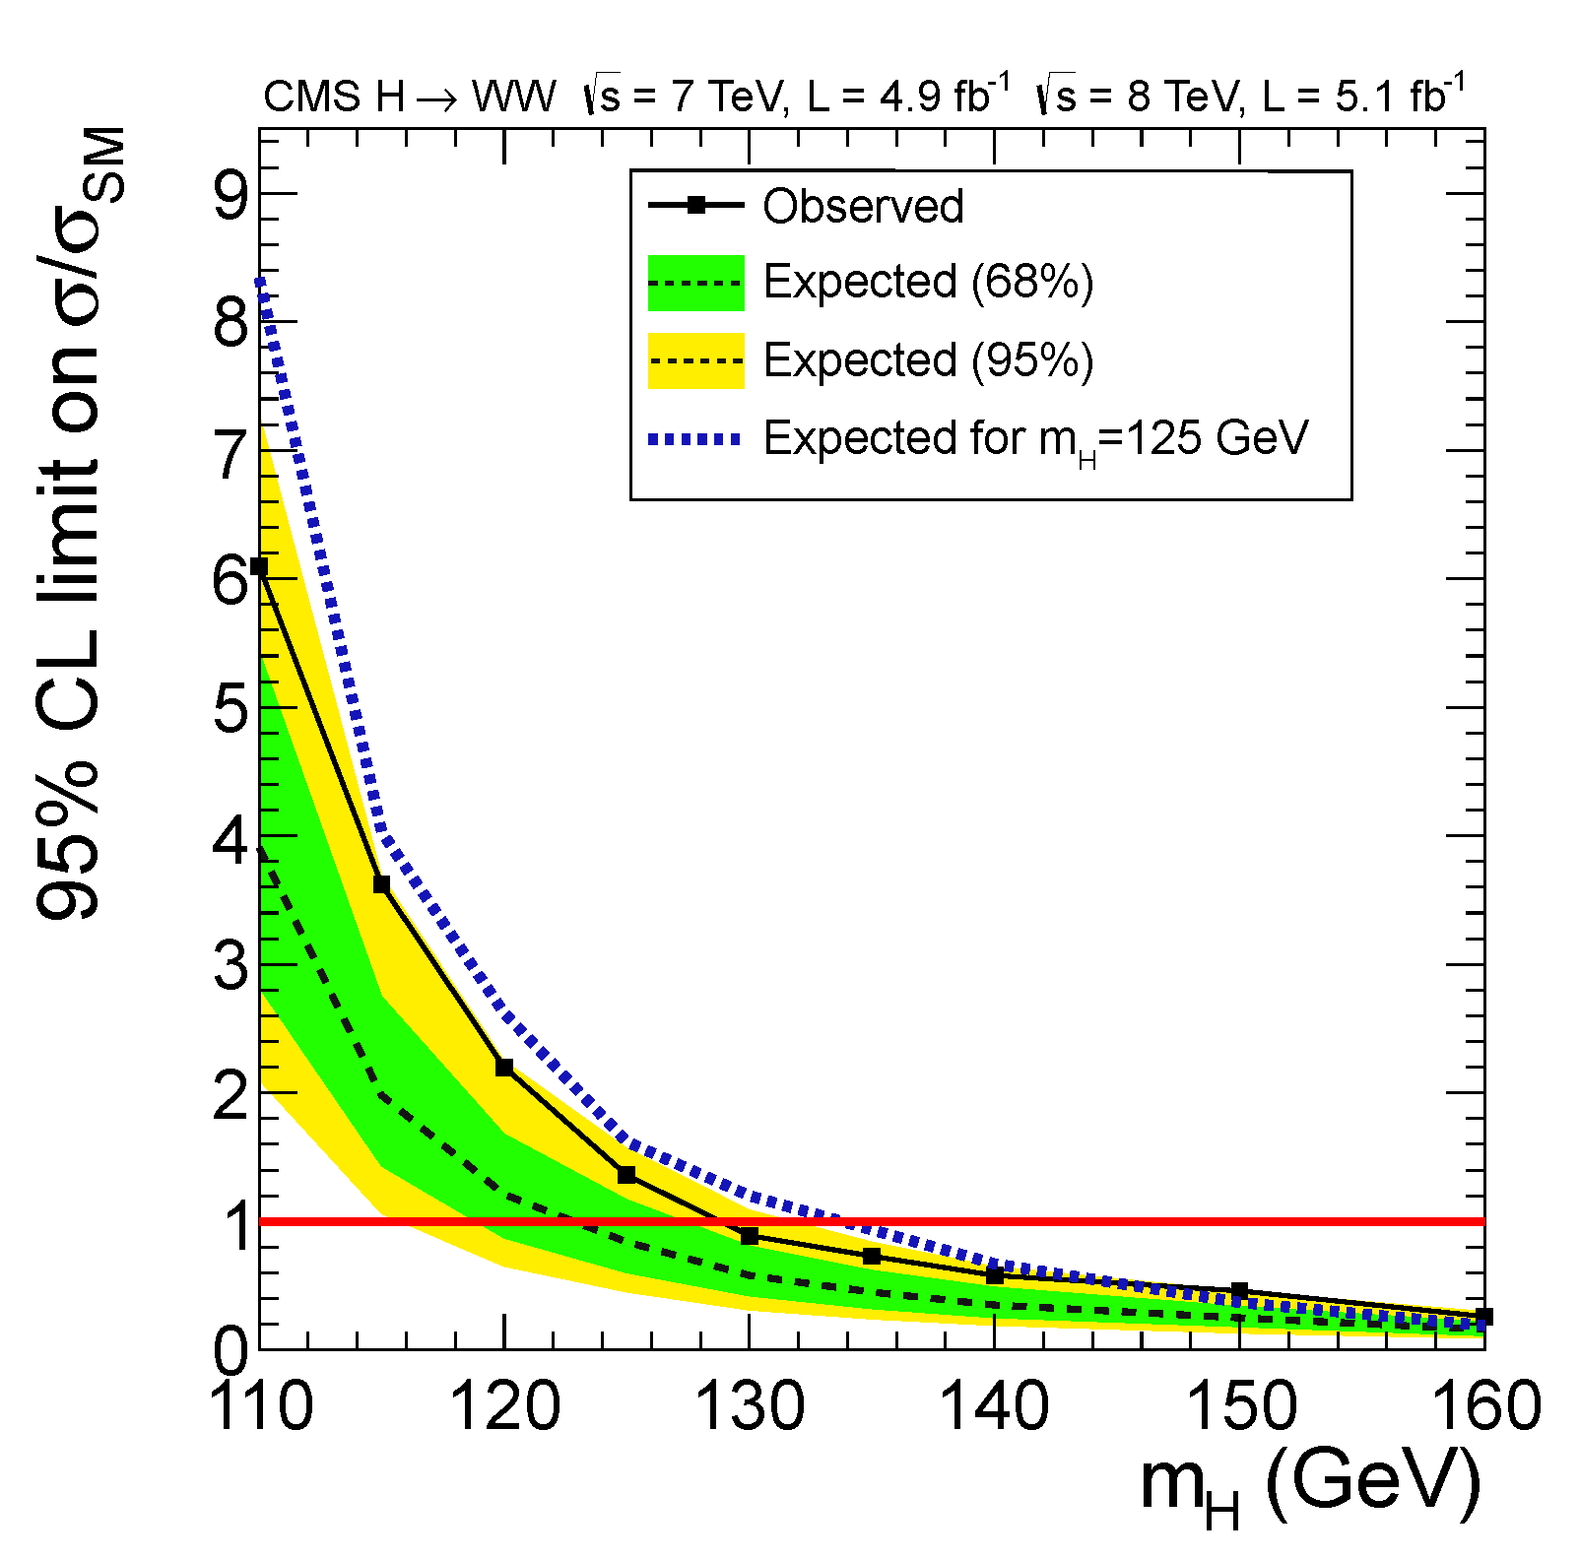
There is a broad excess but
it is not very significant.

Slide 29
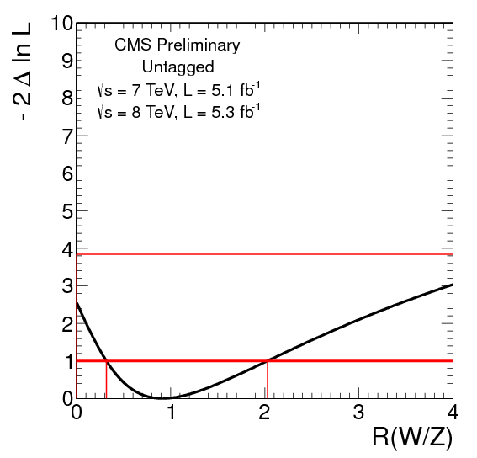
WW and ZZ modes: Custodial Symmetry
H → WW and H → ZZ are related because W and Z bosons are both electroweak bosons
and the Higgs boson determines their properties.
The Standard Model fixes the ratio of B(H→WW) / B(H→ZZ) and this cannot be violated by any other Higgs boson.
Is this upheld by the data?

Slide 30
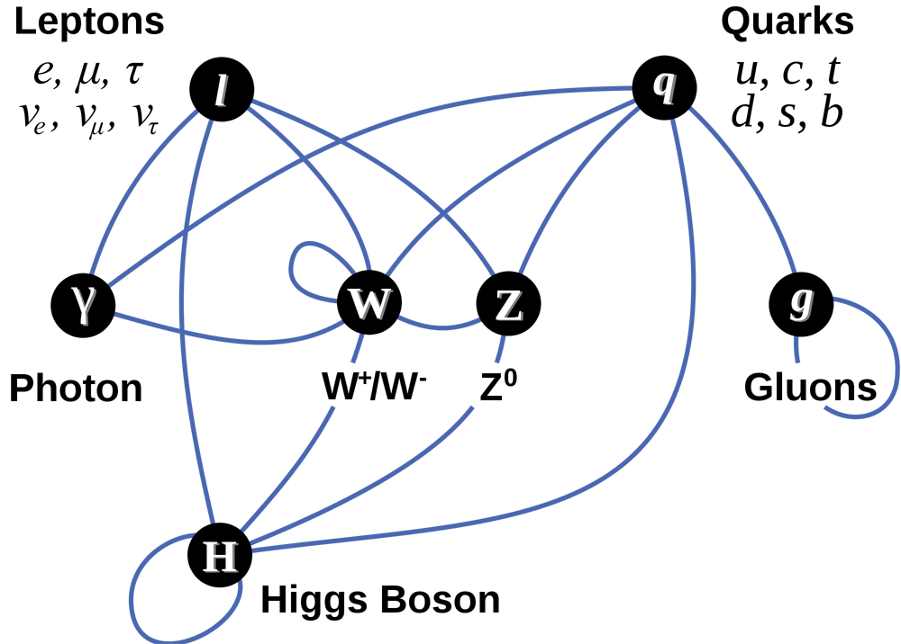

Slide 33
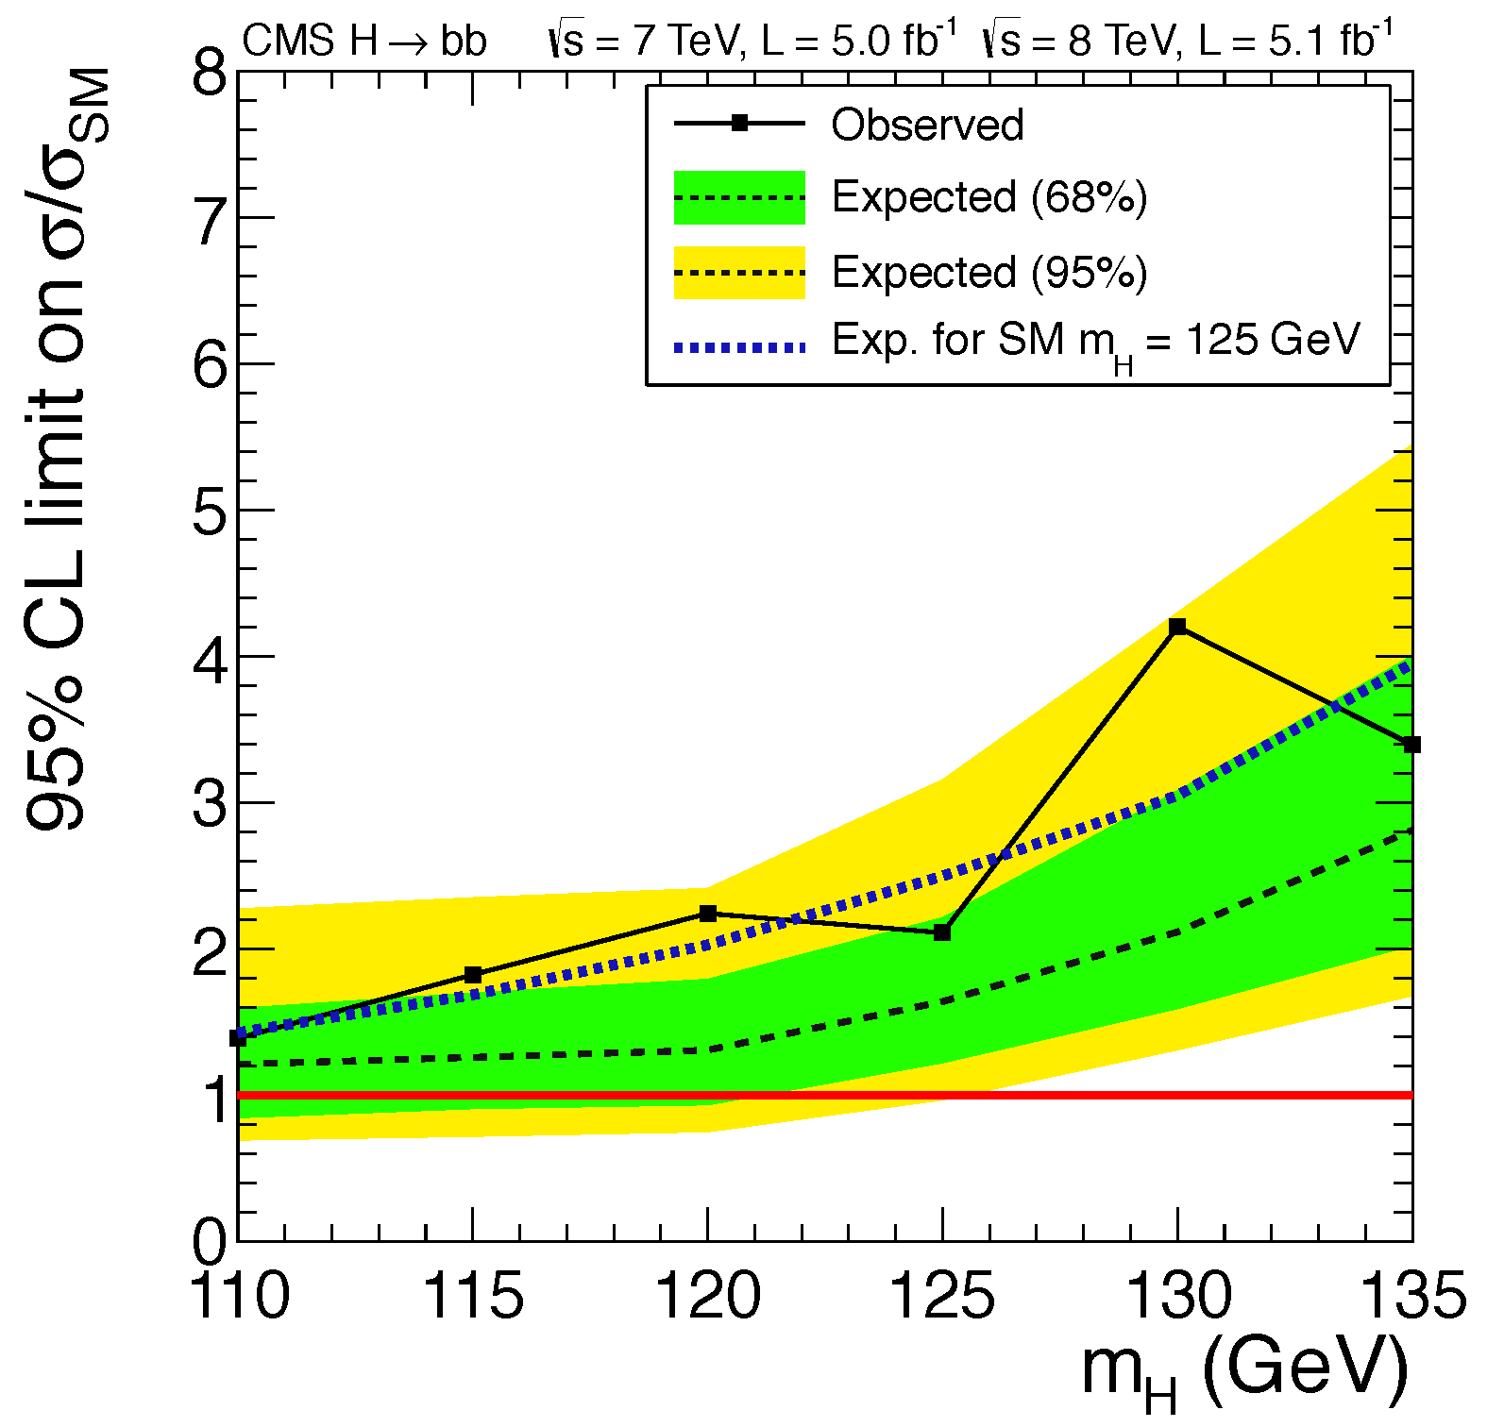
→ a hint of a signal…
The background is huge.
Use a subdominant signal process: pp → VH
where V = W or Z.
Leptonic decays of W or Z provide a cleaner signature.
H → bb would appear as a peak in the M_{bb} spectrum.

Slide 34
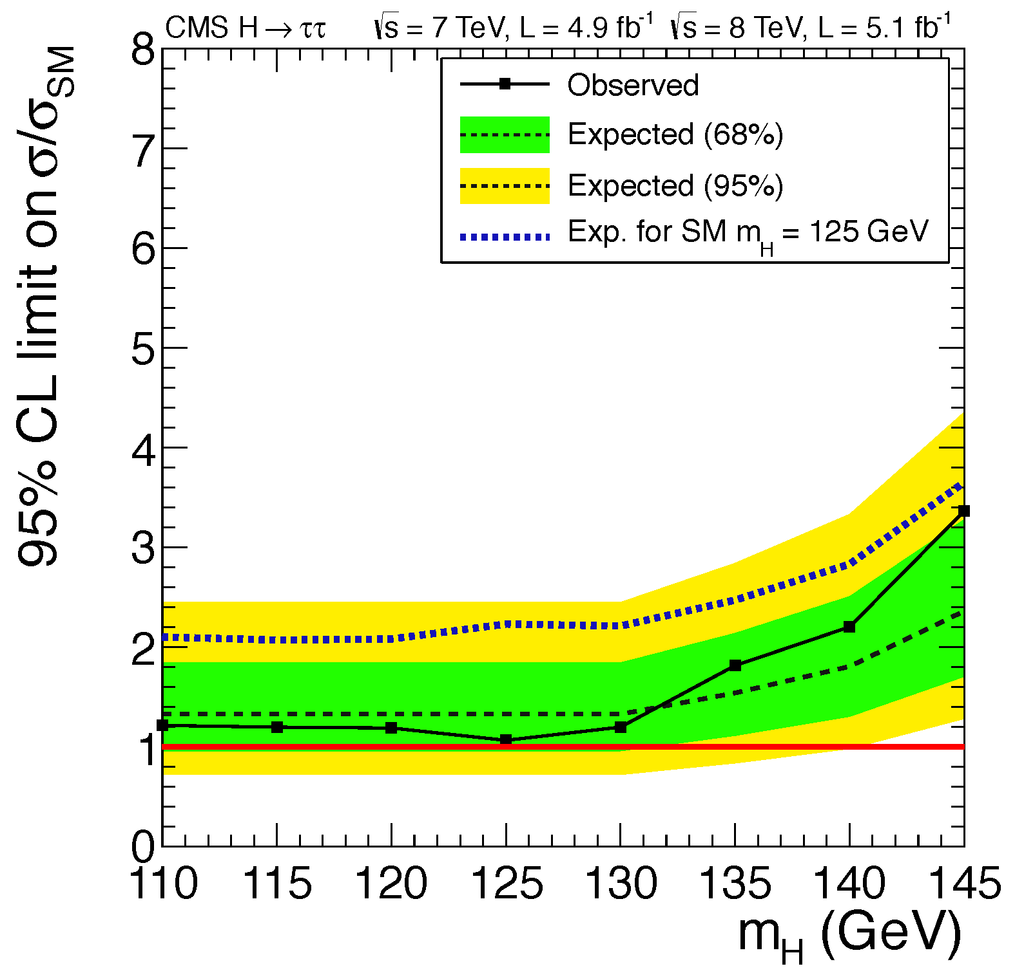
→ definitely no signal???
Tau decays are distinctive – background is not too large.
The τ leptons decay to e,μ and invisible νs,
so no H → τ⁺τ⁻ mass peak can be observed.

Slide 35
What is the overall picture
of Higgs boson decays?

Slide 36
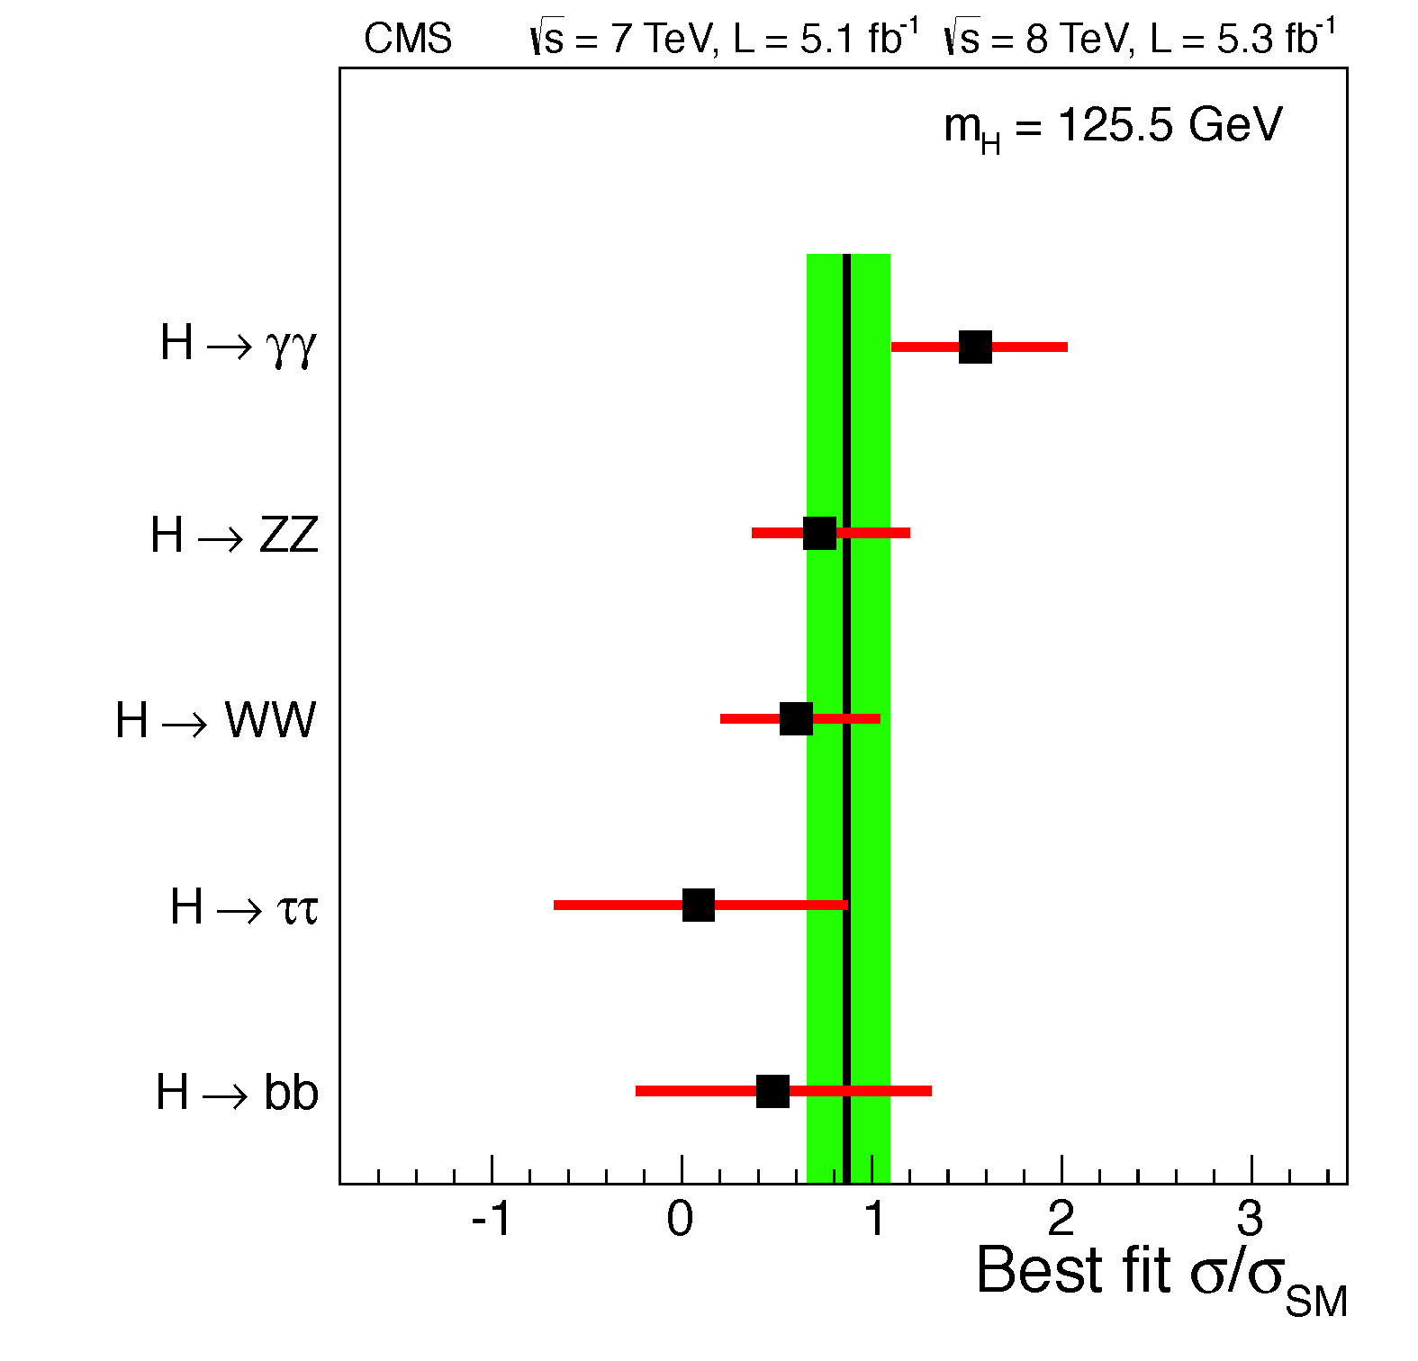
What is the overall picture
of Higgs boson decays?
seems high…
seems a little low…
could it be zero?
hard to tell…

Slide 37
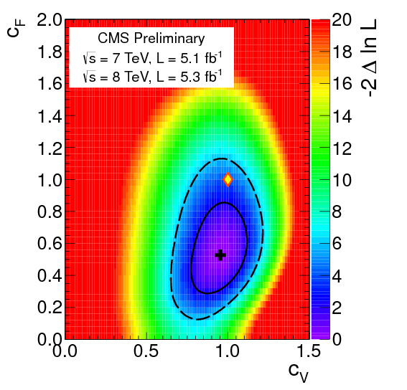
Coupling Constants:
We have seen signals in channels with:
gauge bosons (γγ, ZZ, WW)
3rd generation fermions (ττ, bb)
There is more information, in fact:
H-γγ & H-gg couplings are loop-induced, and involve H-tt and H-WW couplings
Some subdominant processes involve exchange of W bosons in the t-channel (VBF) or s-channel (VH)
Try to explain signal-strength pattern by rescaling
H couplings to gauge bosons c_{V}
H couplings to fermions c_{F}

Slide 38
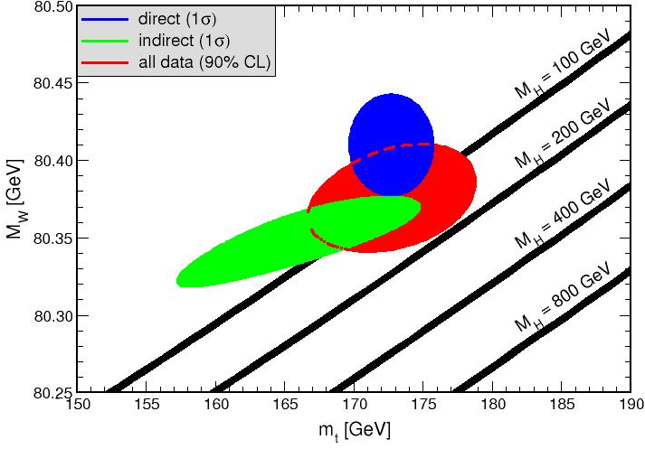
Probing the SM : virtual effects

Slide 39
Now we are probing the SM in a wholly new way!
In the past we were probing virtual effects. Now we are probing tree-level effects.

Slide 40
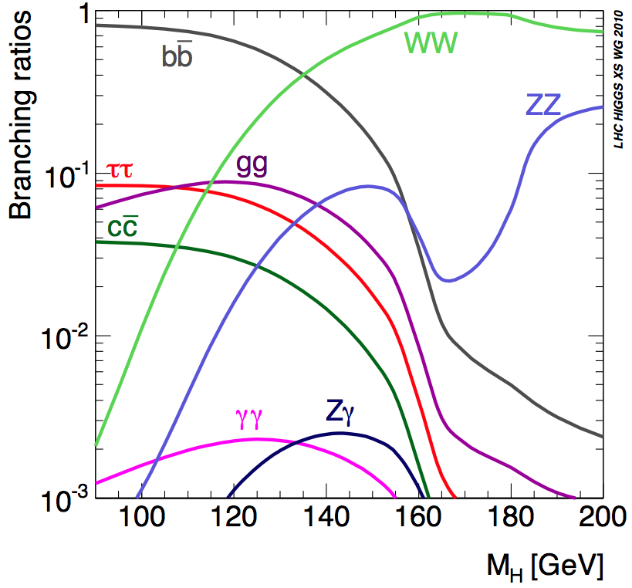
Beyond the Standard Model??
The Standard Model specifies all properties of the Higgs boson once its mass is known:
We are here.
hypothetical Higgs boson mass

Slide 41
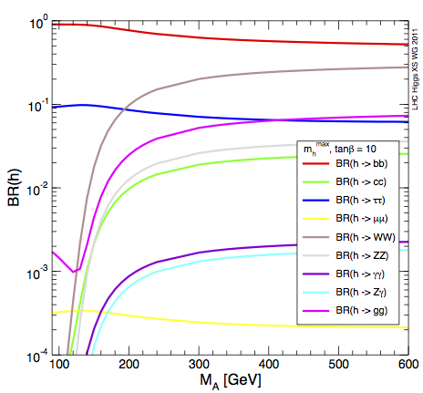
Beyond the Standard Model??
In speculative theories (Supersymmetry, Extra Dimensions, etc.)
the properties of the Higgs boson will be modified.
MSSM
WW
ττ
ZZ
γγ
another Higgs boson mass

Slide 42
Is the new particle really the Standard Model Higgs boson?
Time will tell. Soon.
Hopefully the insights we gain through more analysis
will reveal a beautiful side of particle physics…

Slide 43
Thanks to:

Slide 44
EXTRAS

Slide 45
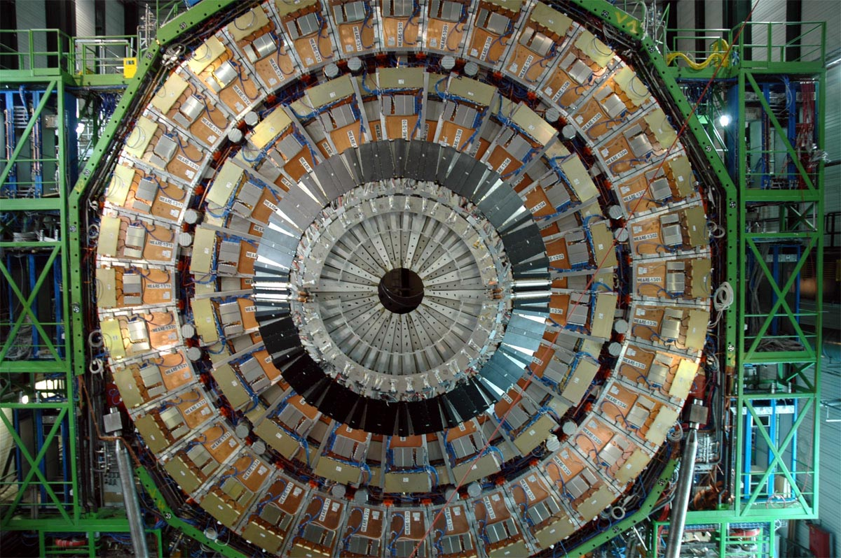

Slide 46
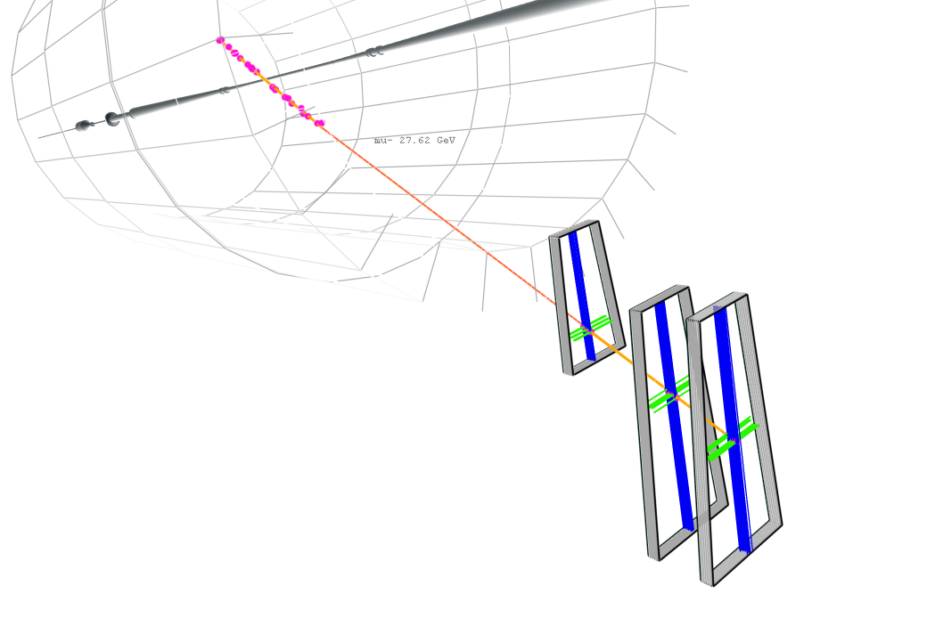
Run 66533, Event 755832

Slide 47
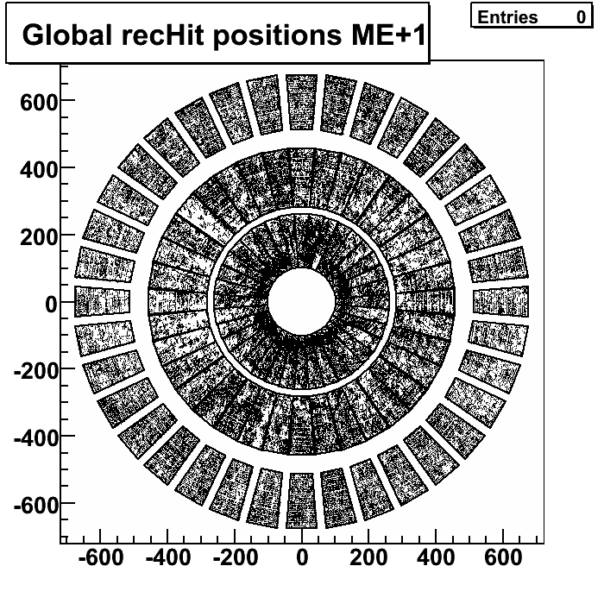
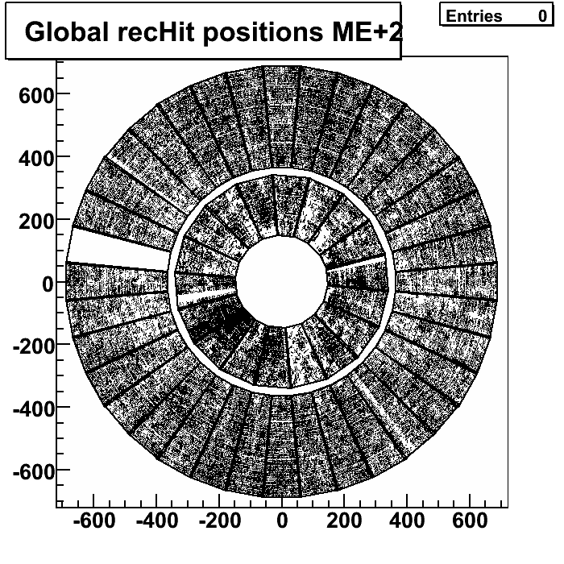
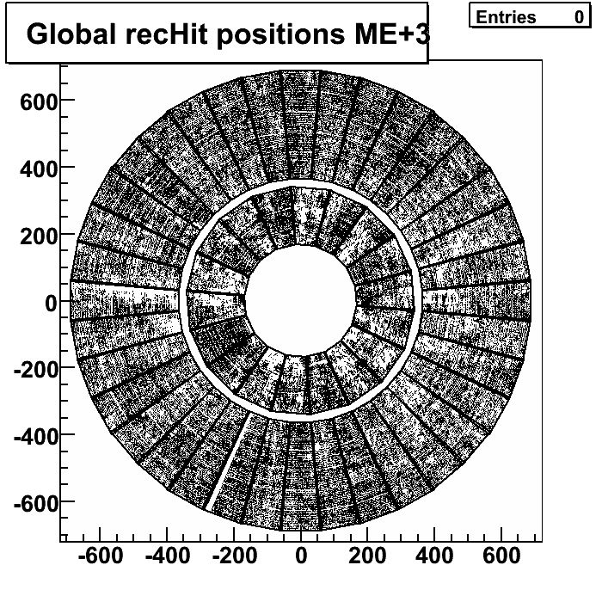
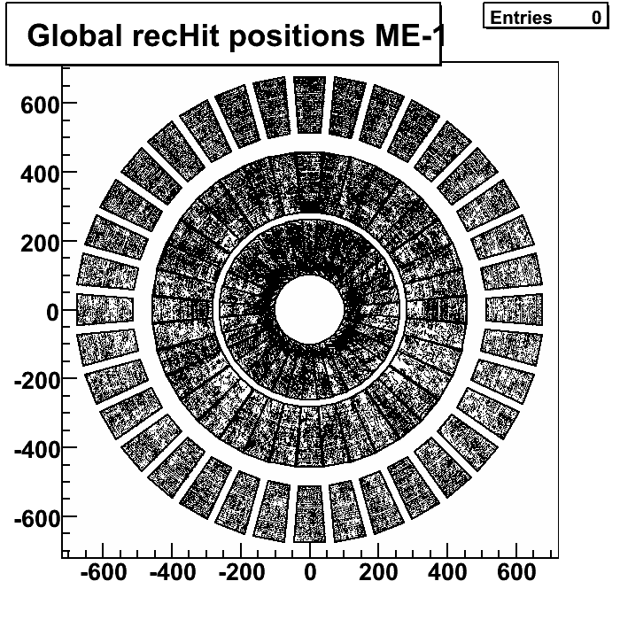
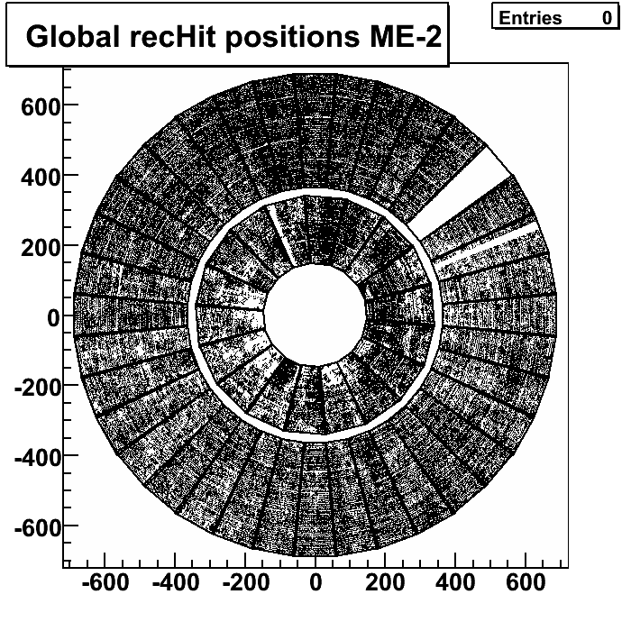
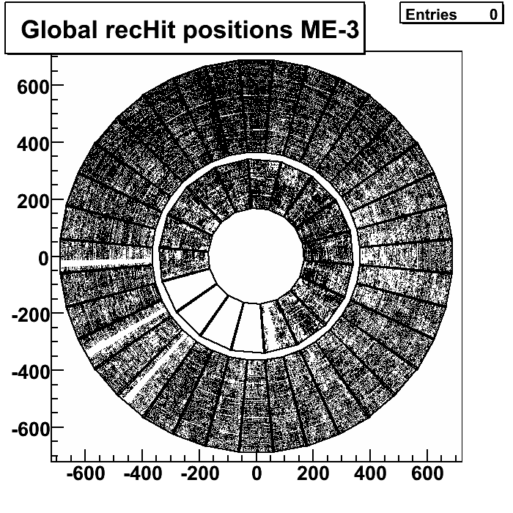
where things stand today
snapshot from March 3, 2009 (local run)
(CERN was re-painting ME4.)

Slide 48
hypothetical Higgs boson mass

Slide 49
hypothetical Higgs boson mass

Slide 51
effective H-gg coupling
effective H-γγ coupling

