Slide 1
W and Z Bosons at the High Energy Frontier
Michael Schmitt
Northwestern University
U. Kentucky Colloquium
April 27, 2012

Slide 2
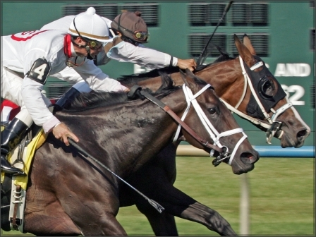

Slide 3
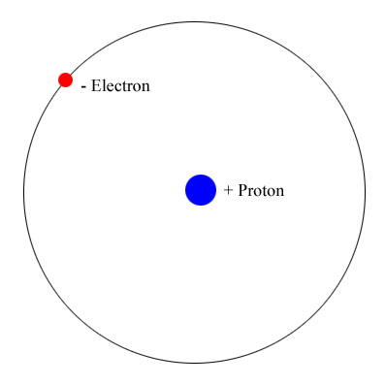

Slide 4
We understand the atomic
structure of matter.
This would be – and is – a
perfectly adequate picture
for most of physics.
Why do particle physicists
consider this view to be
inadequate?
the proton has a finite size (it is not point-like like the electron) so there must be something side – what?
electrons are not unique

Slide 5
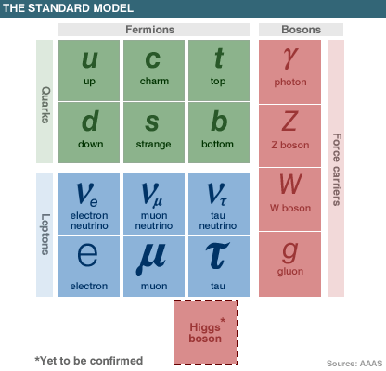
the proton has a finite size (it is not point-like like the electron) so there must be something side – what?
electrons are not unique
the fundamental particles
inside the proton are “quarks”
the electron and its sisters are “leptons”

Slide 6
matter particles (spin-1/2)
force carriers
(spin-1)
Higgs Boson
(spin-0)
(We’ll come back to this.)

Slide 7
We will
focus on
these.
matter particles (spin-1/2)
force carriers
(spin-1)
Higgs Boson
(spin-0)
(We’ll come back to this.)

Slide 8
This resonance is an important piece of the Standard Model:
The Z boson sometimes
decays to a pair of muons.
So we can find Z boson in
events with a μ⁺μ⁻ pair.

Slide 9
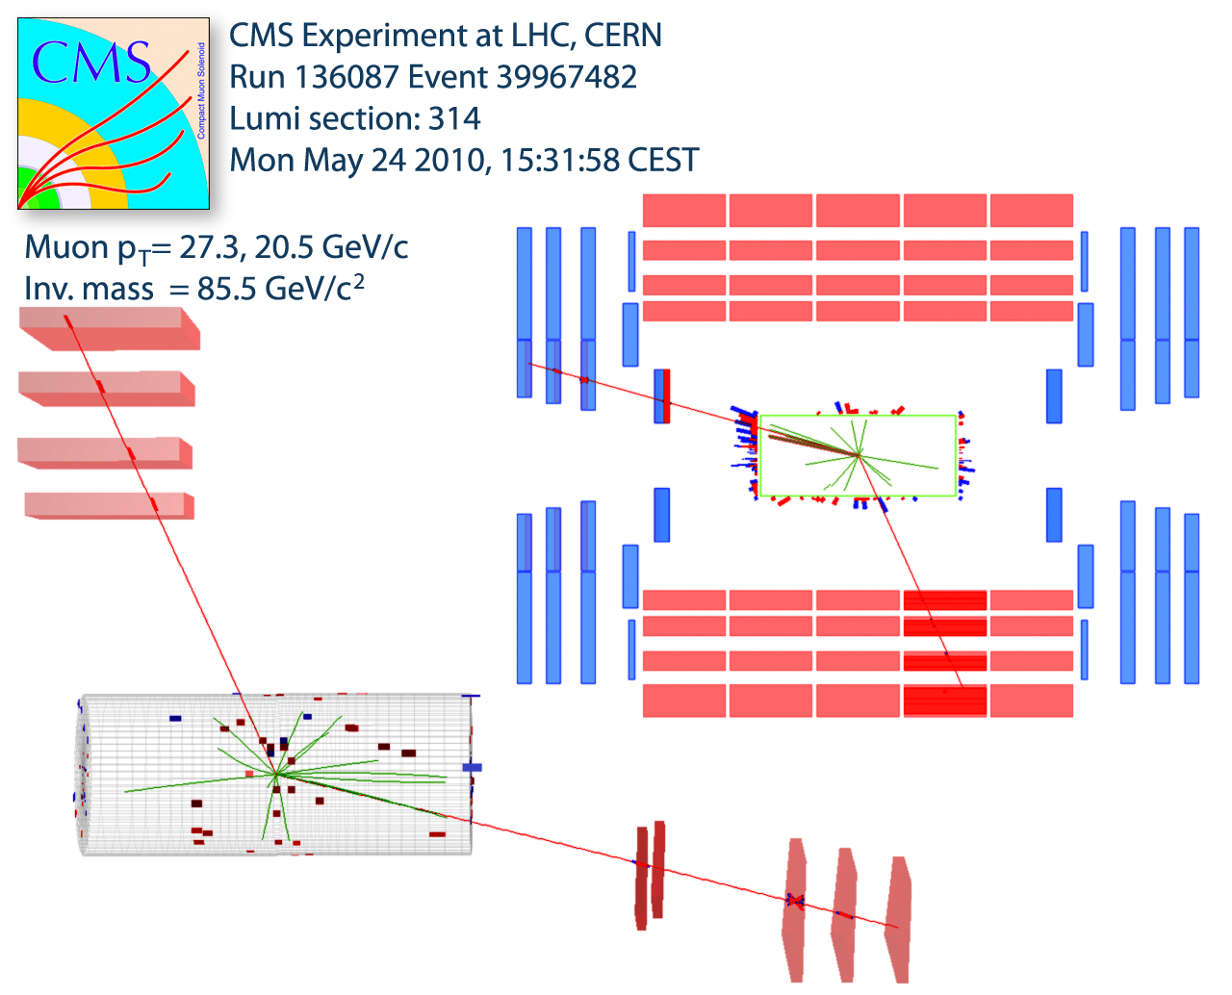
Here is a nice example!
p
p
μ
p
p
μ

Slide 10
The CMS Detector

Slide 11
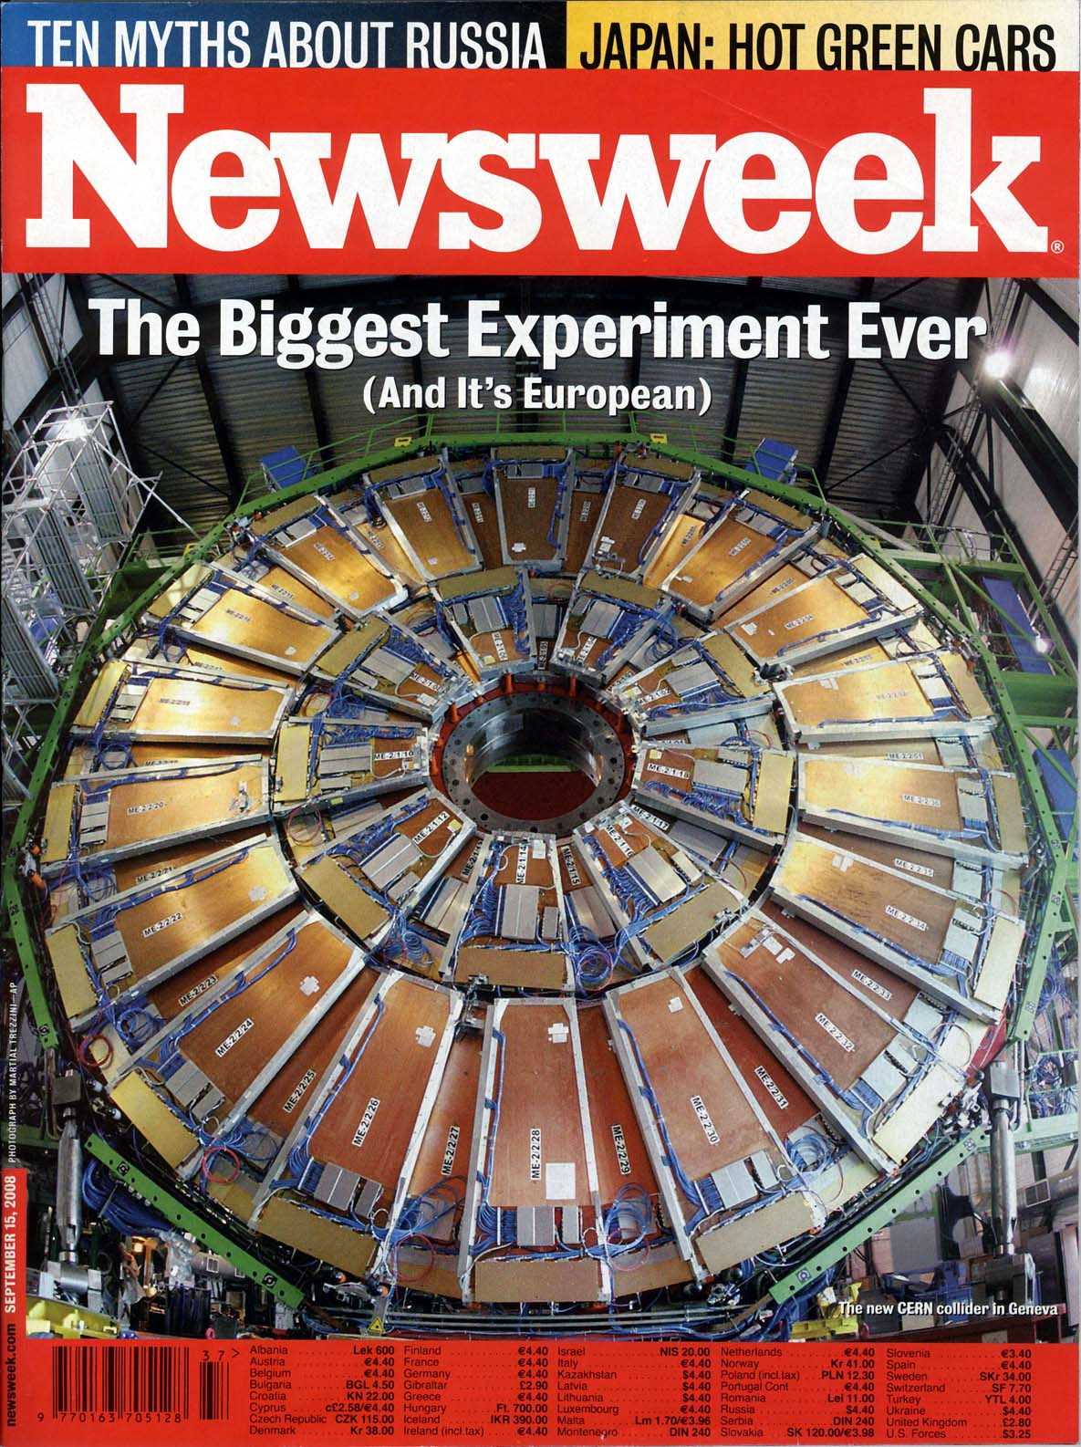
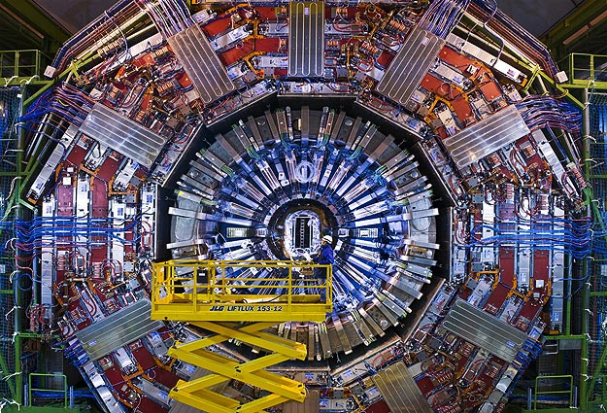
The real CMS Detector

Slide 12
μ is like e
except it is
much heavier
it radiates little
it has no nuclear interactions

Slide 13
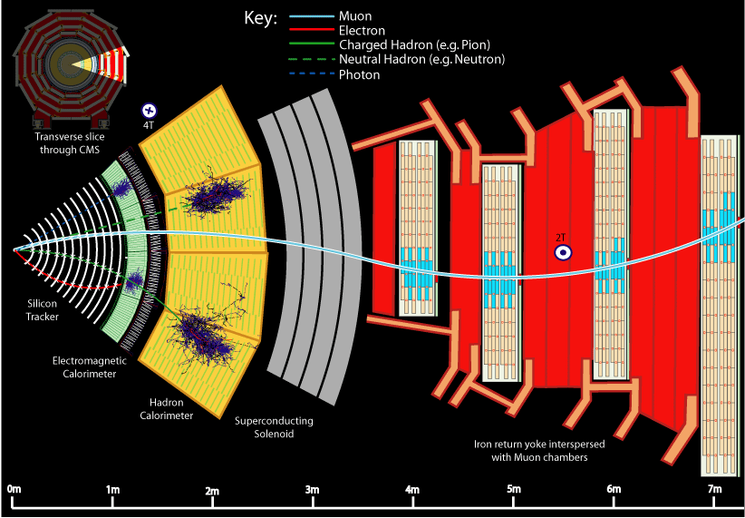

Slide 14
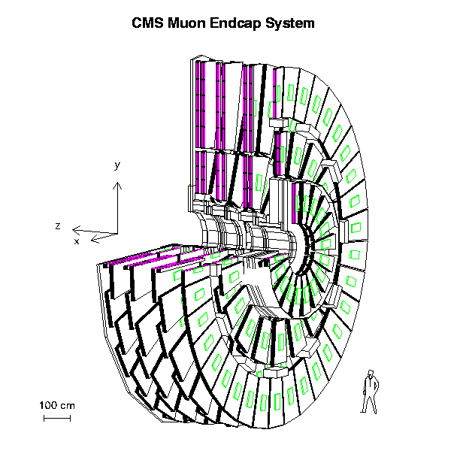

Slide 15
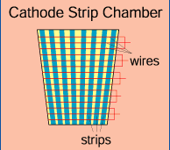
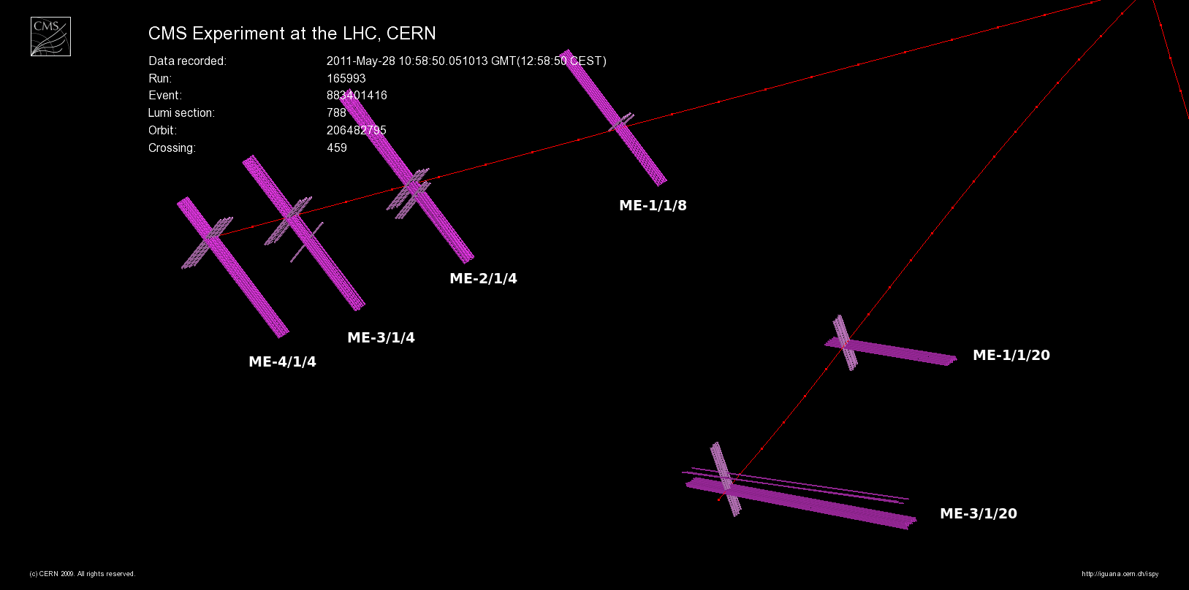
Muon trajectories are measured
in gas ionization chambers.
Many “XY” coordinates are obtained.

Slide 16
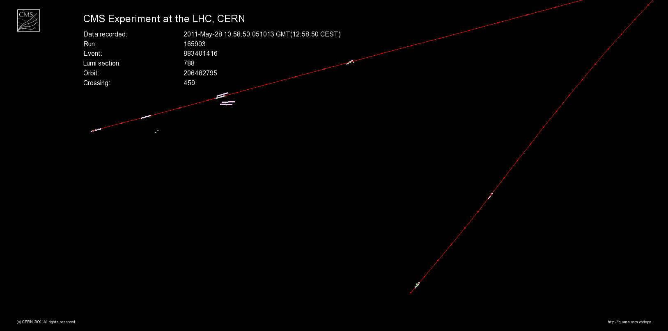
Short segments of the track are formed
from the “XY” coordinates and then
joined to form a muon “track.”
This track is joined to a “silicon” track to
form the muon.

Slide 17
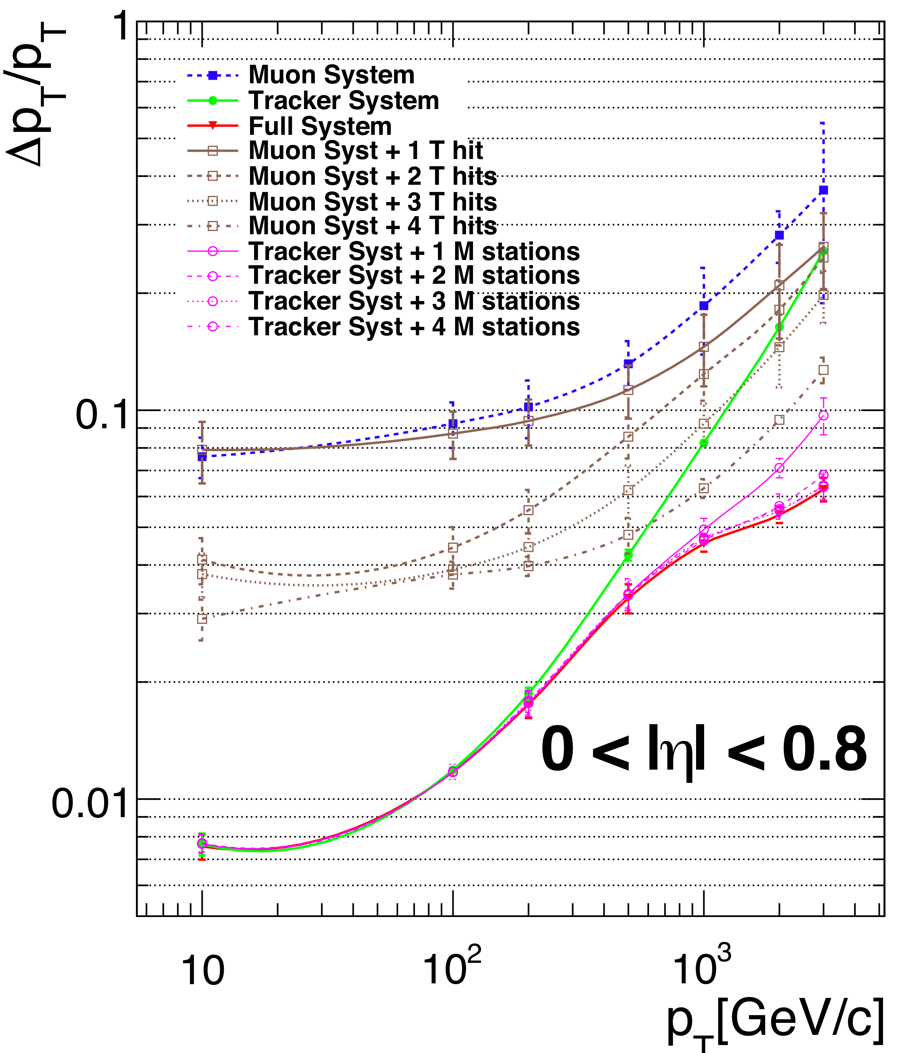
The momentum
resolution is great
for the tracker.
The muon systems
help improve the
resolution for very
high-momentum
tracks
range of
interest

Slide 18
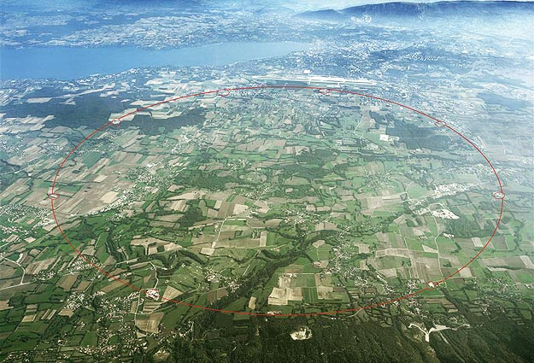
LHCb
p
CMS
ATLAS
p
ALICE

Slide 19
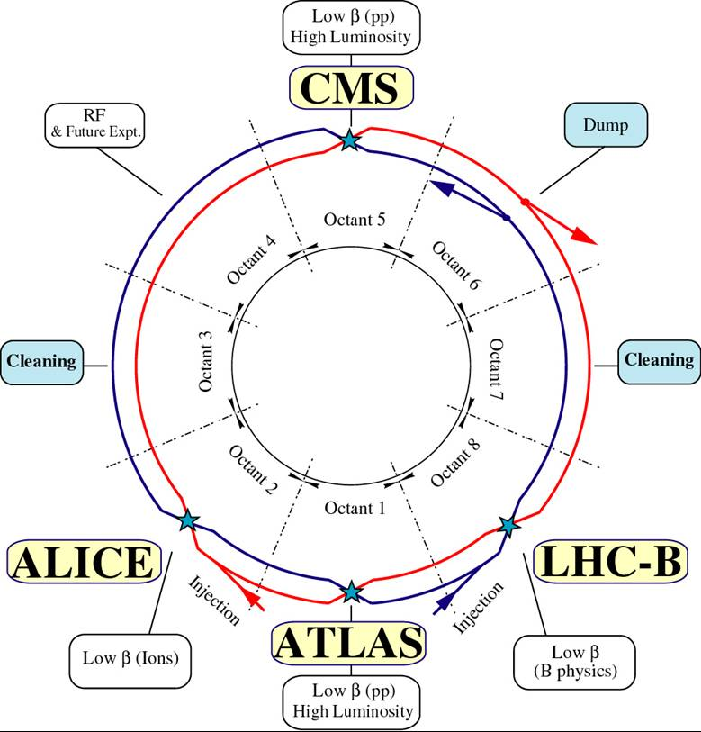
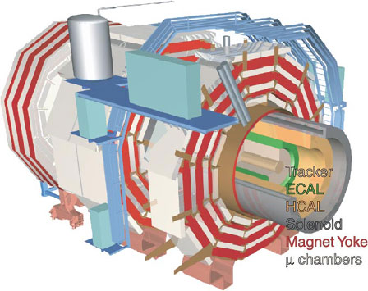
counter-rotating proton beams
3.5 TeV each
now 4 TeV!
γ > 3700

Slide 20
How is this related to Z?
p
p
μ
p
p
μ

Slide 21
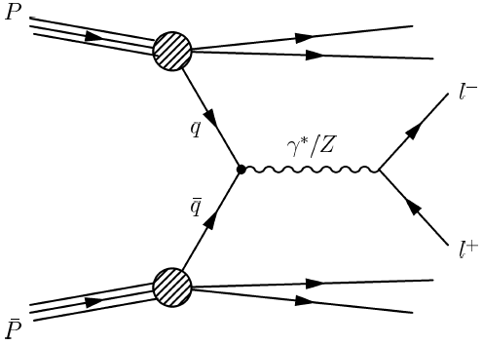
The Z bosons are produced through q – anti-q annihilation:

Slide 22
How do we find a Z signal with di-muon events?
Calculate the invariant mass of the two muons.
If they come from a Z boson, then
that mass should be M_{Z}.

Slide 23
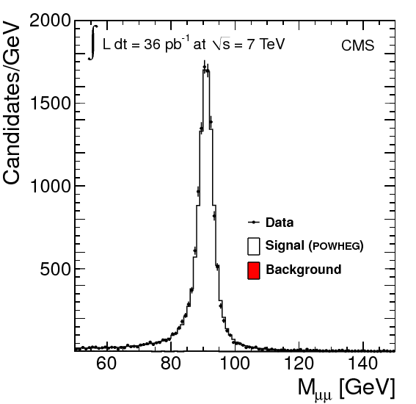
A beautiful Z signal !
M_{Z}

Slide 24
What happened to
the virtual photon?
M_{Z}

Slide 25
The γ∗ events (mainly at low M_{μμ} ) are lost: limited acceptance.
they are light, so they are boosted along the beam directions
they fall through the hole around the beam pipe
the “acceptance” falls rapidly as M_{μμ} decreases
we have to correct for this loss

Slide 26
After all corrections:
mainly γ∗
mainly Ζ
both γ∗ and Z

Slide 27
CMS update
4.5 fb⁻¹
compare to best
theoretical calculation:
“FEWZ”
accurate at NNLO
agreement at 5% level
over
9 orders of magnitude !!

Slide 28
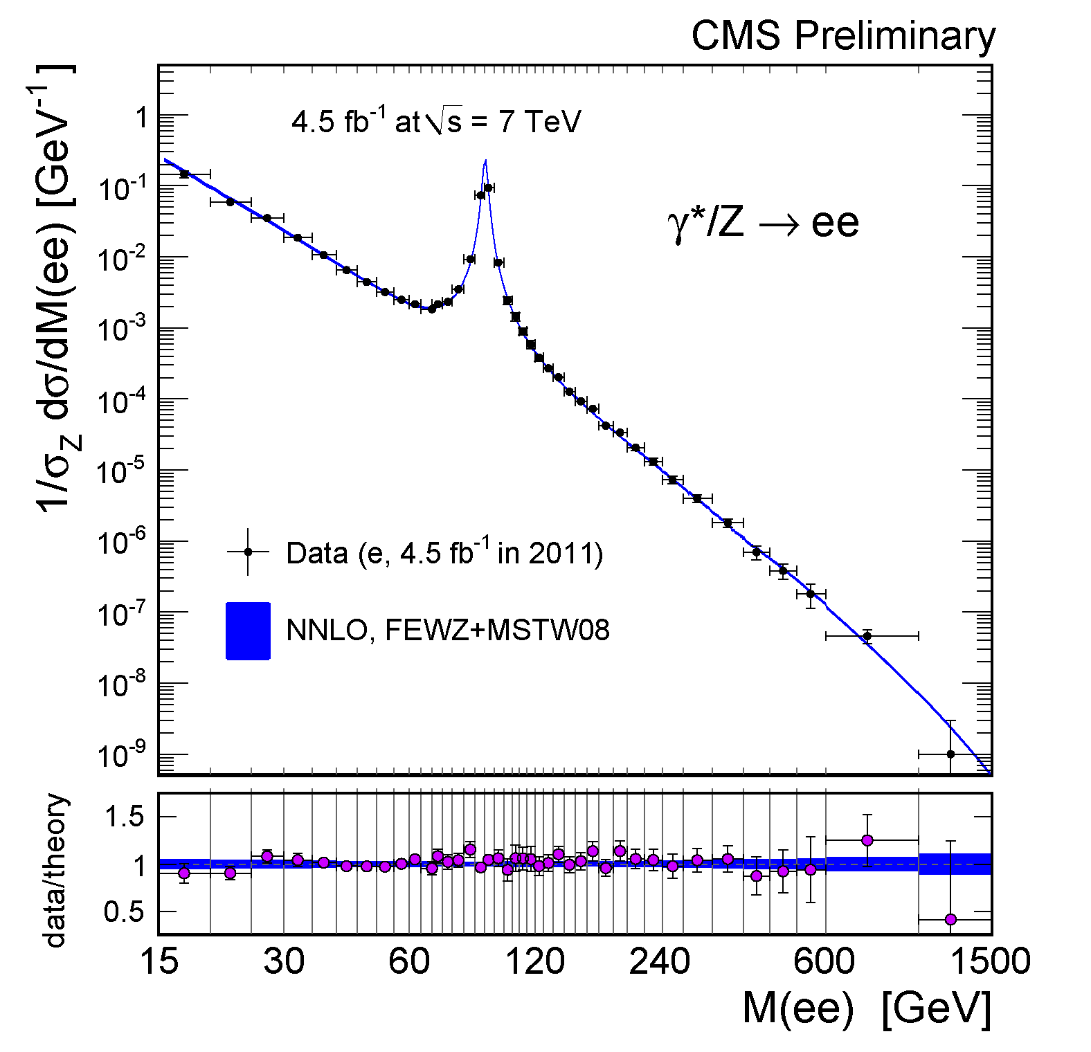
CMS update
4.5 fb⁻¹
We have the results
for the e⁺e⁻ channel.
They agree very well
with the μ⁺μ⁻ results.

Slide 29
The next important piece of the Standard Model is the W:
The W boson sometimes
decays to muon + neutrino.
We must find events
with a μ and a ν.

Slide 30
Problem: neutrinos (ν) cannot be observed directly!
q = 0
no nuclear interactions
weak interactions are so weak that the neutrinos do not interact at all in CMS
Neutrinos are inferred from the absence of a signal…
they certainly carry energy and momentum
there will appear to be a “hole” where particles should be
there will be an apparent energy imbalance → missing transverse energy

Slide 31
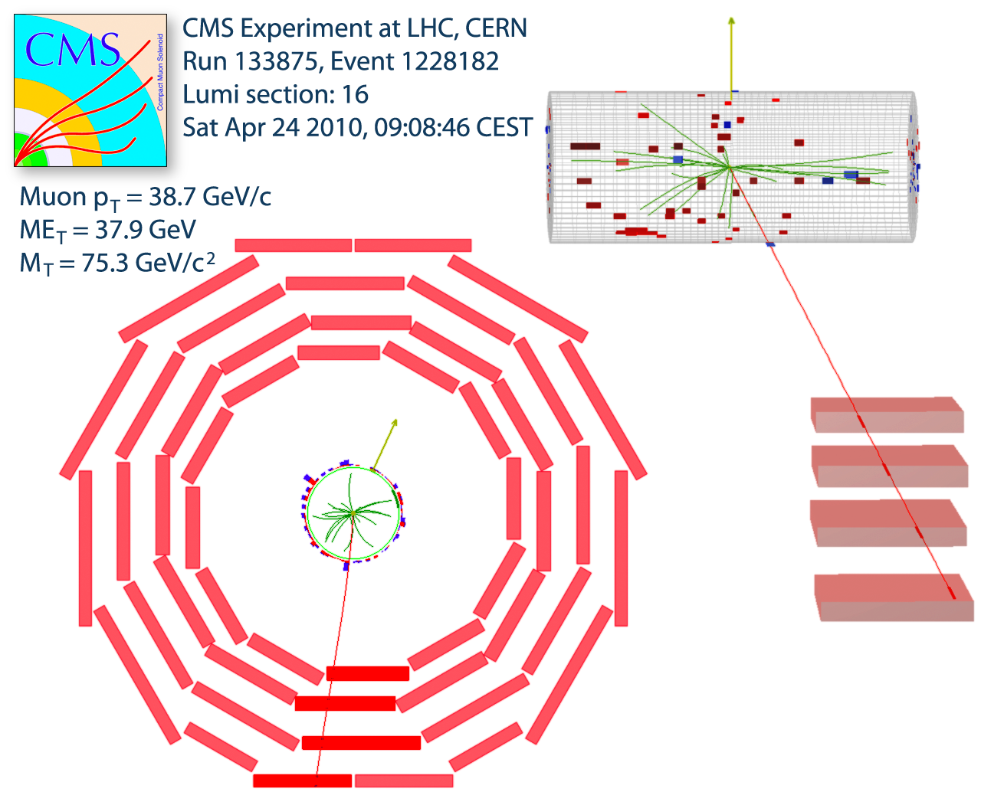
ν
empty
μ
ν
μ

Slide 32
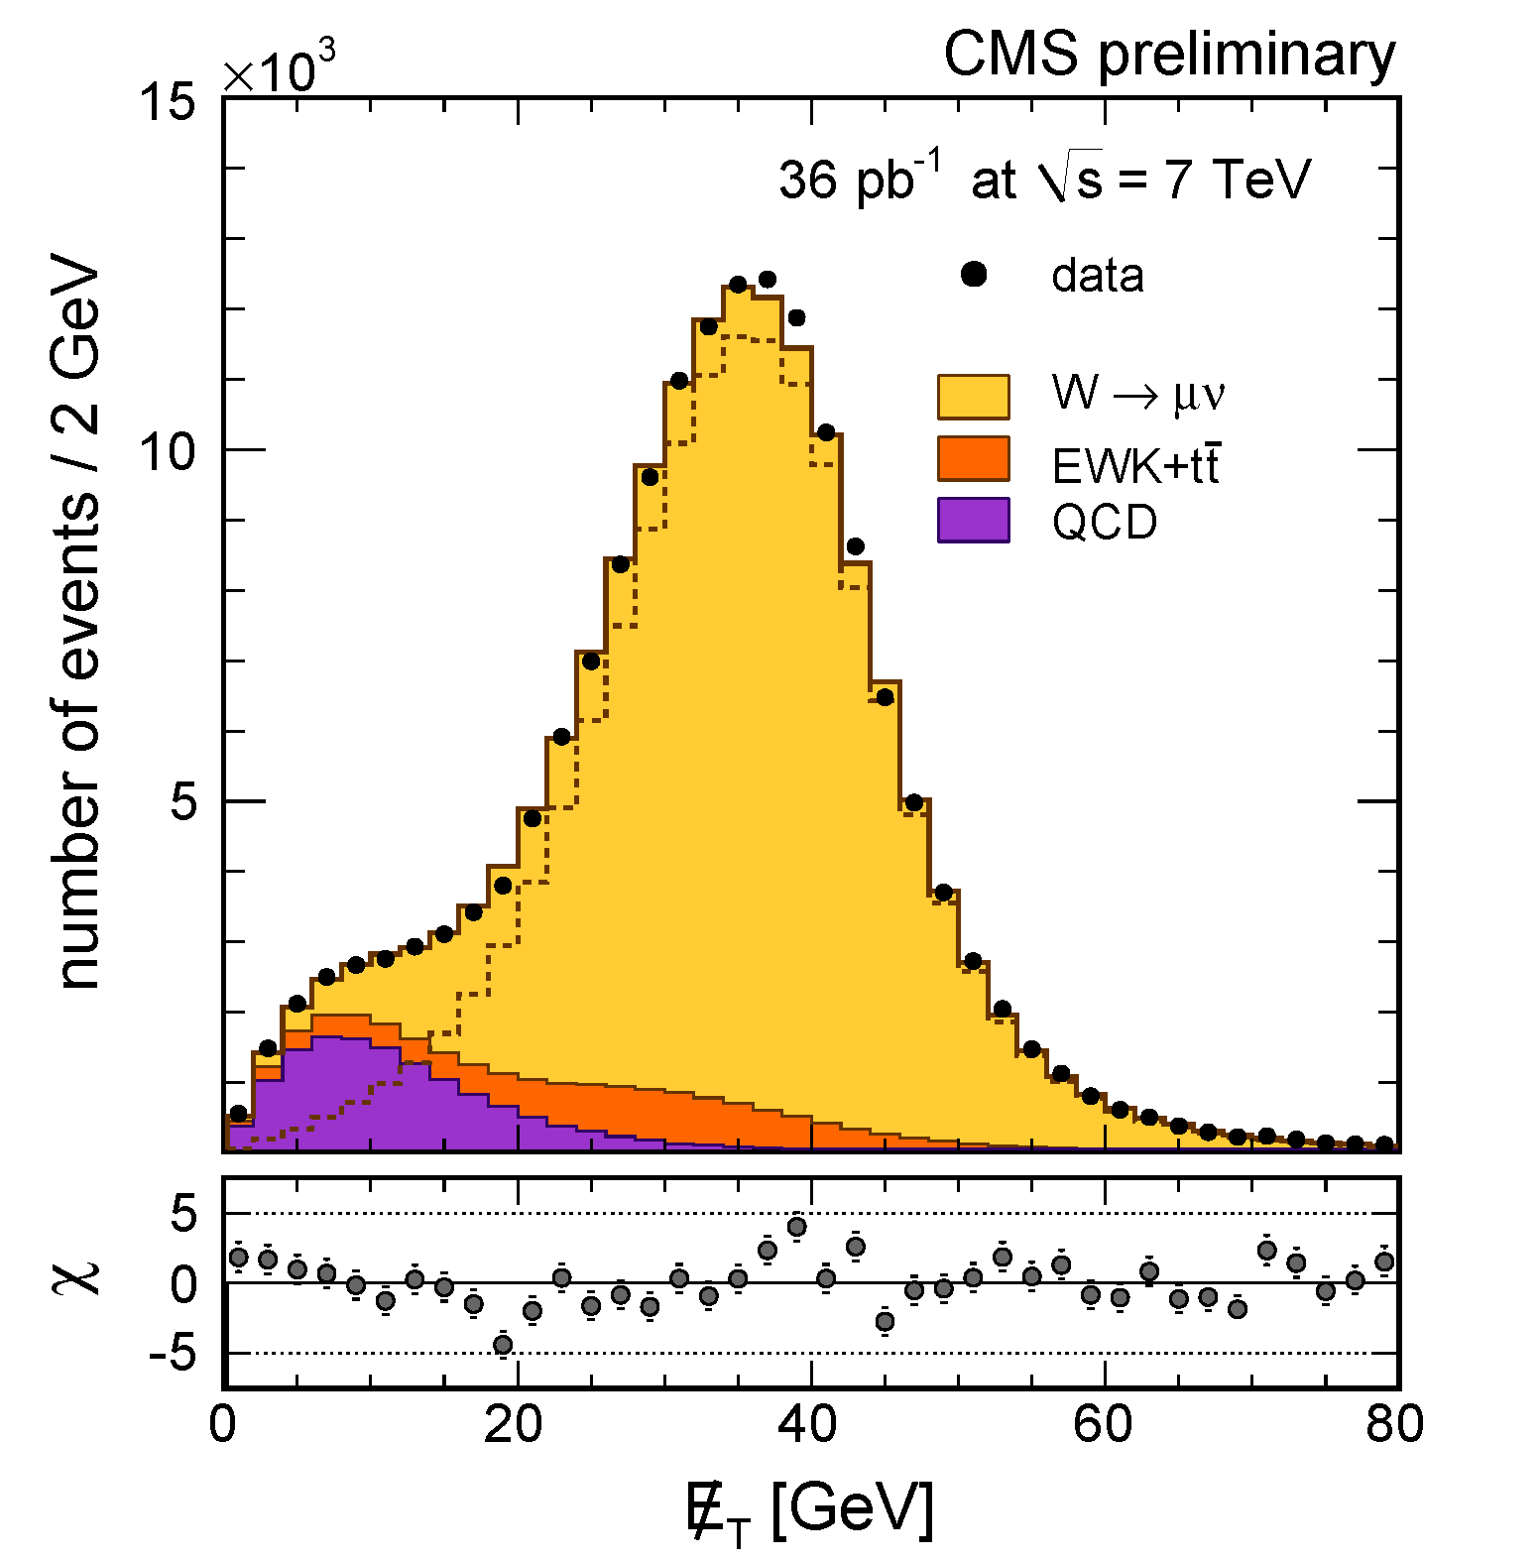
The ν momentum
can be inferred from
the momentum
imbalance.
These neutrinos are
just as energetic as
the muons.
This sample of μν
events is dominated
by W → μν.

Slide 33
Measurements have achieved unprecedented precision for a hadron collider.
Agreement with theoretical predictions is very good.

Slide 34
Notice the numbers of W⁺ and W⁻ events are unequal.
This charge asymmetry comes from the initial state: 2 protons.
W⁺
W⁻

Slide 35
We can measure this asymmetry as a function of the μ angle.
This asymmetry varies with the μ angle due to parity violations in W decay.
The theory is clear.
The result depends on
the u, d quark populations
inside the proton.
This plot compares
four high-quality
predictions to the
CMS measurement.

Slide 36
This is a new measurement in the electron channel: W → e ν.
This measurement uses
more data and is more
precise than the μ one.
The disagreement with
“MSTW2008”
is even starker.

Slide 37
A_{FB} corrected for detector effects and radiation
show for slices of
di-lepton rapidity:
low-Y, small A_{FB}
high-Y, larger A_{FB}
e and μ combined
not corrected for
“q-qbar” dilution
not corrected for
acceptance
(Would require
theory assumptions.)

Slide 38
There have been many other cross section measurements by CMS:

Slide 39
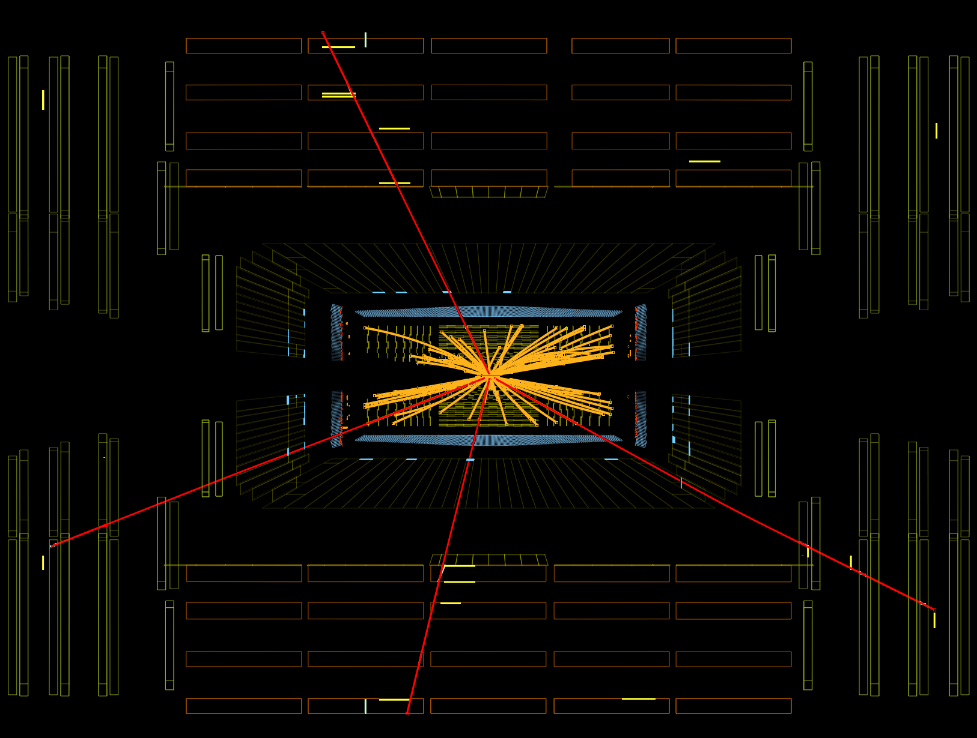
Z Z → μ⁺μ⁻μ⁺μ⁻

Slide 40
matter particles (spin-1/2)
force carriers
(spin-1)
Higgs Boson
(spin-0)

Slide 41
The Higgs Boson:
the key to electroweak symmetry breaking:
an internal symmetry is broken spontaneously
massless gauge bosons acquire mass
the γ, Z and W± are born
the electromagnetic and weak forces are de-unified
a scalar particle is left over : the Higgs boson
the coupling of the Higgs boson to all other particles is determined
depends on the Higgs boson mass
only the mass of the Higgs boson, M_{H}, cannot be predicted
theoretical upper limits around 600 GeV
experimental lower limit at 114 GeV from LEP
searches at the Tevatron excluded a narrow range around 165 GeV
recent searches at the LHC exclude a much larger range

Slide 42
There are several production processes for the Higgs boson.
largest cross section is “gluon fusion” gg → H
The branching ratios for Higgs decays are the key to search strategies.
WW and ZZ are large
for most masses.
Leptonic decay modes
provide a very clean
signature – crucial for
separating signal and
background.

Slide 43
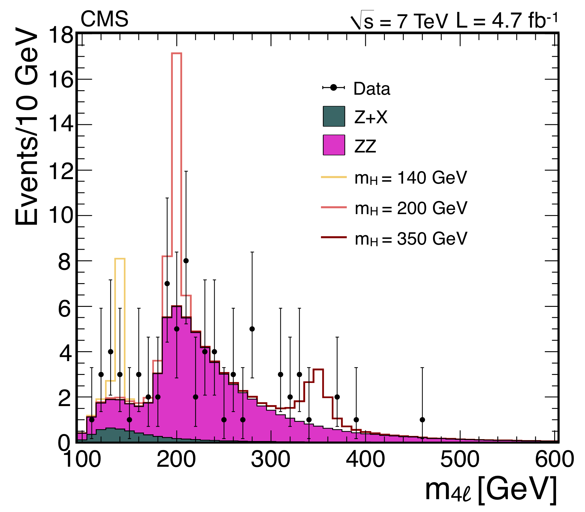
very low backgrounds thanks to 4-leptons
only real background is continuum pp → ZZ
good momentum resolution leads to great mass resolution:
σ_{M} = 1 - 2 GeV for M_{H} = 100 – 200 GeV
a Higgs signal would appear as a narrow peak on top of a smooth background
disadvantage: rather low rate… BR(Z→ll) = 3.3%
to compensate, pay particular attention to e and μ identification.
No obvious signal, but …
maybe a couple extra events in the low-mass region?

Slide 44
No obvious signal, but …
maybe a couple extra events in the low-mass region?

Slide 45
rate is much higher than H → ZZ
backgrounds are manageable – depends on the number of jets
main background is continuum pp → WW but top is important, too,
no real mass information (nominally 20% resolution – see below)
a Higgs signal would appear as an excess in the number of events
exploit subtle differences in kinematic distributions with a multi-variate technique
there is a very modest excess of the number of events.
0 jets
1 jet

Slide 46
Combined Searches for the Higgs Boson:
five channels: H → γγ, τ⁺τ⁻, bb, W⁺W⁻ and ZZ
H → γγ is the best one for M_{H} < 120 GeV
H → W⁺W⁻ is the best one for 120 < M_{H} < 200 GeV
H → ZZ is the best one for M_{H} > 200 GeV
statistical techniques developed and agreed in advance by the CMS and ATLAS experts
γγ
γγ
ZZ
ZZ
WW
WW

Slide 47
Combined Searches for the Higgs Boson:
actual limits given by solid line with dots
dashed line gives expected limit
yellow and green bands give expected fluctuations in limits
?

Slide 48
WW
ZZ
γγ
ZZ + γγ
WW + bb + ττ
localized excess
widespread excess

Slide 49
Conclusions
beautiful measurements of standard model processes
huge samples of W and Z bosons
excellent detector performance
searches for the missing piece of the Standard Model (“Higgs boson”) are underway
final states with of W and Z bosons are crucial
H → γγ plays a key role at low masses
a hint of a signal at 124 GeV – is it just a fluctuation?
more data needed -- and it is coming in already…
CM energy is 8 TeV now
already we have > 1 fb⁻¹ and we expect 15 fb⁻¹ in 2012!

Slide 50
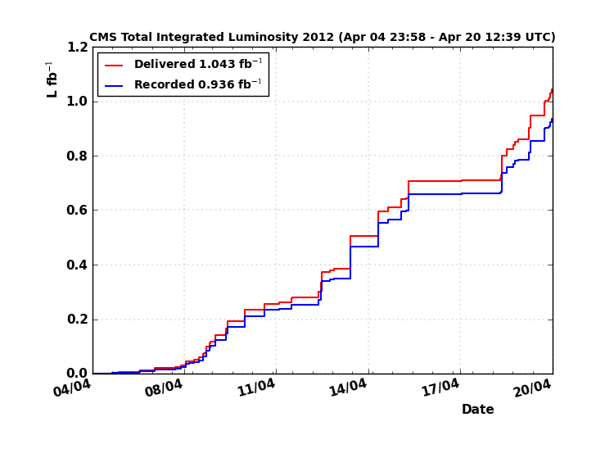

Slide 51
EXTRAS

Slide 52
