Slide 1
Electroweak Results from Hadron Colliders
Michael Schmitt
Northwestern University
Loopfest 2011
May 13, 2011

Slide 2
Results with W and/or Z bosons touch on three physics areas:
parton distribution functions
tests of QCD
genuine electroweak effects
I’ll group the results accordingly.

Slide 3
inclusive σ(W), σ(Z)
W asymmetry
Drell-Yan
dσ/dY
parton distribution functions
tests of QCD
genuine electroweak effects
dσ/dq_{T}
V + jets
V + b(b)
W polarization
di-boson production
V + γ production
A_{FB} and sin²θ_{W}
W mass

Slide 4
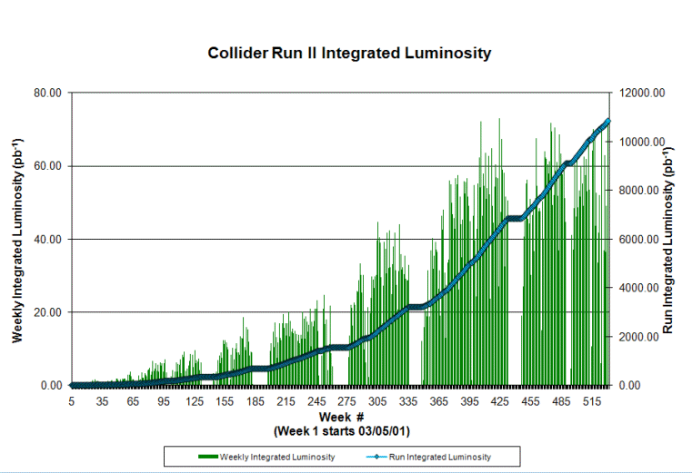
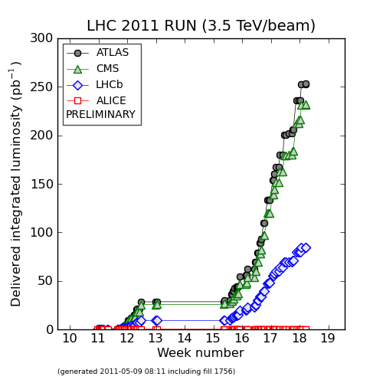
Colliders, Detectors, Data
CDF & D0 @ Tevatron
ATLAS & CMS @ LHC
√s = 1.96 TeV
√s = 7 TeV
about 6 fb⁻¹
about 0.04 fb⁻¹

Slide 5
Inclusive σ(W) and σ(Z)

Slide 6
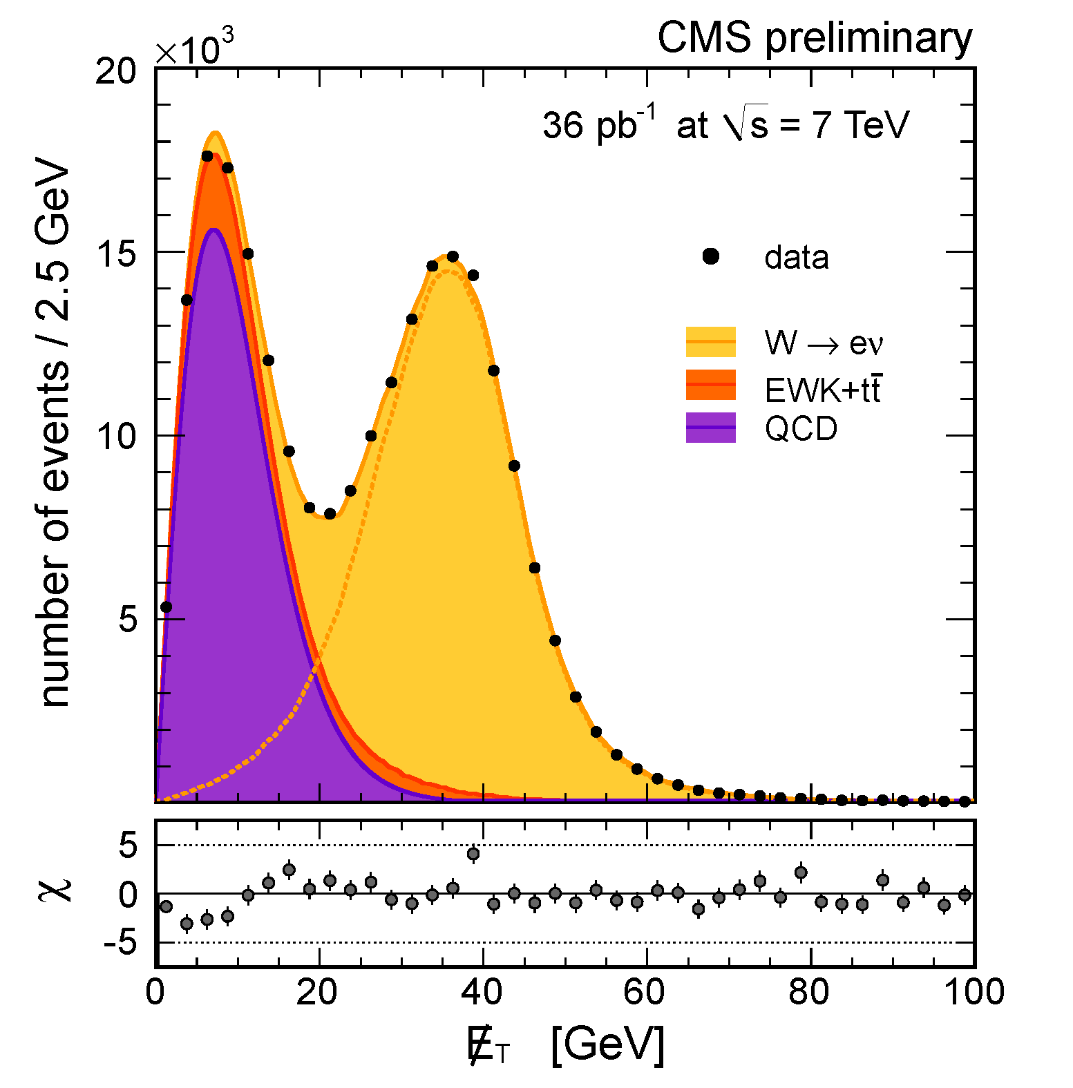
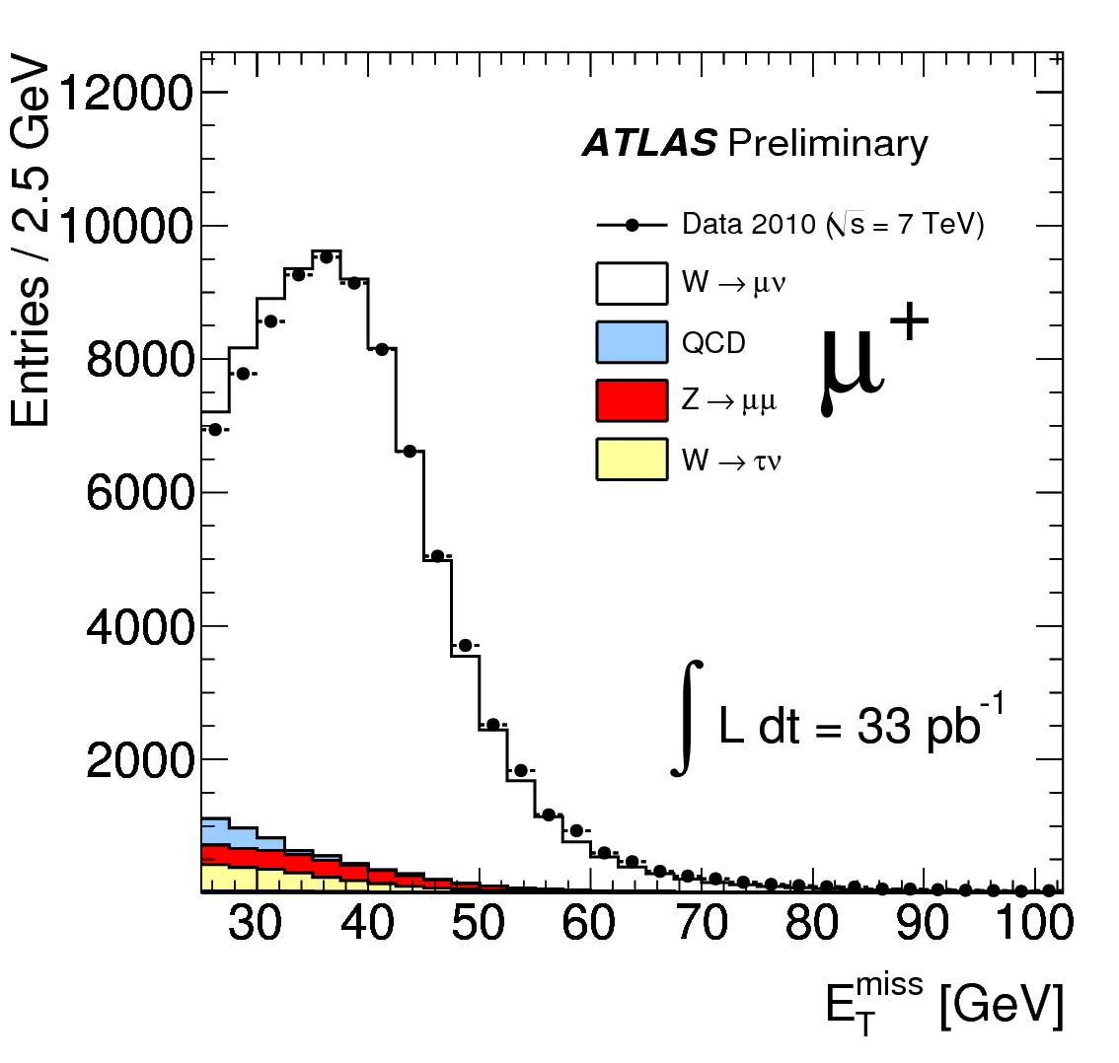
many thousands of events!
CMS PAS EWK-10-005
ATLAS CONF 2011-041

Slide 7
With so many events → measure the cross section for W production:
σ_{W}
luminosity error
dominates

Slide 8
Measure σ_{Z} too, and take the ratio σ_{W} / σ_{Z} – luminosity cancels out:
σ_{W}/σ_{Z}
No luminosity error
Theory error is also much smaller.

Slide 9
Another important ratio σ_{W+} / σ_{W-}
depends on q_{valence} vs. q_{sea}
σ_{W+}/σ_{W-}
Theory error is not
so small : PDFs.

Slide 10
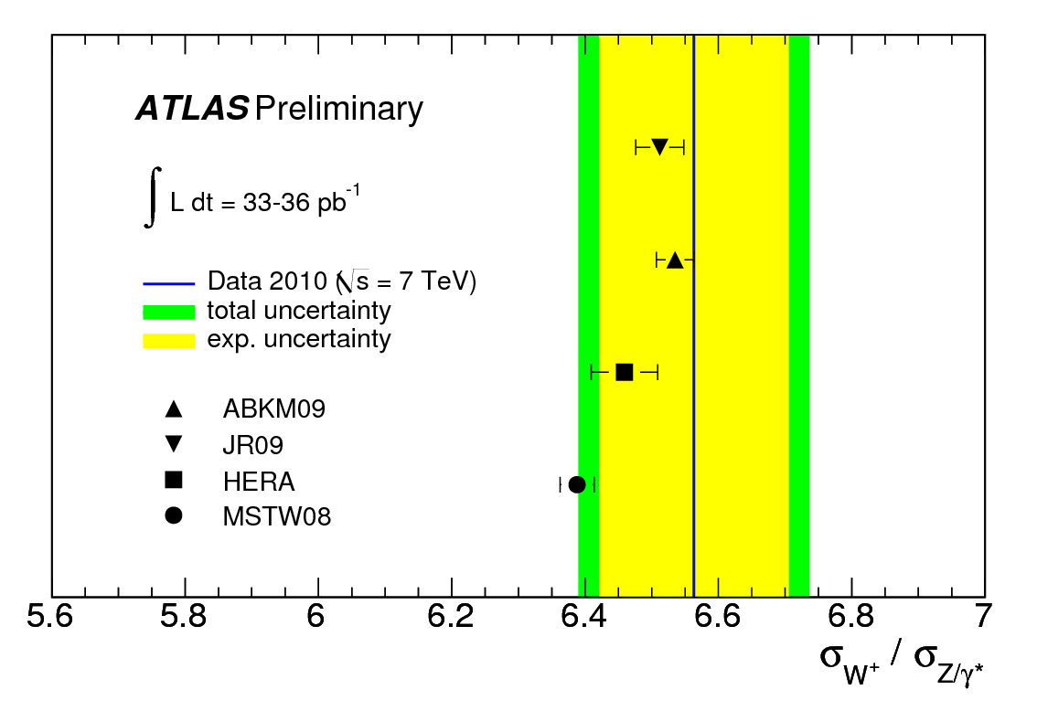
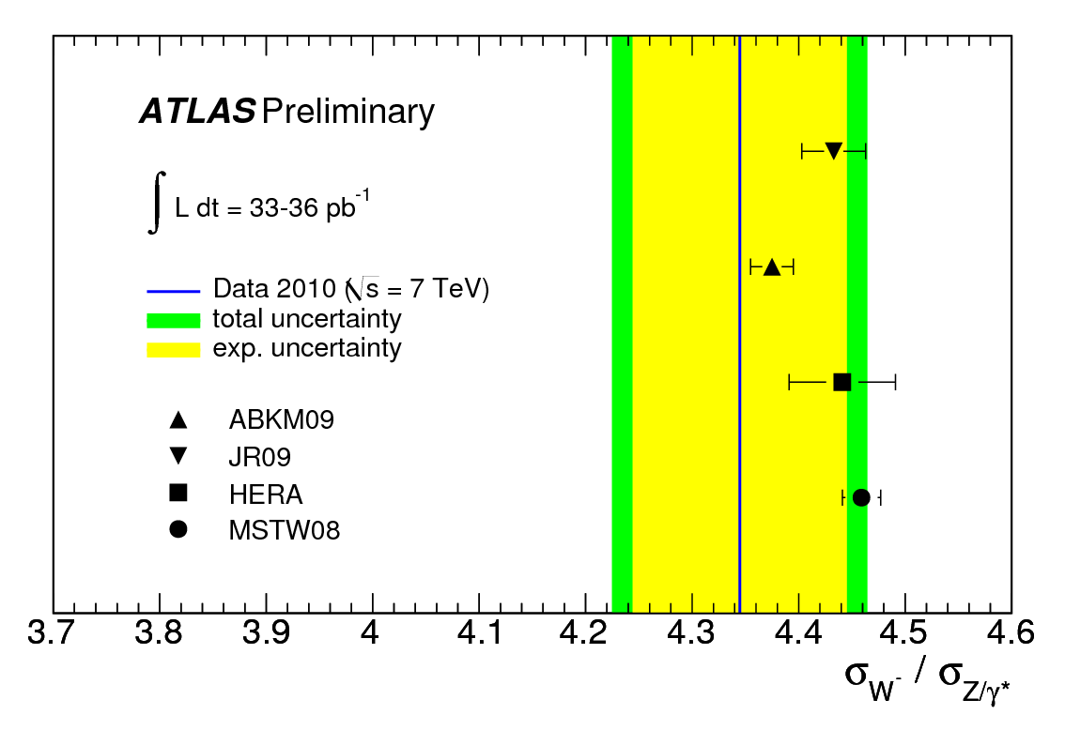
ATLAS checks σ_{W+} / σ_{Z} and σ_{W-} / σ_{Z}
depends on q_{valence} vs. q_{sea}
Vivid demonstration
of the power of these
measurements to
differentiate PDFs
ATLAS CONF 2011-041

Slide 11
Measurements confirm predictions for the total cross sections:
We need to get around the theory error.
We are now reporting “restricted” cross sections, i.e., cross sections within the designated fiducial & kinematic regions, with no acceptance correction.
Advantage: no theory uncertainty on the acceptance.
Disadvantage: not easy to combine e & μ results, or to compare results from different experiments.

Slide 12
Drell-Yan Cross Section
Normalize to σ(Z) to greatly
reduce systematic uncertainties
lower x
higher x
CMS PAS EWK-10-007

Slide 13
NB: We need a good theoretical prediction, too ….
CMS PAS EWK-10-007

Slide 14
In this region of low acceptance, higher-order calculations are crucial…
CMS PAS EWK-10-007

Slide 15
W charge asymmetry
Clearly has something to say about u(x) vs. d(x). (Recall that the quark is mainly from the valence distribution, while the anti-quark is from the sea. Mainly.)

Slide 16
W charge asymmetry
parity violation (PV) occurs
at the production
and at the decay
interesting twist:
(forward) W production is polarized due to PV at production, so there is a strong asymmetry in the lepton decay distribution (in the W rest frame) → the lepton charge asymmetry is useful

Slide 17
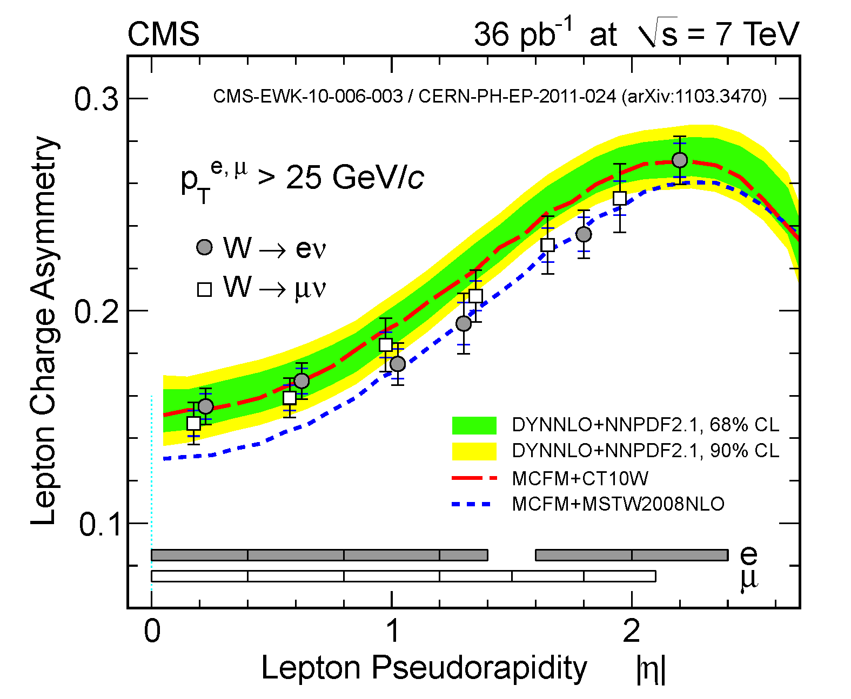
two up-to-date PDF sets
CMS PAS EWK-10-006

Slide 18
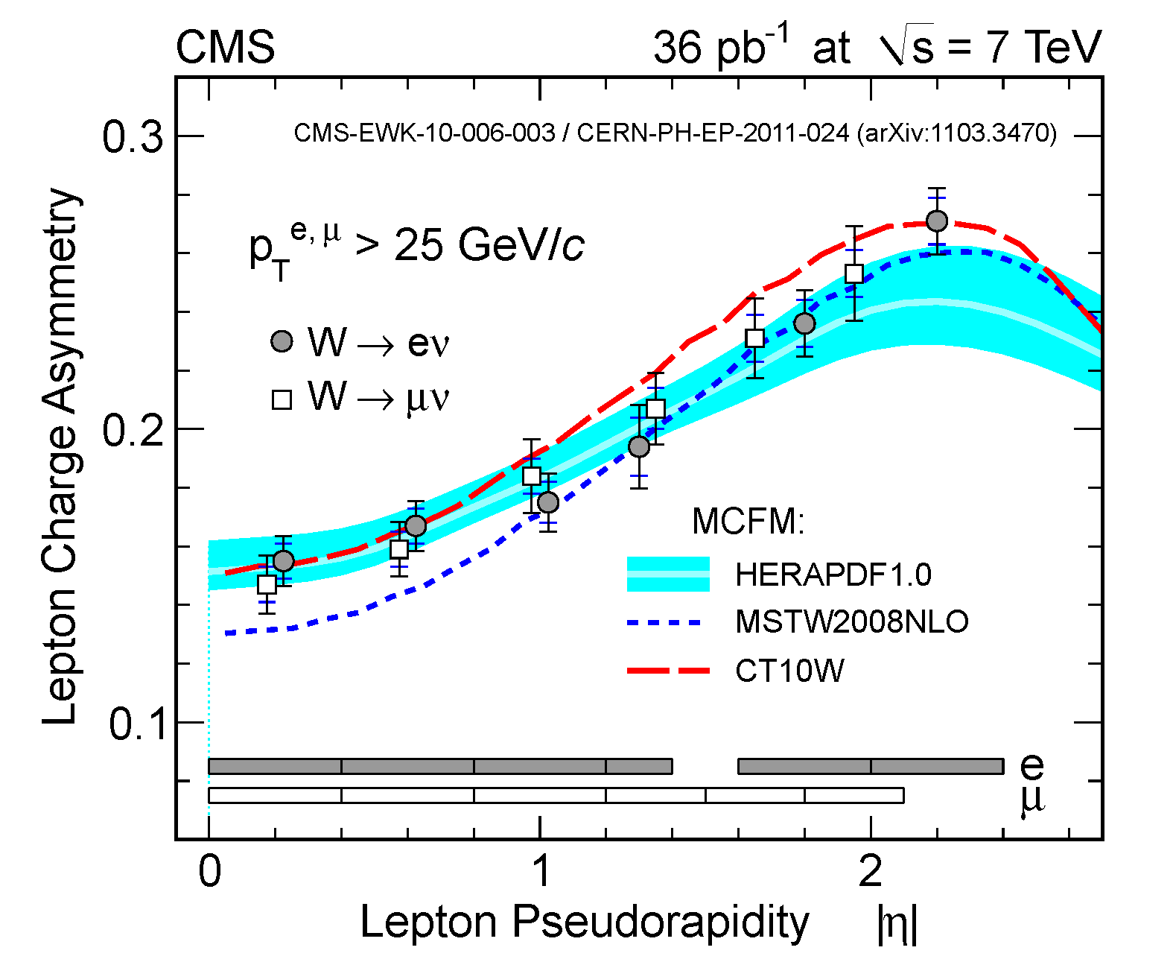
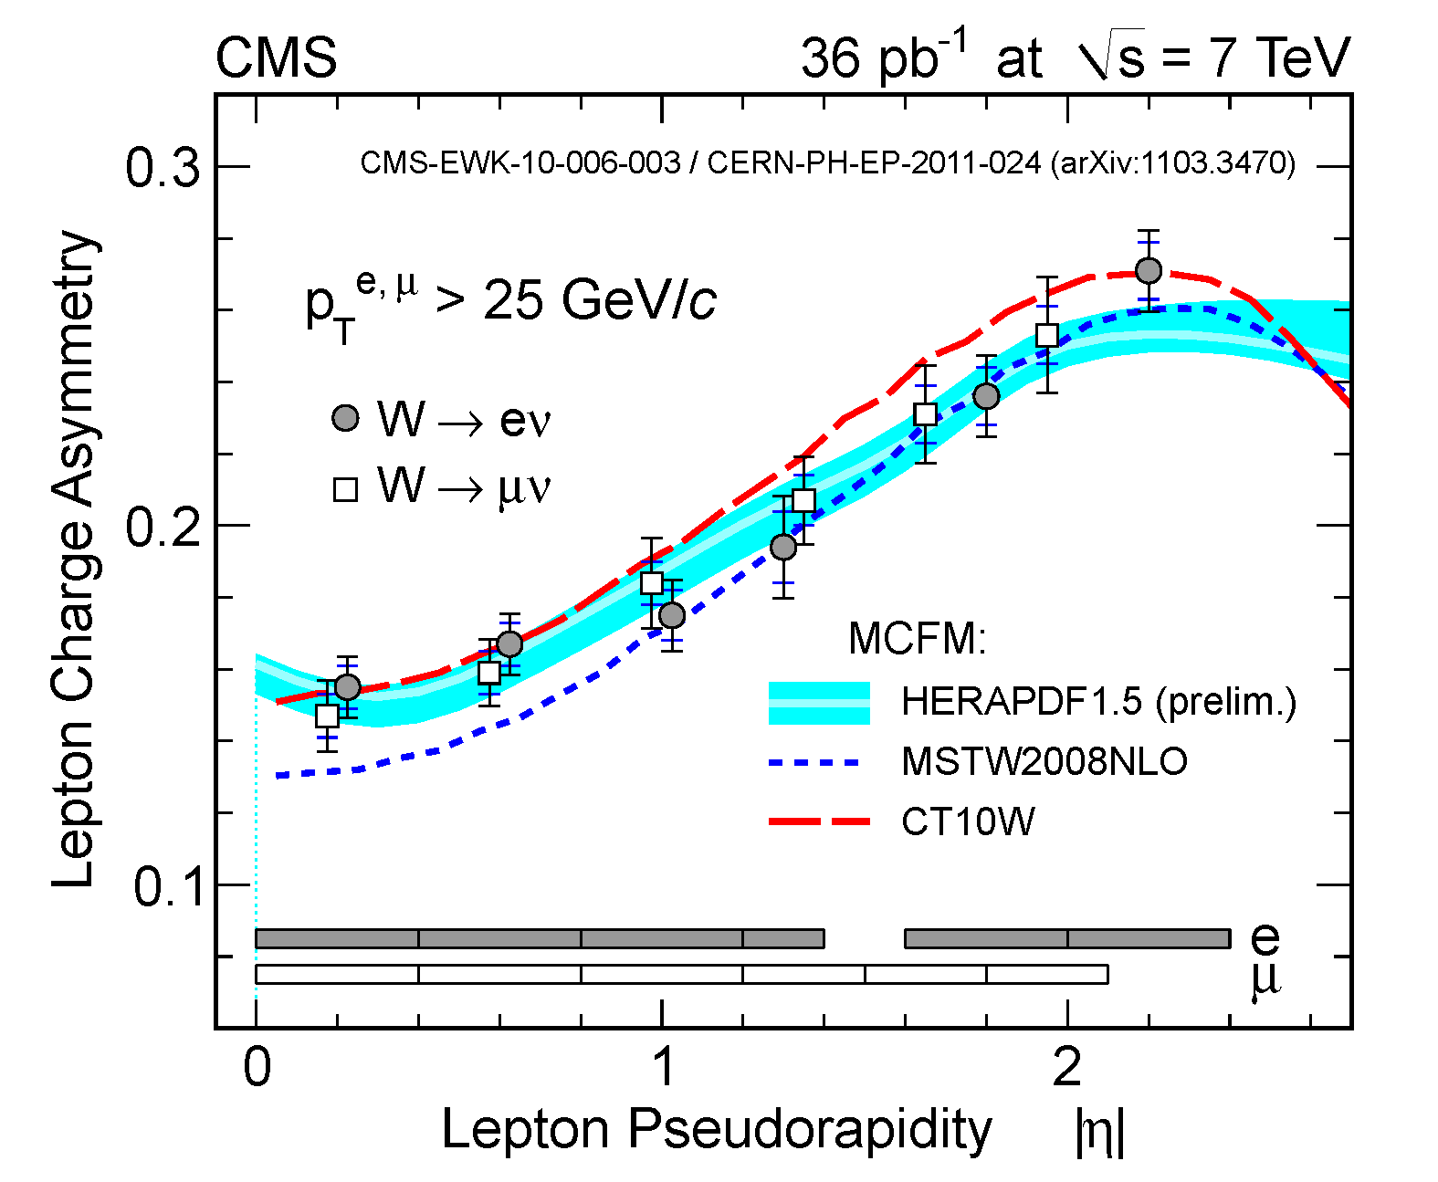
Katerina Lipka (HERAPDF) already incorporated the CMS measurement:
before
after

Slide 19
Maria Ubiali (NNPDF) shows that the W asymmetry measurement leads to significant reduction in PDF uncertainties:
ubar
u

Slide 20
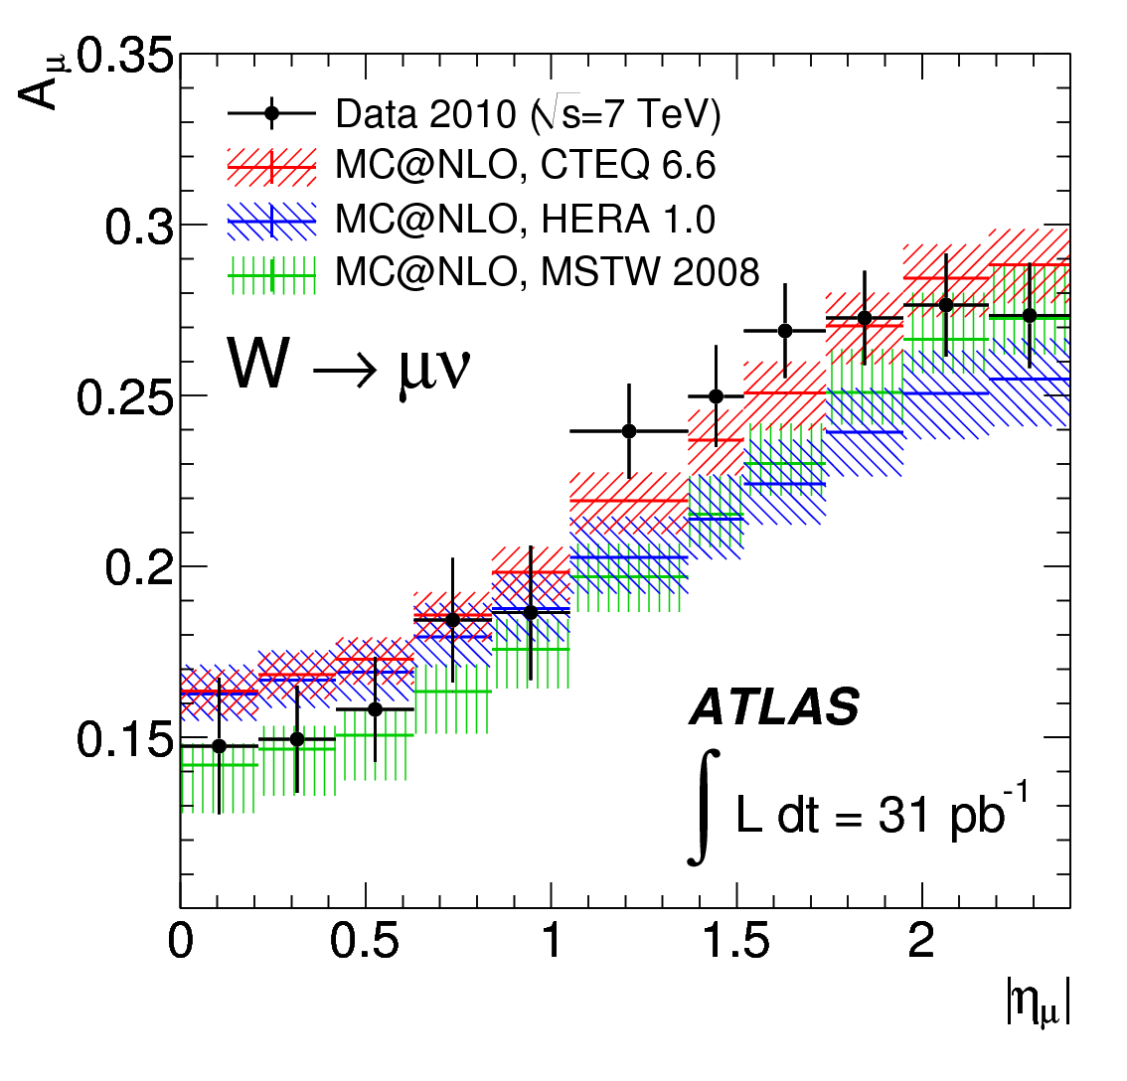
ATLAS measured the W asymmetry with muons:
arXiv:1103.2929

Slide 21
LHCb also measured the W asymmetry with muons:
beautiful!

Slide 22
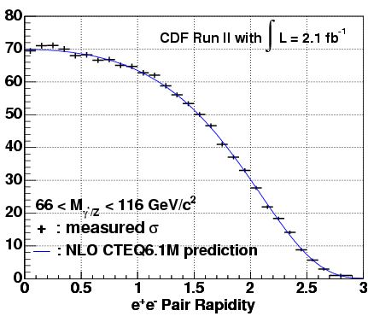
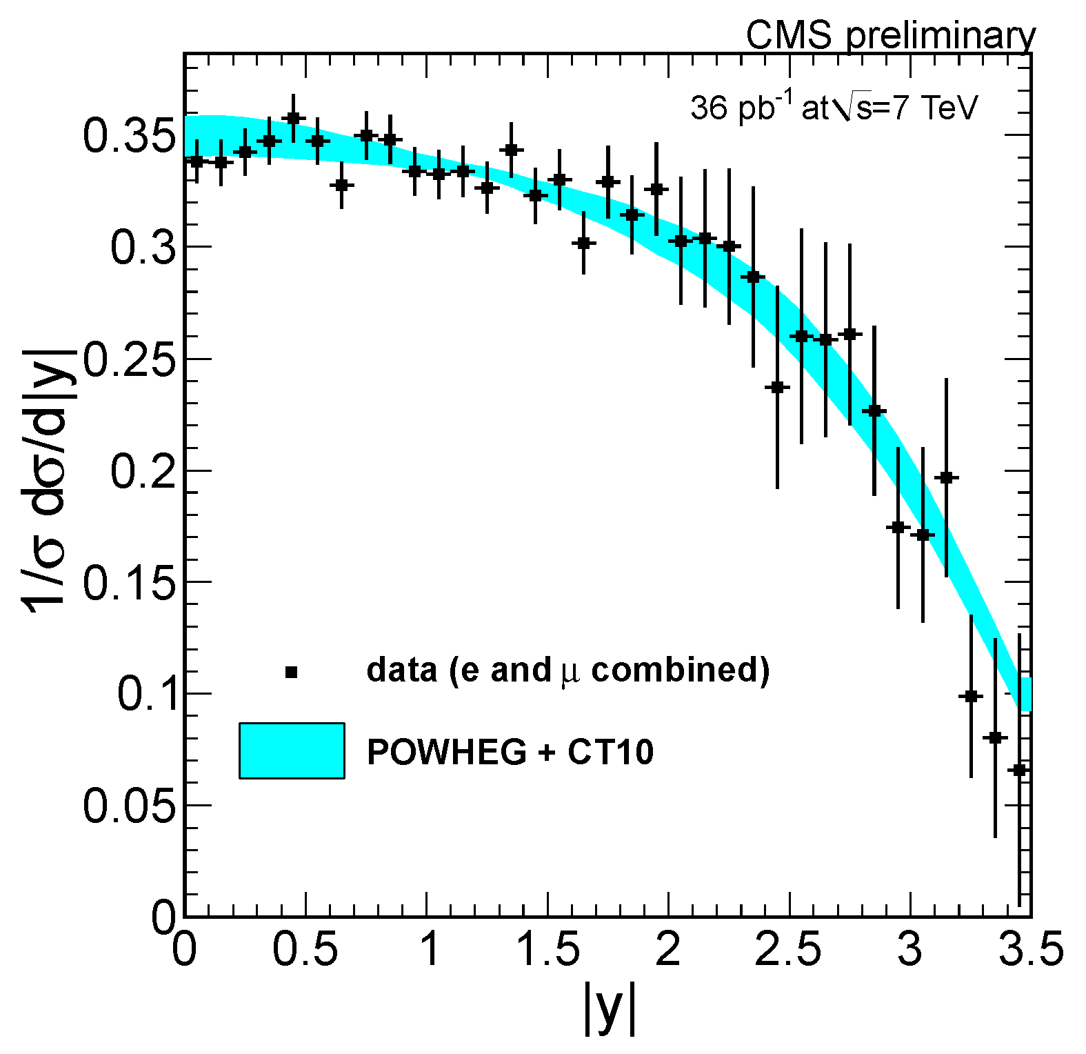
CDF √s = 1.96 TeV
CMS √s = 7 TeV
an up-to-date PDF
Notice that the CMS range in |Y| is significantly larger.
The CMS error bars will diminish rapidly this year.
Soon they will be good enough to constrain the PDFs…

Slide 23
How exactly does the Y distribution relate to the pdfs?
Y gives a constraint on the ratio x₁ / x₂
Or, for fixed M,

Slide 24
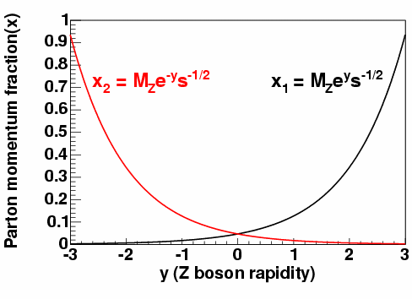
How exactly does the Y distribution relate to the pdfs?
Y gives a constraint on the ratio x₁ / x₂
Or, for fixed M,
lower x
higher x

Slide 25
QCD

Slide 26
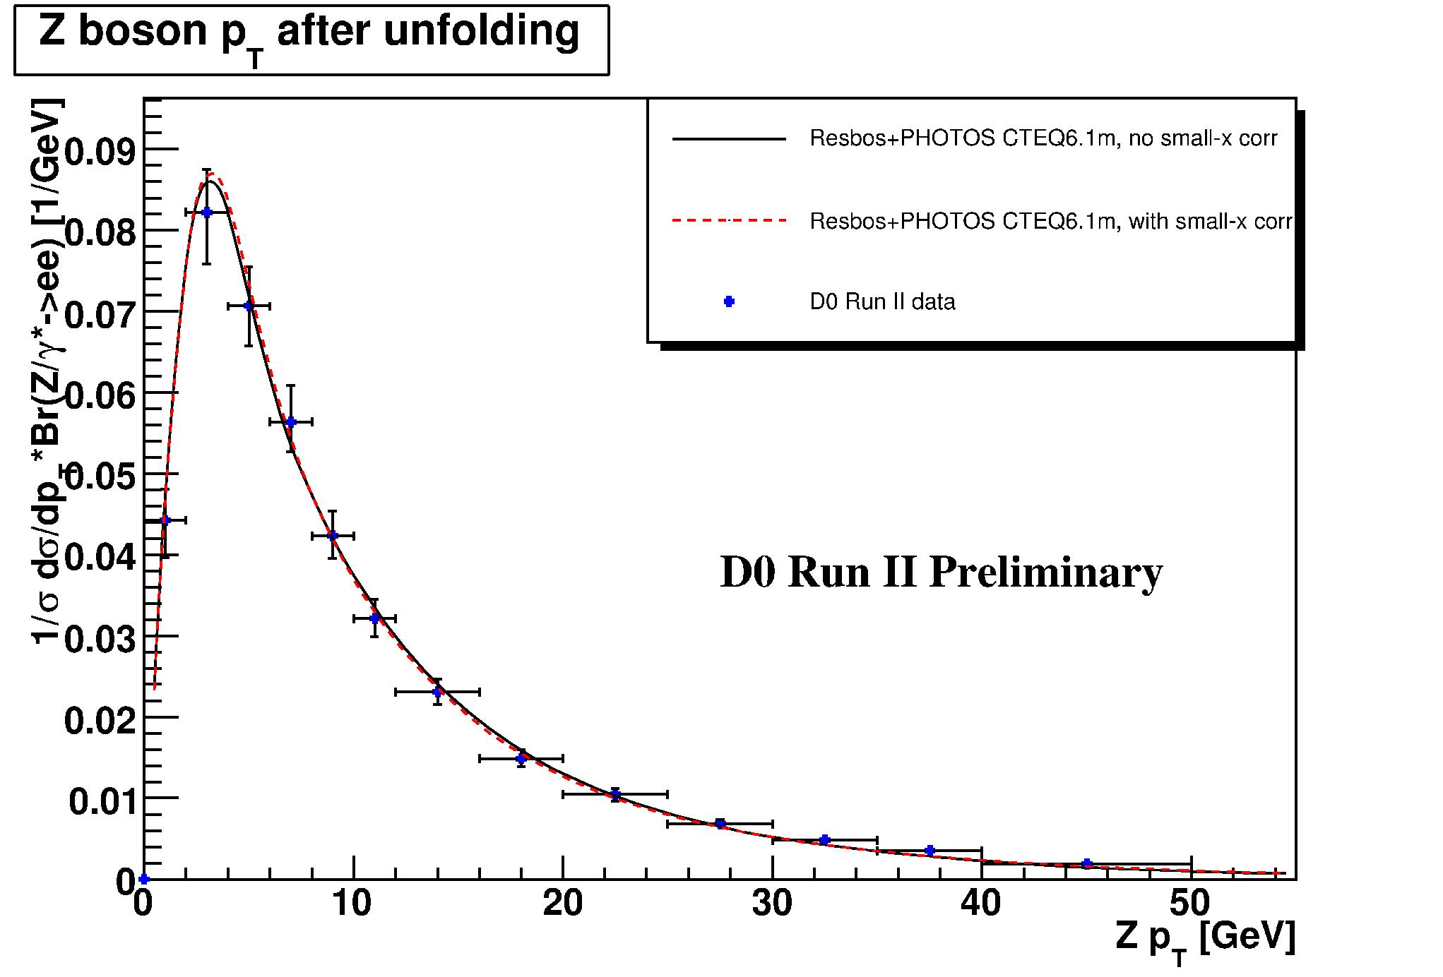
An excellent place to test theory – pQCD – is with the Z p_{T} distribution.
The low – p_{T} part is non-perturbative.
The high – p_{T} part is perturbative & calculable.
Tevatron ppbar
√s = 1.96 TeV

Slide 27
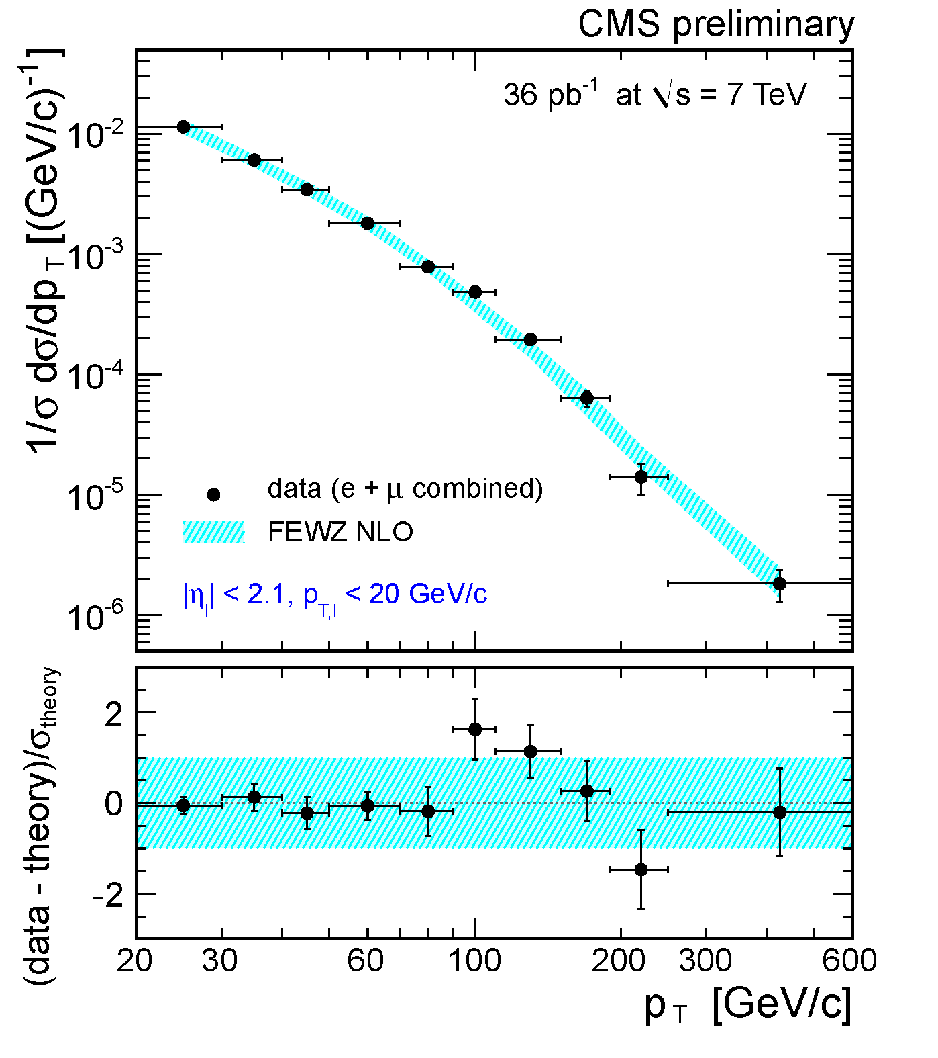
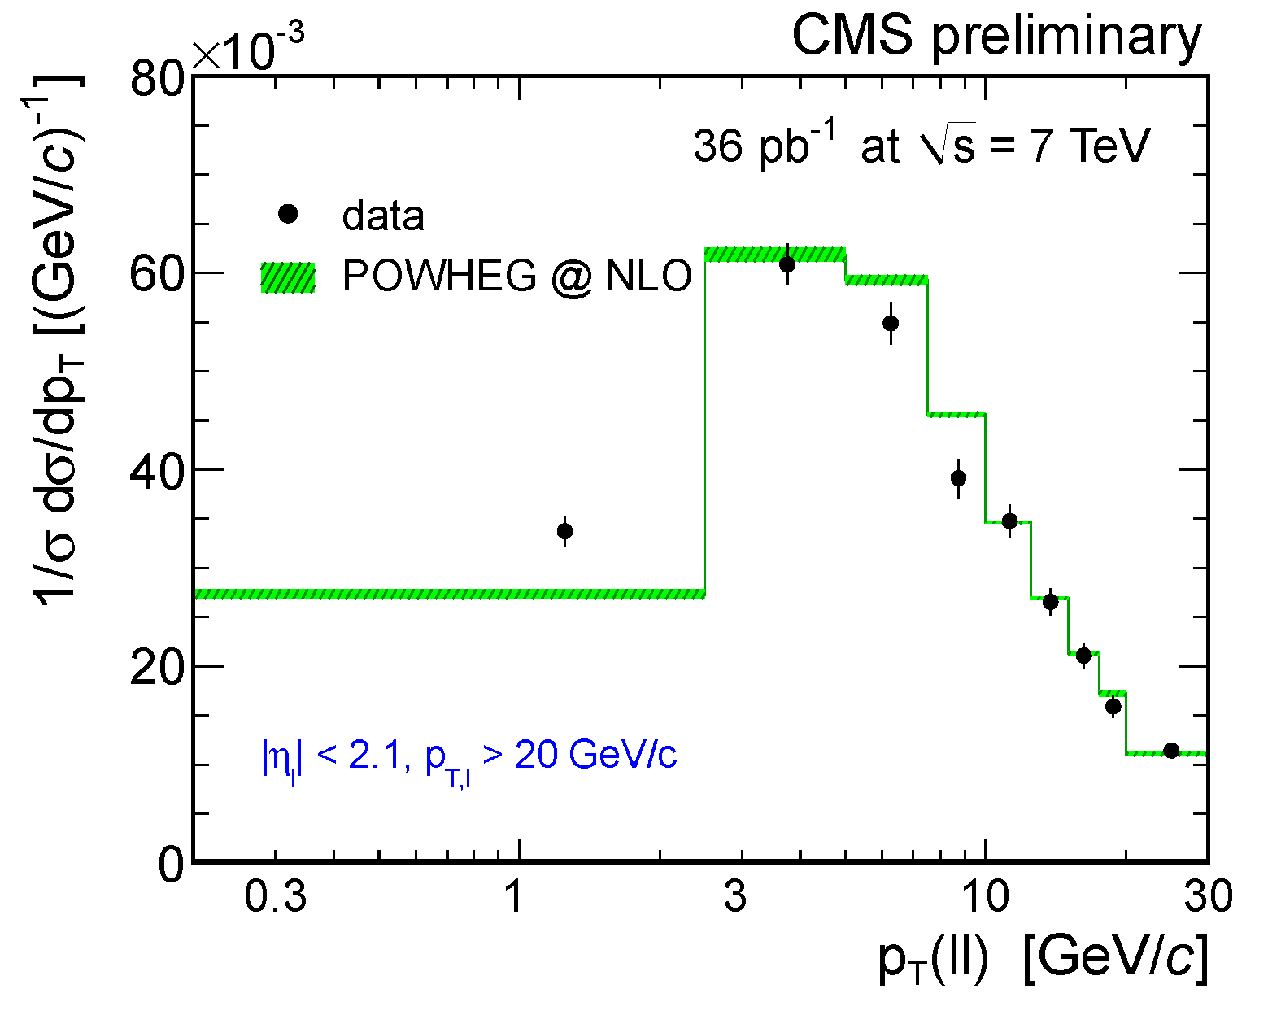
CMS has presented the first measurements of dσ / dq_{T} √s = 7 TeV
high – p_{T} prediction is OK.
low – p_{T} model needs tuning
CMS PAS EWK-10-010

Slide 28
W,Z + Jets
Most W/Z bosons must be recoiling against something.
→ jets
How well do we know the multiplicity and energy spectrum
of those jets?
→ measure This is an important test of pQCD.

Slide 29
W,Z + Jets
Number of jets produced
in association with a W boson
CMS PAS EWK-10-012

Slide 30
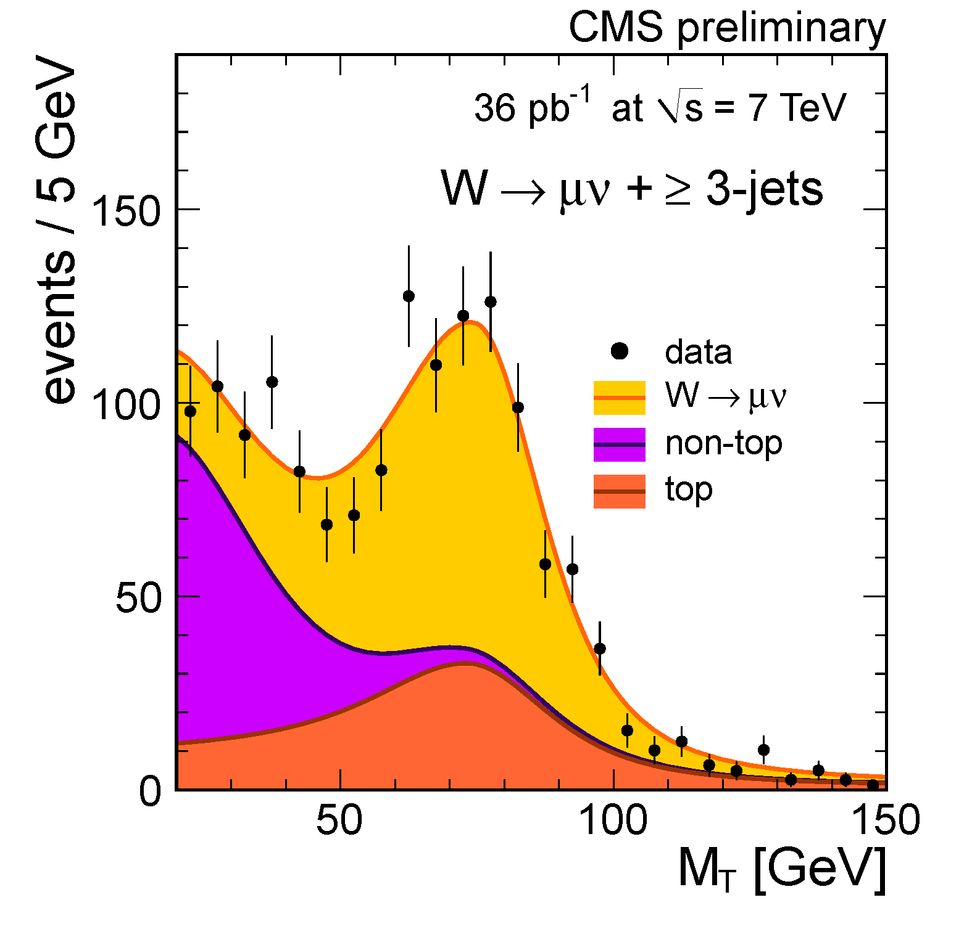
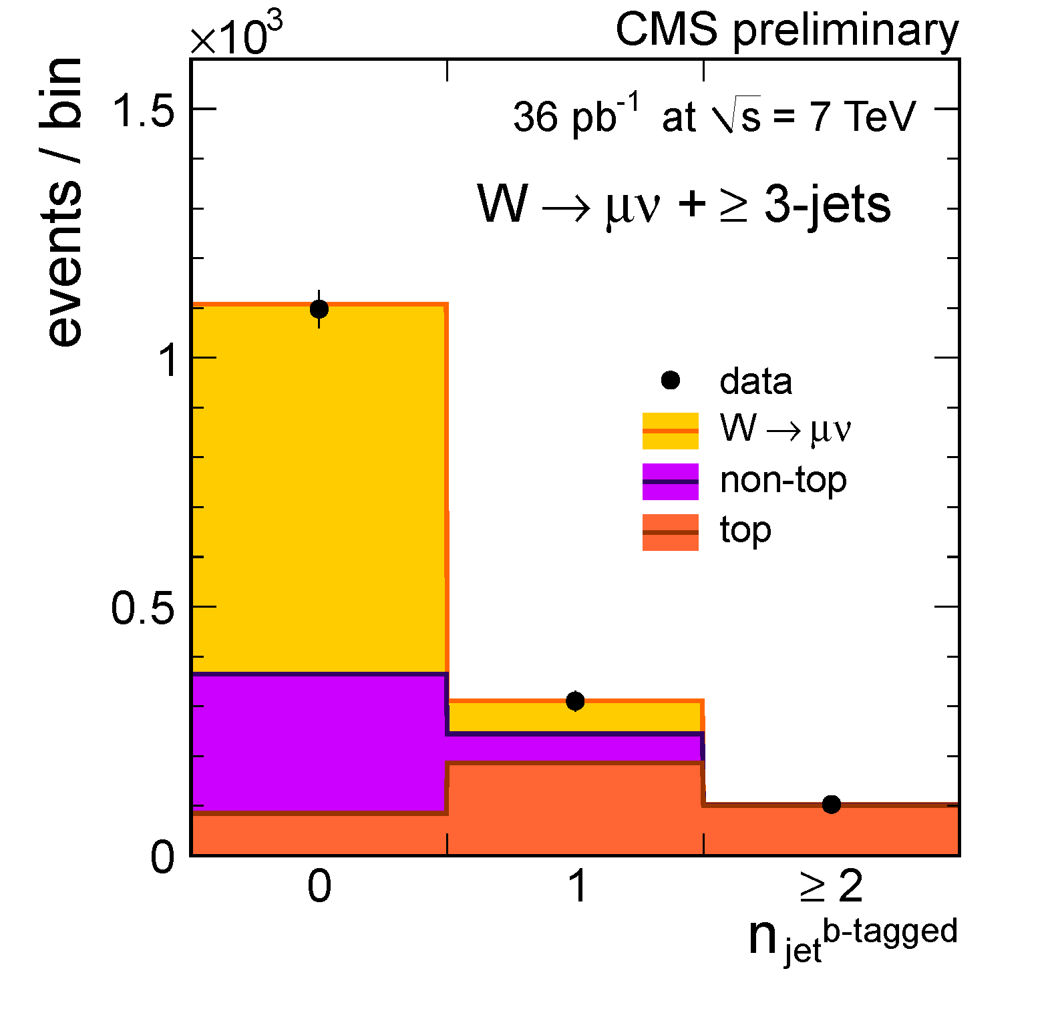
Fit for the
top-quark fraction
W,Z + Jets
CMS PAS EWK-10-012

Slide 31
Notice there is no top-quark
contribution in the Z sample.
W,Z + Jets
W
Z
CMS PAS EWK-10-012

Slide 32
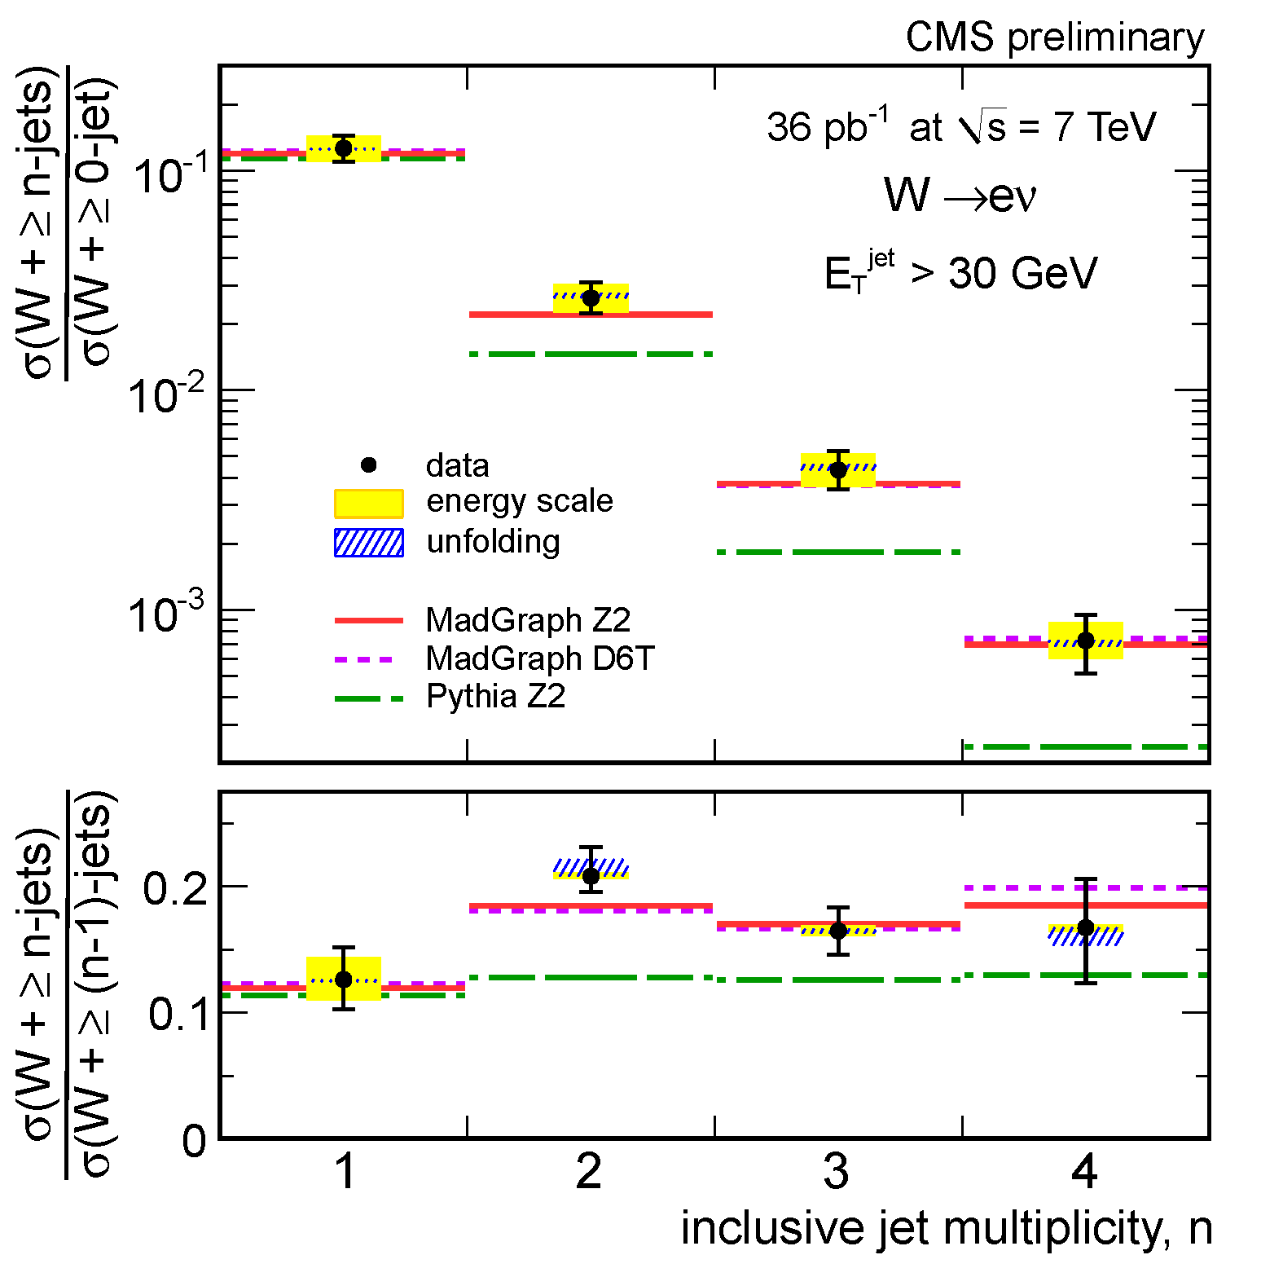
W,Z + Jets
Take ratios to reduce systematic uncertainties:
Good agreement is reached for
matrix-element calculations,
not for parton-shower calculations.
CMS PAS EWK-10-012

Slide 33
W,Z + Jets
The results and phenomenology
suggest some sort of scaling law.
Following Berends-Giele, we tried
CMS PAS EWK-10-012

Slide 34
CMS PAS EWK-10-012

Slide 35
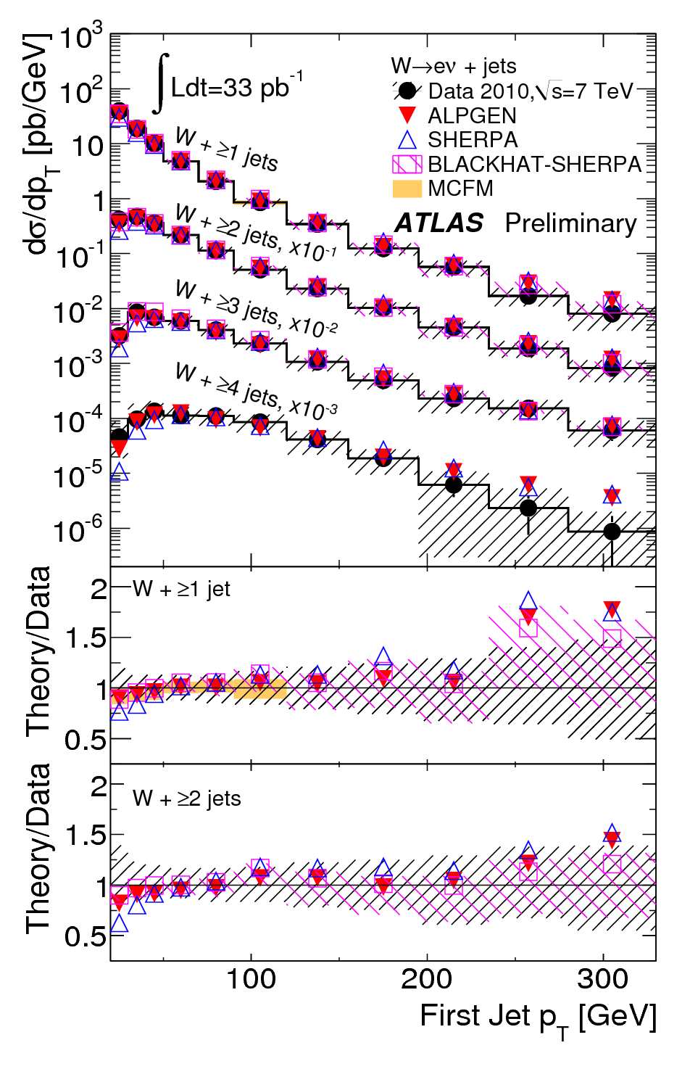
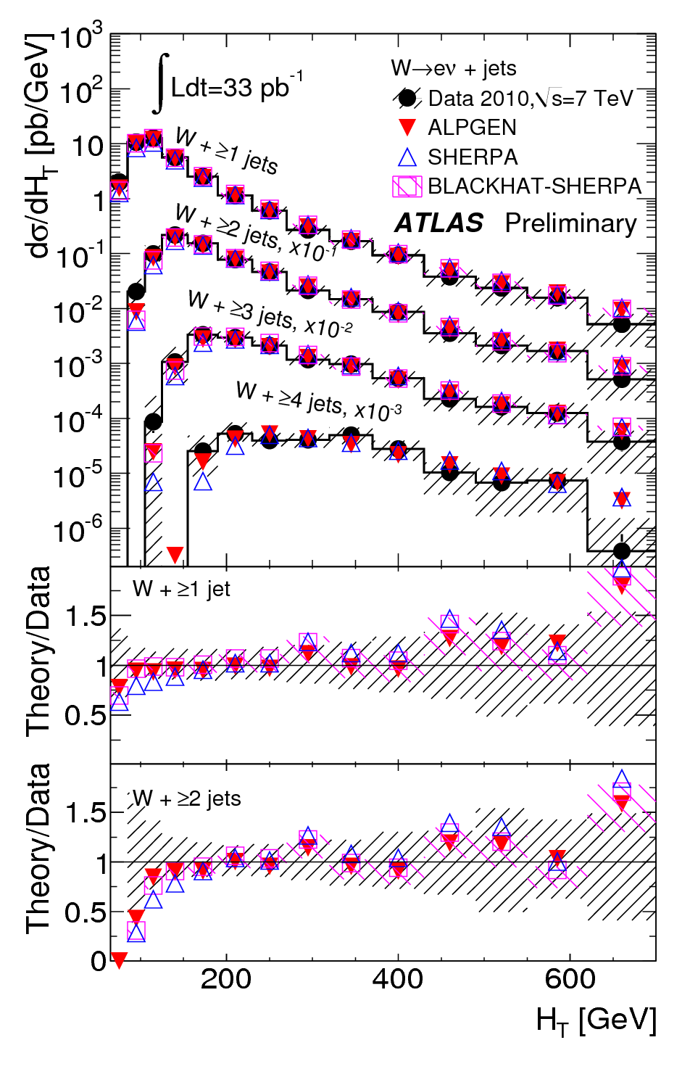
ATLAS:
Nice comparisons
of jet p_{T} spectra
to several theoretical
predictions

Slide 36
Z + b(b)
start with a Z + ≥ 2 jets sample
signal is buried underneath

Slide 37
Z + b(b)
start with a Z + ≥ 2 jets sample
signal is buried underneath
apply b-tag discriminant
“high efficiency”
“high purity”

Slide 38
Z + b(b)
start with a Z + ≥ 2 jets sample
signal is buried underneath
apply b-tag discriminant
“high efficiency”
“high purity”
ask for at least one b-tagged jet

Slide 39
Good agreement is found with the simulation (limited precision)

Slide 40
Good agreement is found with the simulation (limited precision)
Measure the ratio (Z + b-jets) / (Z + any jets) p_{T} > 25 GeV and |η| < 2.1
(fixed-flavor scheme)

Slide 41
bona fide electroweak physics

Slide 42
W polarization
This is a bona fide PV effect. It is something new – it has not been seen at the Tevatron.
i.e., W + 1-jet
i.e., high – p_{T} W
The W will tend to be left-polarized.

Slide 43
W polarization
The W will tend to be left-polarized.
We observe this through a kinematic variable:
at very high p_{T}(W)
will peak toward one - fraction f_{L}
will peak toward zero - fraction f_{R} there is also a longitudinal piece, fraction f₀

Slide 44
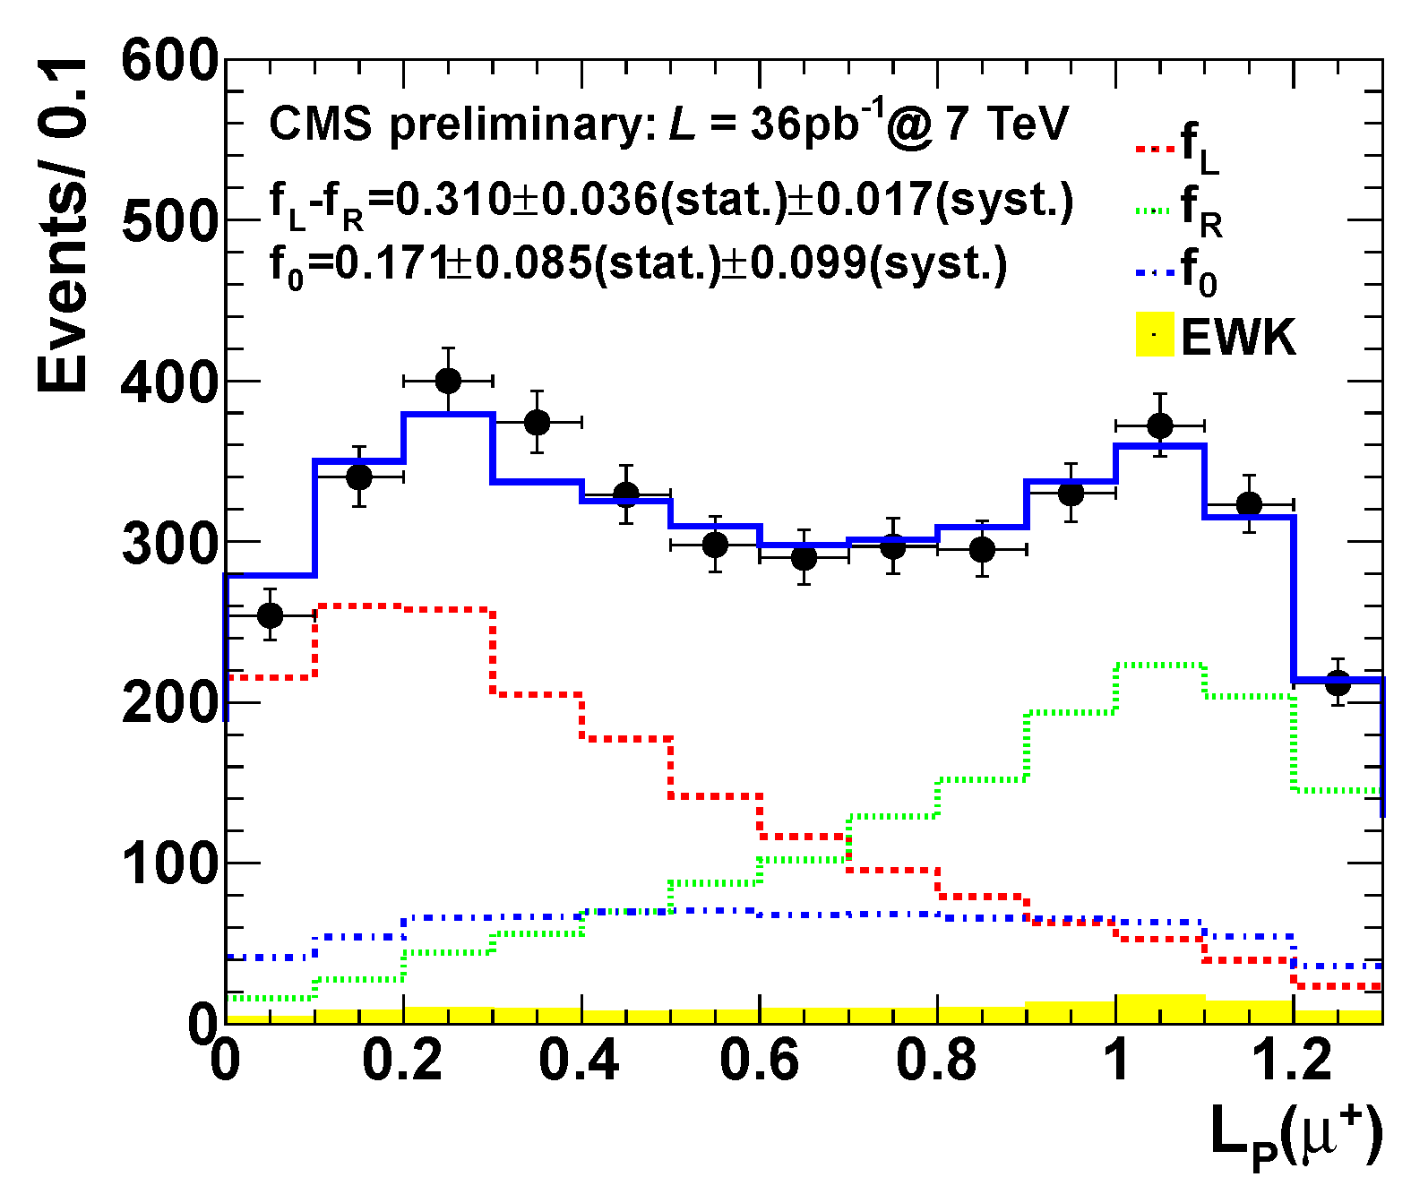
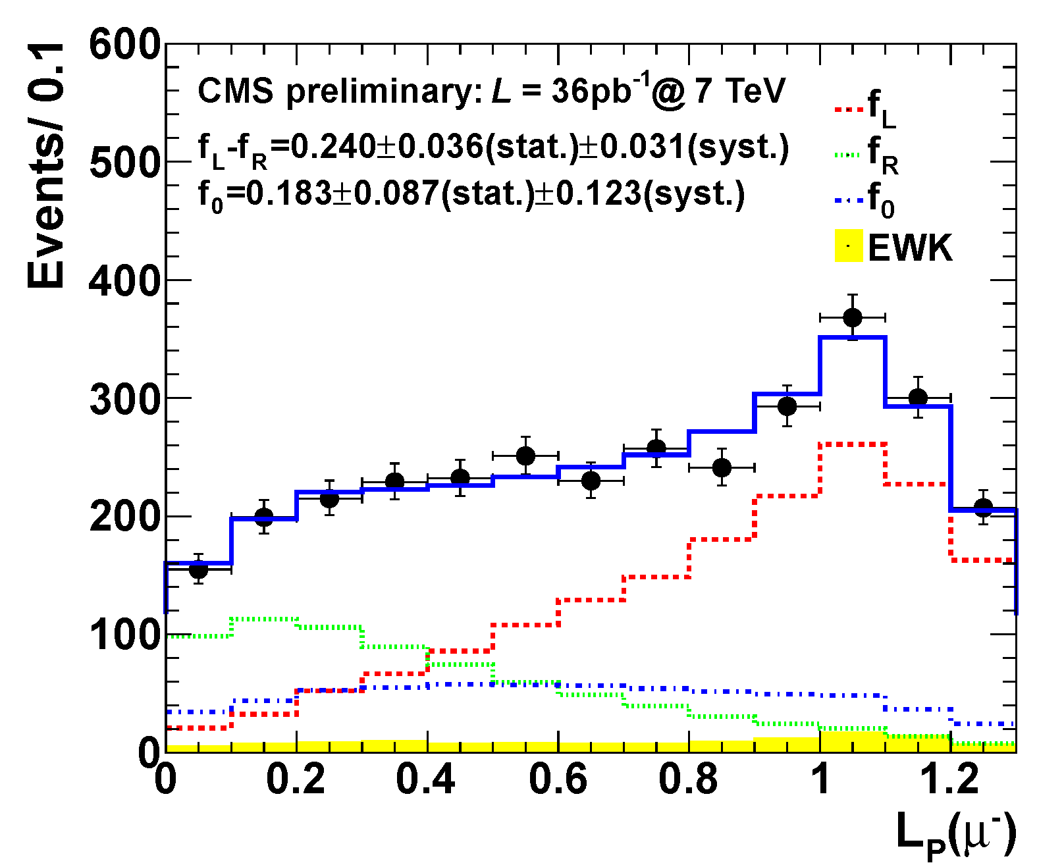
W polarization
In practice, we form templates for f_{L}, f_{R} and f₀
and fit them to the observed distributions:
p_{T}(W) > 50 GeV
W⁺
W⁻
f_{L}
f_{R}
f₀

Slide 45
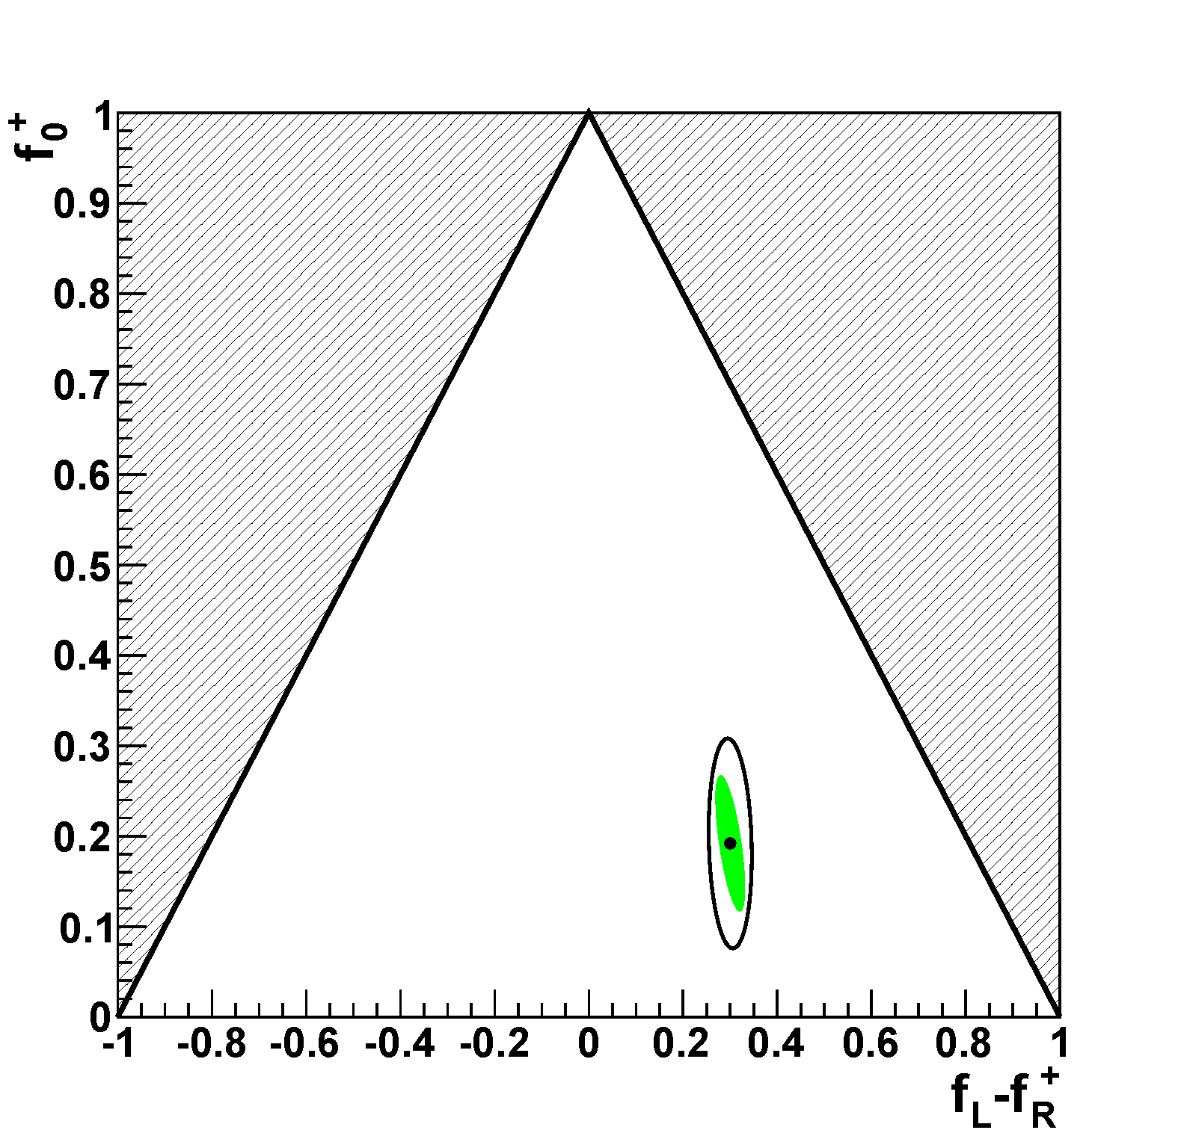
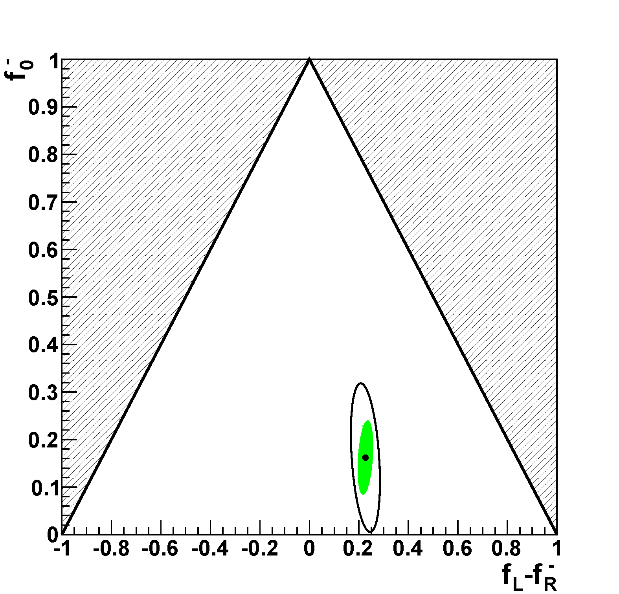
W polarization
These are the fit results for (f_{L}- f_{R}) and f₀ :
W⁺
W⁻
f₀
f₀
f_{L}-f_{R}
f_{L}-f_{R}
A clear demonstration that Ws are polarized.

Slide 46
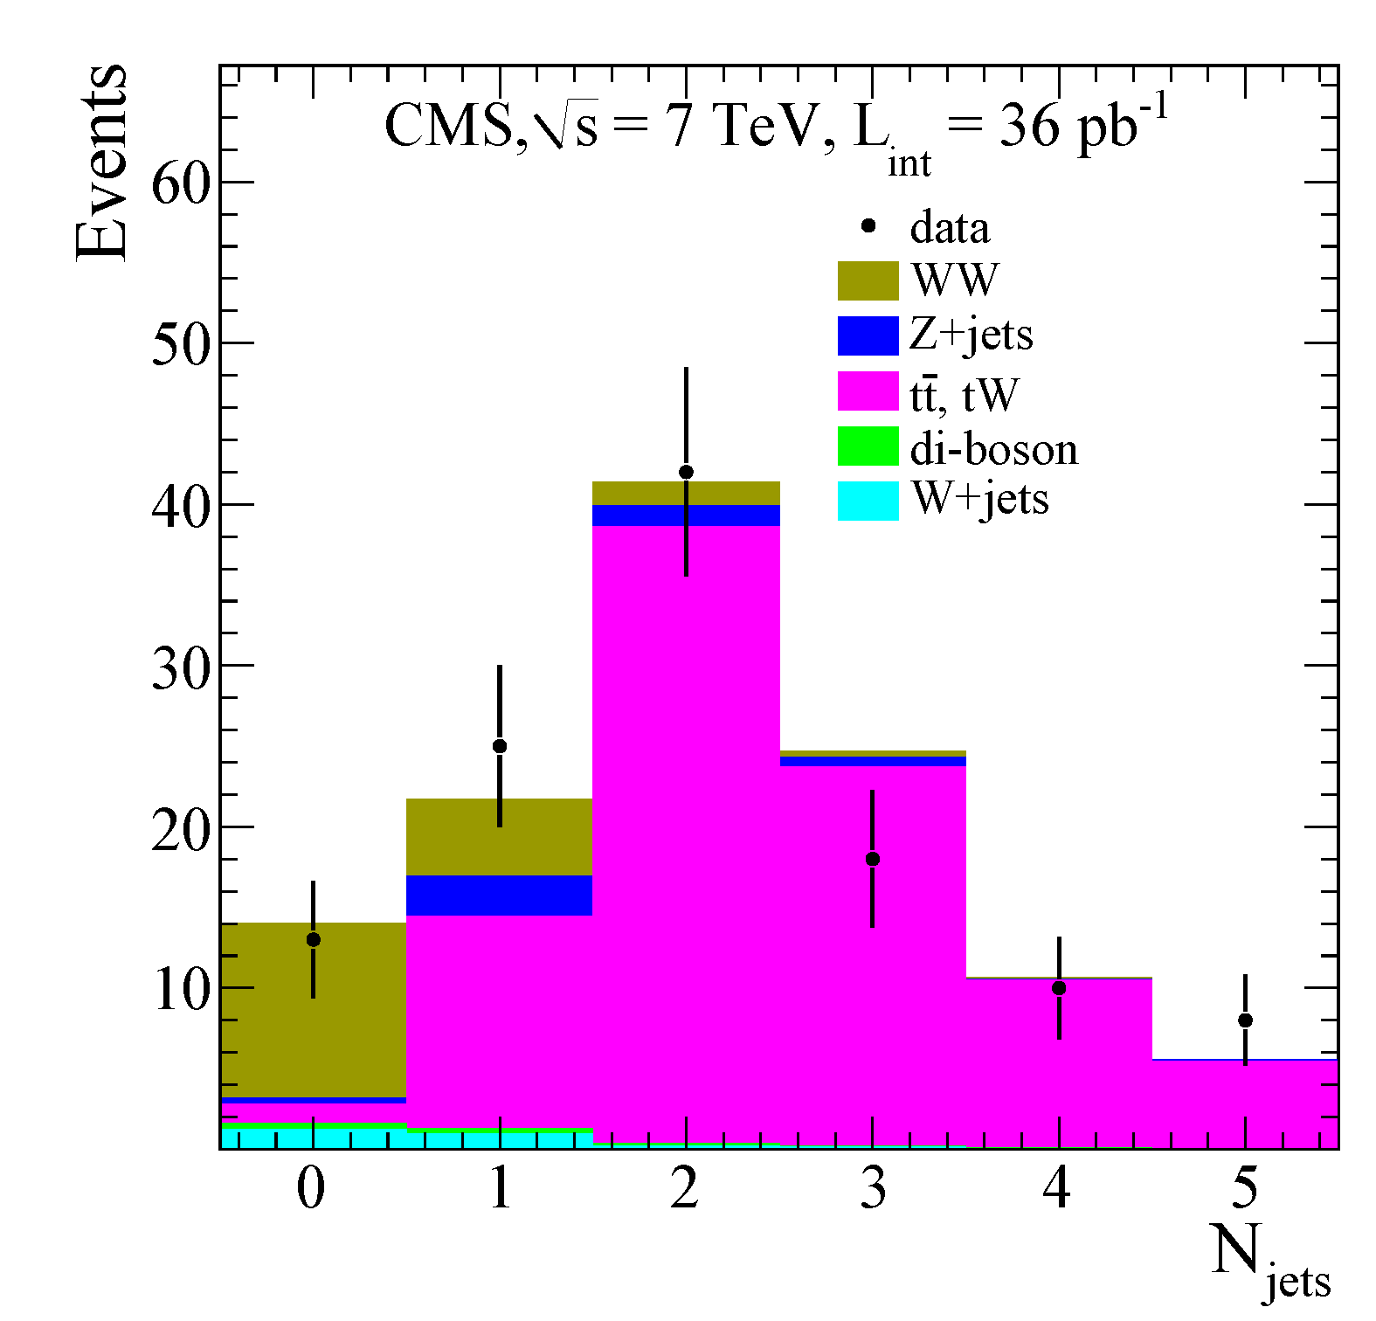
Measurements of σ(WW) in 7 TeV pp collisions:
pp → W⁺W⁻ has two leptons
and MET, but no jets.
The main background (top),
almost always has jets.
The “semi-hadronic” mode,
with one lepton, MET and 2 jets,
is more difficult and will take
more time and more data.
Phys. Lett. B699 (2011) 25-47
σ(WW) = 41.1 ± 15.3(stat) ± 5.8(syst) ± 4.5(lumi) pb
0.4% of σ(W)

Slide 47
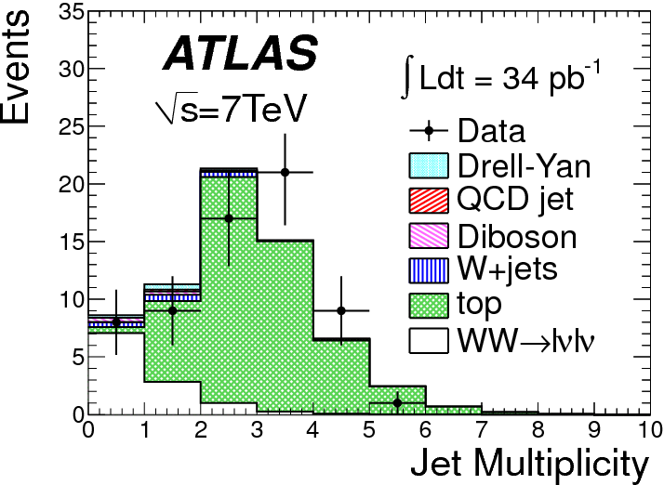
Measurements of σ(WW) in 7 TeV pp collisions:
pp → W⁺W⁻ has two leptons
and MET, but no jets.
The main background (top),
almost always has jets.
The “semi-hadronic” mode,
with one lepton, MET and 2 jets,
is more difficult and will take
more time and more data.
arxiv:1104.5225
σ(WW) = 41 +20-16(stat) ± 5(syst) ± 1(lumi) pb

Slide 48
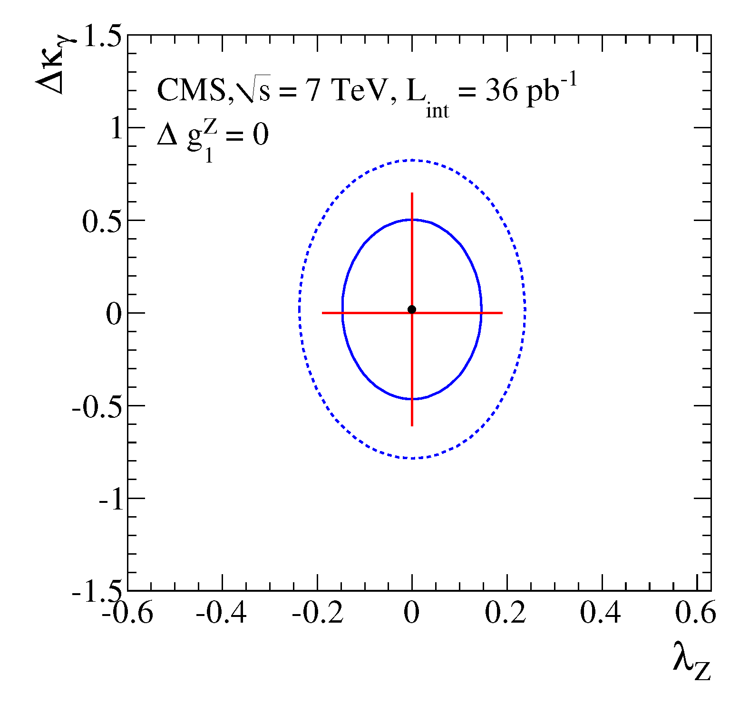
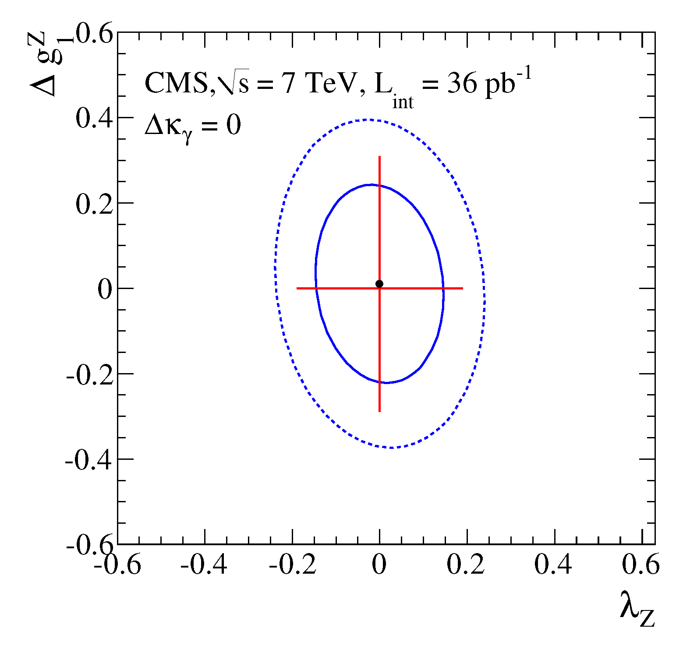
The cross section σ(WW) is sensitive to anomalous tri-linear couplings:
(i.e., deviations from the expected WWZ & WWγ coupling constants)
These bounds are not yet very constraining – more data is needed.
Phys. Lett. B699 (2011) 25-47

Slide 49
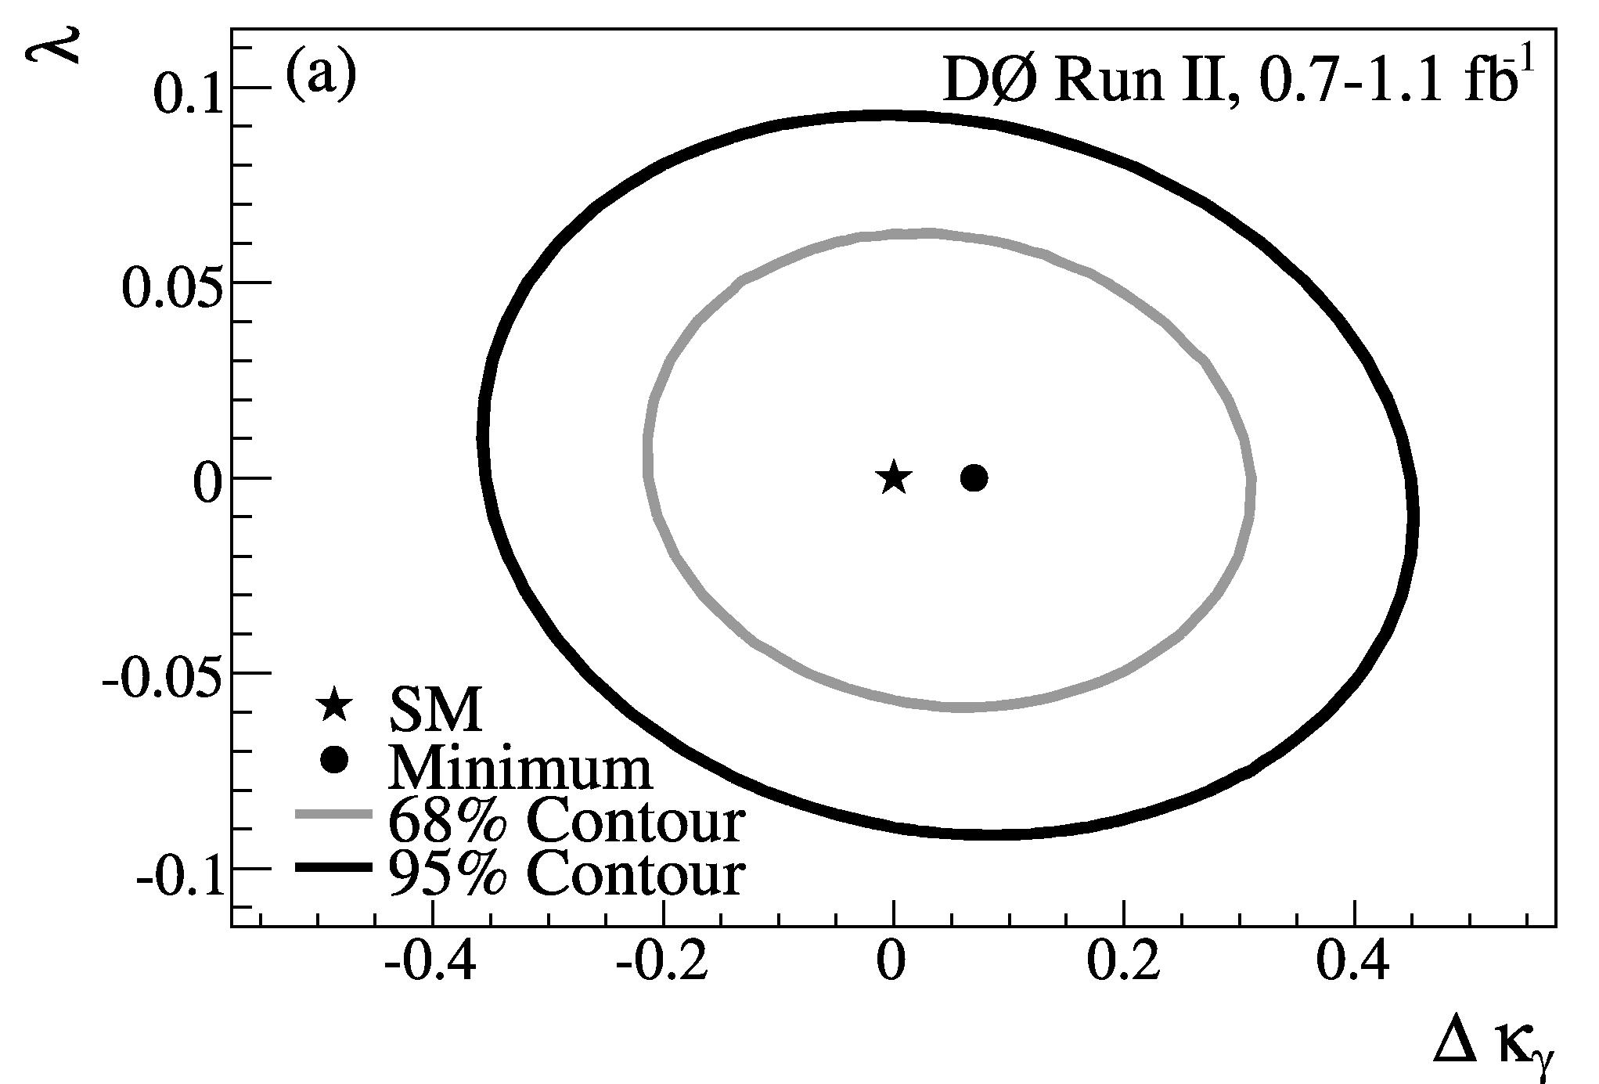
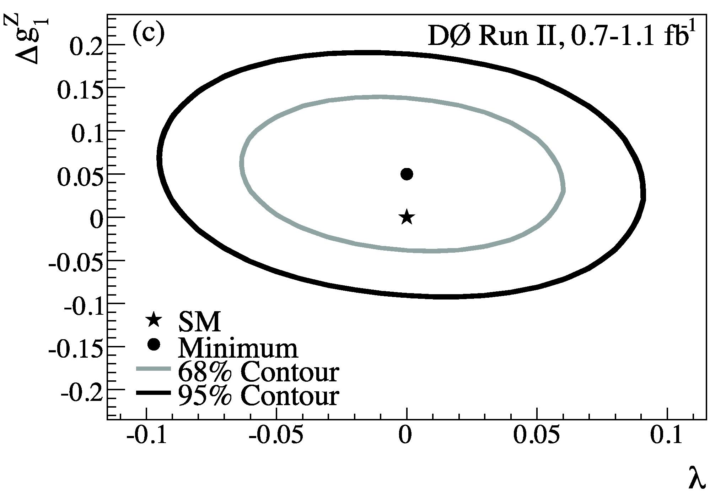
D0 combined results: much tighter bounds than CMS
arXiv:0907.4952
NB: form factors with Λ = 2 TeV.

Slide 50
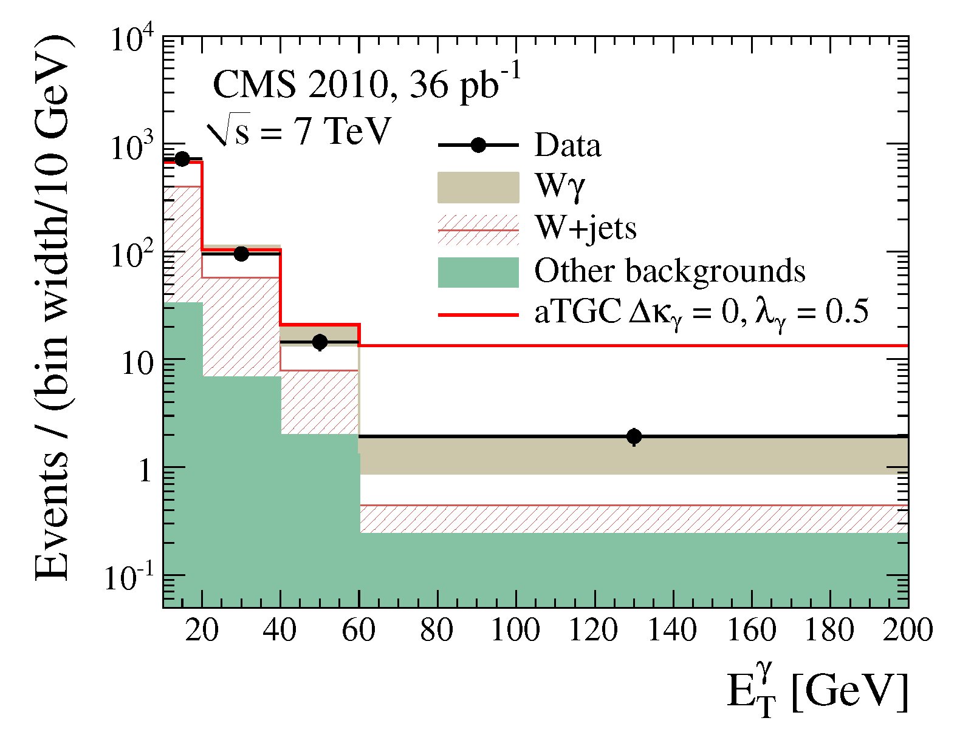
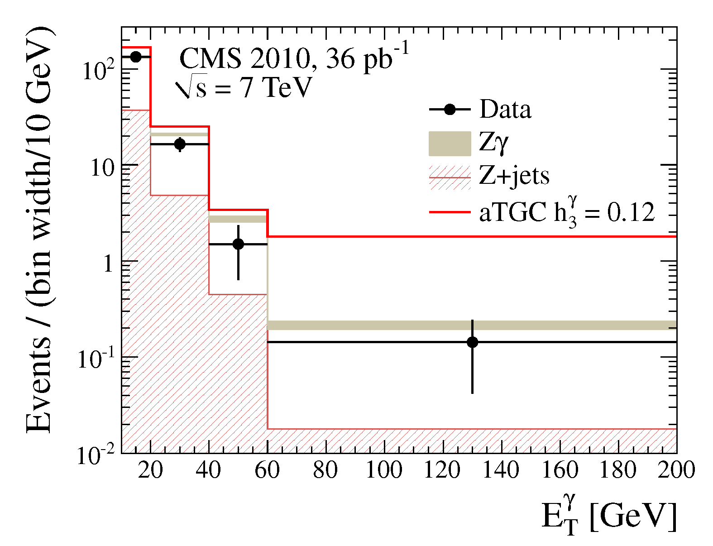
Measurements of other di-boson channels: W+γ and Z+γ
Agreement with the SM is good;
large deviations in the tri-linear couplings would lead to
an excess of high-energy photons:
Sensitivity to smaller values of the couplings requires more data. → interesting results anticipated in 2011.
CMS PAS EWK-10-009

Slide 51
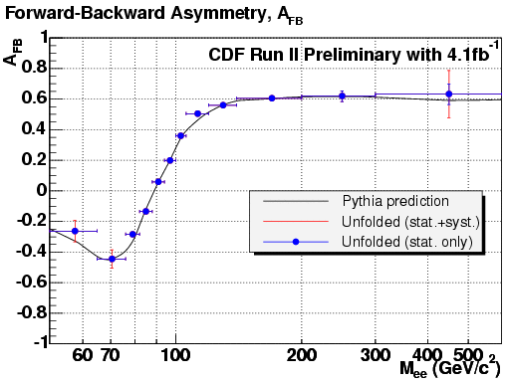
A_{FB} and light quark couplings (sin²θ_{W})
Beautiful result from CDF. LHC has a long way to go (but a start has been made).

Slide 52
A_{FB} and light quark couplings (sin²θ_{W})
CDF have done a nice analysis measuring the angular distributions as a function of Z q_{T}. This analysis confirms the mechanisms for production of Z bosons
at high q_{T} and the fact that the gluon has spin 1.
CMS have begun an analysis to extract sin²θ_{W} or better, the light quark couplings. Perform a likelihood fit to a multi-dimension probability density function;
detector effects are parametrized with analytical functions.
Given only 36 pb⁻¹, sin²θ_{W} = 0.2287 ± 0.0077 ± 0.0036.
CMS PAS EWK-10-011

Slide 53
CONCLUSION
CDF & D0 have produced many advanced results.
You have seen many “firsts” from CMS & ATLAS
based on < 40 pb⁻¹ taken in 2010.
From this point in time, the LHC will be at the
forefront of electroweak physics at hadron colliers.

Slide 54
BACKUP

Slide 55
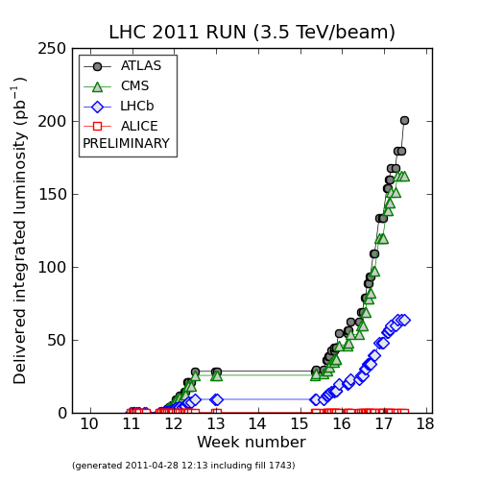
The LHC is off to a great start in 2011:
Integrated Luminosity
as of this morning (April 28).
200 pb⁻¹
40 pb⁻¹
What we had in 2010

Slide 56
e⁻
MET

Slide 57
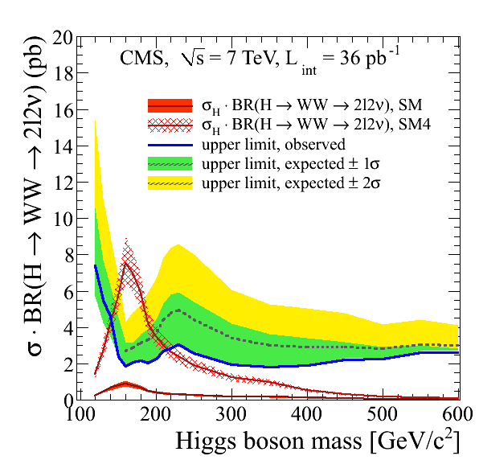
This analysis is important also for the Higgs boson:
There is some sensitivity
for H → WW when
there are four generations.
More data taken this year
will bring sensitivity to the
SM Higgs boson with
three generations…
Phys. Lett. B699 (2011) 25-47

Slide 58
